Slide 1
Fri – Sat - Sunday 30 Sept - 2nd October
Friday
06:00 Operator dump fill #2171, integrated lumi 75 pb-1.
90 m β* optics
Optics ok, collisions at all IPs, but no pots set-up or data taking
Fill 1 lost due to problem with TCTs IP5 – access needed
Fill 2 lost due to “hidden” inner limit on ALFA RP
Fill 3 for optics measurement lost due trip RQTF.A45B2
Fill 4 lost due to UPS down in UJ56 @ 03:05
Saturday
Access
IP2 and Alice: Her Excellency Pratibha Devisingh Patil
Atlas UJ14 – ZDC, IP1 collimator resolver, CMS UL55
15:00 Access required again for UPS in UJ56
22:00 Stable beams #2177, Lumi 3.1e33 cm⁻²s⁻¹
Sunday
13:02 Operator dump fill #2177, integrated lumi 103/106/18.5 pb-1
Access for QPS reset, cycle and take some time to optimise beams in injectors
18:44 Stable beams fill #2178, peak lumi 3.2e33
Alice instantaneous DIP lumi was off by a factor of ~100 (low), potentially dangerous
OK again around midnight
Still in

Slide 2
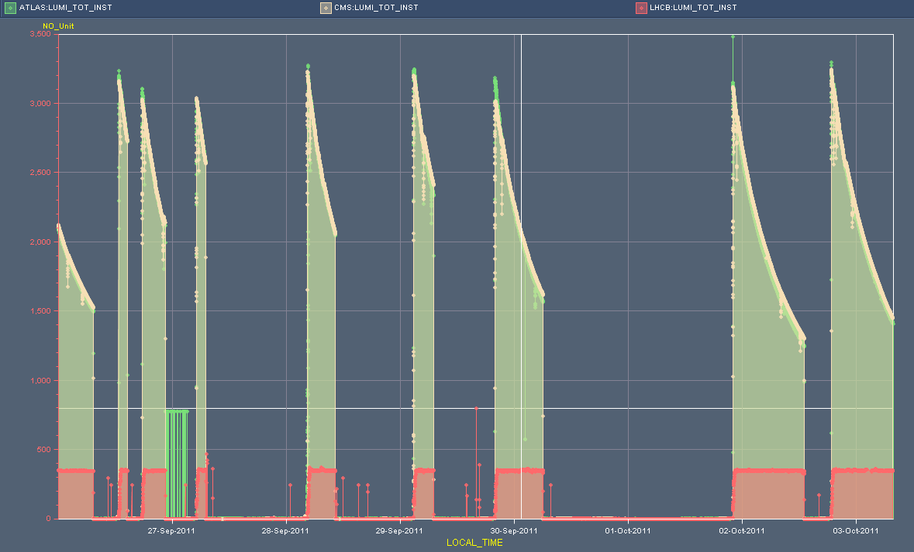
Lumi over the week
3.5e33
Access QPS - Problem PS - Problem arming BIS - Coupling correction during squeeze -Electrical network reconfig, hits Atlas - Access Atlas - Beam dump self trigger, access
UPS
90 m β* - VIP
Problem Orbit Feedback - Abort Gap cleaning at 3.5 TeV postponed
Monday 00:00
Monday 08:00

Slide 3
Fill statistics
fill | Itot | εn [rad] | L-peak | t-phys | L-int | dump
2156 | 1.83E+14 | 2.40E-06 | 3.00E+33 | 12:26 | 91.5 | QPS signal of IT.R1
2157 | 1.82E+14 | 2.25E-06 | 3.20E+33 | 1:48 | 18.7 | RF klystron vacuum
2158 | 1.79E+14 | 2.30E-06 | 3.00E+33 | 4:50 | 43.3 | PC triplet R2
2160 | 1.77E+14 | 2.30E-06 | 3.00E+33 | 1:56 | 18.9 | 4 circuits tripped in sector 56, likely SEU
2165 | 1.81E+14 | 2.20E-06 | 3.20E+33 | 5:50 | 52.5 | pc RCBCH6.R7B2
2168 | 1.81E+14 | 2.20E-06 | 3.20E+33 | 4:11 | 40.5 | UPS fault
2171 | 1.81E+14 | 2.25E-06 | 3.15E+33 | 10:04 | 75 | Operator dump*
2177 | 1.77E+14 | 2.15E-06 | 3.10E+33 | 15:00 | 105 | Operator dump
2178 | 1.82E+14 | 2.20E-06 | 3.20E+33 | 3:30 | 35
 |  |  | Total | 56:05 | 480.4
Previous operator dump 14 Sept.
In one week 0.5 fb-1, while 1.5 days planned no physics

Slide 4
Emittances from lumi vs. Bunch current
M.Lamont

Slide 5
2011 so far
Atlas and CMS over 4.1 fb-1
LHCb @ 1 fb-1
From CMS pages:

Slide 6
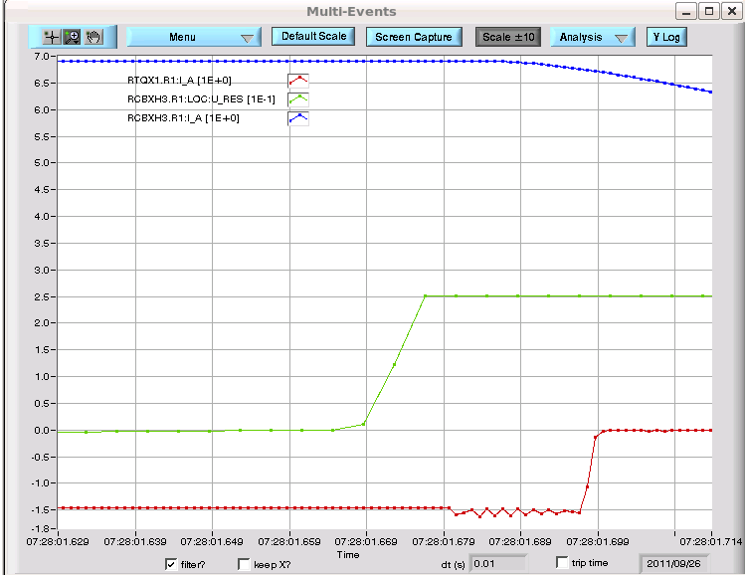
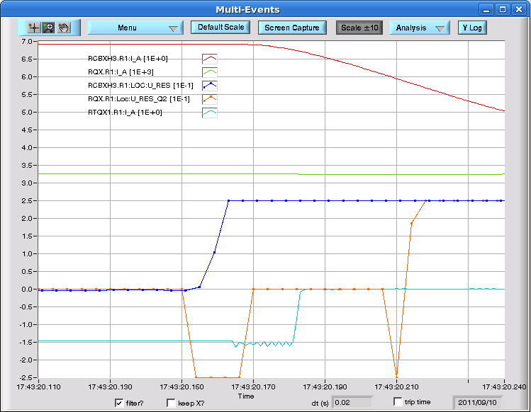
QPS on RQX.R1
Similar event as Sep 10th, where the QPS signal of Inner Triplet.R1 saturates and heaters were fired: SEU?
The only signal from QPS is on the RCBXH3.R1, where the U_res increases and saturates at 250 mV; there is no PM from the main circuit
One more QPS event afterwards, then a very good QPS week
Monday 26th September
10th September

Slide 7
Vacuum over the week: “stable”
5e-7
VGPB.123.4L2 (Alice), VGPB.183.1R5 (CMS)
1e-7

Slide 8
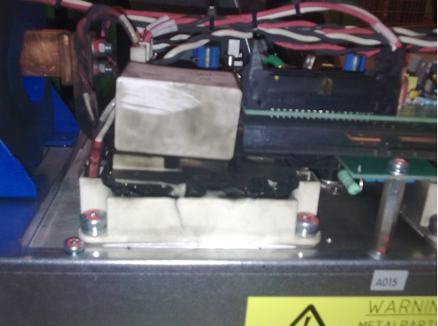
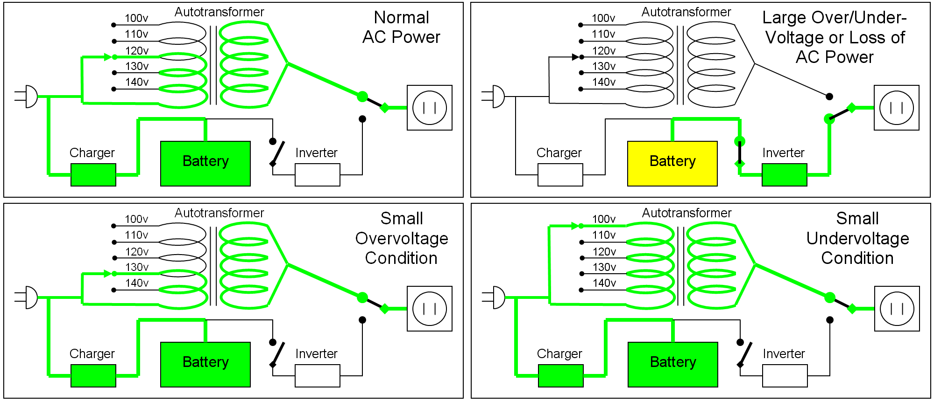
UPS problem Point 5 (UJ56)
Bras mutateur en défaut
Causes:
l'IGBT (transistor de puissance) d'un bras mutateur a cassé. Une expertise plus profonde est en cours par APC/SCHNEIDER
Consequences:
Arrêt LHC par PIC de EBS11/56.
Actions:
Appel du piquet APC/SCHNEIDER intervention.
Diagnostique et dépannage: changement de 2 bras mutateurs, d'une carte alimentation et d'une carte mère
8 hours on Thursday
Same UPS bad contact early Saturday morning

Slide 9
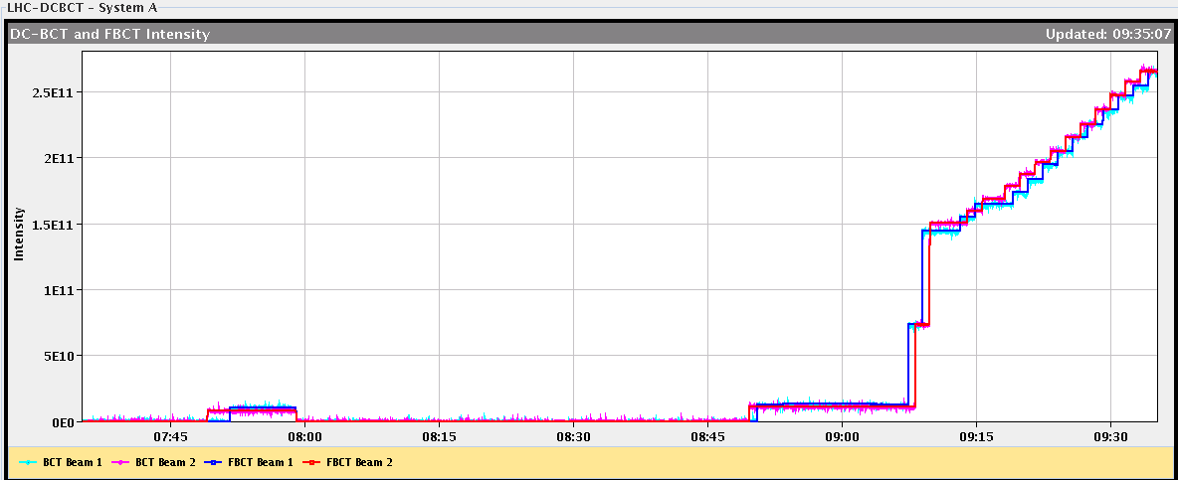
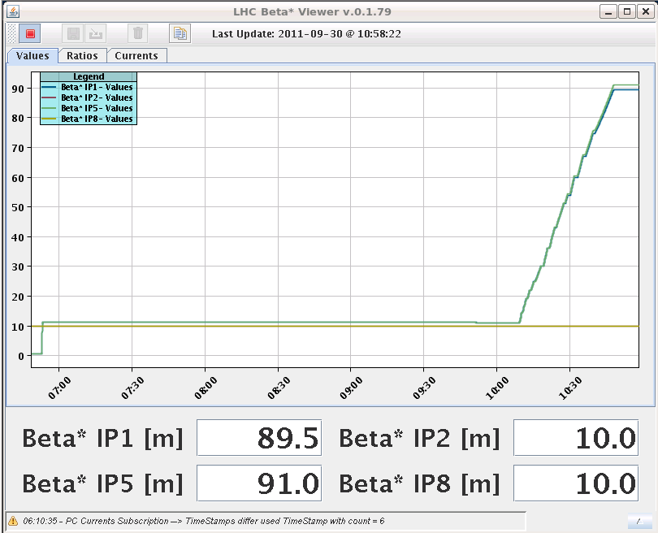
90 m β* optics
Filling scheme: 2 big, 13 small bunches

Slide 10
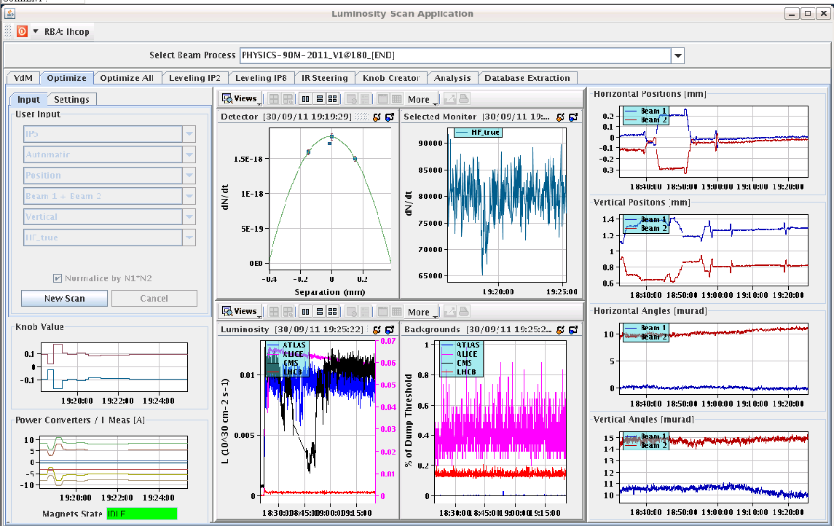
Collisions found in all 4 IPs
Optimization of IR 1 and 5 after collisions were found
The BRANS in IP1 and 5 show nothing, but signals can be seen in IP 2 and 8

Slide 11
Collimator in IP5: TCTH.4L5.B1 and TCTVA.4L5.B1
Found a short circuit somewhere on the 24V power supply used for switches and also other components
Problem came from the downstream anti-collision switches at collimator side (in the tunnel). There was a short circuit between one of the conductor and the ground of the connector
In the tunnel and finally we found that inside a 50 pins connector of the long cable, a small wire of copper was not correctly crimped and was slightly in contact with the metallic cover of the connector
This cable and his connectors have been installed during the cabling campaigns in 2006 and never touched since, so it's difficult to understand why the problem occurs only now...
Jerome Lendaro

Slide 12
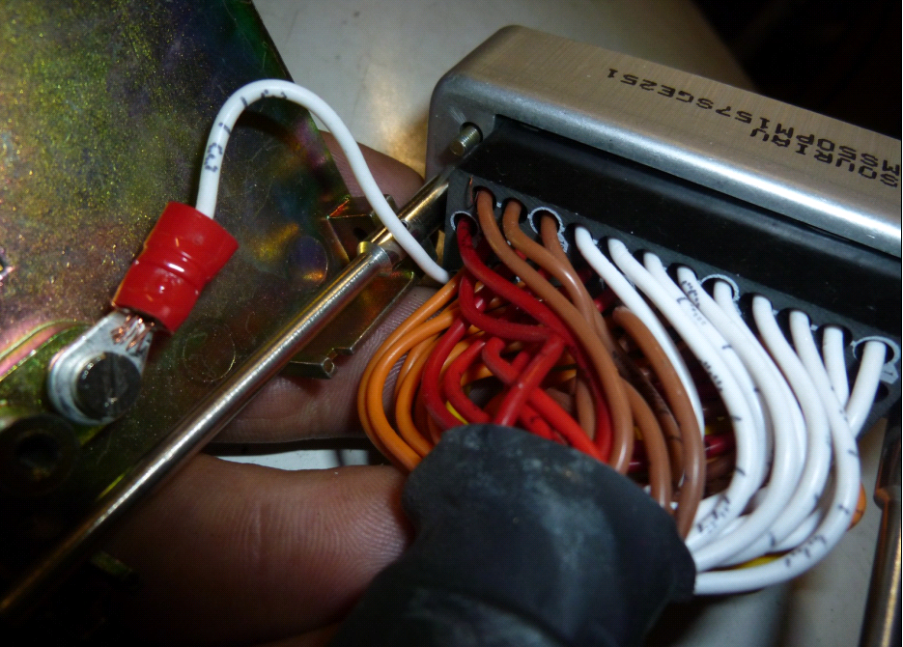
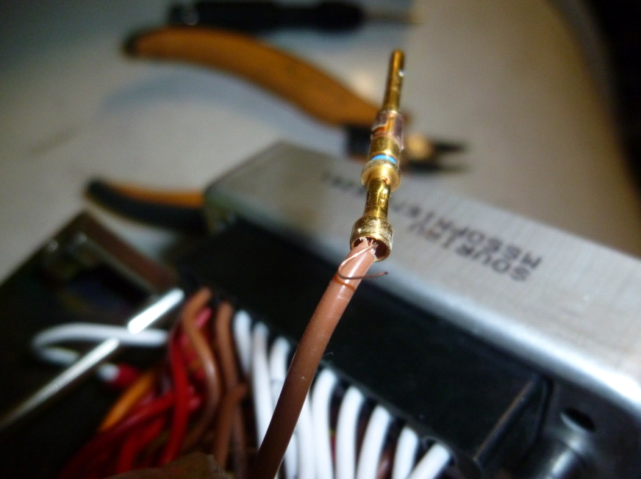
The small wire of copper...
Finally no pots aligned and no data taken with 90 m optics

Slide 13
Abort gap
Fill yesterday

Slide 14
Abort gap over the week
Always more population of B1 abort gap, later during fill
1e10

Slide 15
Other things to note….(from Alick)
Again had to mask several stripline BPMs in YASP as they continued to give large position readings ( from 2 to 20mm), both with pilot and nominal bunches. As mentioned yesterday, this change has been present since Friday.
TI2 may benefit from a bit of re-steering next time around
Generally injection OK, but transfer lines do need re-steering about every second fill
Injection Sunday afternoon:

Slide 16
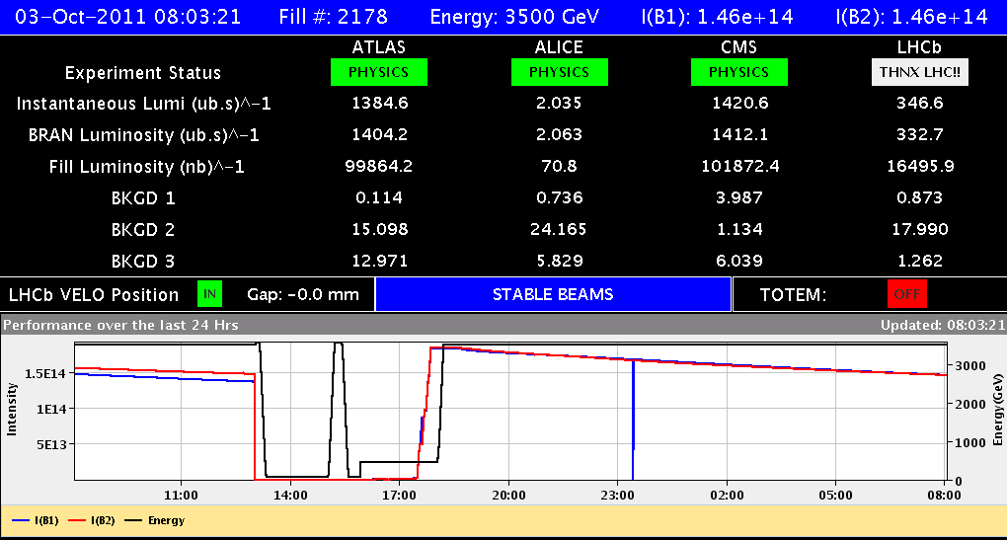
Present filln #2178
Reached 100/102/16.5 nb-1
Could be the third fill in a row to be dumped by operator

Slide 17
Plan for week 40
Physics with some perturbations
Abort gap cleaning at 3.5 TeV
25 ns MD Thursday
Large pile up MD, to be confirmed
This week’s coordinators: Barbara Holzer & Ralph Assmann

