Slide 1
Saturday 24 September 2011

Slide 2
Saturday
7:34 power restored in Meyrin (duration 8:33 hours) but still problems with injectors (PS timing, probe beam intensity too high, booster distributor)
Temporary fix for the main dipole circuit of TI8
9:47 checking injection and emittance evolution in LHC
12:50 injection for physics
14:40 stable beams fill # 2150
1.28E11 average protons/bunch
2.7E33 cm-2s-1
Larger emittances in the SPS 1.6 - 2 μm
High losses at LHC ring BLMs – 80% of dump threshold
19:19 beanm dump: nQPS on RQF.A45 (probablySEU), quench heaters fired on Q9R
Luminosity delivered: 38 pb-1

Slide 3
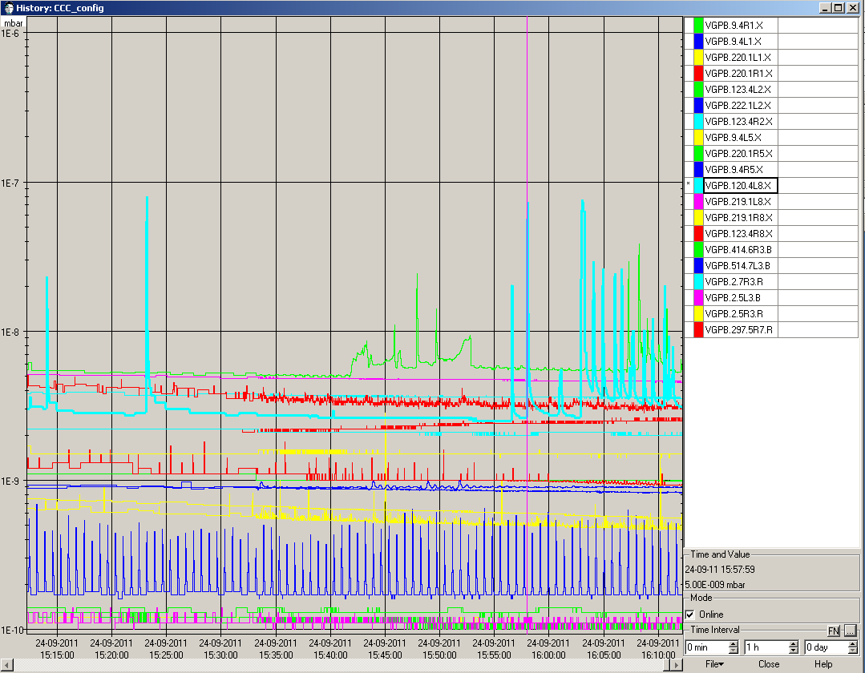
Vacuum activity L2 and L8 (fill 2150)

Slide 4
Comparing emittance fill 2140 to fill 2150 (after ~1hour at flat top): Fill 2150 emittances about 20% larger
→ explains most of the difference in luminosity (with respect to beam intensity between these two fills)
Emittance calculated from luminosity and mean bunch intensity: 30% lager for fill 2150 (2.5 μm compared to 1.9 μm)

Slide 5
Night
Fill # 2151
Clean injections
Stable beams 00:06, duration 16 minutes
1.23E11 average protons/bunch
2.7E33 cm-2s-1
Luminosity delivered: 2.5 pb-1
Q-FB B2 switched off during squeeze (manual B2 tune adjustment H: -0.004, V: -0.002)
B1 horizontal tune increased by +0.002
Dump by LBDS. N. Voumard:" the dump has been issued by the tracking system (BETS) on MKBHB beam 2. We had an unexplained increase in the generator voltage strength on the dilution kicker MKBH generator B. This increase happened about two seconds before the dump and looks like an increase of one or two bits. This can come from various sources (PLC ADC card that generates the power supply reference or the acquisition card of the BETS or the power supply itself). I will make further investigations on Timber"

Slide 6
Night
Fill # 2152
Stable beams 02:36, duration 2:17
1.2E11 average protons/bunch
2.6E33 cm-2s-1
Luminosity delivered: 19 pb-1
Again Q-FB B2 switched off during squeeze
4:53 dump: Loss of Cryogenics, Probable SEU on temperature reading of a current lead in A45
Fill # 2153 currently in the machine

Slide 7
Other Issues
S34 QPS controller on MQ.29L4 needs an access today, SIS QPS-OK masked at the moment
MKI-B2 went faulty when launching the softstart, solved by piquet intervention
LBDS B2 MKD-A and MKD-F went faulty after the beam dump, solved by piquet intervention
Dry dump to verify that everything was Ok
Problem on orbit reading and the RT-TRIM (SIS interlock latched)
restart OSFU_ORBIT_ACQ and OSFU_QQPR_ACQ subscription

