Slide 1
Thursday 22 September 2011

Slide 2
Thursday Morning
Fill # 2138
6:33 hours in stable beams (4:29 – 10:58)
2.9E33 cm-2s-1
1.18E11/bunch
53 pb-1 delivered
Dumped by QPS controller in RR17, possible SEU
ALICE still large fluctuation on luminosity measurement
11:20 Quench heater power supply discharged on RB.A45 (magnet B24L5)
11:23 ADT H2B2 has been put back in operation
13:26 LBDS self-trigger for beam 1 (during injection of Fill # 2139)
communication problem leading to wrong energy reading (ffff), second time this year.

Slide 3
Afternoon
Fill # 2140
5:54 hours in stable beams (15:00 – 20:54)
3E33 cm-2s-1
1.2E11/bunch
50 pb-1 delivered
Dumped by QPS, Quench loop of RCBXH3.L2 opened (inner triplet H dipole corrector)
Vacuum quiet during injection
~16:30 ALFA roman pot interlock limits set to +/- 20 mm
~16:40 ALFA RPs at target 25 mm positions
ALFA could not finish all measurements
19:31 Change of the beam intensity threshold for the wire scanners to 2.5e13 protons at injection (it was 2.1e13). No change at 3.5 TeV

Slide 4
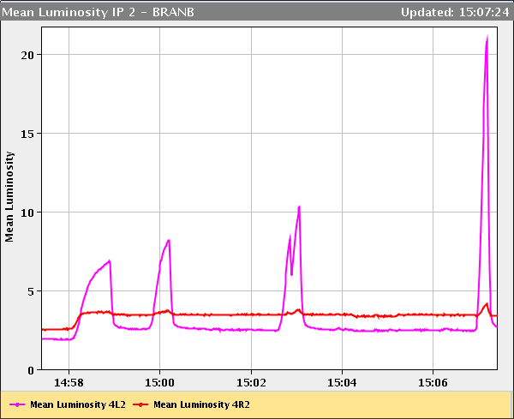
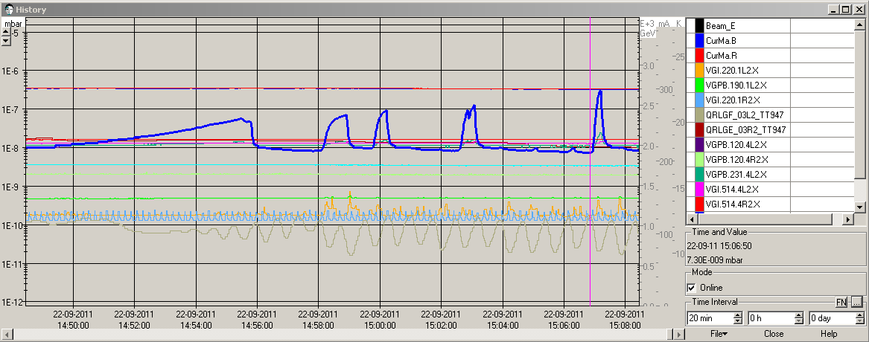
Vacuum spikes left of IP2
ALICE BRANs
Vacuum pressure left of
IP2 (VGPB.123.4L2.X)

Slide 5
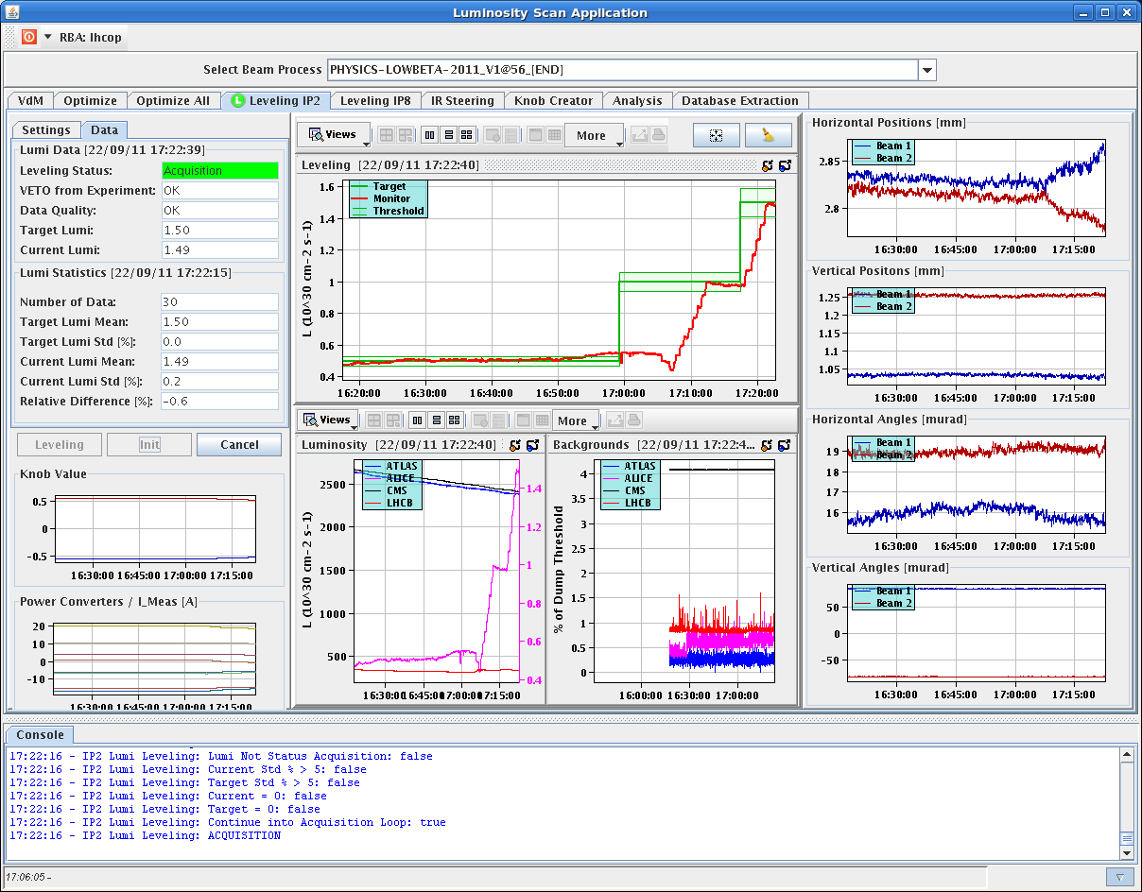
ALICE Lumi leveling switched on again

Slide 6
Evening – Night
21:00 ALICE short access in the shadow of the rampdown
Fill # 2143
0:16 hours in stable beams (03:22 – 03:38)
Peak lumi: 2.8E33 cm-2s-1
Bunch intensity: 1.2E11
1.1 pb-1 delivered
Dumped by BLM (vacuum spike at the D1 L8 when doing a LHCb lumi step)
Vacuum ok (max. at 1e-8 level) during ramp and squeeze
4:30 – 6:00 no beam from SPS (SPS transmitter fault)
6:36 LHC filled (1.25E11/bunch)
7:30 stable beams

Slide 7
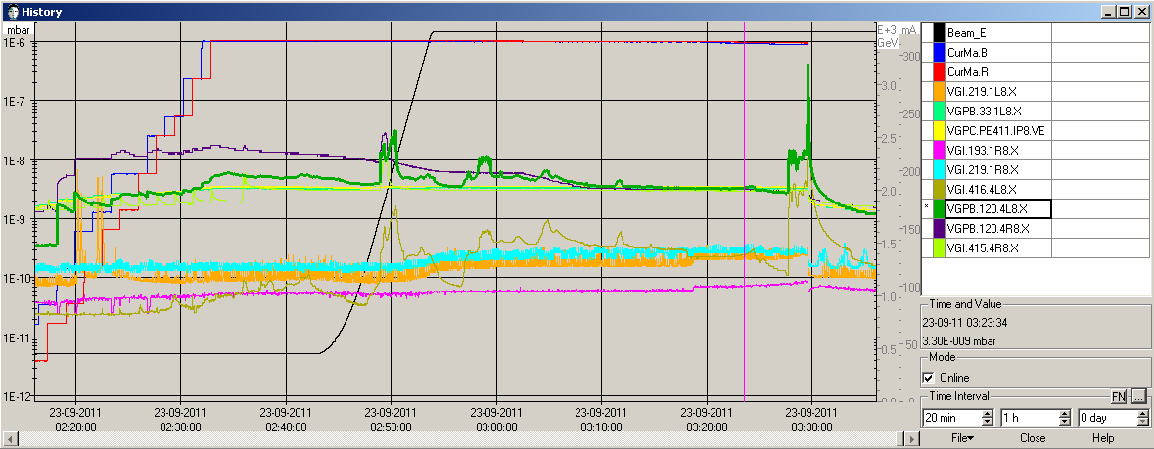
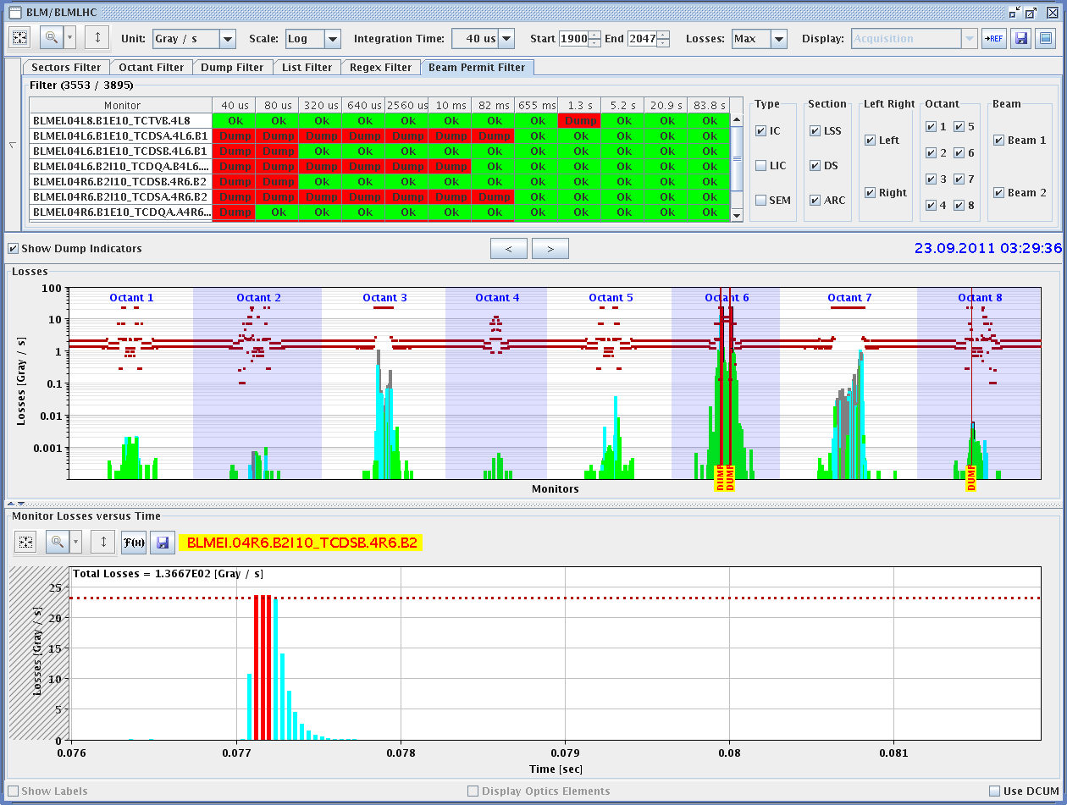
Beam Dump Fill # 2143

Slide 8
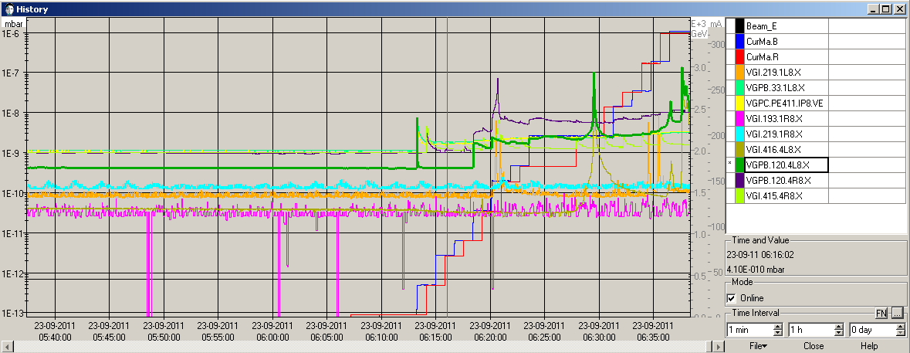
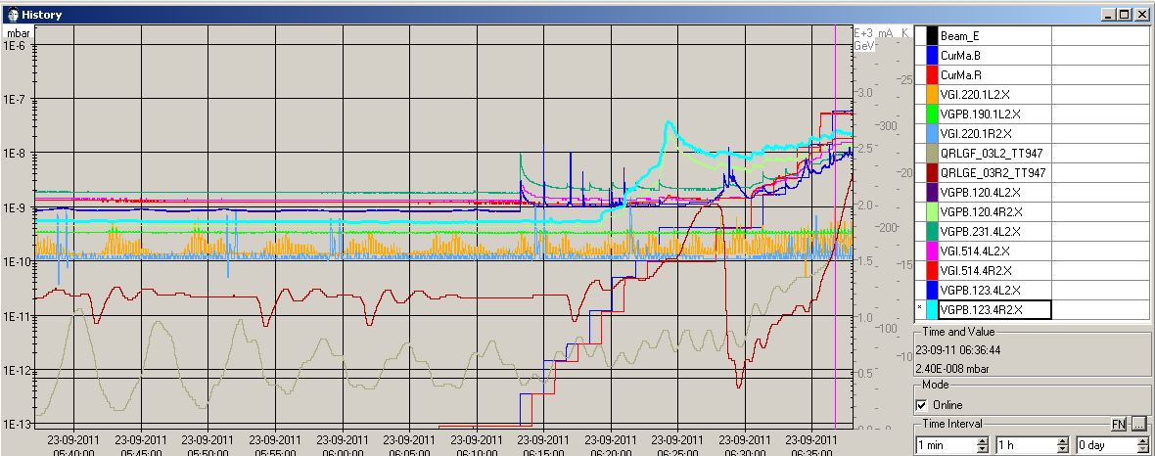
Morning
Fill #2144

Slide 9
Other Issues
Accesses pending:
Access is needed for LBDS team in UJ63 to exchange a card (to avoid the communication problem)
Access needed to recover communication with the QPS unit for MB.A9R1 (right of IP1 RB.A12)
TI8 Injection line re-steering
When attempting to execute the task "Load OUT-OF-BEAM thresholds for TOTEM XRP" we noticed that it failed. Only after updating the motor positions of the ALFA RPs which were used during this afternoon's data taking we could successfully run the task, although according to the task label it adresses TOTEM RPS. Maybe there is some mix-up between TOTEM and ALFA devices.
Issue with loogbook

Slide 10
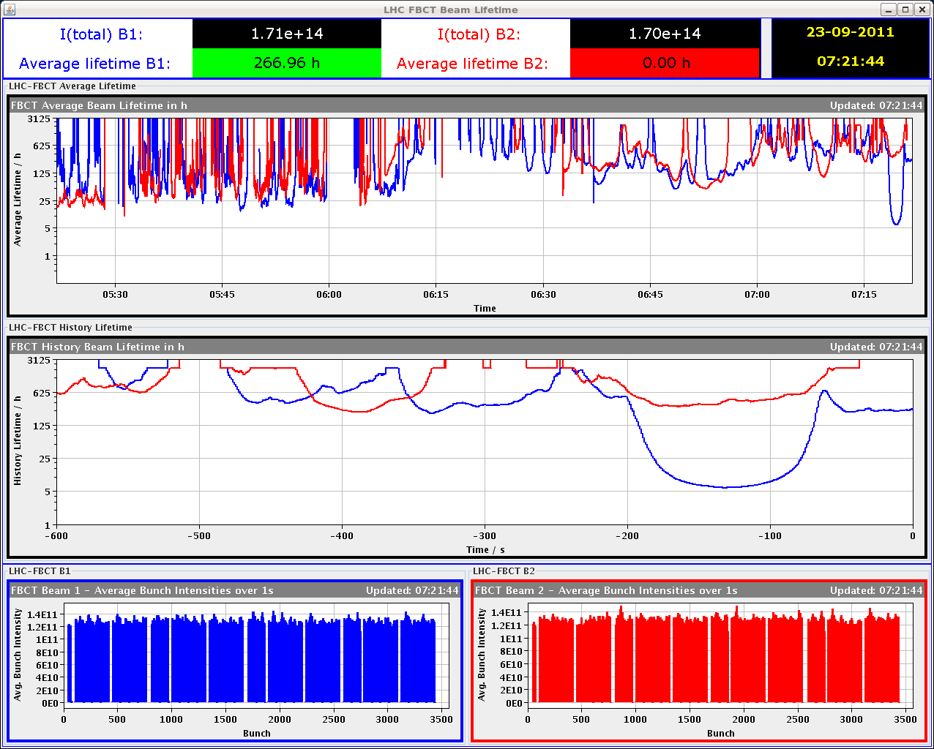
Beam Losses during Squeeze
Fill #2144 orbit feedback did not converge for a long time in V beam 1

