Slide 1
Summary week 38
Coordination by E. B. Holzer & J. Wenninger
Production

Slide 2
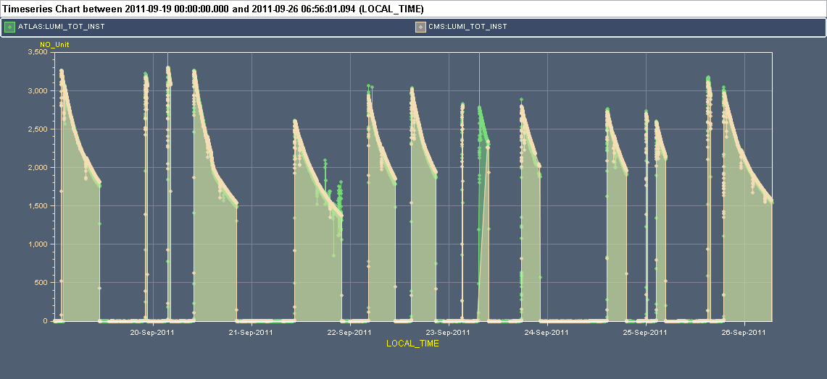
Stable beam periods
No major break-downs, but average time between fills increased by many small problems..
Luminosity drop due to a/ intensity, b/ emittance.
3.5x10³³
Ib ~1.2E11
Ib ~1.25E11
Ib ~1.3E11
Vac
Pt2
Power
Cut
Booster
Mon
Tue
Wed
Thu
Fri
Sat
Sun

Slide 3
Stable beams fill list – 15 fills
Fill | L (10³³ cm⁻²s⁻¹) | Length (h) | Int. L (pb-1) | Dump cause
2124 | 3.2 | 9.5 | 78 | QPS Q7L5
2126 | 3.2 | 0.3 | 3 | RF B1 arc detection
2127 | 3.3 | 1 | 7 | QPS QTL11.R7B2
2129 | 3.2 | 10.5 | 78 | B1 RF trip
2135 | 2.6 | 10 | 70 | QPS S45
2138 | 2.9 | 6.5 | 53 | QPS on RSD/F A12B1
2140 | 3.0 | 6 | 50 | QPS on RCBXH3.L2
2143 | 2.8 | 0.2 | 1 | Vacuum P8, TCTV BLMs
2144 | 2.8 | 2 | 20 | QPS on RQX.L1 – IT CRYO lost
2147 | 2.8 | 4.5 | 37 | QPS on RCBXH2.L1
2150 | 2.8 | 4.5 | 38 | nQPS S45
2151 | 2.7 | 0.3 | 3 | LBDS BETS MKB
2152 | 2.6 | 2.2 | 20 | SUE T sensor S45
2155 | 3.2 | 0.5 | 6.5 | RQT13.R5B1 PC
2156 | 3.0 | 12.5 | 91 | QPS on RQX.R1 – IT CRYO lost

Slide 4
Statistics
Integrated luminosity: 556 pb-1
Per fill 37 pb-1
Best week for CMS 493 pb-1
Best week for ATLAS 515 pb-1
In stable beams: 70 h / 176 h ~ 40%
9/15 dumps in stable beams from QPS.
~ 1 every 60 pb-1
~2/3 dumps related to SEEs.

Slide 5
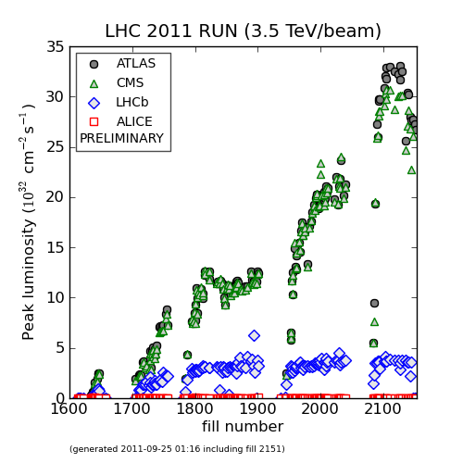
Peak luminosity
Reflects lower intensity (vac.) and then larger emittances.
Last fills missing.

Slide 6
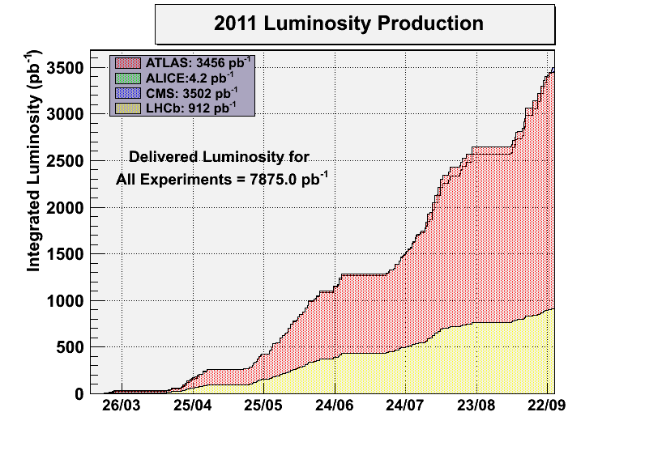
Integrated L
~3.6 fb-1 ATLAS/CMS
> 920 pb-1 LHCb
Slope
~ 0.45 fb-1/week
Last fill missing !
Slope
~ 50-60 pb-1/week

Slide 7
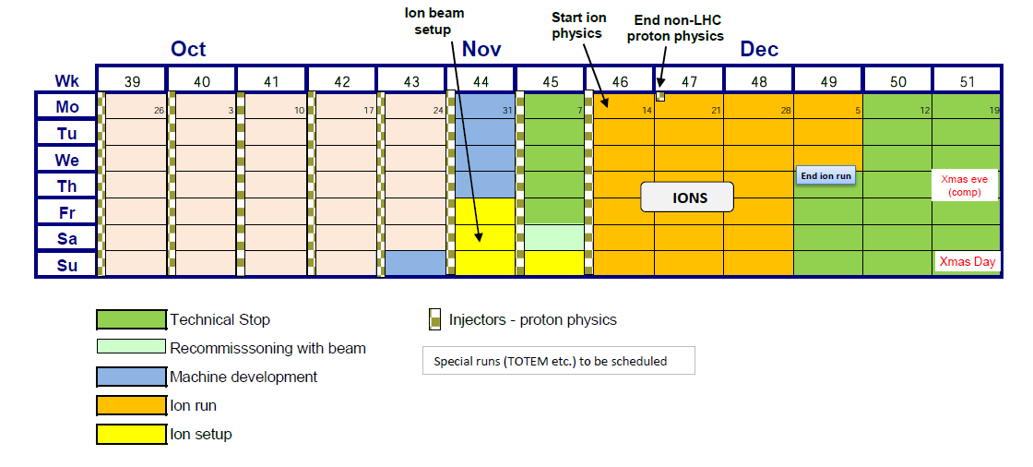
A bit of extrapolation
Assuming that we get 3 ½ more good weeks + 1+ week for 90 m, floating MD etc
We can reach 5 fb⁻¹ for ATLAS/CMS, > 1 fb⁻¹ for LHCb

Slide 8
Injection
‘(Poor) Business as usual’ :
Many line re-adjustments.
Flipping back and forth between good and bad within the same day – quite some frustration !
When the SPS LSS6 MSE is in ‘bad mood’ – pray !
Last Wednesday rMPP agreed to the proposal to open TCDI from 4.5 to 5 sigma.
Waiting for decision to be put into practice. The sooner – the better !

Slide 9
Vacuum – the return of the spikes
Wednesday night: large spikes at injection leading to beam dump triggers from vac. valves.
Dropped intensity to 1.2E11/b for 1 ½ days.
Thursday+: large spikes in IR8 leading to a beam dump on TCTVs in stable beams.
Spiky vacuum on Pt8 again…
In long fill pressure in TDI region increasing steadily.
Try again to open TDI further?
Situation has stabilized, but vacuum spikes appear from time to time – to be watched.

Slide 10
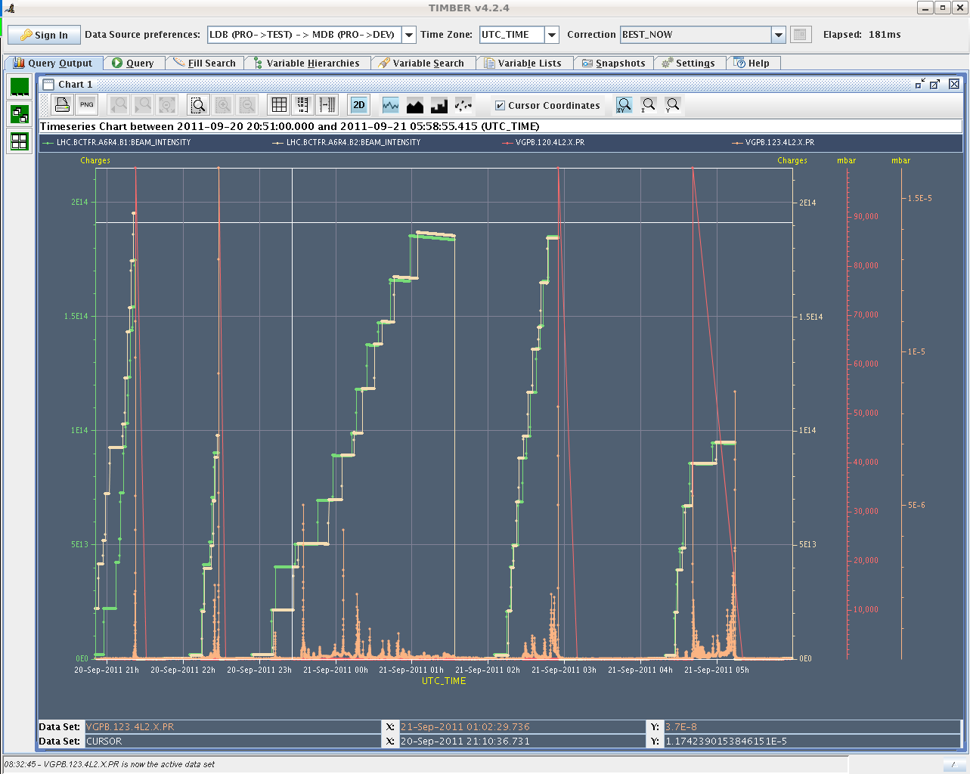
Vacuum IR2 during the night Tue→Wed

Slide 11
Emittances
When the bunch was increased again on Friday, the luminosity performance degraded.
Diagnostics is made difficult by the absence of systematic emittance logging (and of reliable measurements) along the chain.
BSRT relative measurements seem to confirm larger emittances on flat top.
Sunday morning booster crew re-adjusted the beams.
Luminosities jumped back up to earlier values.
Needs follow up…

Slide 12
Abort gap
Tuesday afternoon a problem on the klystron control (polar) loop induced longitudinal noise on the beam.
This lead to a record (?) abort gap population slightly above 1.2E11 p.
Triggered an effort to make abort gap cleaning operational at 3.5 TeV.
Settings prepared, tasks in sequencer (since Friday).
Some final changes to be done.
Then ready for test with a batch of 144b and 12b on either side of the abort gap.

Slide 13
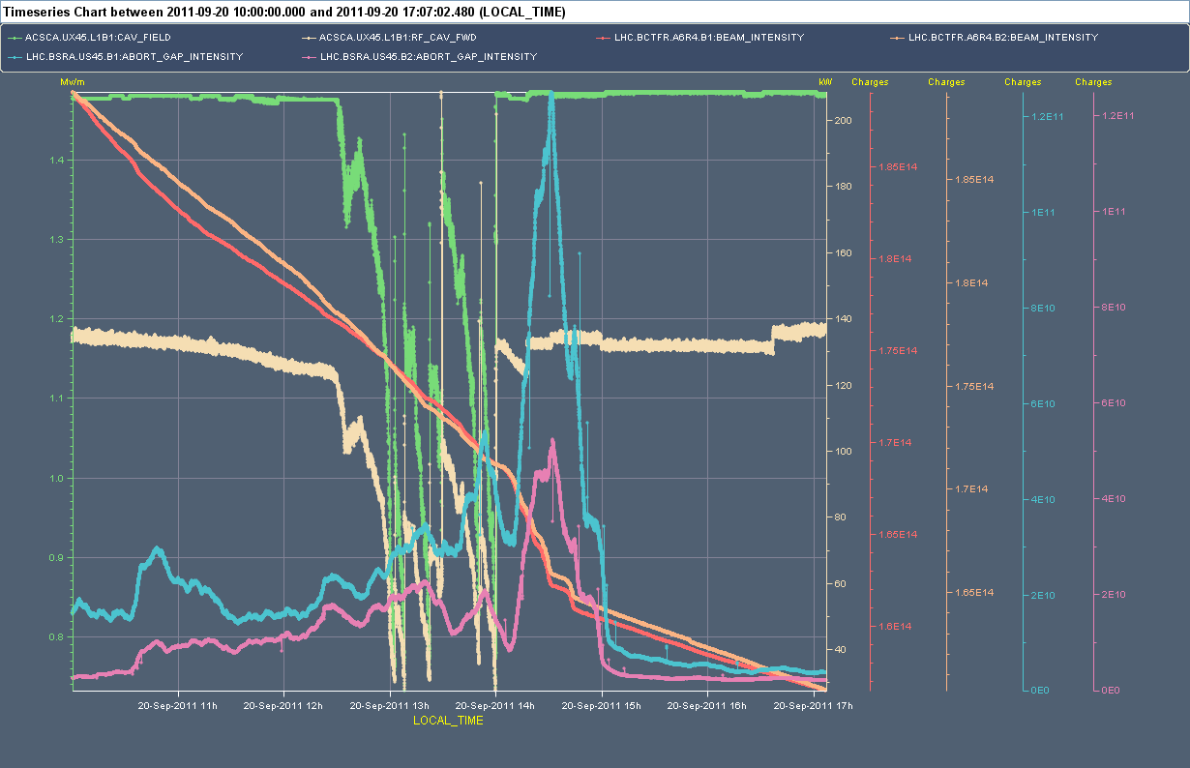
Abort gap population
1.2E11
BSRA B1
Why was B2
affected?
BSRA B2

Slide 14
Tune FB
2 fills lost in squeeze on QFB due to poor signals.
Once Q dragged onto 1/3 resonance.
Once the usual RQTF/D trip.
Recommendation is to switch off QFB (or leave it off if switched off by itself) when Q signal poor.
Watch out B2 → see below.
Check tunes before going into collisions and correct if necessary.
Same recommendation in case lifetime in collision seems low.
B2 issue:
The orbit FB is pushing the B2 H CODs systematically → leads to a dp/p shift and a Q shift via natural Q’.
Check/correct tunes if FB was off.

Slide 15
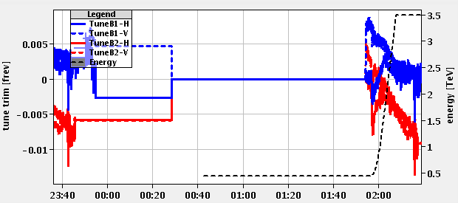
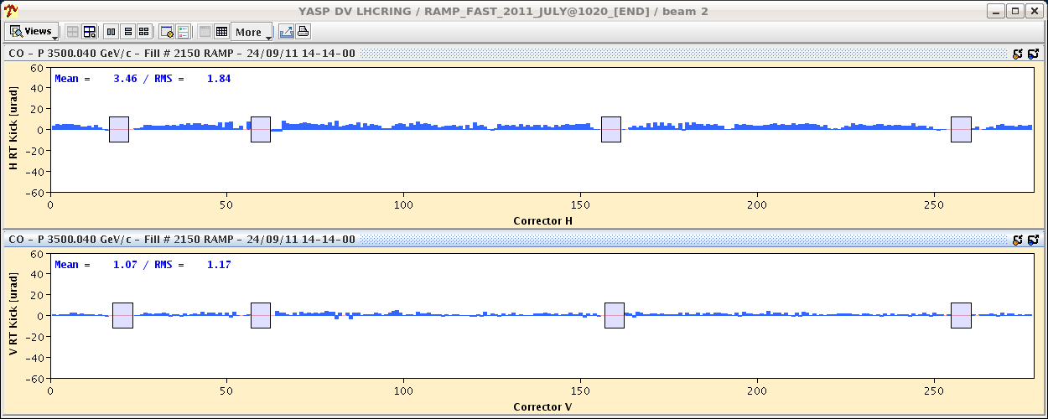
B2 tune
B2 horizontal correctors syst. shifts → lower energy

Slide 16
Miscellaneous
RF limitations on intensity lifted by RF group.
Klystron power issue on 5B2 solved. Power on FT now ~160 kW instead of 200 kW.
Fine-tuning of the regulation of the ferrite current with temperature and fine-adjustment of the cavity tune.
ALFA in beam during 2 fills at 25 mm (after approval by rMPP). Interlock limits set to 20 mm.
TOTEM settings and interlocks ready.
The setting of one H RP was shifted by 0.1 mm away from the beam wrt agreed setting to be consistent with the loss map situation.
The warning limit was not set correctly – not changed.

Slide 17
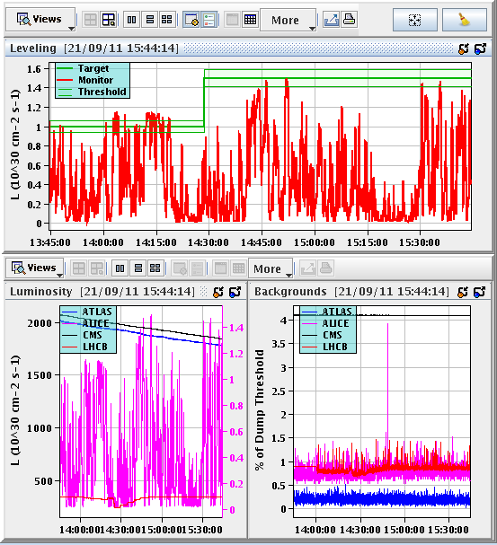
ALICE
ALICE luminosity showed erratic behavior Wed-Thu.
Adjustments or leveling impossible.
According to ALICE this is due to parasitic-parasitic collision (from their timing).
LDM checks did not confirm this hypothesis. Parasitic bunches at the level of 0.1-0.5%.
Problem has disappeared…

Slide 18
This week
Production.
Electrical network reconfiguration?
Abort gap cleaning test at 3.5 TeV - Tuesday?
Special filling – 1 shift.
90 m optics – Friday-Saturday
To be done: incorporation of changes from ALICE pol. reversal.
Machine settings – no problem expected.
Collimator settings & interlocks – quite some work here !
Coordination : M. Lamont and J. Uythoven

