Slide 1
Friday
09:40 Fill 2145 dumped on QPS board problem for triplet L1. Collected 20 pb-1.
QPS board had to be exchanged.
Quench heater were fired, lost CS and CM.
Cryo recovered around 11:30.
Accesses…
point 1: QPS
point 8: EPC (RCBH21.R8B2, RCBH32.L1B1)
point 7: collimation
point 4: RF
point 6 : LBDS
ATLAS, ALICE, CMS

Slide 2
Friday
Late afternoon: transfer line steering again.
Abort gap cleaning for 3.5 TeV included in the sequence – without excitation.
17:45 Fill 2147 in stable beams, 2.8E33 cm-2s-1 with 1.25E11 p/bunch.
All 3 fills with 1.25E11 p/bunch had consistently lower luminosity than fills with 1.2E11 p/bunch.
Emittances at injection were good. There seem to be blow up somewhere along the LHC cycle. BSRT comparisons of the fills seems to confirm larger emittances.
19:00 ALFA RPs in at 25 mm.
21:15 ALFA out again.

Slide 3
Friday
Problems in fill 2147:
ATLAS BLM had to be masked out…
DIP problems → problem with the leveling.
Vacuum spikes increasing steadily in Pt2.
22:15 Beam dump, 37 pb-1. QPS on RCBXH2.L1.
22:40 Power cut in Meyrin, short-circuit between Meyrin and Pt1.
03:40 S67 tripped, lost communication of QPS MB.C24L7 – circuit breaker.
06:00 MPE accessing S67 to rearm circuit breaker.
In TI8 the main dipole circuit is tripping all the time…

Slide 4
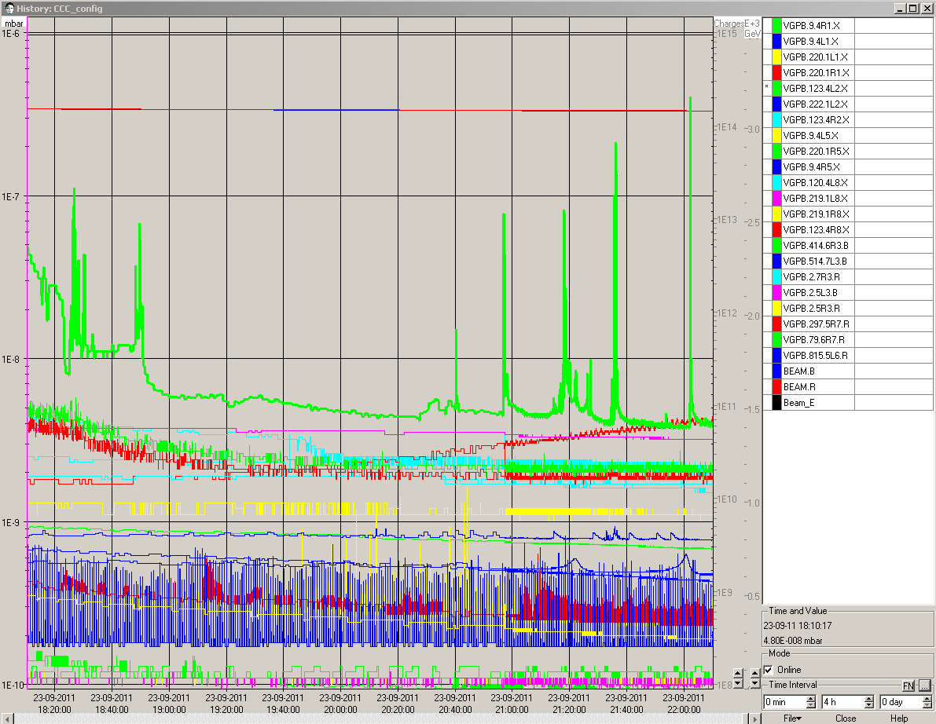
Fill 2147 – vac Pt2

