Slide 1
Wednesday
Following the struggle with the vacuum in IR2 over the night, drop intensity to 1.2E11/bunch.
Fill first B1 – pretty quiet – then B2 – quite some activity. Decided to ramp and see…
IR2 solenoids off after B1 injection – in the hope to perform some (enhanced) cleaning.
10:20 Fill 2135 to stable beams, 2.6E33 cm-2s-1.
Lower lifetime of B1 cured by QH trim of +0.003.
Vacuum (activity) in IR2 decreasing steadily.
11:20 All solenoids in IR8 off to enhance scrubbing.
ALICE luminosity oscillating – impossible to perform any kind of leveling.

Slide 2
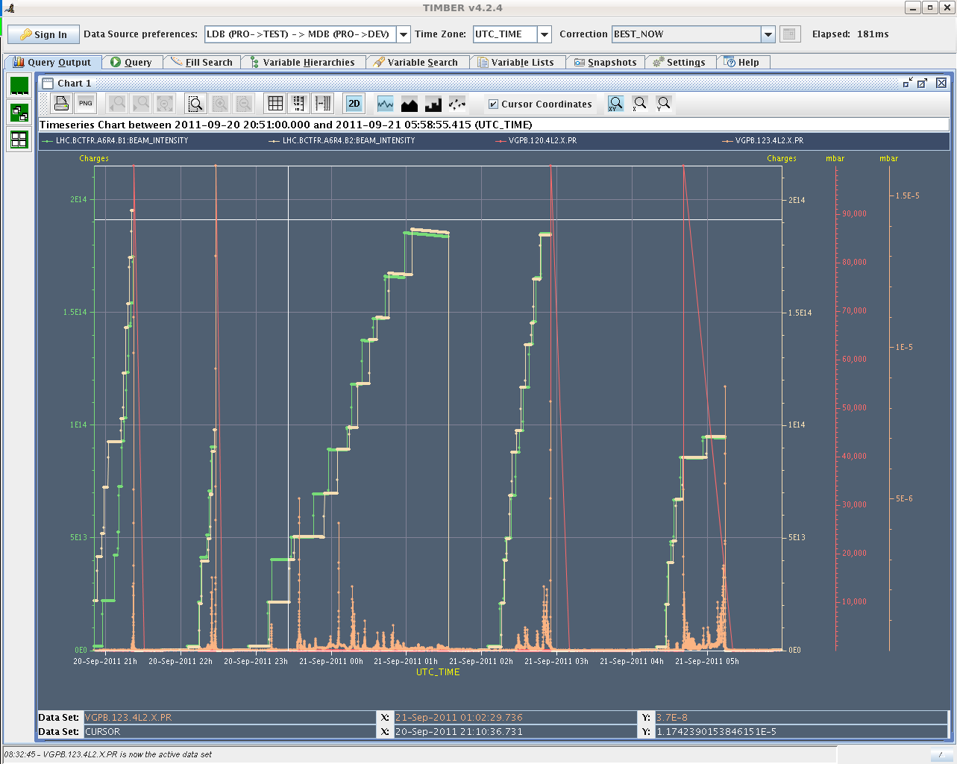
Vacuum during the night…

Slide 3
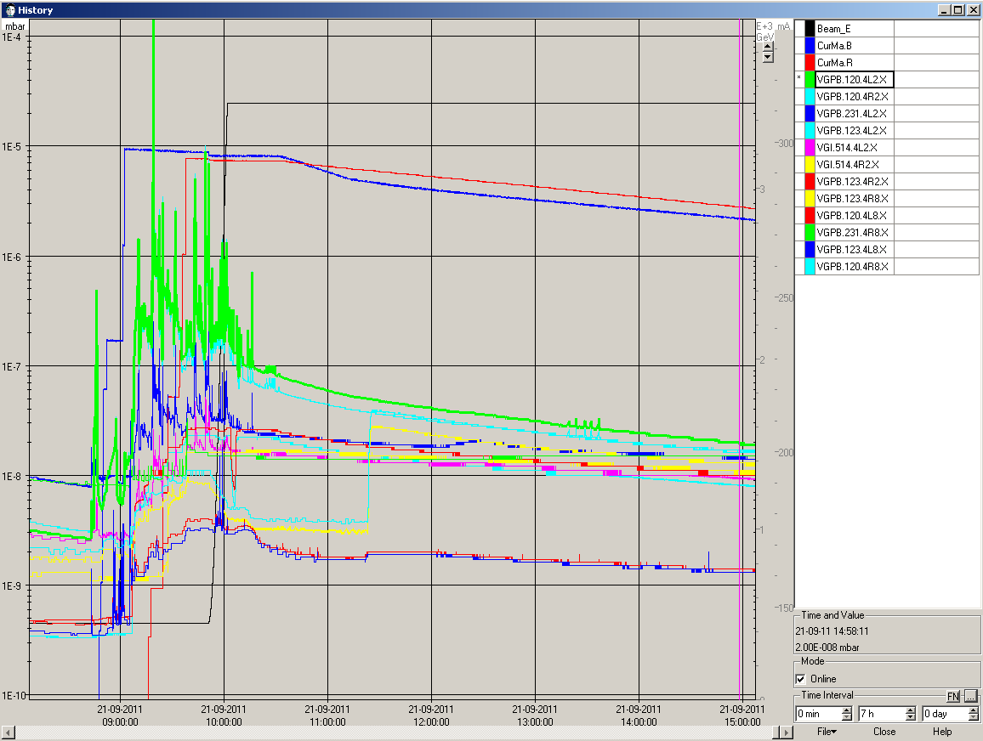
Vacuum fill 2135

Slide 4
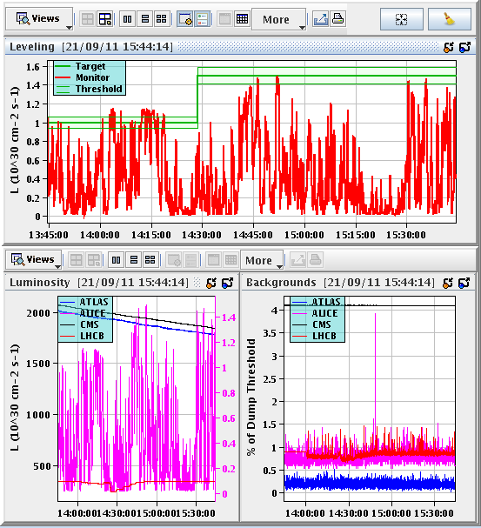
ALICE luminosity

Slide 5
Wednesday
22:00 Fill 2135 dumped, 70 pb-1. S45 trip. Quench loop opened.
Switch on solenoids in IR+IR8.
Steering required on TI2.
04:30 Stable beam fill 2138, 2.9E33 cm-2s-1, 1.2E11/bunch.
Vacuum IR2 quiet during injection.
Later vacuum still spiky, but peaks lower by ~1 order of magnitude.
Again ALICE lumi too unstable for leveling.

Slide 6
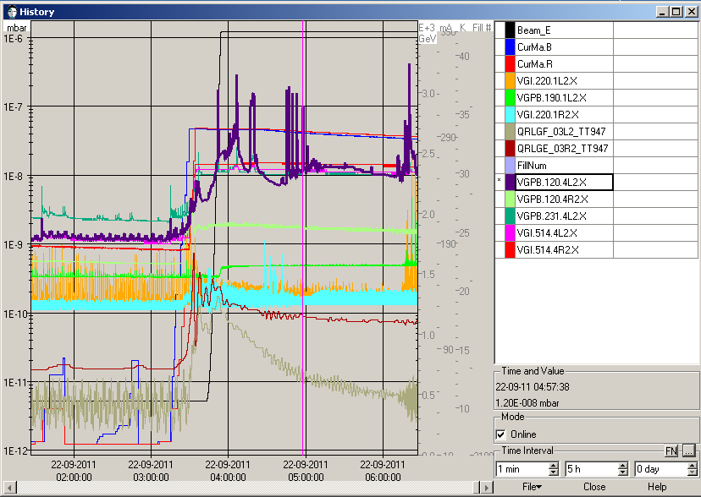
Vac

Slide 7
Issues etc
Tune noise ‘problem’ seems to have started with fill 2094 on 10.9. Noise bursts that swamp the signal.
Not correlated to intensity.
Latching of IQC on MKI-B2 fall-time fixed.
Tolerance windows adapted (4 ns) to drift pulse shape.
ALFA can move in to 25 mm.
Interlock limits to be updated today.
Abort gap cleaning at 3.5 TeV (start at end of squeeze) will be prepared this week (settings, sequence). To be tested next week with one injection of 12 and another one of 144 (tbc) at the sides of the abort gap.

