Slide 1
Monday
11:00 Fill 2124 dumped. QPS on Q7.L5. 78 pb-1.
‘Not fully explained activation of the quench signal of RQ7.L5. Detection algorithm of QPS agent was not activated, problem more likely due to an instability in the interlock loop linking PC, PIC and QPS.’
Precycle. During injection Q7.L4 trips. Access needed to change a 48V supply.
18:00 Filling again.
19:45 Beam dumped during filling by beam excursion on B2. PM indicates that B2 was unstable before injection. Tune was found off near 1/3. Possibly damper making it unstable…

Slide 2
Evening & night
22:20 Fill 2126 in stable beams. Not for long… 3 pb-1.
22:40 Dump – circulator arc detection on RF L1B1.
00:00 TCP.D6L7.B1 lost its position when going to injection. Piquet intervention – motor had lost steps – micro power cut on rack. Problem repeated twice… has happened before on the same jaw (lower V).
03:40 Fill 2127 in stable beams, 3.3E33 cm-2s-1.
04:20 Dump, QPS fault on RQTL11.R7B2. 7 pb-1.
Not clear what happened. Power cycle recovers QPS.
Refilling. Beam lost in the squeeze. Tune FB dragged B2 H tune onto third order resonance.

Slide 3
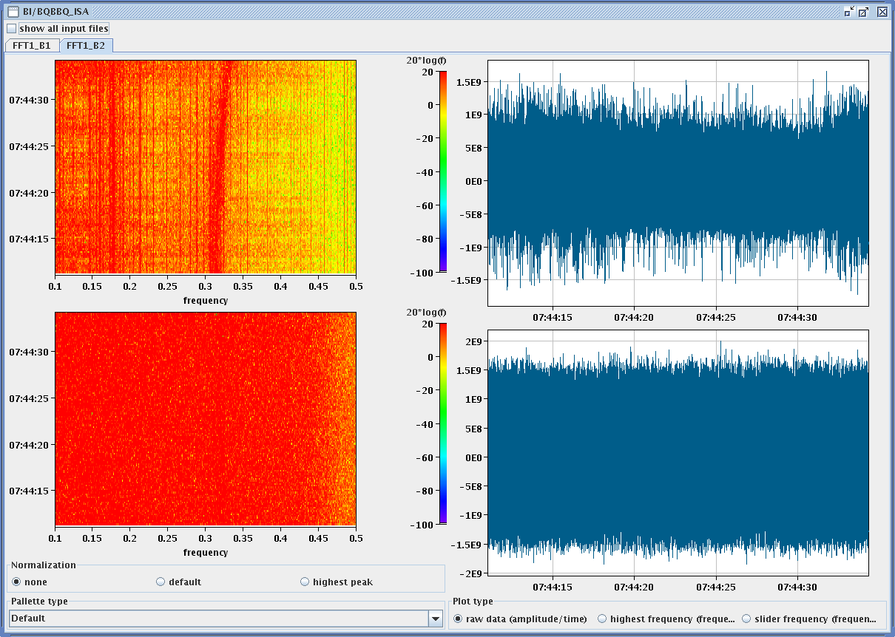
Tune trace for B2.

Slide 4
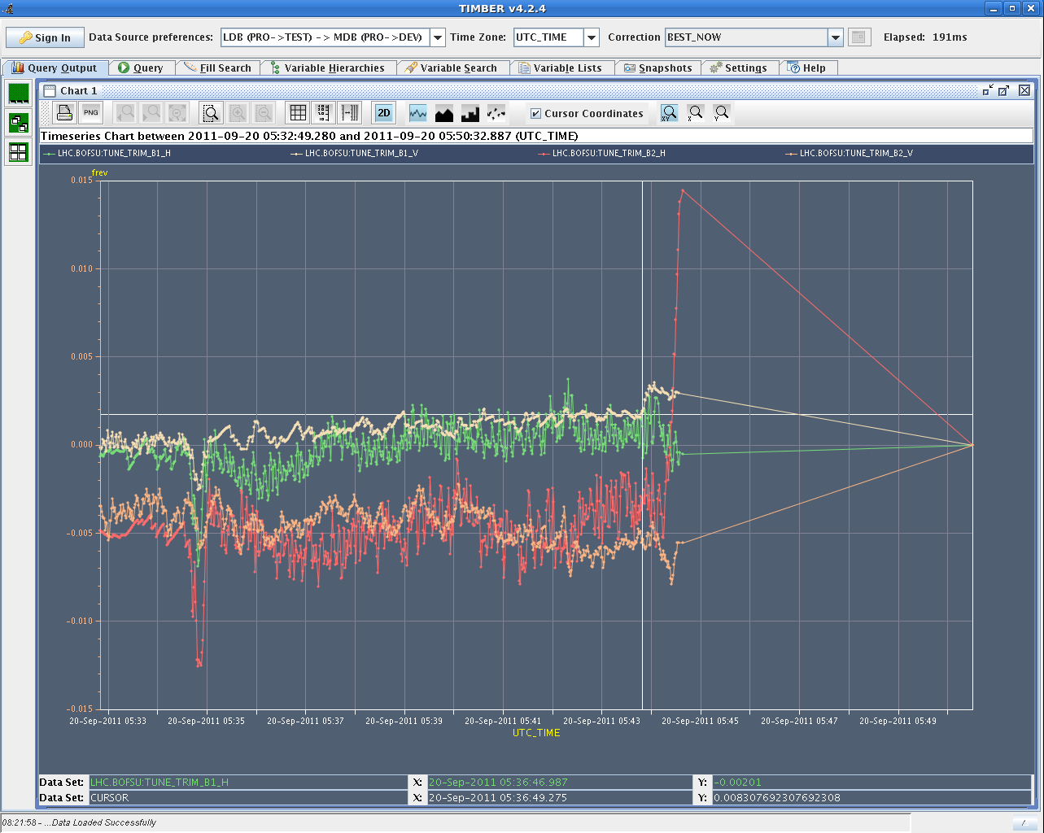
Tune correction

