Slide 1
Tue 13/9 – Wed 14/9
00:56 STABLE BEAMS #2103. Initial Luminosity >3.1x10³³ cm⁻² s⁻¹ on both high luminosity experiments (1.31x10¹¹ p/bunch)
09:08 Lost patrol in point 4. Beams dumped. End of fill #2103. ~70 pb⁻¹ in 8 hours. The doors that caused the loss of patrol was not well closed!

Slide 2
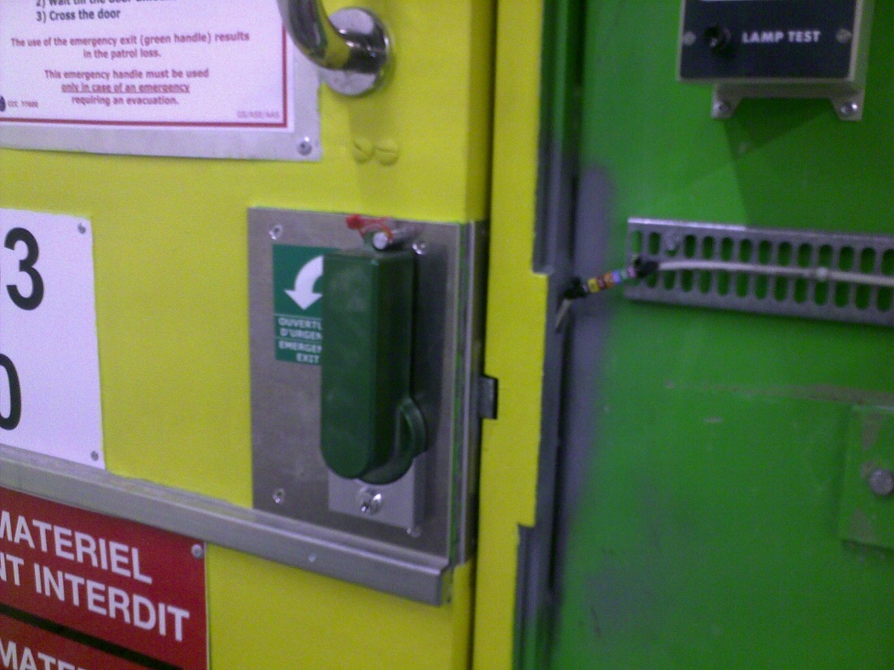
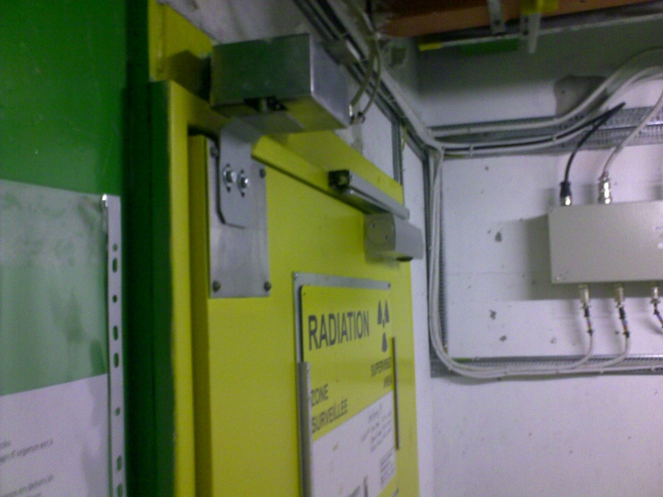
Tue 13/9 – Wed 14/9
YCPS03=US450,YCPS04=US450 not well closed after access on 11/9 + technology of XX(?) -century

Slide 3
Tue 13/9 – Wed 14/9

Slide 4
Tue 13/9 – Wed 14/9
Temporary actions being considered:
Suppress door closer so to avoid a partial closure of the door and allow early detection of the problem
Measurement of the door behaviour in ventilation conditions typical of machine operation

Slide 5
Tue 13/9 – Wed 14/9
11:30 End of patrol in point 4. In the shadow access to ALICE and ATLAS.
12:30-14:30 TDI.4L2 controls problem (required setting different from measured motor position) ➔ OK after repeating the sequence twice!!
14:30-16:00: Damage to 18 kV cable (between BA2 and Meyrin) during the work for the replacement of the SPS 18 kV cables ➔ Electrical network configuration required ➔ Wait at injection with pilot bunch during intervention. ATLAS detector switched off for precaution.

Slide 6
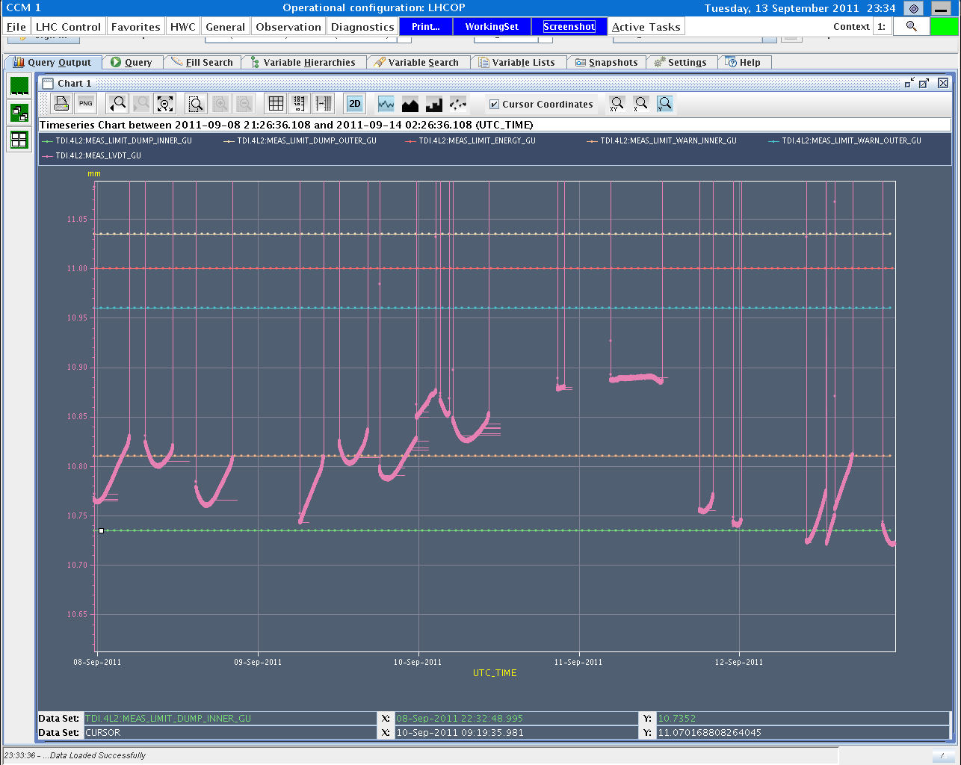
Tue 13/9 – Wed 14/9
11:30 End of patrol in point 4. In the shadow access to ALICE and ATLAS.
12:30-14:30 TDI.4L2 controls problem (required setting different from measured motor position) ➔ OK after repeating the sequence twice!!
Due to noise in the measurement of jaw positions leading to gap opening outside limits.
TDI.4L2 gap interlocks were changed by 100um to avoid an interlock due to a drift of the position reading.
S. Redaelli

Slide 7
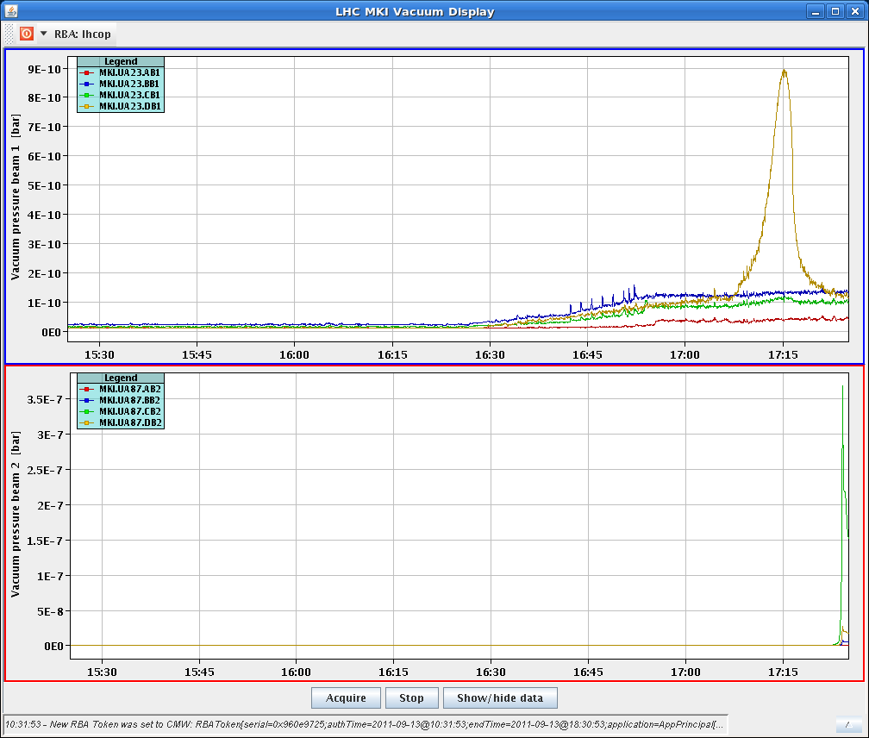
Tue 13/9 – Wed 14/9
Vacuum pressure spike on MKI in point 8 during the squeeze (e-cloud solenoids are on). Local orbit drift during the squeeze leading to e-cloud build-up in the magnet?

Slide 8
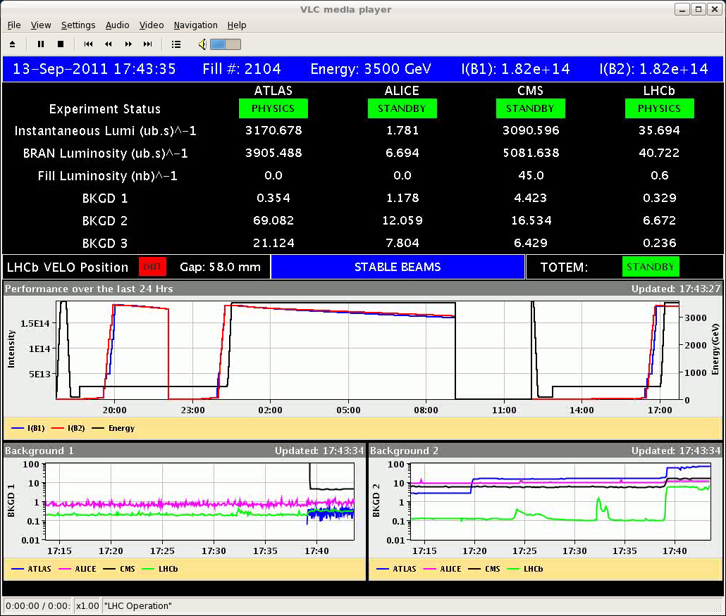
Tue 13/9 – Wed 14/9
17:45 STABLE BEAMS #2104. Initial Luminosity ~3.1x10³³ cm⁻² s⁻¹ on both high luminosity experiments (1.31x10¹¹ p/bunch)

Slide 9
Tue 13/9 – Wed 14/9
21:05 Lost of Cryo Maintain in matching Section R5. Wrong temperature reading on the current lead of RQ6.R5. ~32 pb⁻¹ in 3.3 h
23:30-01:00 No beam from SPS (RF low level problem)
02:39 STABLE BEAMS #2105. Initial luminosity >3.2x10³³ cm⁻²s⁻¹ in both high luminosity experiments. 1.36x10¹¹ p/bunch.
Fill saved by cryo-operator rapid intervention on cryo temperature reading
>3 fb⁻¹delivered to ATLAS

Slide 10
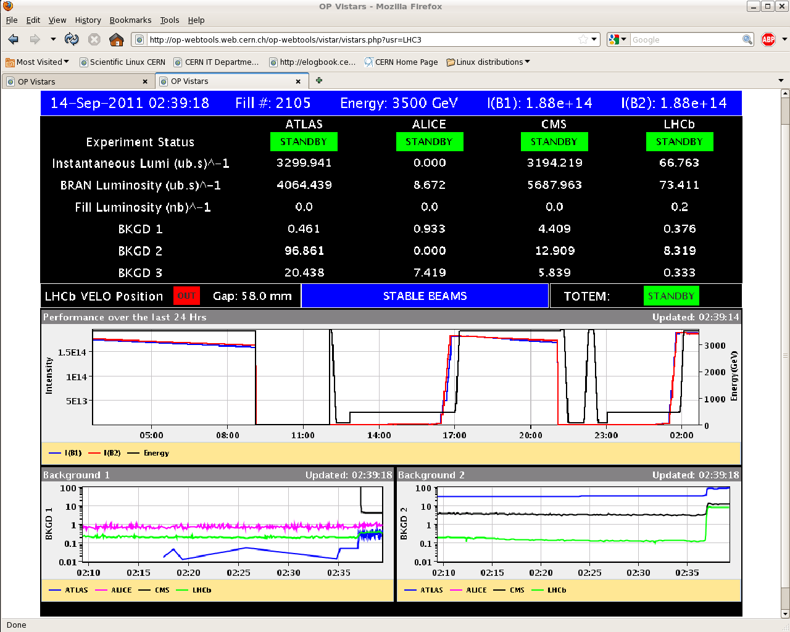
Tue 13/9 – Wed 14/9

Slide 11
Plans and pending issues
Luminosity runs
Pending:
Reconfiguration of the electrical network. Urgent?
Damper set-up for higher intensity (4 hours)
TI2 TCDI alignment checks (2 hours)

Slide 12
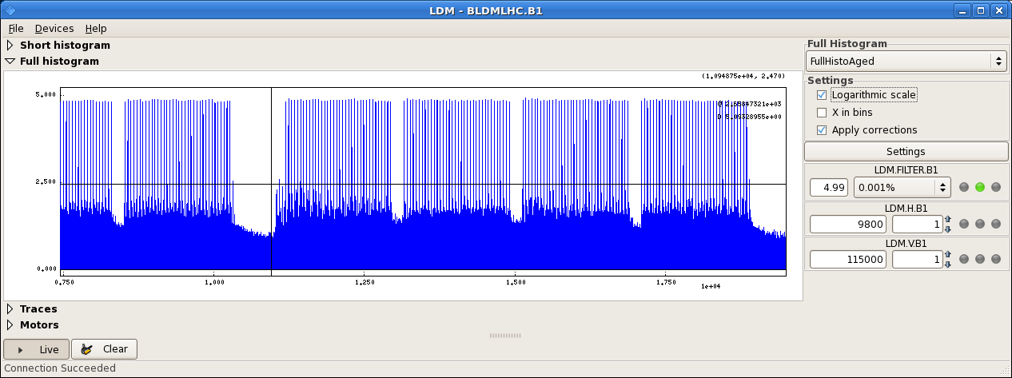
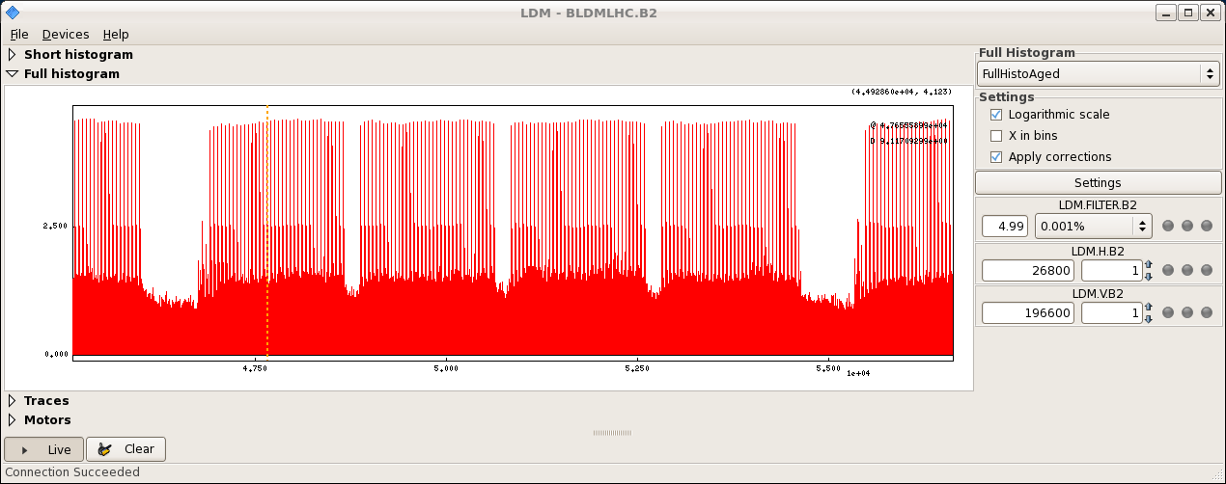
Tue 13/9 – Wed 14/9
E. Bravin

