Slide 1
Network/Controls issue 15 September 2011 1h00 – 9h30
P.Charrue on behalf of the BE/CO group

Slide 2
Report from eLogbook & CO experts
1h07: Task 'Make LHC.USER.INJ resident’ in sequencer cannot reach the end of its execution
Followed by several issues with controls software not running, DIAMON giving many reds alarms, and several servers are unreachable
1h17: TI calls IT firstline who replied that it does not seem to be their fault
Around 2h00: several CO experts were called (Greg, CO piquet, Mark and Enzo)
Enzo arrived in CCC and started the investigations
Several servers could not connect to the NFS world
Some machines (cmw1, jas5 and diam1) where fully working while others only partially
All faulty servers were connected to the IT/CS IP57 switch: "P874-RV-IP57-SHP3L-4115" which appeared OK by IT/CS expert remote diagnostics
All CO efforts were concentrated to check the NFS exports, faulty servers and working servers to identify the cause of a possible network bandwidth overflow
No evidence were found that controls servers were contributing to the problem
8h00: CO calls again IT/CS (E. Martelli) to ask for them to recheck their diagnostic
9h30: decision was taken to reboot the switch: "P874-RV-IP57-SHP3L-4115" .
The reboot of the switch unblocked all servers and every system was able to reach normal operational state

Slide 3
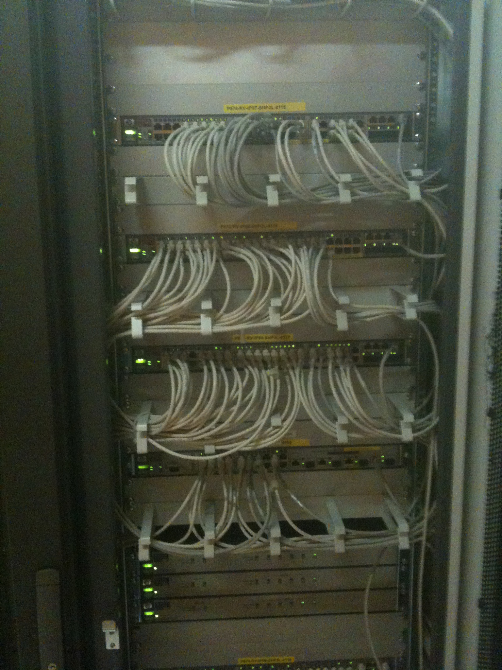
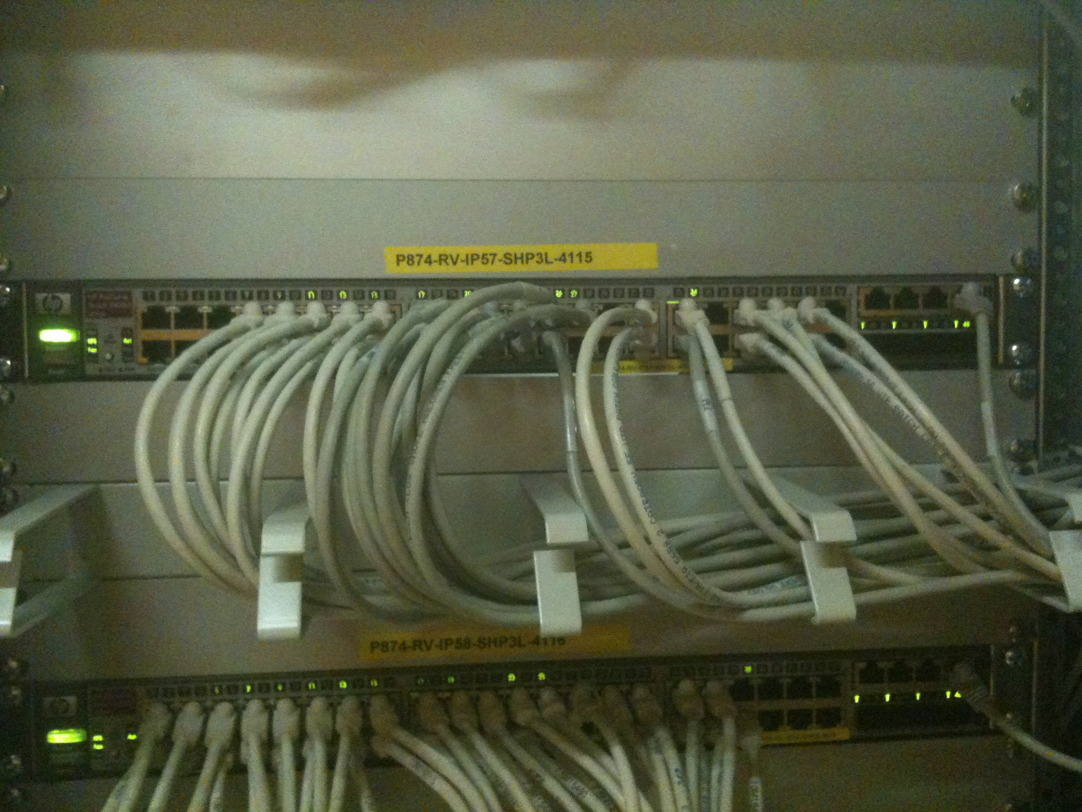
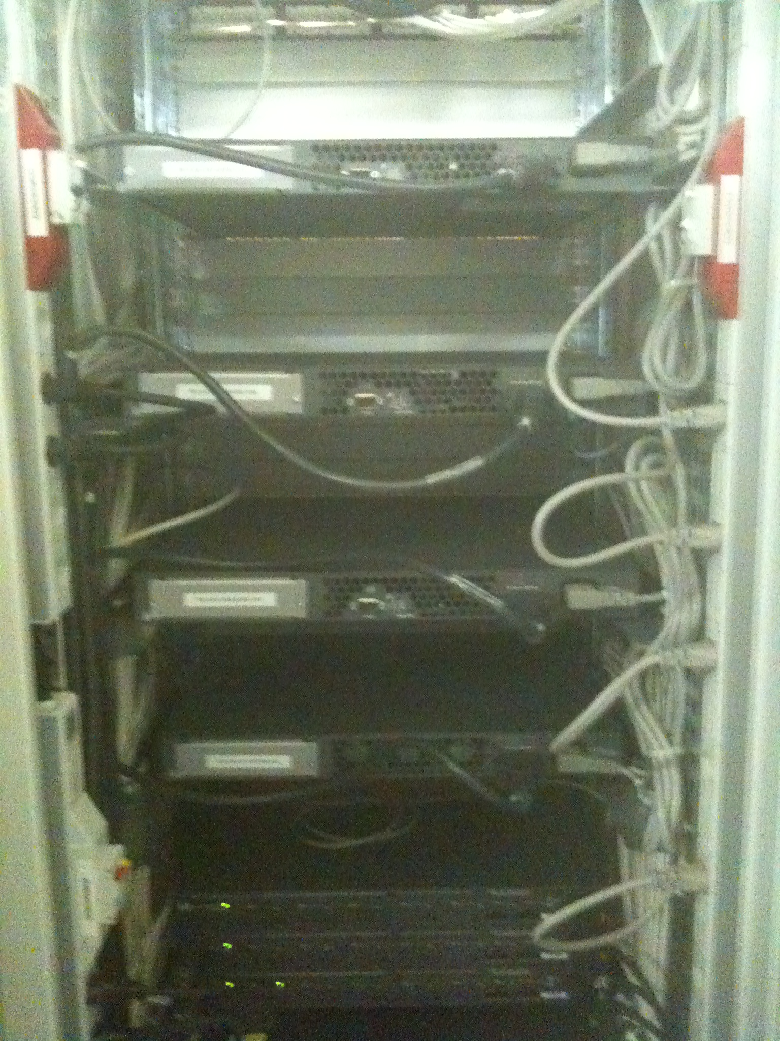
The IP57 switch

Slide 4
Impacted servers
CS-CCR-CMW1, CS-CCR-QPS12, CSM-CCR-QPS23, CS-CCR-QPS23, CSM-CCR-QPS12, CSM-CCR-DIAM1, CS-CCR-DIAM1, CSM-CCR-DIAM2, CS-CCR-DIAM2, CS-CCR-Q4DS7, CSM-CCR-Q4DS7, CS-CCR-INCA2, CS-CCR-TIM10, CS-CCR-MONI, CS-CCR-PVSS4, CS-CCR-LSA1, CS-CCR-INCA4, CS-CCR-INCA3, CS-CCR-JAS5, CS-CCR-TECRG1, CS-CCR-RAMS2, CS-CCR-COCA

Slide 5
First analysis
The origin of the problem which put the switch in a bad state is not yet found
From our investigations (A. Bland) the problem is in no way related to ICMP, UDP or TCP protocol, it is only related to packet size or switch buffer availability
We are certain that the Procurve 3400CL uplink to the IP57 switch interface of the CCC/CCR router was working perfectly
According to IT/CS remote diagnostics the IP57 network switch seemed OK but the reboot of this switch solved instantly all problems
IT/CS is now closely collaborating with BE/CO studying all diagnostic traces to find the explanation

Slide 6
How to react next time
When a network issue is suspected, IT/CS has requested that their network piquet must be called in to the CCC by TI
IT/CS has now added extra diagnostics from their IP57 switch, to have more information in case it happens again

