Slide 1
LHC Status Fro Morning 9-Sep
Bernhard Holzer, Joerg Wenninger
Week 36:
Todo’s:
Ramp up for stable beams:
264 – ≈ 5h
480 – short fill
912 – long fill
1380 – finally !!

Slide 2
Thu Morning
Injection: a bit of a problem at the pre- Accelerators
(49641.7)
912
912
Squeeze & Adjust: “butter weich”

Slide 3
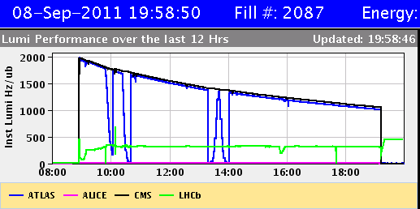
Thu Morning
A real nice 912b * 1m*10h = 50 pb ⁻¹ fill
(49641.7)
Atlas Lumi-Scan: done
LHCb so sorry: was above 300. We separated it with lumi scans in V
to get < 100.
We incorporate this additional separation for the next fill.

Slide 4
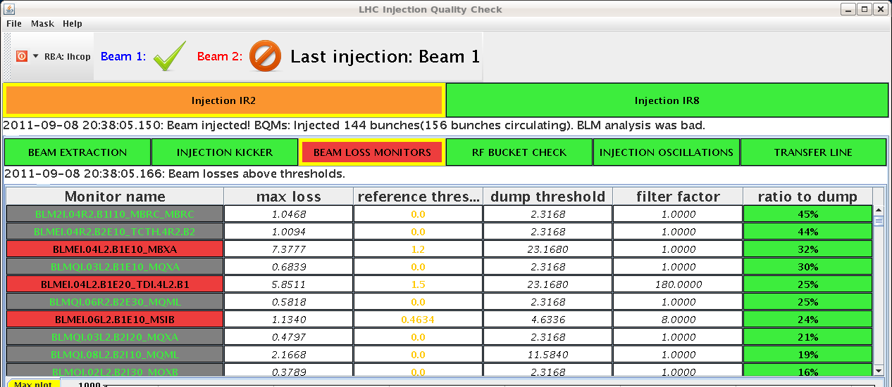
Thu Late:
Injection: minor problem: RQT12.R1B1 tripped during combo at -284 A.
External interlock from QPS.
injection losses ok ... at 144 bunch transfer !!
some problems with last transfers of beam 2.

Slide 5
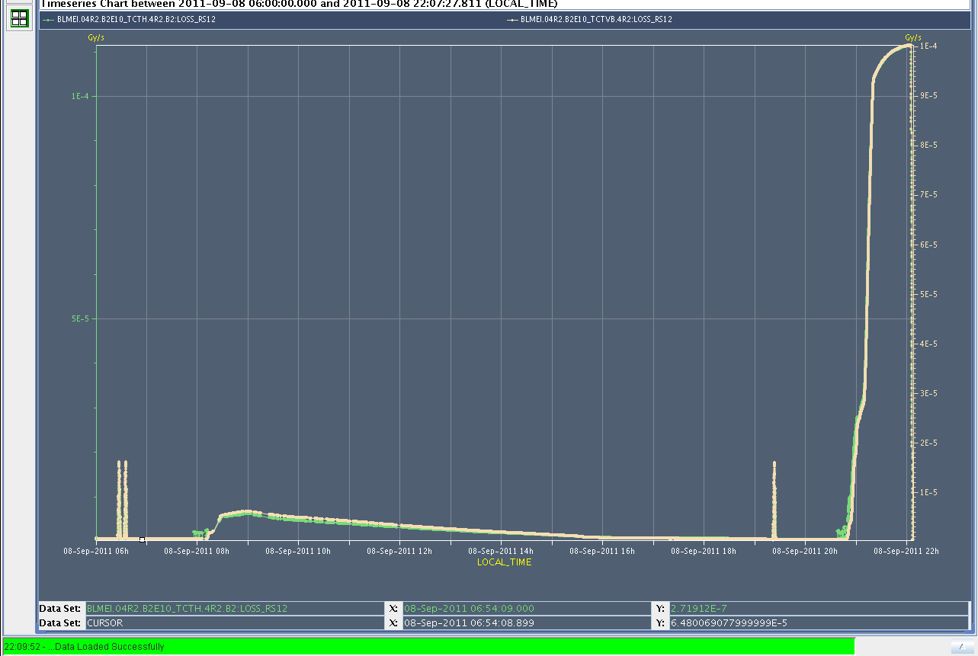
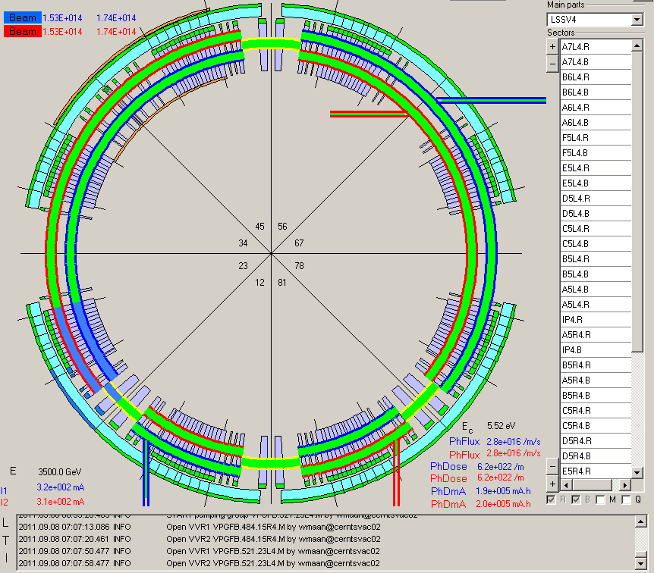
Thu Late:
21:04h Ramp & Flat Top: Losses on TCTV.4R2 at flat top.
High interaction rates in ALICE.
21:04h Vacuum
According to the vacuum display, there is no communication with the valves in sector 23.PLC disconnected @ 21:04
(PLC ... SEU ?)

Slide 6
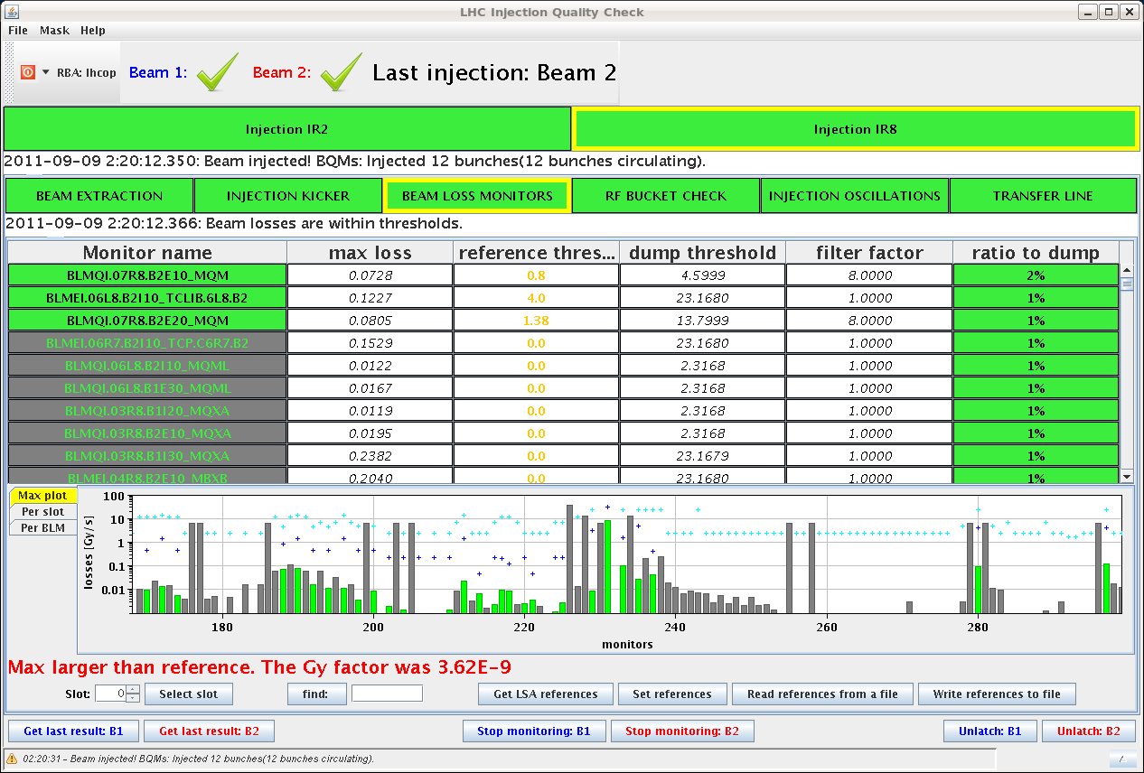
Thu Night:
22:05h Squeeze & Dump
Dump Classification: Collimator position not correct
“The measured gap exceeded the beta* limits for several collimators in IP1 and IP5.”
position limits as a function of time were tightened with respect to the values used for beta* = 1.5 m.
2) Limit functions for the collimator gaps as a function of beta*were extended to cover the range < 1.5m.
02:09h Injection: ... ok

Slide 7
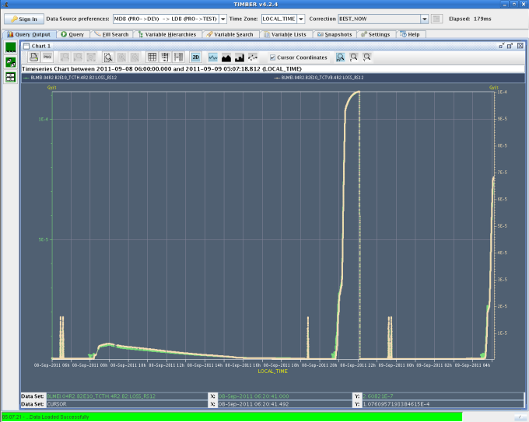
Thu Night:
02:57h Dump ... Cryo
high heat loads in sector 45
(with 60 buches circulating !)
04:03h Injection
05:10h Ramp, Squeeze, Lumi
and again Alice background ...

Slide 8
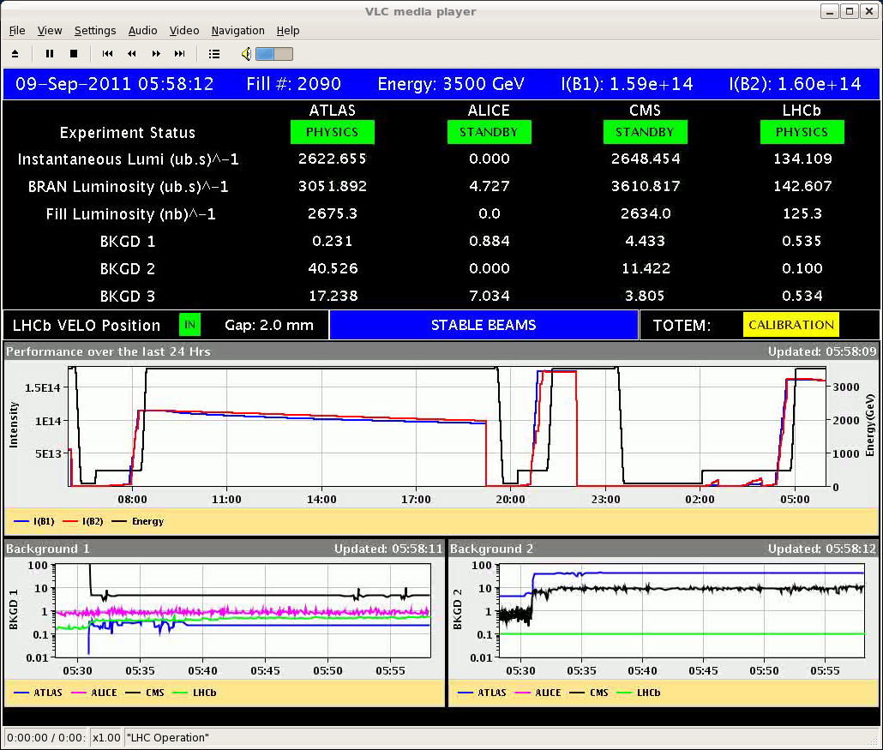
Thu Night:
05:10h Lumi
50 pb ⁻¹
06:51h Dump
Beams dumped, sector 45 lost
Initiating event: the quench loop of Q8.L5 was opened

Slide 9
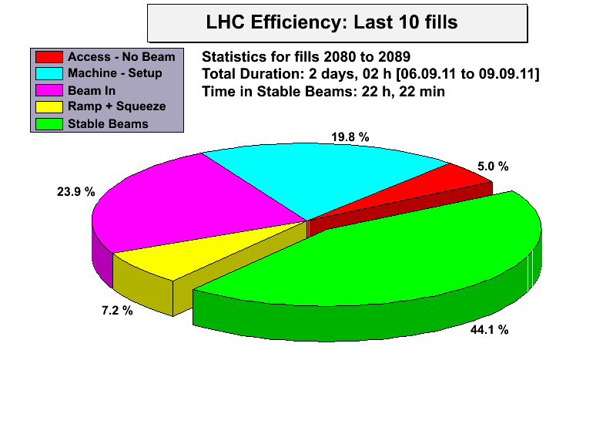
Resume:
Todo: Alice ??
stable conditions

