Slide 1
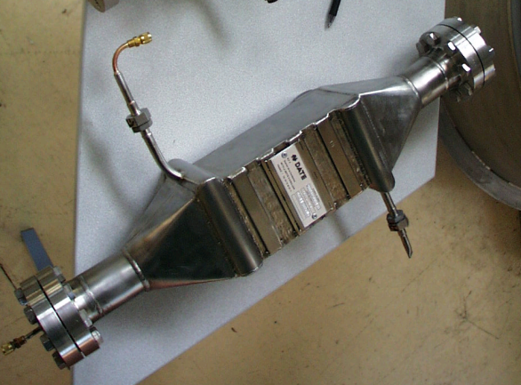
1.8 K cycle and specificities
Cold Compressor
300 K under
atmosphere
Active
magnetic
bearings
3-phase induction
Electrical motor
(rotational speed:
200 to 700 Hz)
200 to 800 Hz)
Fixed-vane
diffuser
Outlet
Cold under
vacuum
Spiral volute
Axial-centrifugal
Impeller (3D)
Pressure ratio
2 to 4
Inlet
Stainless Steel Plate
CC:
- 3D wheels
- Bearings (300K)
HX:
- Very Low Pressure
HX
“Mixed” Compression P ratio ≈ 80

Slide 2
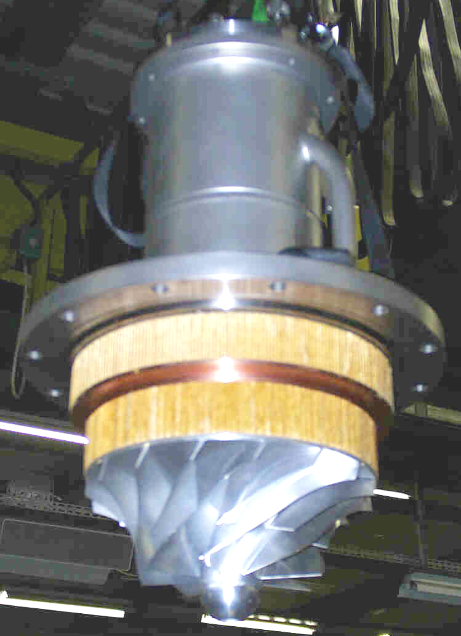
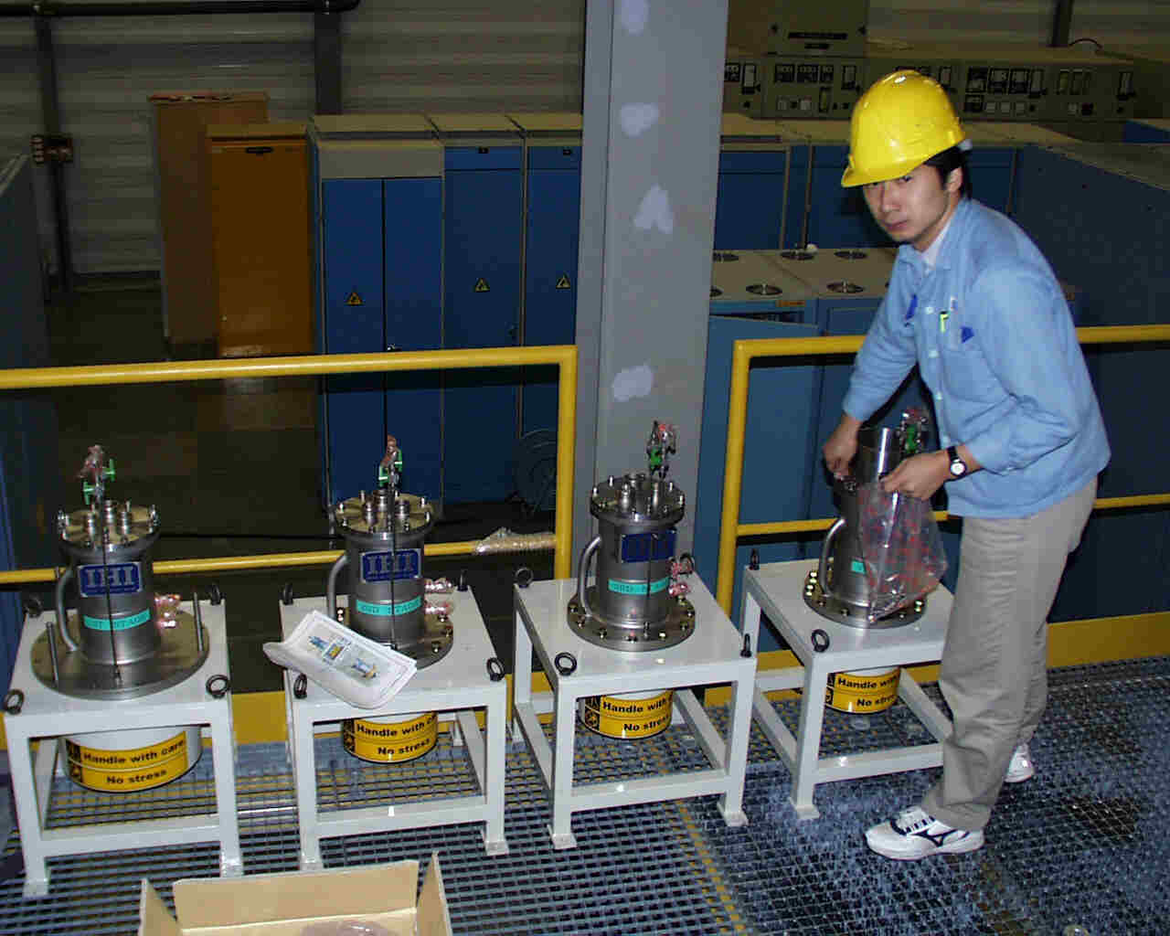
Hydrodynamic cold compressors for 1.8 K ref.
125 g/s GHe from 15 mbar with 4 stages

Slide 3
Cryo failure on Cold Compressor Unit
Cold Crompressor Unit:
  The CCU is composed of four compressors which by pumping on the helium bath allow to cool the magnets from ~ 4K down to 1.9K.
  The problem occurred on CC4
Several hypothesis:
  Single Event
  Driving Electronics
  Compressor
  …
Historic:
  13.08.2011 – 02:40am:
    Cryo is in Nominal conditions, Stable beam. The CC4 magnetic bearing controller has lost this feedback position value -> The PLC sees a difference between position – feedback -> send a stop order to CC4. During the stop the shaft’s magnetic center has moved.
CRG-OA
15.08.2011

Slide 4
Cryo failure on Cold Compressor Unit
Historic (next):
  13.08.2011- morning:
    Access request needed, 3 tries to restart CC4, but each time it stops ~150Hz.
  13.08.2011- afternoon:
    Access request, recalibration of the magnetic center of the shaft.
    Restart around 5pm, CC4 at nominal speed during 7 hours.
  13.08.2011- 23:40:
    Same failure !!
  14.08.2011- 09am:
    Decision to change the electronics controlling the CC4 speed.
    Restart around 2pm, CC4 at nominal speed since then.
CRG-OA
15.08.2011

Slide 5
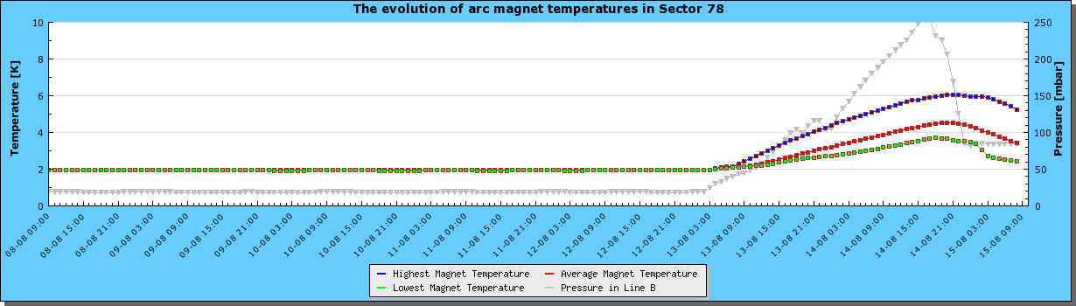
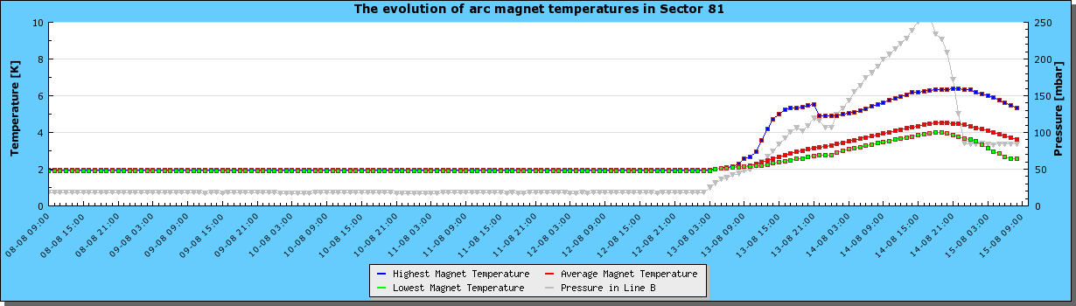
Where do we stand ?
3.4K
3.6K

Slide 6
Estimated Recovery time
~ 30 hours from now

