Slide 1
Week 32 Started with luminosity production…
Coordination by G. Arduini / J. Wenninger

Slide 2
Overview of week32 – major timeouts
Tuesday evening
PSB RF
Wednesday evening
Beam 1 capture - RF
Thursday
SPS dipole exchange (vac. leak)
Saturday early morning
Cold compressor Pt8
1
2
3
4

Slide 3
Stable beams fill overview
Fill | Phase | Peak L [10³³ cm⁻²s⁻¹] | Length [h] | Int. L [pb⁻¹] | Dump cause
2009 | STABLE | 2.1 | 15.3 | 76 | Sector 81 trip (QPS quadrupoles)
2010 | STABLE | 2.05 | 18.8 | 85 | RQT12.R7B1 (QPS-SEU?)
2011 | STABLE | 2.1 | 8.5 | 45 | SIS interlock (communication RF FEC)
2022 | STABLE | 1.95 | 5 | 30 | SUE on QPS for RCBXV2.R1
2025 | STABLE | 2.2 | 8.5 | 52 | Cold compressor Pt8
Bunch intensity pushed up to ~1.3.5e11
Average emittance ~2+ microns
Peak luminosity 2.2x10³³ cm⁻²s⁻¹ (fill 2025)
Integrated luminosity 290 pb-1

Slide 4
Intensity increase
Over the week the bunch intensity was pushed to 1.35E11.
No major issues in the LHC related to intensity:
Higher vacuum (improving), background reported by the experiments.
For one fill beam1 lifetime lower, but good for last record fill.
High losses at the TCTVB.4R8 – up to 60% of dump threshold on very long RS (83 seconds).
Some worries in the SPS with the electrostatic septum for the North Area physics.
Sparks, ion trap trips.
Some condition observed (?) – tbc.

Slide 5
Record fill – peak L
Fill 2025, 1.35E11/b, 104 MJ.
The last nice thing we saw in the LHC for the week…

Slide 6
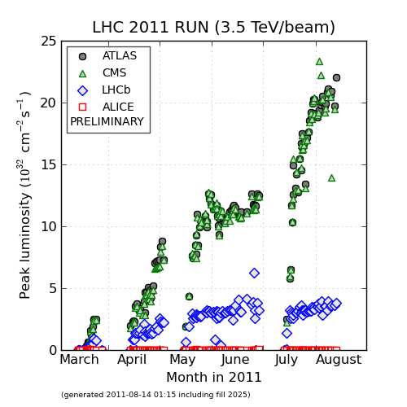
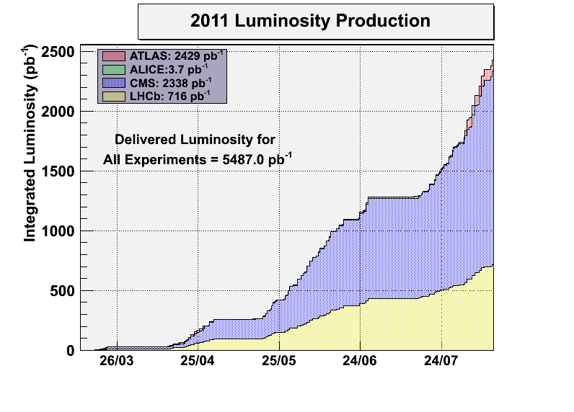
Statistics

Slide 7
RF capture beam 1 - Wednesday
First symptoms of the problem:
Large(r) losses during the last injections of beam1.
In the night of Tue-Wed this led to a beam dump by ALICE+BLMs. A post-mortem analysis revealed strong de-bunching and bunch lengthening of the first 144b batch.
Investigations Wednesday evening by the RF colleagues were not successful in identifying the problem.
The problem could be re-produced – it affected mostly the first injected 144b batch. Beam 2 not affected.
Saturation of RF LL electronics could be excluded by changing gains. As a side effect this led to a dump by SIS on total RF voltage.
RF experts used the Thursday stop for SPS magnet to investigate in Pt4.

Slide 8
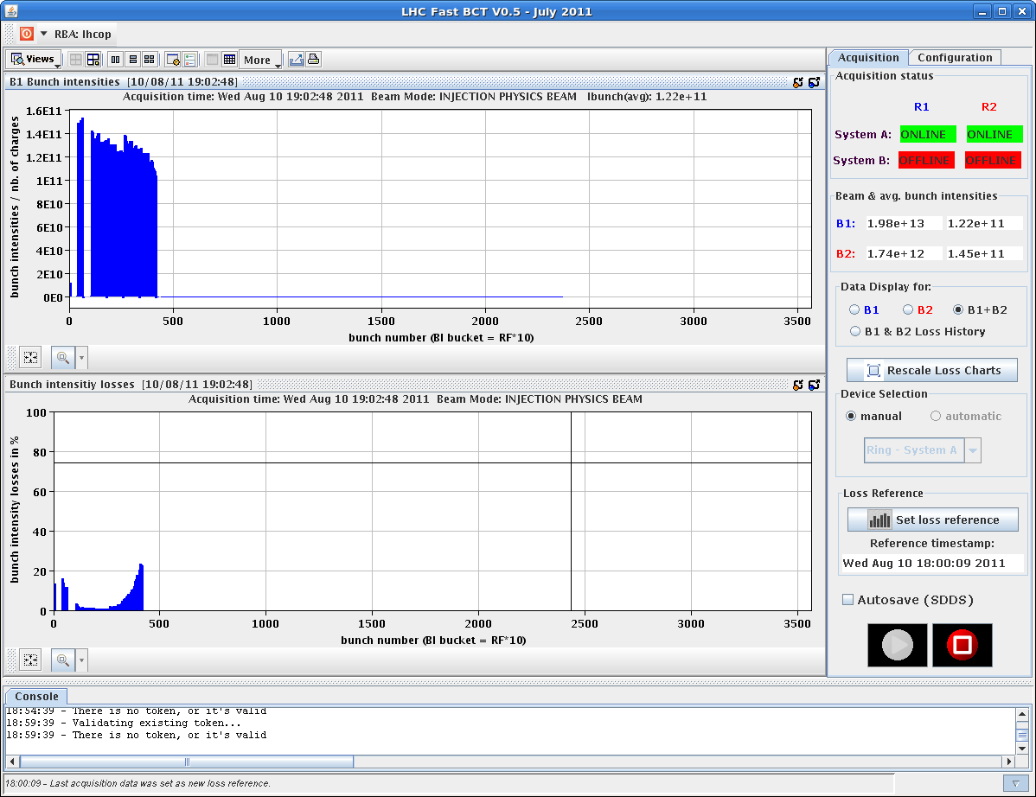
Capture issue beam 1
Beam 1 losses at injection of 144b
B-by-B intensity
B-by-B losses

Slide 9
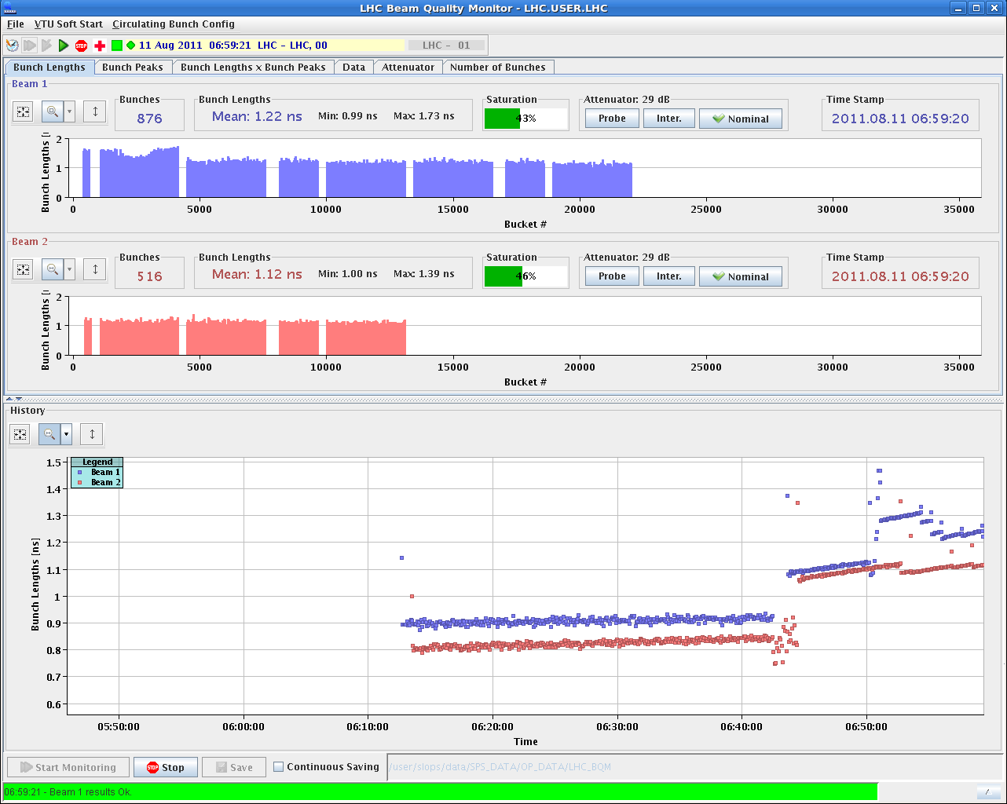
We could survive…

Slide 10
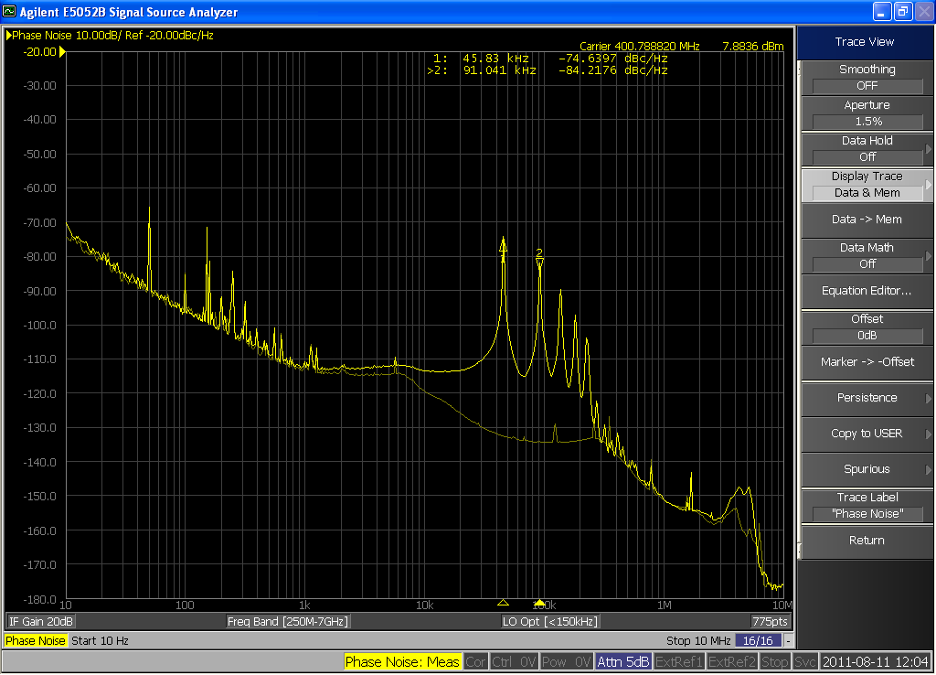
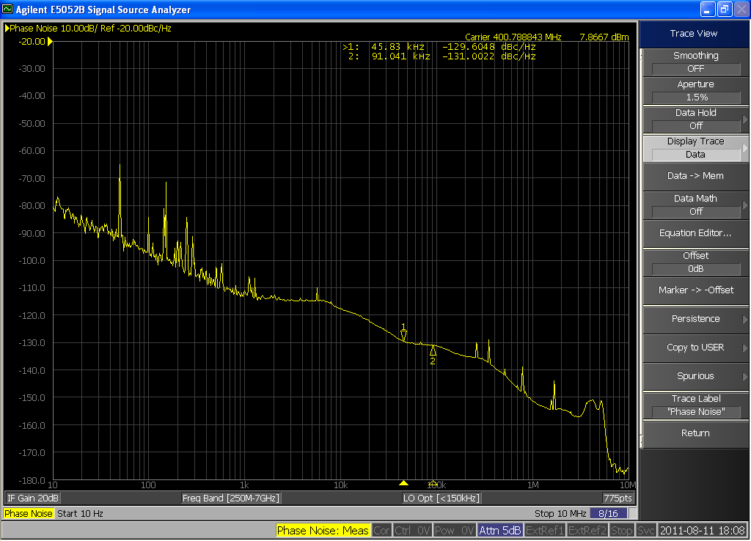
RF detectives at work in Pt4
Without beam, Cav4B1 at injection settings had a large phase noise, locked at 4x frev. Cured by cold reset of the firmware.
Similar issue found on Cav4B2 – with lower amplitude. Not solved by reset. Gain reduced on loop for the moment.
>> no more capture problems from then on.
Cav4B1
Cav4B1
after reset

Slide 11
SPS magnet exchange - Thursday
Beam off at 07:15.
New dipole in place in cell 520 ~12:00.
Magnet aligned and brazed ~17:00 – start of pumping.
Beam back in the SPS ~21:30.
Vacuum conditioning with 50 ns.
Nominal 50 ns beam on flat top at ~23:00.
16 hours from beam off to beam ready in SPS

Slide 12
Cold compressor Pt8 – Night Fri-Sat
Saturday 02:45: trip of cold compressor in point 8
Cause: sudden variation in the measured value of the rotation speed of the turbine on magnetic bearings leading to a fast stop of the compressor.
Sat morning: diagnostics, attempts to restart the compressor failed on the same fault.
Sat 14:30: intervention of the cryo controls team to recalibrate the parameters controlling the rotation and axis of the turbine
Sat 17:30: Compressor restarted
Sun 00:24: Trip of the compressor, again on the same fault.

Slide 13
Cold compressor Pt8 - Sunday
Sunday morning: decision to exchange the electronics of the cold compressor.
13:30: Cold compressor restarted.
Cryo conditions expected for Tuesday.

Slide 14
In the shadow of the timeouts - Thursday
‘Dry’ squeeze test first to 1.0 m and then on to 0.55 m.
1 m OK.
From 1 m to 0.55 m → trip of all RQ6’s. Once more a dI/dt problem – LSA parameters too optimistic. Not the first time !
Beta* information not correct below 1.5 m. New conversion tables I to beta* checked. They will be updated during the TS.

Slide 15
In the shadow of the timeouts - Sunday
An ‘extractable’ SPS cycle with a new SPS optics based on an integer tune of 20 (instead of 26) was setup quickly to test extraction into TI2.
Interest of this optics is a higher instability threshold (for LIU).
Due to the speedy setup beam quality was not ideal (in particular longitudinal - satellites), but good enough.
Individual bunch of ~1E11.
Beam was sent to the downstream TED along TI2 in the afternoon.
Steered easily to standard OP reference !
Betatron mismatch of a few % only.
Some issues with losses in the extraction channel – to be checked with cleaner beams.

Slide 16
Q20 optics
Textbook-like trajectory response !

Slide 17
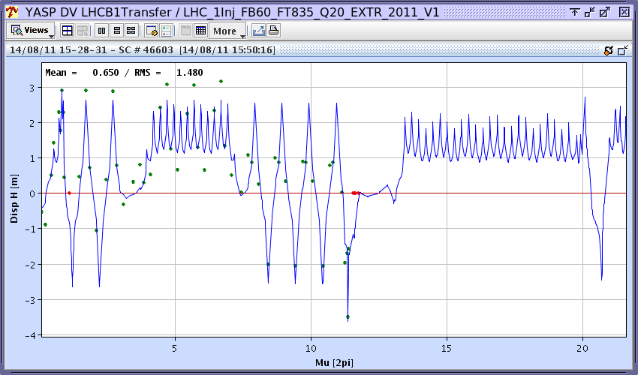
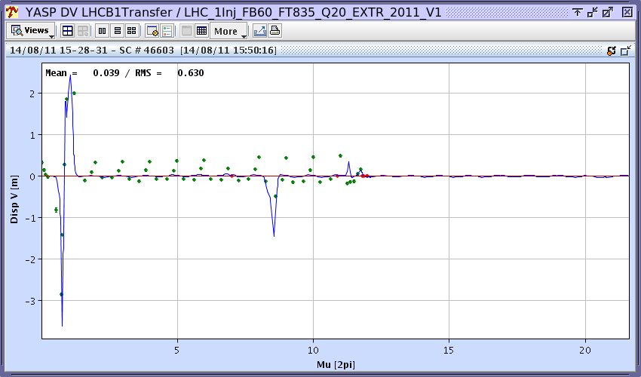
Q20 optics
Dispersion – some beating, good part from SPS.

Slide 18
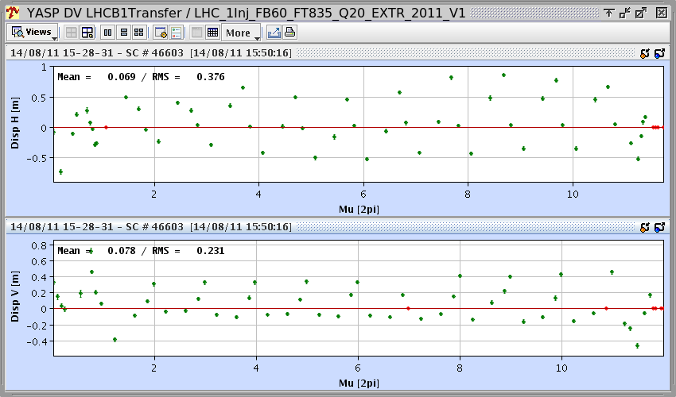
Q20 optics
Dispersion error – some beating, good part from SPS.

Slide 19
Injection issues on beam2
Strong modulation (~ 1 mm) of the injection oscillations along the batch in H plane for fills 2011 and 2022.
Not present on B1 → not beam instability in SPS.
Some change with time. Present since ??
SPS MKE4 kicker checked – apparently no change.
Ver
Hor
Hor
Ver

Slide 20
…disappear again !
Modulation of oscillations along batch disappeared in fill 2025.
To be watched !
Hor
Ver

Slide 21
MKI temperatures
Injection kicker temperature exceed now 60 degres in Pt8 after a fill consecutive fills.
Injection interlock temperatures:
Different interlock levels for MKI2 and MKI8.
MKI2 threshold : 41 deg.
MKI8 threshold : 61 deg.
If temperature at end of fill above those values → immediate Softstart conditioning to check kicker pulse signals.

Slide 22
Losses at TCTVB.4R8
Slow loss on TCTVB.4R8 are now systematically above warning level of 30% of dump threshold on 83 s RS.
The losses are correlated to:
LHCb luminosity,
Vacuum R8,
Certain loss types in IR3 (for example local vacuum),
And more ?
Those losses are no immediate danger. It may be wise to prepare a threshold increase by a factor 2 on the 83 s RS for the TCTVB BLM.

Slide 23
Vacuum, Lumi and losses TCTVB.4R8
Lumi LHCb
TCTVB
Vacuum

Slide 24
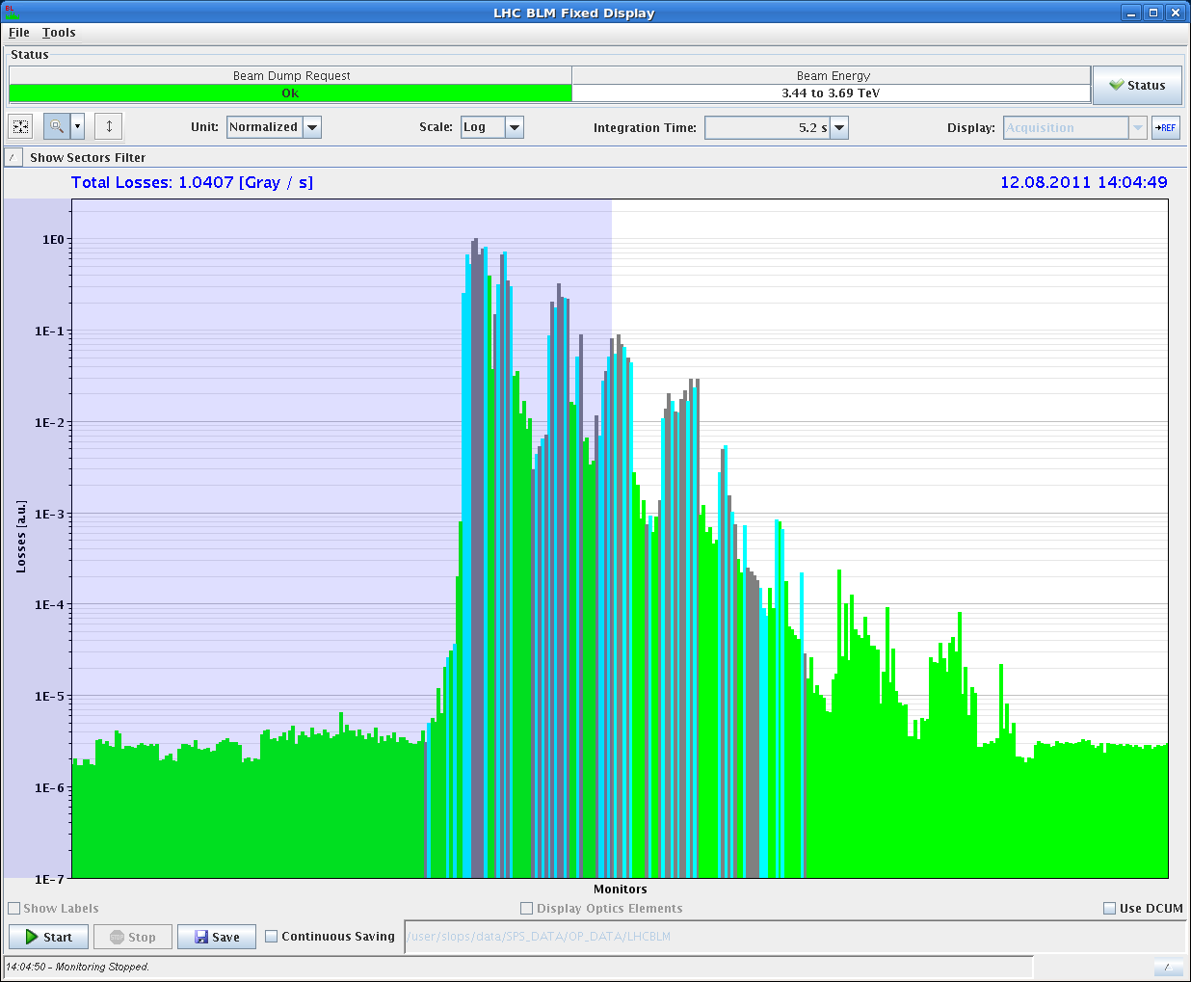
And the periodic loss maps
Loss maps were performed at injection and 3.5 TeV (stable beams conditions).
RPs of TOTEM and ALFA ‘in beam’.
Loss maps are Ok – awaiting final numbers from coll. team.
B1 V @ 3.5 TeV

Slide 25
Next
Beam conditions expected some time on Tuesday.
Today:
Access in Pt4 for RF.
Pre-TS work – to be confirmed.
Possible powering tests overnight.
On the menu for beam:
Watch out vacuum in Pt8.
LHCb polarity change.
TOTEM & ALFA moving in during stable beams.
‘End of fill’ tight collimators.
Coordination by B. Holzer and J. Uythoven.

