Slide 1
Mon 25/7 – Tue 26/7
PROFIBUS controller problem (SEU) on cryo valve on DFBMH (600 A circuit RQ6.L7B1/2). Loss of cryo maintain ==> Beam dump. End of fill #1975 after ~2.5 hours (13 pb⁻¹)
14:30. Beam dump (fill 1976) due to BLM on TCSG.L7B1 while going in collision (long running sum).
18:00 Verification of the effect of solenoids on vacuum in point 8. No effect on vacuum pressure in D1.L8
18:30 beam dump due to RF trip at the end of the squeeze (fill 1977)
22:30 Stable beams #1979: Initial luminosity 1.3x10³³ cm⁻²s^{-1.} Larger emittance from the injectors
04:30 QPS trip on RCO/RCD/RCS.A56. End of fill #1979 after 6 h (~23 pb⁻¹)
Following fill lost during the ramp (QPS trip – RQTL7.R7B1)
07:00: Trip of Sector 12

Slide 2
Mon 25/7 – Tue 26/7
13:20 Filling. Emittances small but comparable to previous fill
Fill 1976 1975
B1H 1.6 1.3
B1V 2.0 1.5
B2H 1.8 1.8
B2V 2.3 1.95
Difficult to believe the values particularly for Beam 1...

Slide 3
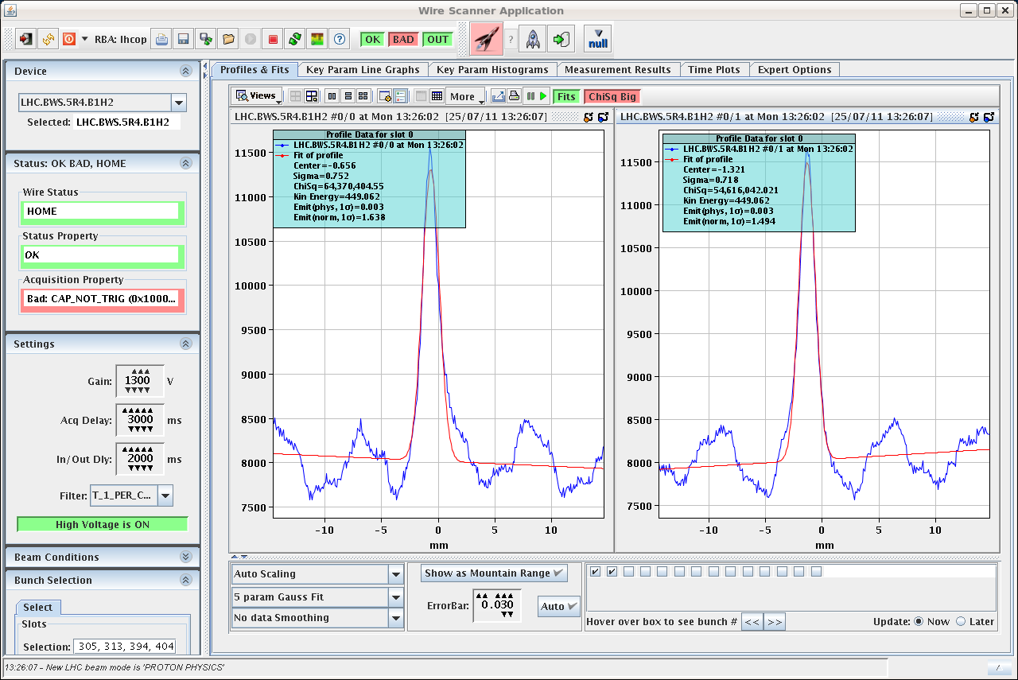
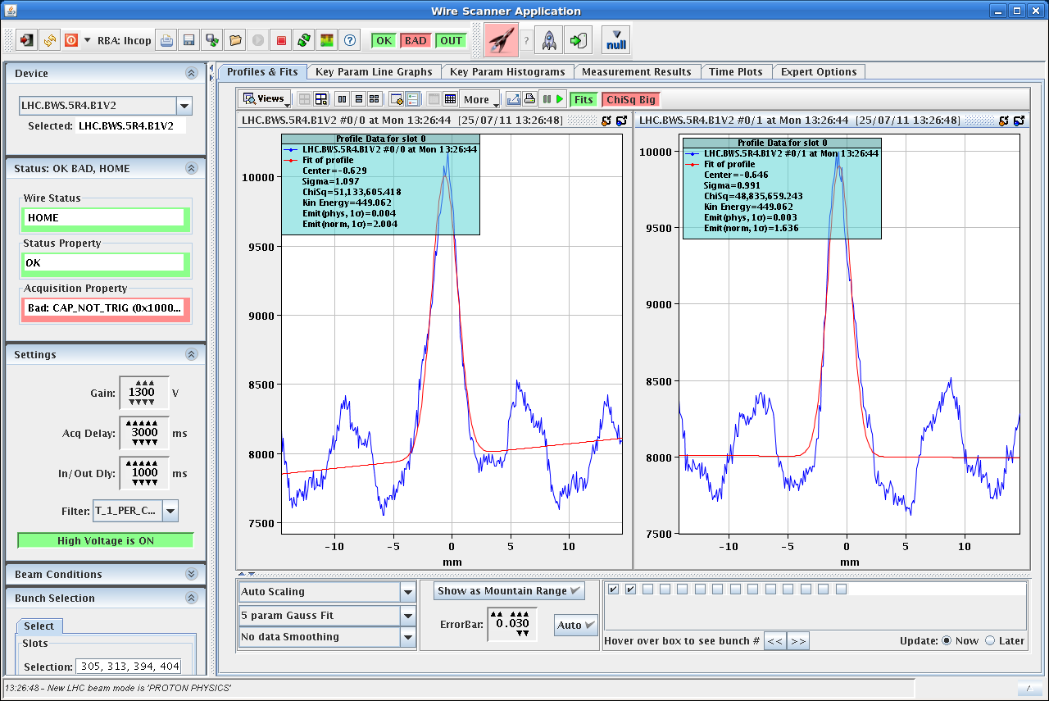
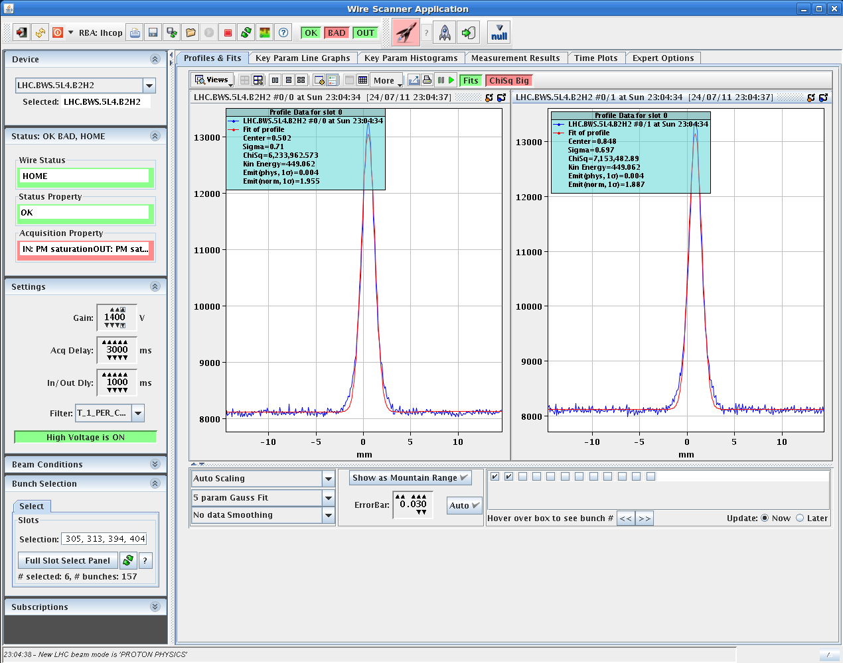
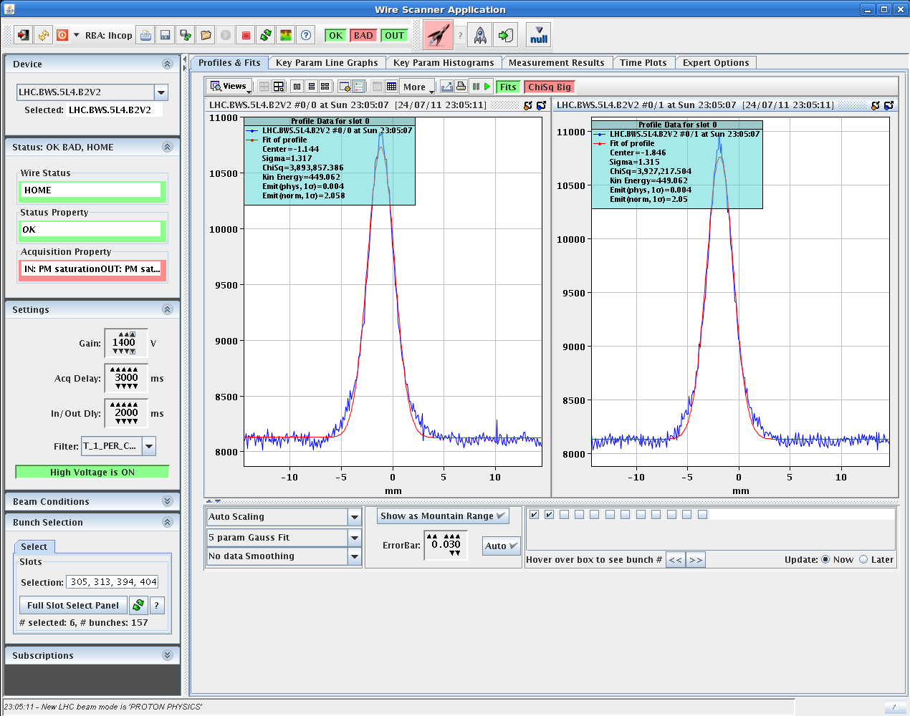
Mon 25/7 – Tue 26/7

Slide 4
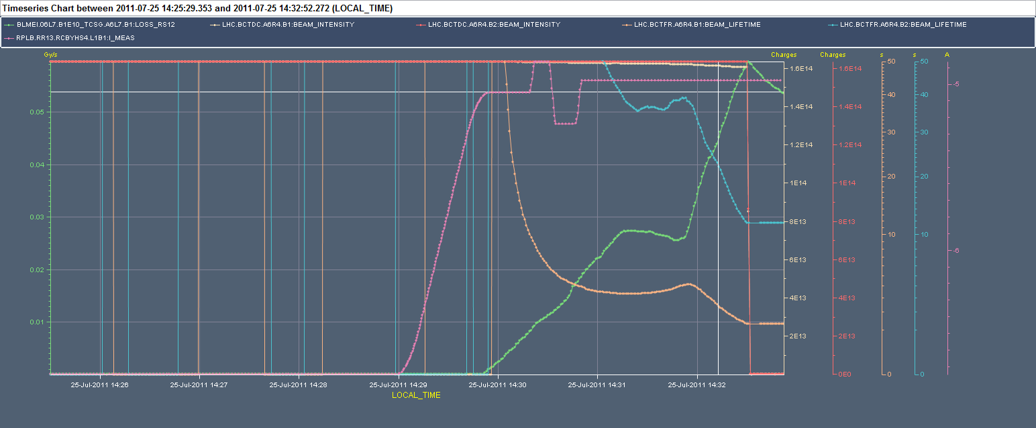
Mon 25/7 – Tue 26/7
14:30. Beam dump due to BLM on TCSG.L7B1 while going in collision (80s running sum). Lower lifetime particularly on B1 after horizontal separation scan in point 1.

Slide 5
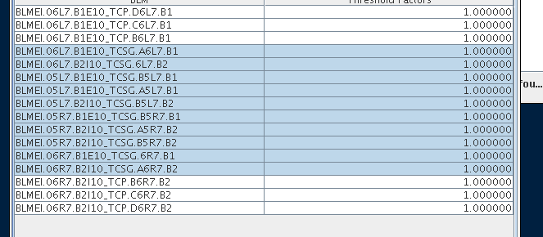
BLM thresholds
After verification with collimation team (Stefano), MPP (Markus), BLM team (Barbara):
The Master threshold for 10 monitors protecting TCSGs in IP7 have been increased by a factor 10 (for integration windows higher than 10ms) to provide more margin for optimization in particular in view of possible increase in intensity, luminosity
Vacuum thresholds close to TCPs (now at 4x10⁻⁷ mbar) likely require increase to 2x10⁻⁶ mbar ➔ to be confirmed with vacuum team today

Slide 6
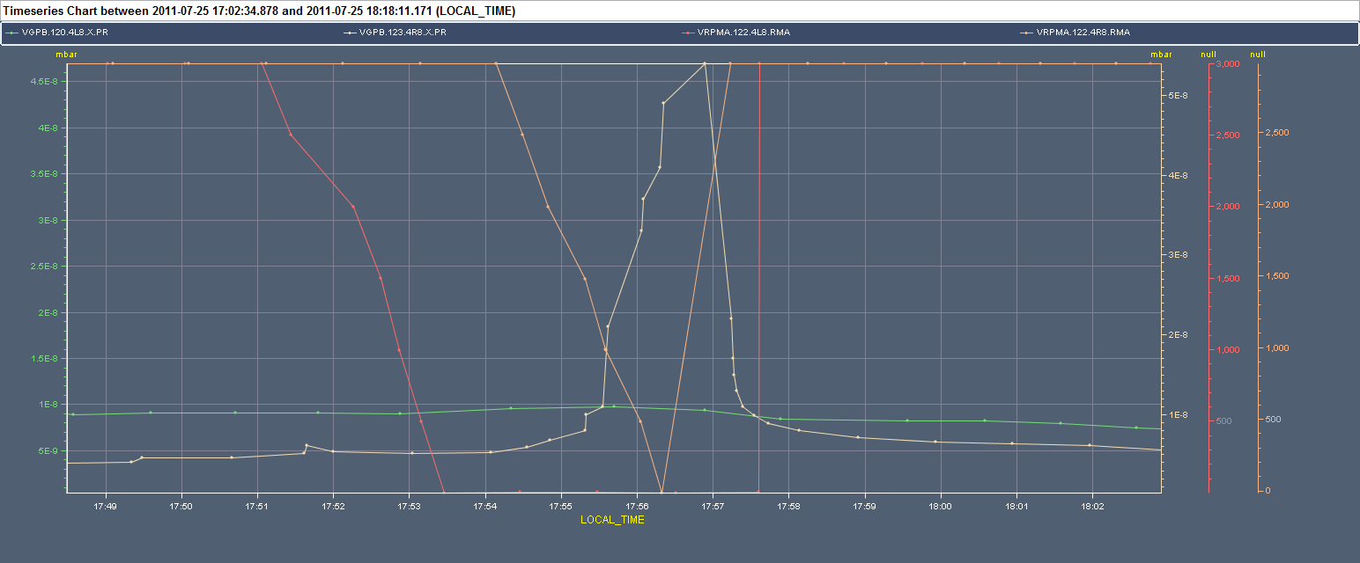
Vacuum in point 8 (L8)
17:30: Re-inject after blow-up verification in the SPS ➔ blow-up was not effective due to drift in working point ➔ now back to emittances of ~2 μm
Solenoids off at injection to verify the possible correlation with e-cloud ➔ No correlation of vacuum pressure with solenoid current for L8 (but for R8). e-cloud not responsible for pressure spikes

Slide 7
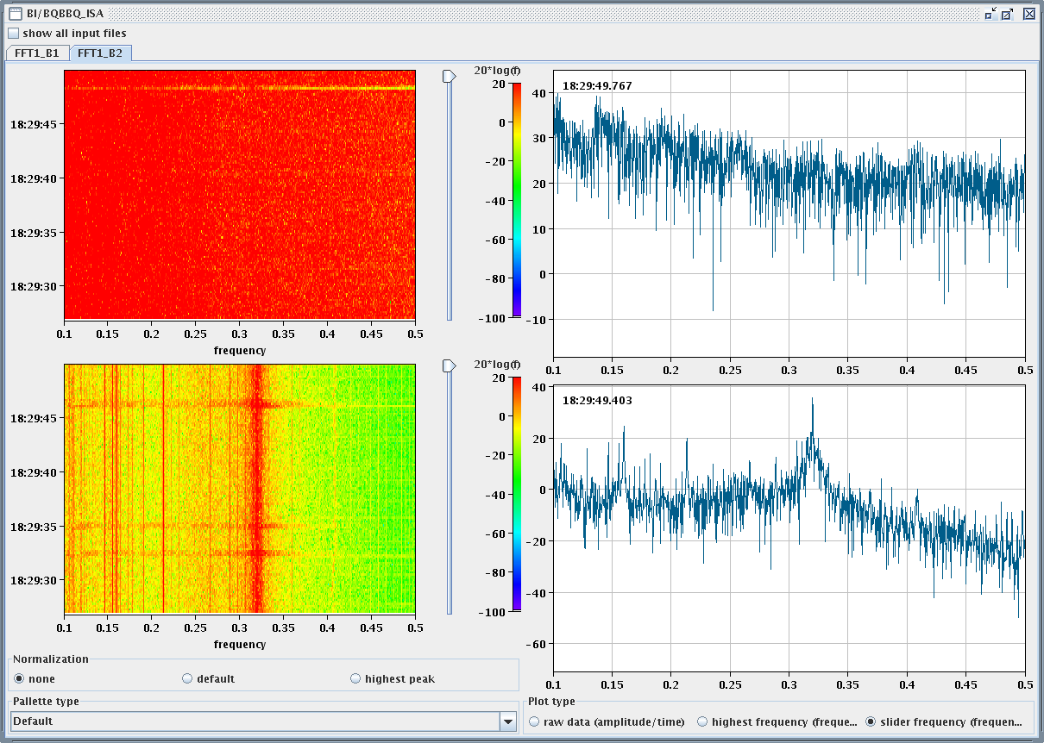
Fill 1977
18:30 Lost tune feedback signal in the last part of the squeeze (H2) ➔ possible issue with the detector ➔ Ralph investigating
Loss of 1 RF module (M2B1 crowbar - 3rd time: thyristor likely to be changed ➔ piquet defining the need for/preparing the intervention possibly today (4 hours access) during daytime

Slide 8
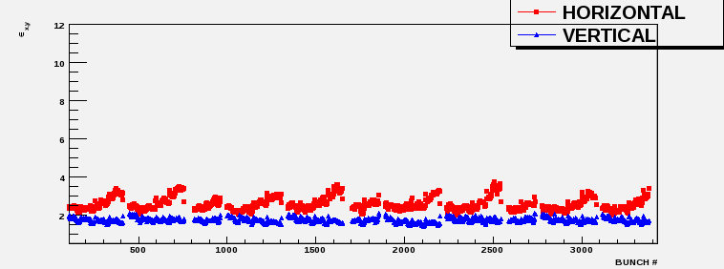
Fill 1979
Finally in physics at 22:30. Initial luminosities rather low: 1.3E33
Emittance varying along the bunch train ➔ already coming from SPS.

Slide 9
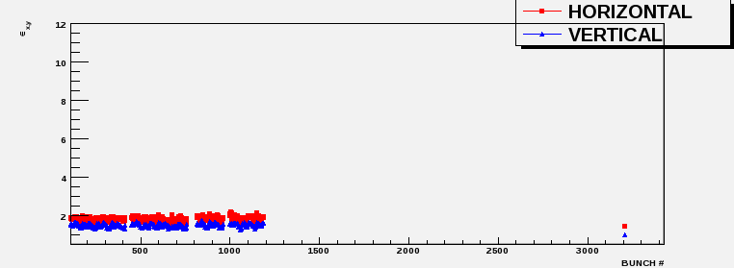
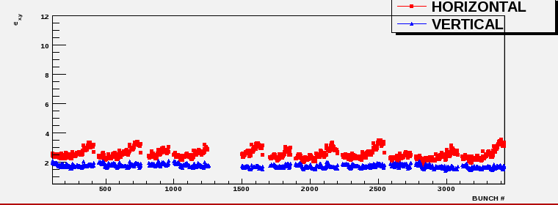
Emittance
Fill 1976 – Before tuning in the SPS
Fill 1977 – After tuning in the SPS
To be reviewed with SPS this morning. In the night preliminary re-adjustment.

Slide 10
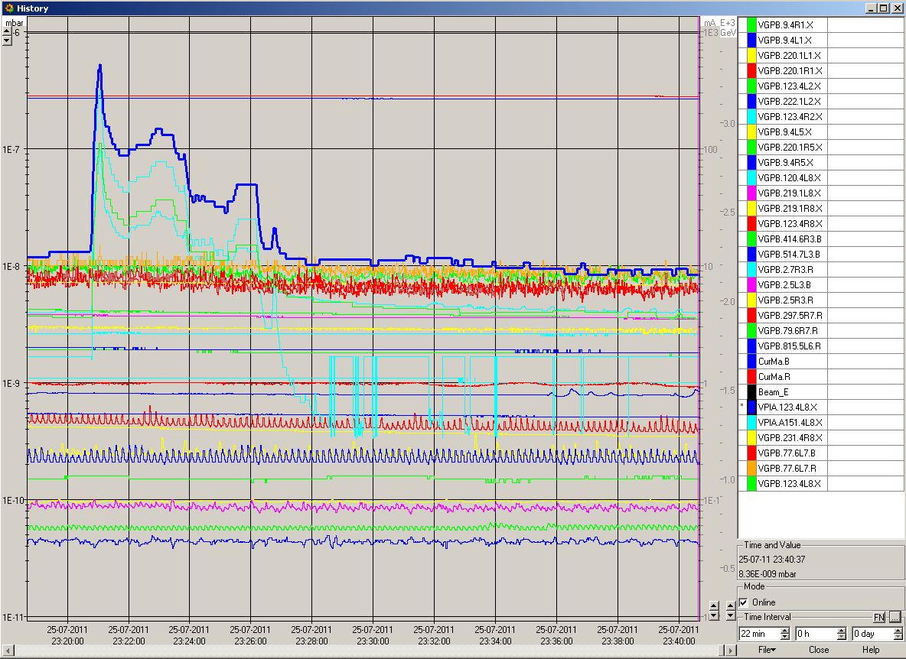
Vacuum activity in point 8
Still pending the understanding. Vacuum activity correlated with low lifetime and separation in point 8

Slide 11
Plan
Morning: Access for RF / QPS
Possibility of access for experiments
In parallel verification of beam quality in the SPS and off line investigations of the vacuum issues in point 8
Restart in the afternoon (aim for intermediate emittance or slightly lower intensity if blow-up in the SPS proves not to be reproducible)

Slide 12
Fill overview
Fill | Termination | Peak L (cm⁻²s⁻¹) | Length (h) | Int. L (Average ATLAS/CMS) (pb⁻¹) | Dump cause
1975 | STABLE | 1.6E33 | 2.5 | 13 | Cryo valve PROFIBUS (SEU?)
1976 | ADJUST | 1.6E33 | - | - | BLM TCSG.L7
1977 | SQUEEZE | - | - | - | RF Module trip
1979 | STABLE | 1.3E33

