Slide 1
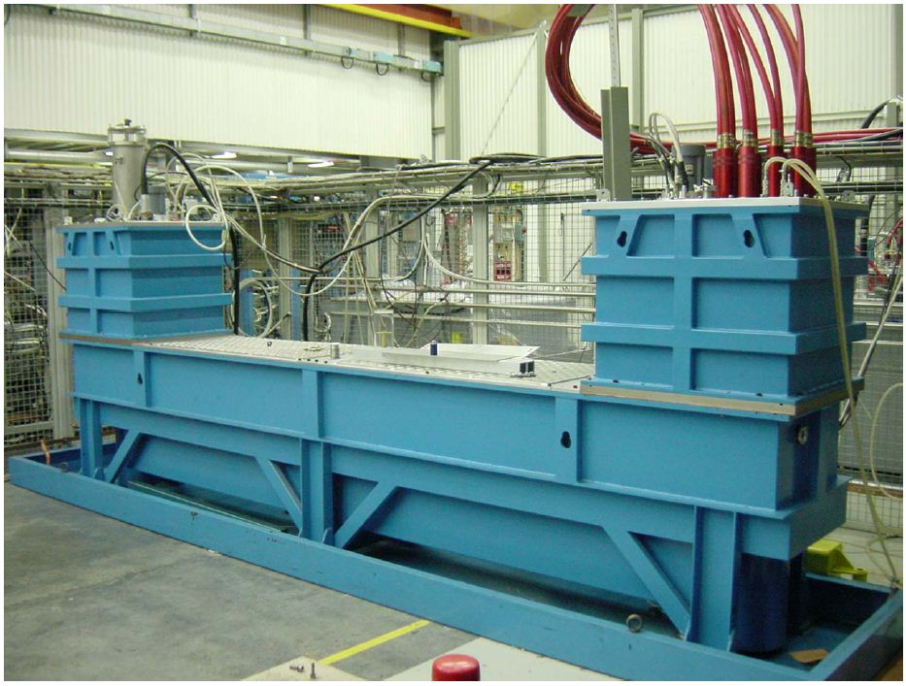
MKI2 thyratron erratics (untriggered) turn-ons of 28 July 2011 M.J. Barnes
Acknowledgements:
Alain Antoine, Nicolas Magnin & Volker Mertens
Notes:
1 RCPS charged 2 PFNs
4 PFNs (2 RCPS) at each of Pt2 & Pt8
DS
MS
PFN

Slide 2
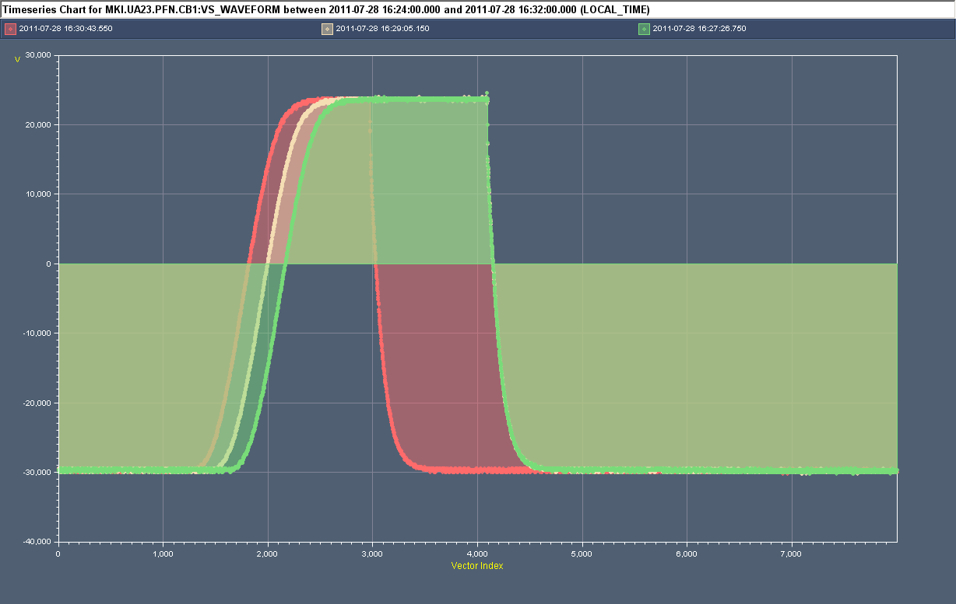
MKI2 Erratic of MS3 at 16:30:43hrs ON 28/7/2011
Normal (triggered) turn-on
Erratic (untriggered) turn-on of MKI2 MS3
At 16:30:43hrs an erratic (untriggered) turn-on of MKI2 MS3 at full PFN voltage;
Interlocks detected erratic. Control (machine protection) philosophy is to trigger all MS and DS of system (within a delay of 1µs). Hence all 4 kicker magnets pulsed for up to 4.5µs.
Circulating beam was not in IP2 and therefore not disturbed.
Batch was extracted from SPS but saw no kick at MKI and went straight into the TDI.
Note: this MS was put in place during last TS and has since made 5 erratics (only last 2 effected beam).

Slide 3
MKI2 Erratic of MS3 at 18:03:09hrs ON 28/7/2011
PFNs 1 & 2 at normal voltage (~50kV)
PFNs 4 at low voltage (~33kV) because of PFN3 switch erratic
Erratic (untriggered) turn-on of MKI2 MS3
At 18:03:09hrs an erratic (untriggered) turn-on of MKI2 MS3 occurred during resonant charging – sending current to one of the four kicker magnets;
Interlocks did NOT detect erratic of MS3 (at 33kV): hence no immediate action was taken to turn-on other thyratrons. PFNs discharged via the DS after 4ms (no further magnet current);
The failure occurred early in the charging process, and the extraction from the SPS was inhibited;
The circulating beam which was swept over the aperture and protection elements (~17% of normal kick) for ~9µs.

Slide 4
Actions
MS3 has suffered 5 erratics since being installed at last TS. It is suspected that electrical noise is a contributor to the problem, but this MS is particularly sensitive to the noise. Thus this switch should be swapped if the fault occurs again soon, or if there is an occasion (LHC stop of several hours, or at the latest in the next TS);
There is possibly a dying electronics card (fan out), trigger unit, or some cabling problem (cold soldering, bad contact) AND the erratic detection card for MS3. As a rare event such things could be (although not necessarily) time consuming to solve. Hence the recommendation is to exchange the candidate electronics cards, and maybe part of the cabling as far as accessible, by spares.
Future plans include a fast inhibit of SPS extraction in the event that an MKI fault is detected.

