Slide 1
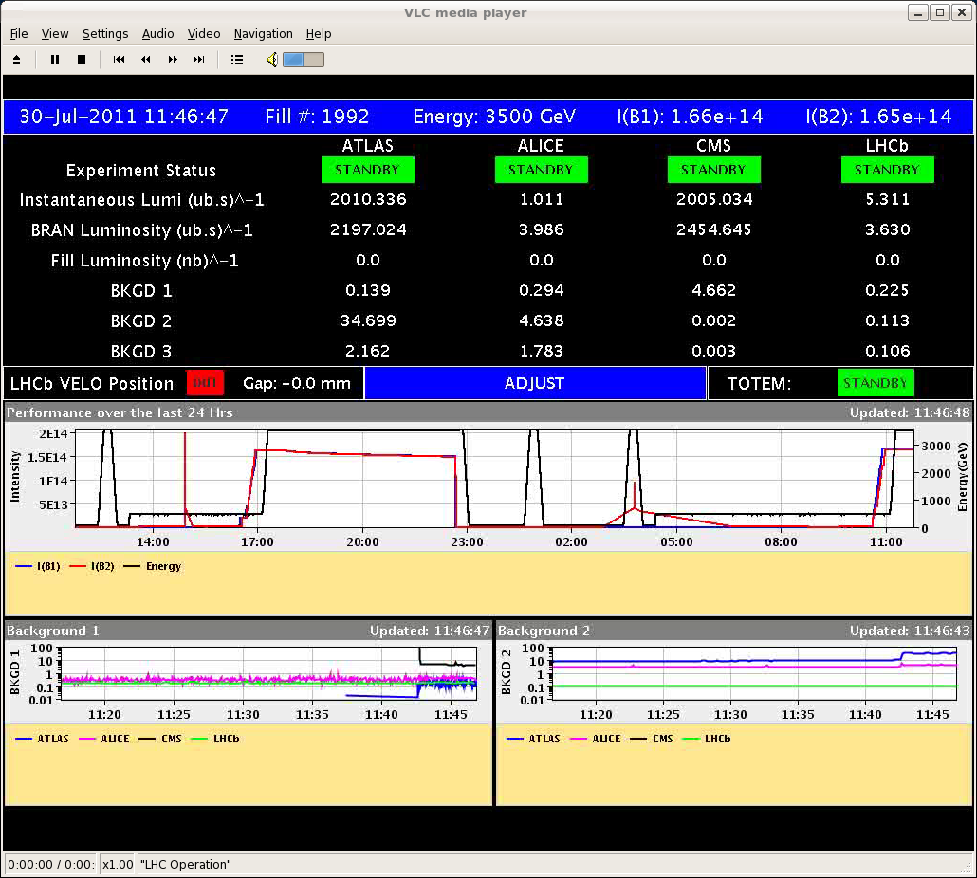
Saturday
12:00 Fill 1992 in stable beams.
Lumi for the first time above 2E33 cm-2s-1.
This time tune shift of +0.002 before colliding.

Slide 2
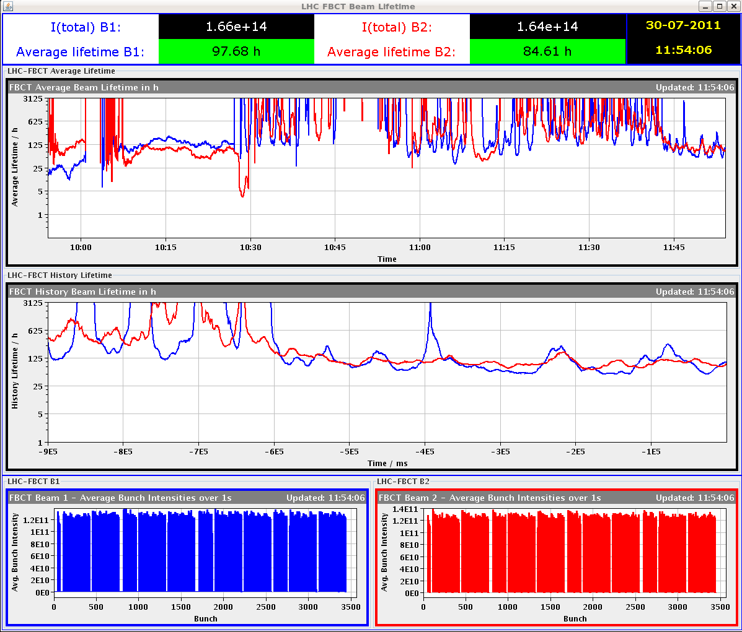
Lifetime 50-100 hours when going into collisions

Slide 3
It did not last…
12:40 Dump due collimator interlock IR1 – communication lost.
Access needed – power supply had to be changed. Could be SUE, but could be ‘normal’ failure.
Problem with MAD in UJ16 – problem with the detection system. It had to be disable to close, then re-enabled (access piquet).
During MKI2 softstart another erratic on MS3. Occurred above the normal operational voltage. Triggering of the other switches worked correctly.
Access in IR2.

Slide 4
Saturday PM
MKI2 intervention
Installed magnetic cores on trigger inputs to MS3 tank.
Replaced crate for MS3 & DS3 heater and reservoirs.
Replaced 3 trigger units for MS3.
Added 2 scopes for diagnostics.
S78 tripped on spurious nQPS signal.
Performed 3 softstart sequences, 20 shots in inject and dump – no problems.
21:45 Refill for physics.
23:00 Stable beams fill 1993, L = 2E33 cm-2s-1.
Tune shift +0.002 – again lifetimes 50-100 hours.

Slide 5
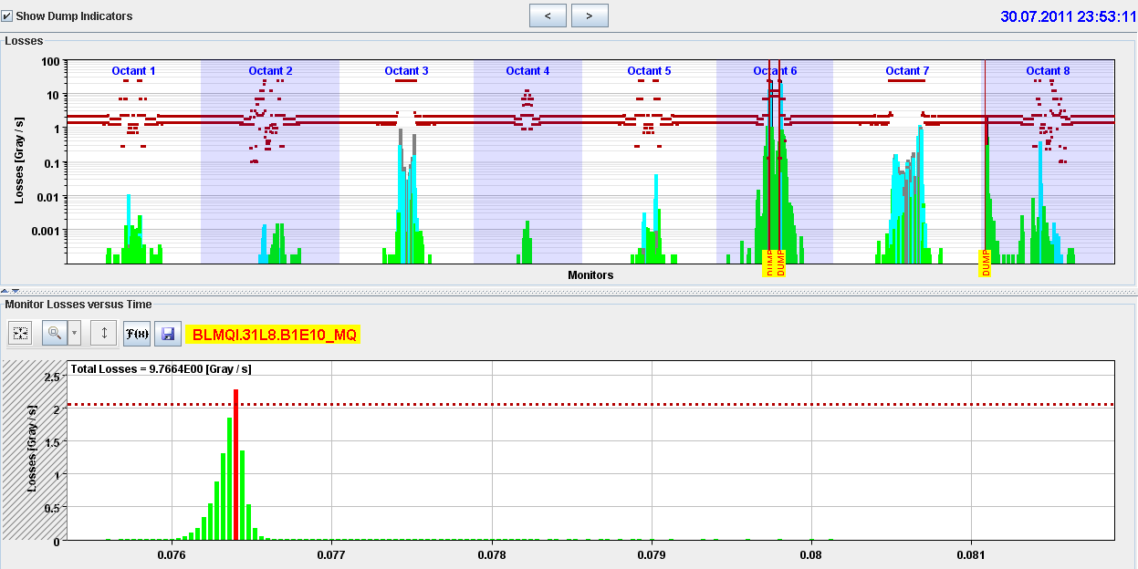
UFO
End of fill @ 23:45 - arc UFO – 31L8
Fast and strong.

Slide 6
Night
Interlock problem on TCP.6R3.
This collimator became ‘red’ on the fixed display during the fill, but no interlock. Alarm on limits. After the ramp down the interlock could not be reset.
STI piquet disabled a resolver.
02:20 RF HOM interlock line2 B2 at injection.
Reset by piquet, no T increase visible in logging, only small increase of power with current
03:50 Stable beams fill 1994, L = 2.03E33 cm-2s-1.
Again tune shift +0.002.
04:40 Beam dumped – HOM again on line2 B2.
Glitch on T reading visible in logging. Piquet compensated for a T offset in one reading.

Slide 7
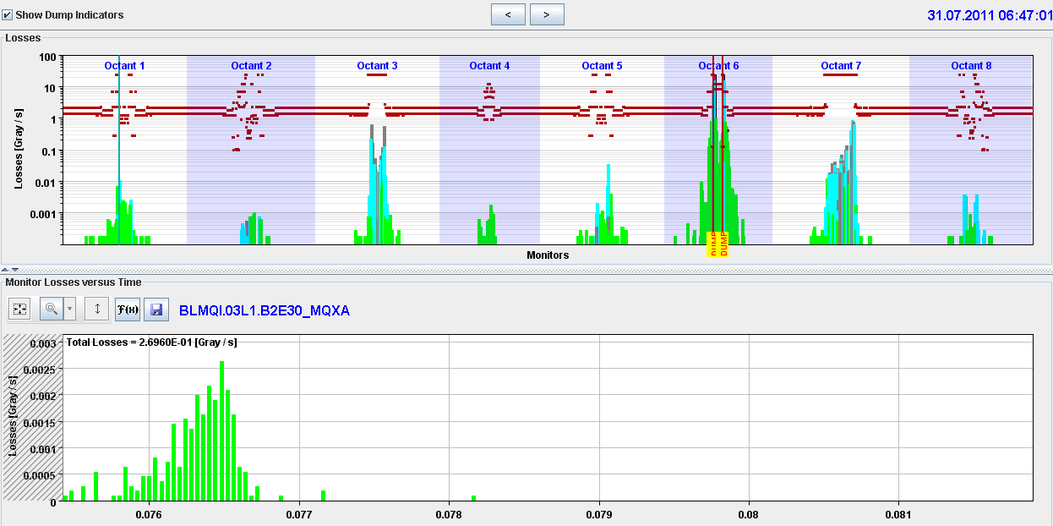
Refill…
07:00 Beam dumped just before stable beams by ATLAS. L over 2E33 cm-2s-1.
Mini UFO in triplet region. Similar events have been seen in ALICE and LHCb.

Slide 8
Saturday
Nice fills …. that do not last – none longer than 1 hour !
Dropping intensity a bit…
Cryo Pt8: problem with insulation vacuum on cold box. They are trying to work around.

Slide 9
Fill list
Fill | Termination | Peak L (cm⁻²s⁻¹) | Length (h) | Int. L (pb⁻¹) | Dump cause
1975 | STABLE | 1.6E33 | 2.5 | 13 | Cryo valve PROFIBUS (SEU?)
1976 | ADJUST | 1.6E33 | - | - | BLM TCSG.L7
1977 | SQUEEZE | - | - | - | RF Module trip
1979 | STABLE | 1.3E33 | 6 | 23 | QPS RCO
1980 | RAMP | - | - | - | QPS RQTL7
1982 | STABLE | 1.7E33 | 3 | 13 | El. net
1985 | STABLE | 1.75E33 | 11 | 50 | El. net
1986 | STABLE | 1.85E33 | 2.5 | 14 | RF klystron vac
1990 | STABLE | 1.85E33 | 7.5 | 41 | PC trip RCBXV3.R1
1991 | STABLE | 1.88E33 | 5 | 27 | Cryo valve UJ16
1992 | STABLE | 2E33 | 1 | 6 | Collimator control PS US15

