Slide 1
Monday 18.7.2011
1 fill with 1092 bunches (6 h stable beams)
3 fills with 1380 bunches (20 minutes in stable beams)

Slide 2
Fill # 1955
9:49 Dump: RQTL7.L7B1 tripped fill #1955
Integrated luminosity [pb⁻¹]:
Atlas: 18.8 CMS: 18.7 LHCb: 6.1
Remote reset of the QPS crate on RB.A81
Unusually high temperature on collimator TCSG.D4L7.B1 (position “right up”) without beam: 55 deg → interlock masked

Slide 3
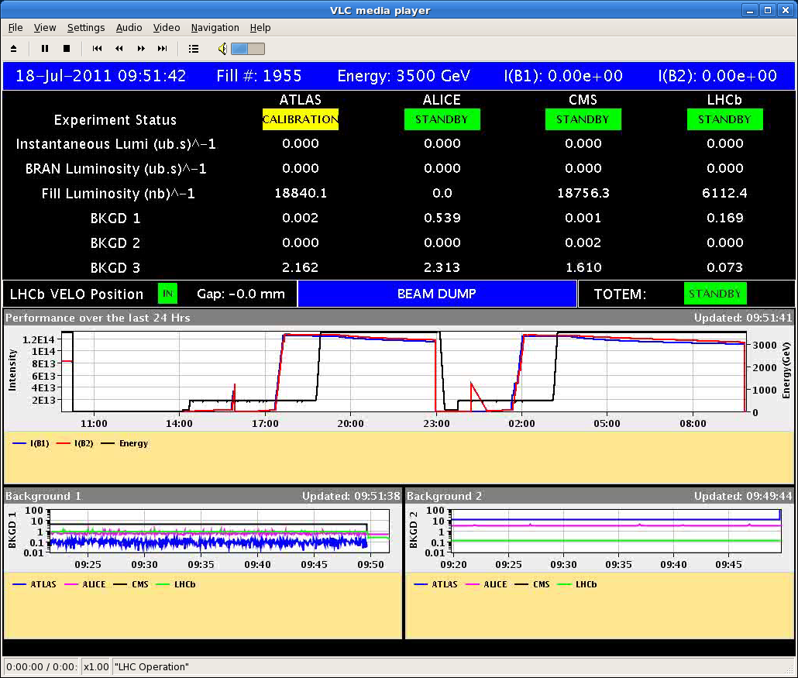
Fill # 1955

Slide 4
Fill # 1956
11:55 beam injected:
Re-adjusting BPM phasing (E. Calvo)
Tune, chromaticity
MKI kicker length checked by M. Barnes
Emittance(inj): ~ 2.5 μm rad bunch intensity: ~ 1.2E11
Beam Intensity: 1.66E14
Injection
Beam 1 MSIB: 54% of BLM threshold
Transfer line: BPM partly missing – partly high oscillations

Slide 5
Fill # 1956
Waited 1 hour after injection for UFO’s to calm down
trip of RCD.A56B1 and RCO.A56B1 during the ramp, beam survived → reset and reloaded at flat top
Not obvious to find target luminosity Alice
15:40 DUMP: Cryo lost probably due to SEU on a thermometer at a current lead (beam2 IP5).

Slide 6
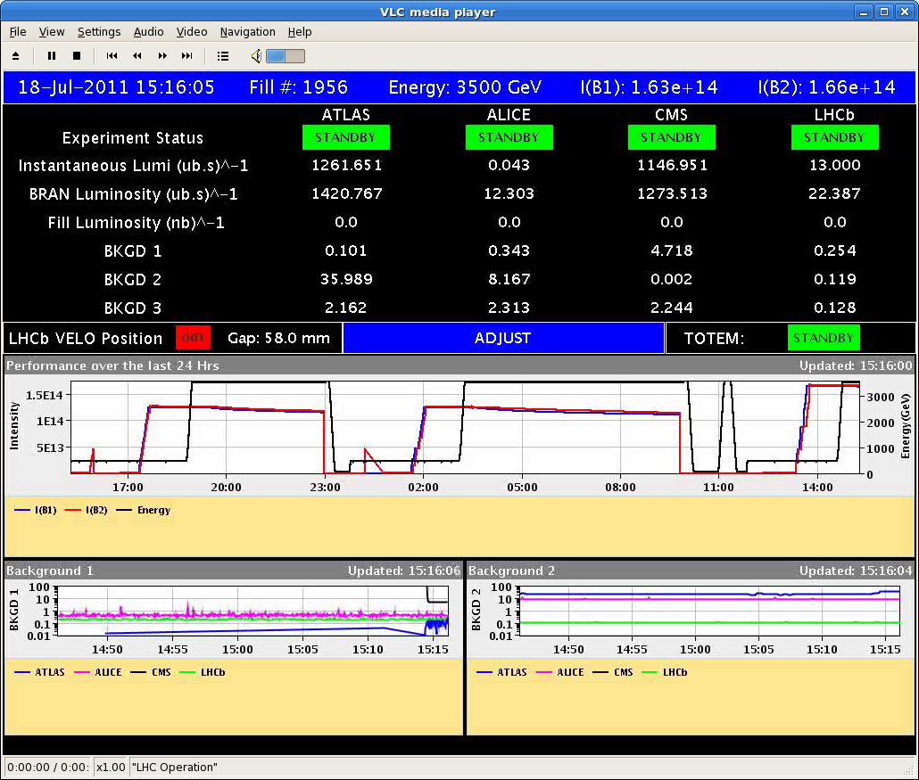
Fill # 1956

Slide 7
Fill # 1957
Injection:
MKI vacuum B2: spike of 1.5E-8 bar
Injection losses B1 up to 70% of BLM threshold (MSIB)
Wait ½ hour for UFO’s to calm down
Emittance(inj): ~ 2.2 μm rad bunch intensity: ~ 1.3E11
Beam Intensity: 1.77E14 Energy/Beam: 100 MJ
35% of BLM threshold on TCTVB.4L2 83s integration time → consider adapting 83s thresholds

Slide 8
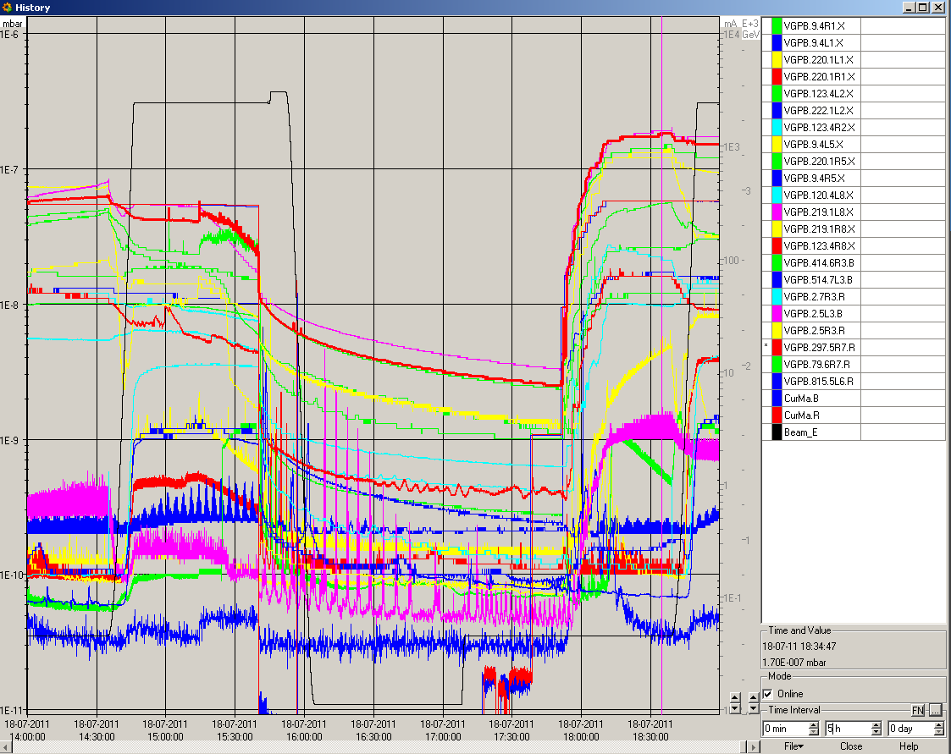
Vacuum up to ~2E-7 mbar in IP3 and IP7

Slide 9
Fill # 1957
BRAN Luminosity 1.4 – 1.5
But only for a couple of seconds

Slide 10
Fill # 1957
DUMP: BLM voltage status interlock in IP7 caused by high losses when going in collision

Slide 11
Fill # 1958
Wait ½ hour after injection for UFO’s to calm down
Emittance(inj): ~ 2.0 μm rad bunch intensity: ~ 1.2E11
Beam Intensity: 1.66E14
mask the BLM HV status interlock in IP7 in the SIS for the first minutes of the collisions
BLM_SR7_C_HV_STATUS would have given an interlock when adjusting LHCb luminosity
Atlas and CMS adjustment before went without large losses
Alice adjustment afterwards without big losses
Alice optimized: factor 10 below target luminosity

Slide 12
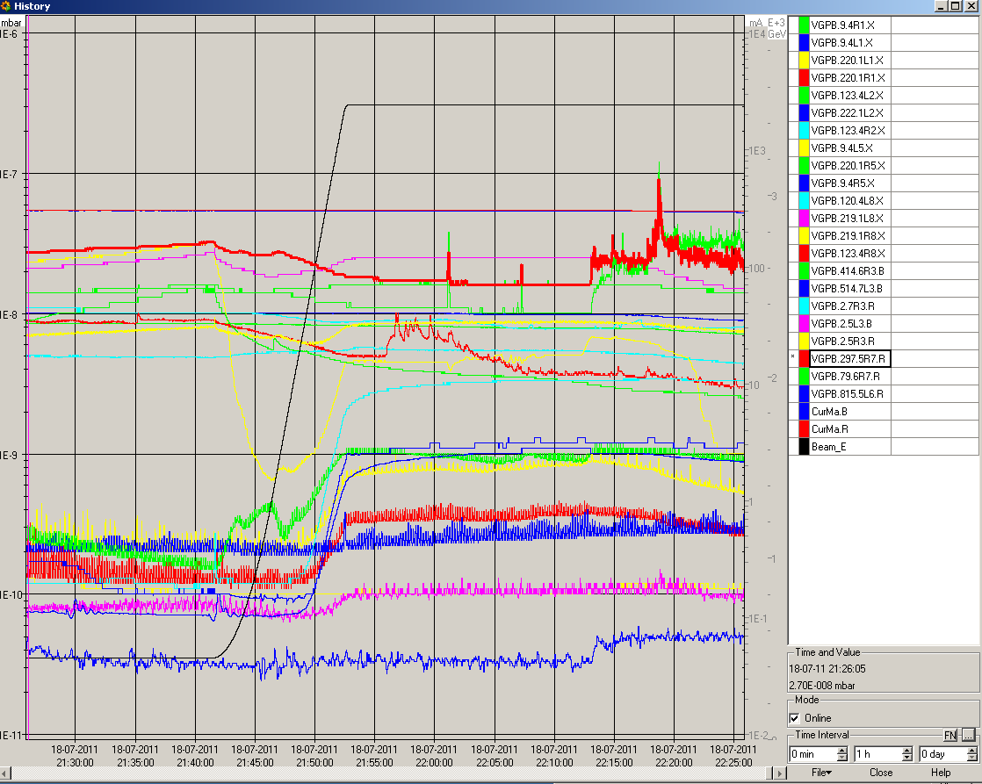
IP7: Vacuum spike and BLMs in warning when adjusting LHCb

Slide 13
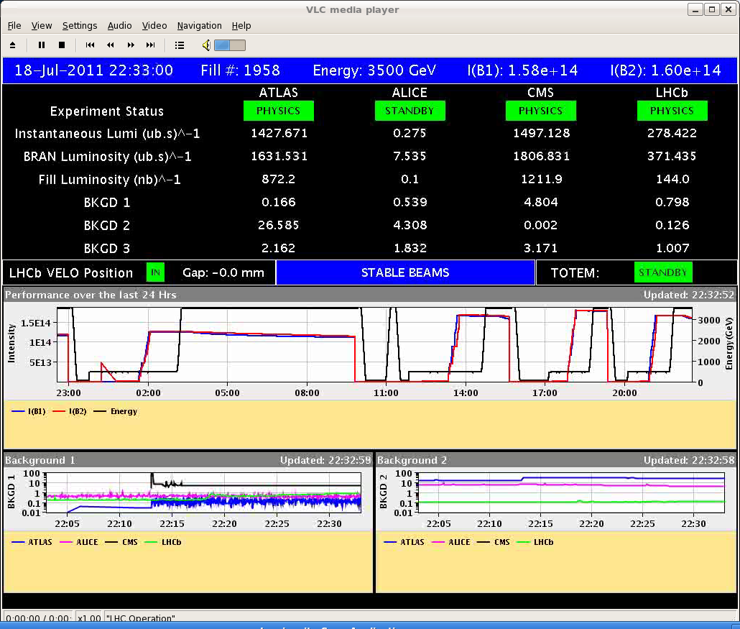
New record luminosity … but not for long
22:39
beam dump: cryo lost in sector 3-4

Slide 14
PLAN
Beam back: this afternoon
Alice collision scheme?
Luminosity production with 1380 bunches
Adiabatically decrease emittance and increase bunch intensity
BLMs:
adapt 83s collimator thresholds
SIS HV interlock?

