Slide 1
Thursday, June 30th
07:02 Beam dump. End BI MD. Ramp down and cycle.
07:45 Access for repair of wire scanner power supply and circuit breaker of AC dipole.
08:21 Access finished. Prepare for head-on beam-beam MD.
08:51 Wrong sequence manipulation (“LOAD-DRIVE INJECTION SETTINGS IN PC” while converters playing functions) → trip of RB’s in all sectors.
H. Thiesen managed to switch back ON the PCs. Then drive them at injection. Injected without precycle of the mains. OK for beams.
08:51 Problem to open TED downstream of TI8. No beam 2!
Traced back to an issue with the LHC access system
12:53 Both beams available for beam-beam MD. Beam-beam MD can start.
14:45 No beam from SPS (18 kV intervention)
16:48 Start injection MD (nominal emittances, MKI’s, UFO’s)

Slide 2
TED Problem TI8: Report Tono Riesco
Une appel de la CCC vers 12 nous signalant un probleme sur le veto TED 87765. Nous allons au point 8 pour vérifier l’état des signaux.
Dans le système PLC LASS il n'y avait aucun problème.
Après quelques vérifications, nous avons trouvé un relais de la boucle câblée du TED tombé. Avec l'aide extérieur (poussant avec le tournevis), le relais a collé et le problème a disparu.
Nous avons eu le soupçon d'une manque de tension et nous avons suivi les alimentations du relai qui avait uniquement 45 V contre les 53 habituels. En suivant le câblage avec les mesures nous avons trouvé une borne d'alimentation avec le vis cassé et le câble touchant sans être bien serré.
Comme accordé par téléphone, vous allez continuer avec l'injection jusqu'au prochain TS (4 juillet).
SI jamais vous perdez encore l’état du TED, le piquet accès interviendra pour changer l’équipement.
Je vais informer le piquet acces de la procedure pour le replacement du bornier défectueux.

Slide 3
Friday, July 1st
01:40 Recovery from injection MD.
03:18 Start RF MD. Ongoing…
Decided to delay intervention on ADT damper to Friday afternoon.
RF MD will be ended 2h early: 14:00
Then access…

Slide 4
MD Report Thursday R. Assmann, F. Zimmermann, G. Papotti
Day | Time | MD | MP
Thu | 06:00 | Ramp down, cycle.
 | 08:00 | 450 GeV: Head-on beam-beam limit – up to 3e11p per bunch, coherent modes. BI parasitically. | A
 | 16:00 | 450 GeV: Injecting nominal emittances, MKI & UFO’s – 50ns, blow-up in SPS, SPS scraping and losses, injection into LHC, nominal emittance. | B
Fri | 01:00 | Switch back to operational injection settings. Verification.
 | 03:00 | 450 GeV → 3.5 TeV: RF – longitudinal beam stability. | B

Slide 5
Head-on beam-beam MD (Werner Herr et al)
Lost 4 hrs for technical problems.
Had 2 fills with approx. 2 – 2.5E11 p/bunch and emittances initially smaller than 2 mum.
Lifetimes in collisions low at the beginning, still believing reasonable.
Tune-shift and luminosity as expected (approximately 0.015/IP).
Performed scan for orbit effects and tune scan, analysis will be done offline.

Slide 6
Fills for head-on beam-beam limit
Twice nominal bunch intensity, half nominal emittance!
Fill 1:
B1 B2
Intensity per bunch 2.3e11 p 2.2e11 p
Emittance H: 1.6 um 1.7 um
Emittance V: 1.6 um 1.9 um
Fill 2:
B1 B2
Intensity per bunch 2.2e11 p 2.3e11 p
Emittance H: 1.9 um 1.9 um
Emittance V: 1.7 um 2.1 um
Highest bunch intensities as achieved the day before in LHC (2.7e11) still to be tested
Will have somewhat higher emittance

Slide 7
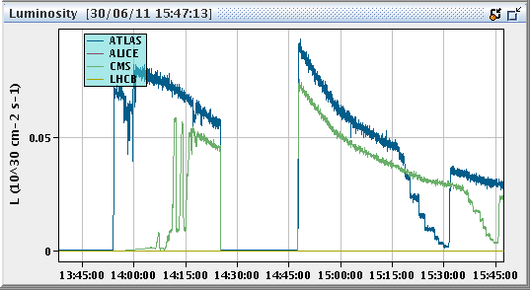
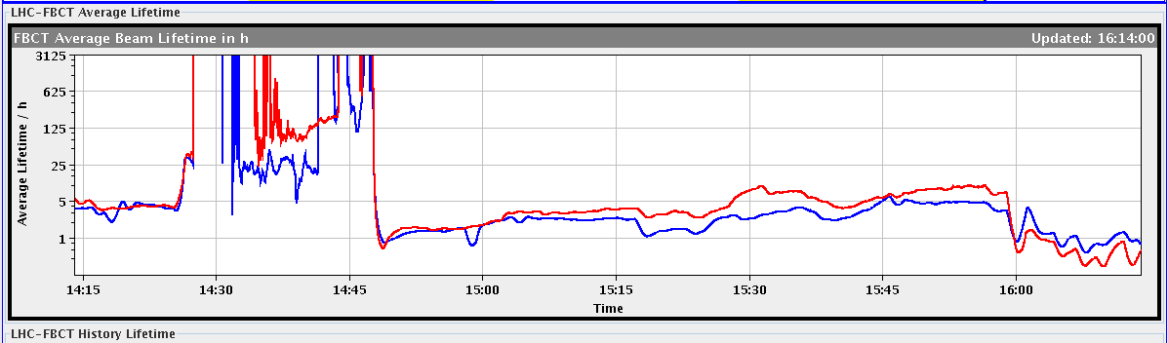
Luminosity and Lifetime
Start collision, fill #2
Luminosity
Separation scans
Twice nominal bunch intensity, half nominal emittance!
No effect on beam lifetime
Start collision, fill #2
Tune scan
Lifetime

Slide 8
Injecting nominal emittances V. Kain et al
Longitudinal checks:
Created satellites in PS
Increased bunch length (up to 5 ns) into SPS: create satellites in SPS
Increased dp/p at extraction to > 2 ns. Changed freq. of 800 MHz
Switched off 800 MHz. Change of radial steering in the SPS.
no significant degradation of injection quality (12 or 36 bunch injections). Radial steering effect due to changing position at scraper . We therefore did not try to move the momentum collimator and also did not check the momentum acceptance with TCDIs.
Transverse checks:
Scanned with H and V scraper for 2.5 um emittances. 12 bunches injected without scraping did not dump the beam.
Inj. emittances of ~ 3.5 um with comparable losses to 2.5 um on TCDIs and nom. scraping (int. loss in SPS due to scraping 10 %). Injected emittances up to 7.5 um and varying scraping with expected unacceptable losses for physics filling. The TCDIs were kept at nominal settings throughout the test.

Slide 9
MKI & UFO’s
J. Uythoven et al.
Worked on B2 only, where additional BLMs have been installed.
Tested pulsing MKI-D and MKI-A only, without beam, after having filled the machine with 12 pilots. All worked fine.
Then used nominal filling scheme, of 1380, but did not inject the last batch of 144 bunches - so 1236 bunches injected.
Moved in the TT40 TED and disabled the MKE extraction kicker and pulsed the MKI on the last injection batch without beam.
The following injection kicks were made:
4 kickers: 23:05, 23:38, 23:54, 23:56
MKI-D only: 00:15, 00:22, 00:29
4 kickers: 00:35
MKI-A only: 00:40, 00:48, 00:56, 01:02
4 kickers: 01:07, 01:18, 01:29, 01:30, 01:31, 01:34, 01:35, 01:37, 01:38.

Slide 10
MKI & UFO’s – Preliminary Conclusions
UFOs are about evenly distributed over the different MKIs.
On the first two times we pulsed the MKIs without injecting beam (all MKIs) there was a clear correlation between pulsing the magnets and the occurence of UFOs at the MKIs
After the first few pulses, we basically did not see many UFOs any more.
At the end of the MD we had an avalanche of UFOs, mainly on MKI-D, but it did not seem to be directly related to pulsing the MKIs.

Slide 11
MD Planning Fri – Sat (1. – 2.7.)
Day | Time | MD | MP
Fri | 03:00 | 450 GeV → 3.5 TeV: RF – longitudinal beam stability.
 | 14:00 | Ramp down, cycle.
 | 15:00 | Access to fix the ADT. 2h intervention.
 | 18:00 | 450 GeV → 3.5 TeV: Long-range beam-beam limit – lifetime, emittance versus beam-beam separation. Collimation with changing crossing angle. | C
Sat | 02:00 | Ramp down, cycle.
 | 04:00 | 450 GeV: Non-linear dynamics – Dynamic aperture, non-linear chromaticity and frequency map. | A
 | 12:00 | If needed: Precycle.
 | 14:00 | 3.5 TeV: Collimation – combined cleaning, faster setup. | A
 | 22:00 | Ramp down, cycle.

Slide 12
MD Planning Sun – Mon (3. – 4.7.)
Day | Time | MD | MP
Sun | 00:00 | 3.5 TeV: ATS – correction & pre-squeeze. | A
 | 08:00 | Ramp down, cycle.
 | 10:00 | 450 GeV: Beam distribution in LHC – scraping, halo, tails, BLM limits, … (high intensity) | B
 | 14:00 | 450 GeV: Quench margin at injection – observation with special QPS instrumentation, losses from TCLIB collimator, TCDQ checks in parallel | C
 | 22:00 | 450 GeV: R2E – slow controlled losses (1e13p on Q14.R2.B1). | A
Mon | 06:00 | Technical Stop
Needs from experiments:
30.6., 08:00 to 16:00 – Luminometers on in ATLAS and CMS
01.7., 18:00 to 02:00 – Luminometers on in ATLAS and CMS

