Slide 1
Tuesday June 21st
00:15: Stable beams fill 1883, 1.1E33 cm-2s-1.
Seems the 144 bunches beam 1 doe not fit properly on the injection kicker waveform. Systematically the last 5 bunches are kicked.
Kicklength for beam 1 shorter than for beam 2:
beam 1: 7.85 us
beam 2: 8.1 us.
Injection kicker pulse length increased by 200 ns on B1. Operational limits in injection kicker app updated accordingly. IQC limits also adjusted.
Updated the operational limits for the MKIs...these were still rather relaxed.
18:15: fill #1883 dumped by SIS interlock (OFSU down)
47.5 pb-1 in around 18 hours.
Refill delayed due to RF problems (noise) in the SPS.

Slide 2
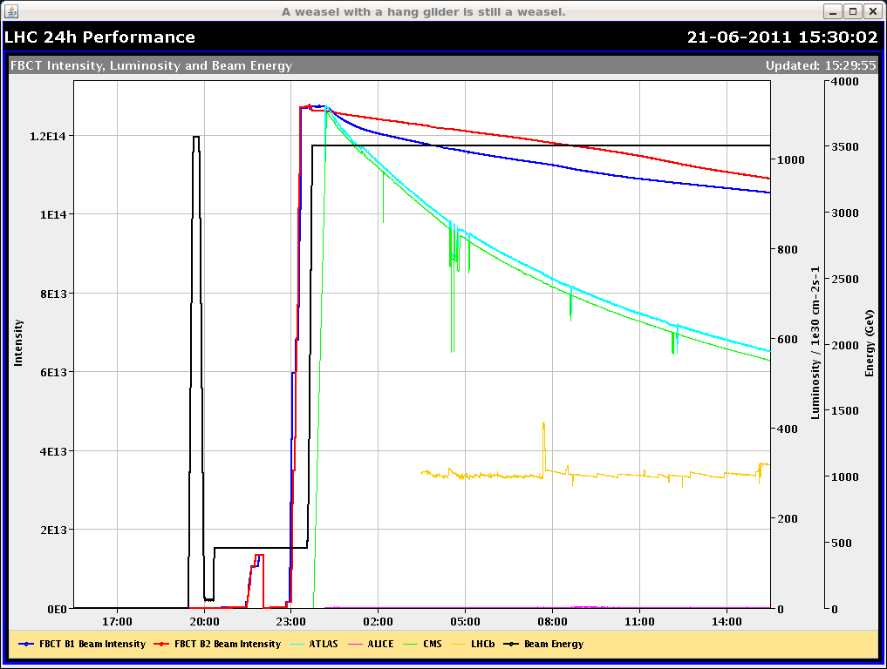
Long fill #1883 after 15h in stable beams

Slide 3
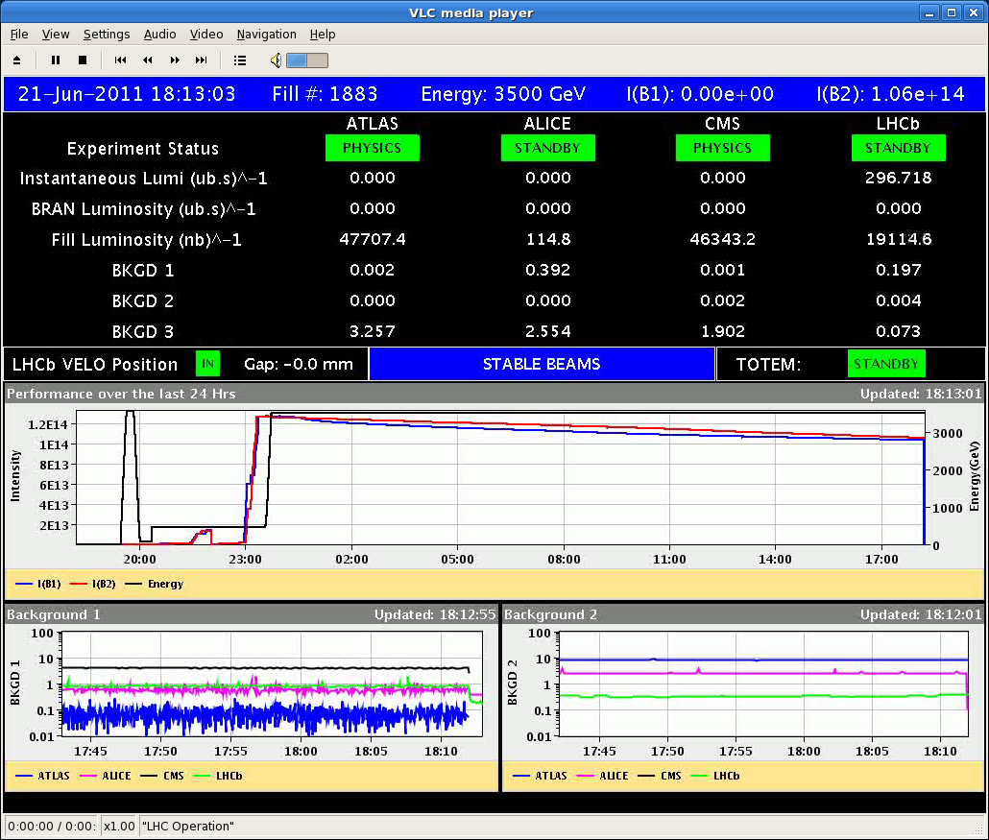
47.7/46.3 pb-1 collected

Slide 4
Tuesday June 21st
18:44 Summary of BLM intervention:
Configuration for Mobile monitors have been deployed in LSA. We need to restart the concetrator in order to pickup the new configuration.
Restarted the LHC-BLMS-ACQ-MEAS.jvm @ COLSA
Restarted the LHC-BLMS-ACQ.jvm @ COLSA3
Result:
The 6 new monitors appear in the display.
the 2 of them which have been already connected show a signal.
Note: the remaining 4 channels need still configuration in the processing electronics and (probably) access. to be done at a later time.
QHPS is discharging in S12 (cell 23.L2).
Masked the SW interlock "RB_A12_QPS_OK" because one of the quench heaters on MB.A23L2 is discharged.

Slide 5
Wednesday June 22nd
01h30: Pilot bunches from SPS
stopped due to a number of things: bad beam quality in the SPS, Persistent BPM LSS4(new) interlock, crash of BIC cfv-ba4-cibtt40
When injecting beam:
the injection oscillations on the horizontal plane for both B1 and B2 were very large (~4mm) and not realistically correctable.
The horizontal emittances were bimodal and very large ... something was kicking the beam in the horizontal plane.
Suspect that there is still a problem with the RF synchronisation & rephasing between SPS and LHC. (Note that CNGS worked well over night, so for us this rules out beam position at extraction.)
Beam dump at 07:45 (if at 3.5 TeV).
Machine on standby at 08:30 at the latest - until 12:30. No access.

Slide 6
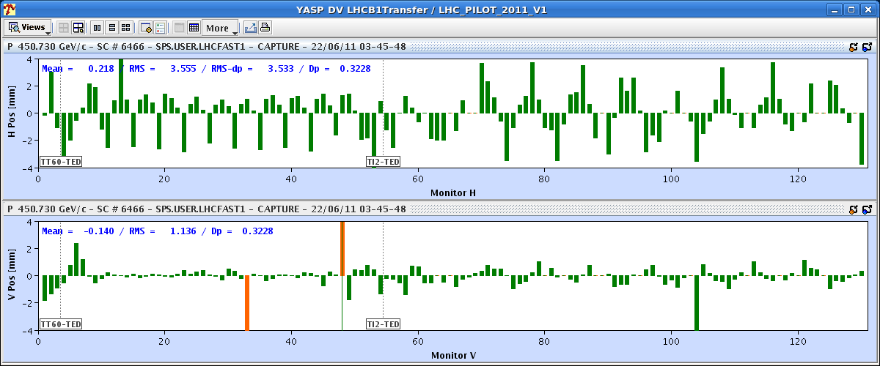
Injection Oscillations

Slide 7
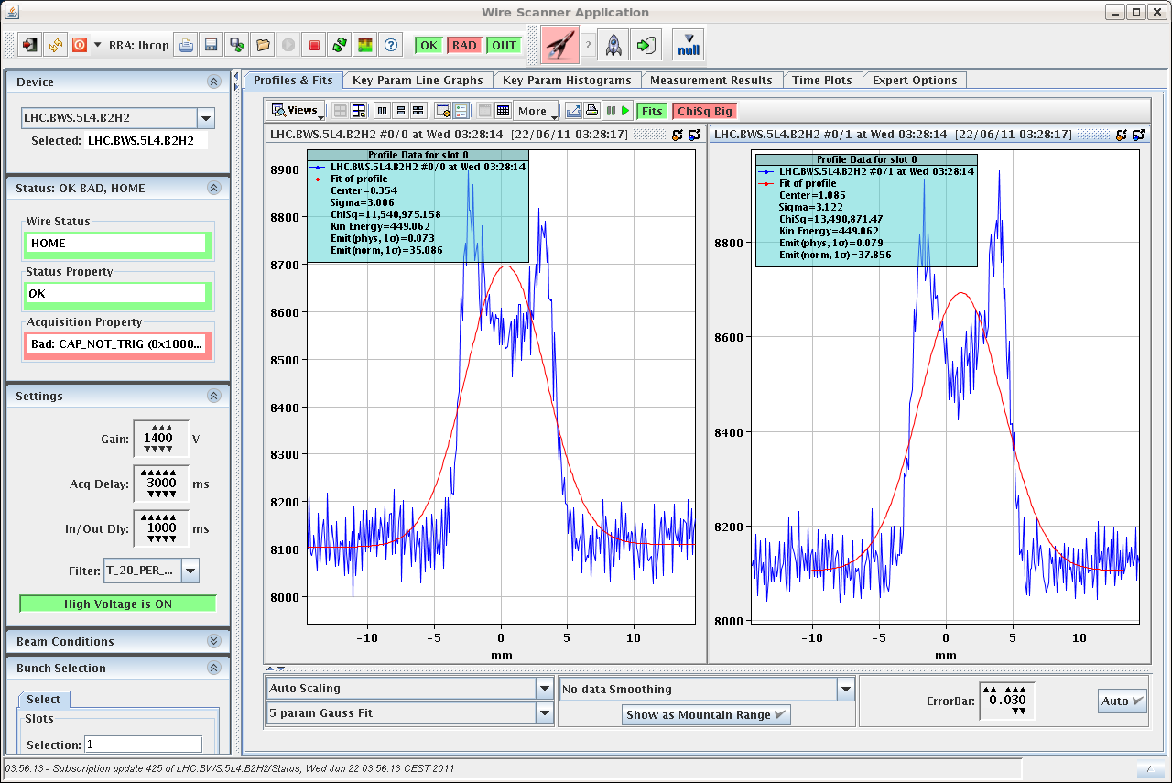
Distribution

Slide 8
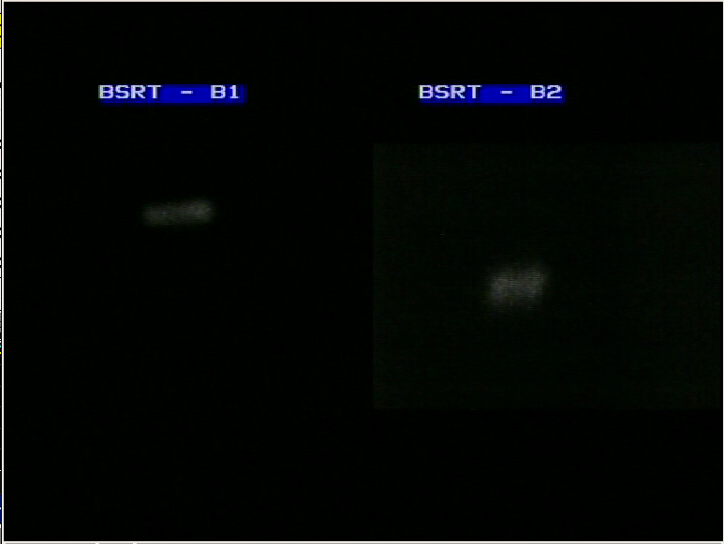
Screen

Slide 9
Ahead
12:30: Restart the accelerators.
Check injection kicker pulse.
Collimation loss maps (450 GeV, 3.5 TeV): ran out of 4 week qualification interval.
Next intensity step: 1092b → 1236b

