Slide 1
Saturday
Cruising in stable beams…
13:00 Beam dump – cryo lost on Pt5. Crate power supply. Fortunately the cryo team maintained conditions to be able to restart quickly.
Lost again patrols on Pt5 – this happens very frequently during access in Pt5.
18:00 Machine closed.
19:00 Refilling.
20:30 Beam lost in the early part of the squeeze. SIS dump on B1 – excursion in dump region.
Beam excursion > 1.4 sigma (~ 1 mm) measured by one of the redundant BPMs. This BPM had an offset ~0.5 mm all along the fill. One of the typical excursion during the squeeze (peak at 0.4mm in IR6) made go over threshold.

Slide 2
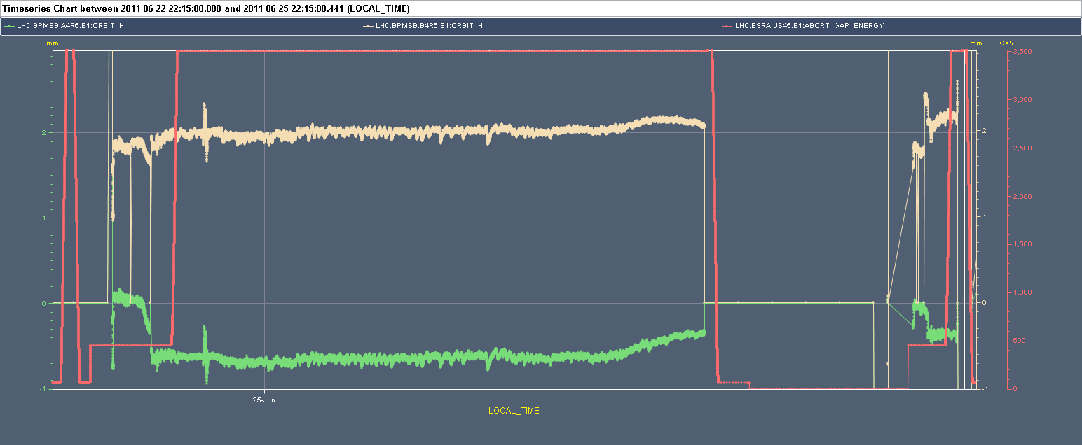
Interlocked BPMs B1
BPM ‘B’ – issue with a ‘wiggle’ in the squeeze.

Slide 3
Saturday night
21:30 lost cryo again in Pt5 while injecting. Apparently bad manipulation. Pre-cycle.
23:00 Refill.
Interlock limit increased by +0.4 sigma on faulty BPM.
This time squeeze OK (better) for interlock BPMs.
01:00 Stable beams
LHCb lumi to 6E32 cm-2s-1 just before stable beams. Unfortunately SB were declared in those conditions..
01:40 Beam dump – vac in IR4.
ADT in fault just before.
Small UFO just before. Coincidence?

Slide 4
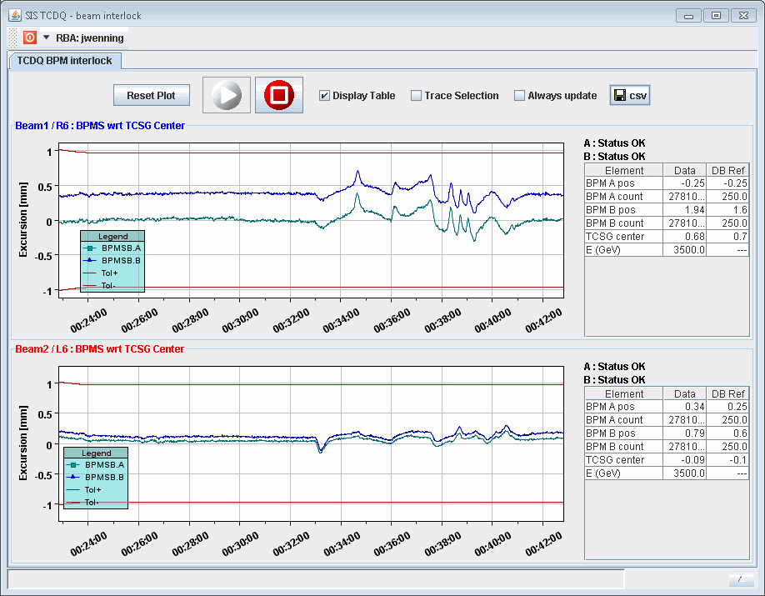
SIS interlock BPMs
Squeeze – OFB has some difficulties with B1.

Slide 5
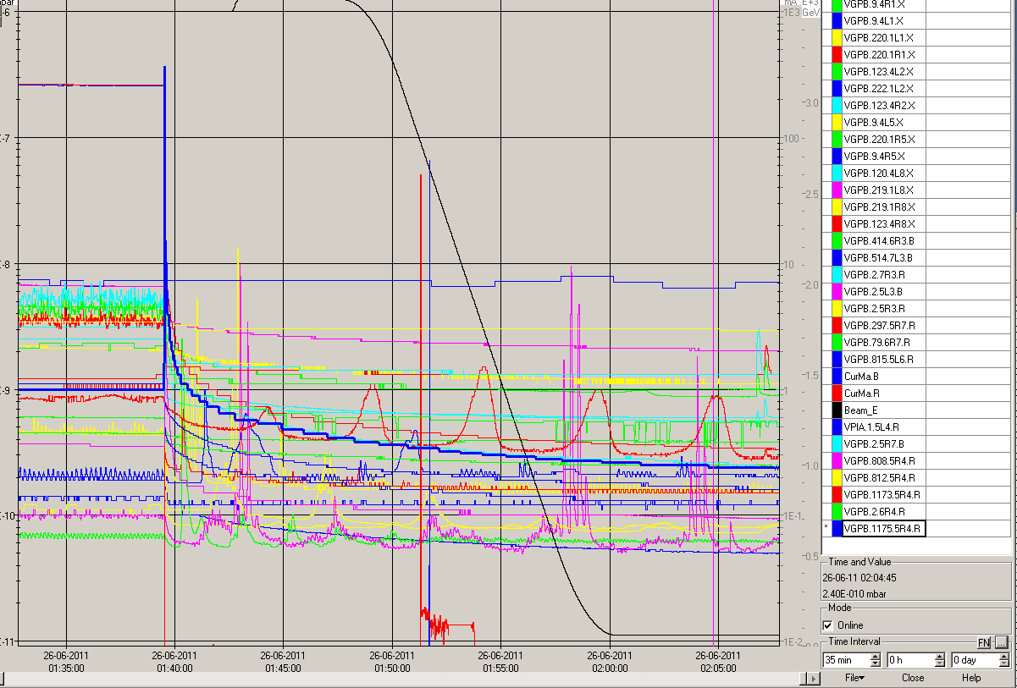
Vacuum spike

Slide 6
Saturday night
03:00 Refill.
04:20 Stable beams fill 1804.
06:30 Beam dump again vacuum in IR4.
There are regular vacuum spikes in IR4.
Gas injection of BGO seems OK.

Slide 7
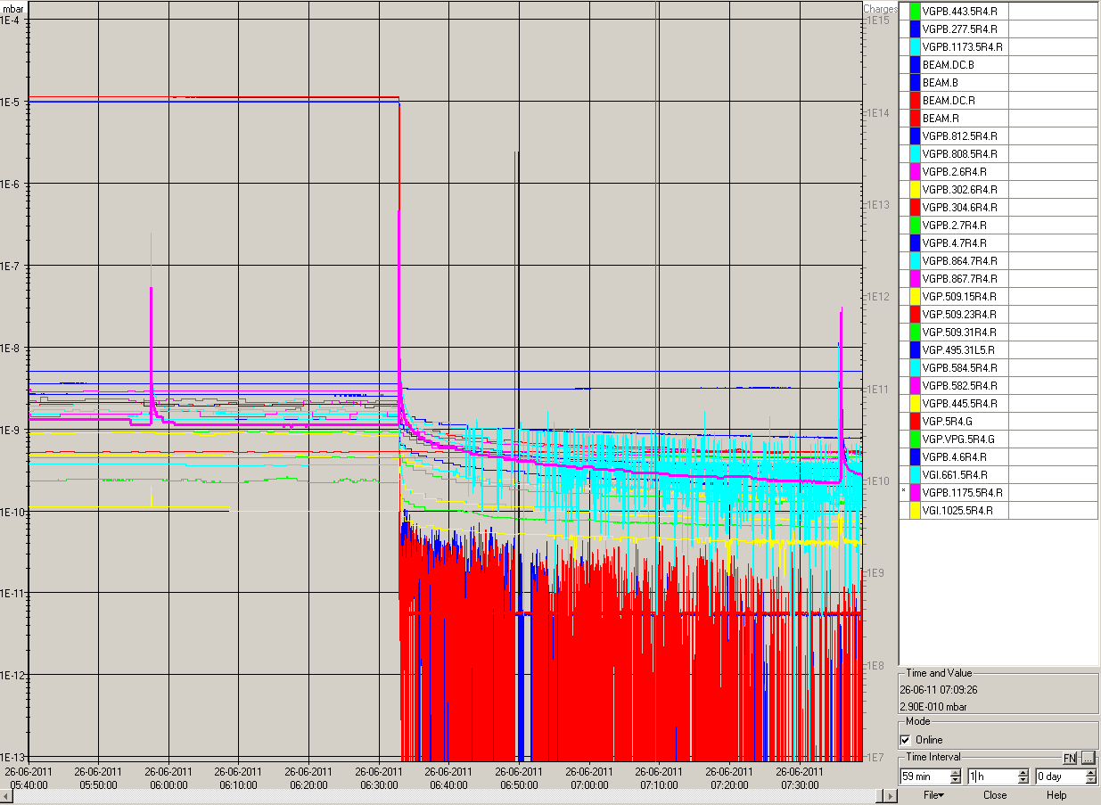

Slide 8
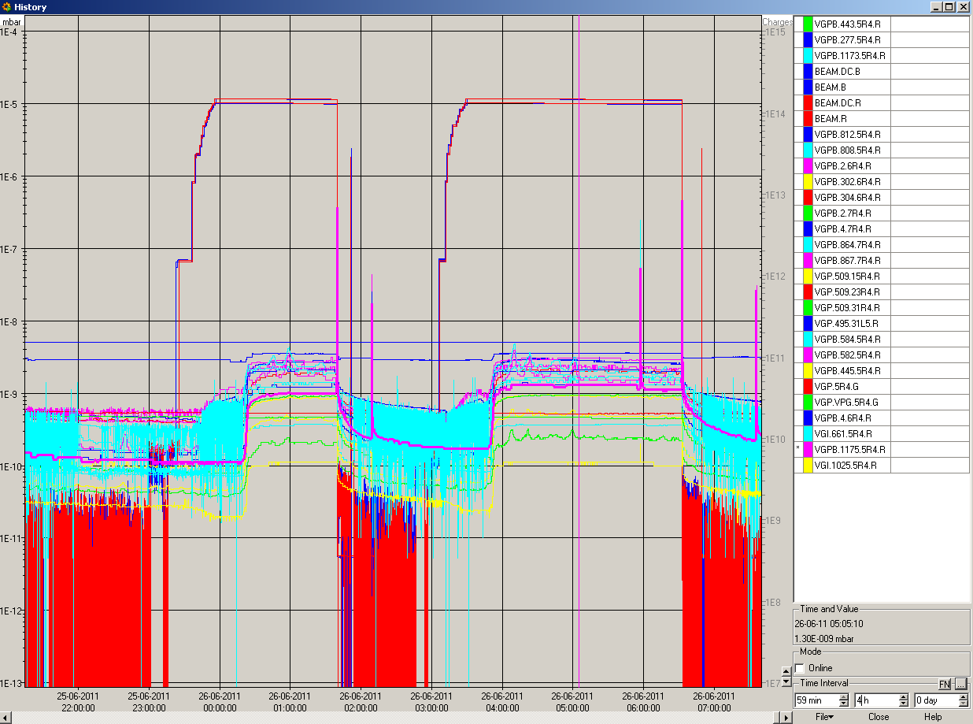

Slide 9
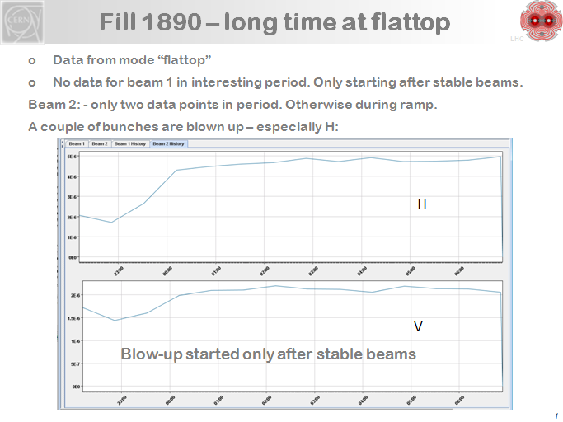
VK

