Slide 1
Thursday
Cryo recovery until 18:00.
Accesses in the background to fix various consequences of the lightning strike (and more).
Power on some BI crates.
Repair PC RCBH27.L1B2.
New BLMs for UFOs and quench tests.
QPS.
Cryo in Pt3.
AUG in TI2.

Slide 2
Thursday
Beam back at 19:45.
20:15 Lost S81 – RQD.81.
QPS expert does not find the problem. Discharge and circuit OK so we proceed. To be followed up.
23:00 Injection tuning on 12b 50 ns.
Find a ‘not too good trajectory’.
During the correction of TI2, discovered a bug in the steering code when a correction was calculated on an averaged trajectory – was treated like a closed orbit. Explains some of the problems seen on Monday. Bug fixed.
Good steering achieved with 12 bunches. Pretty reproducible.
00:30 Check of new B1 kicker pulse length (+200 ns).
Looking better now.

Slide 3
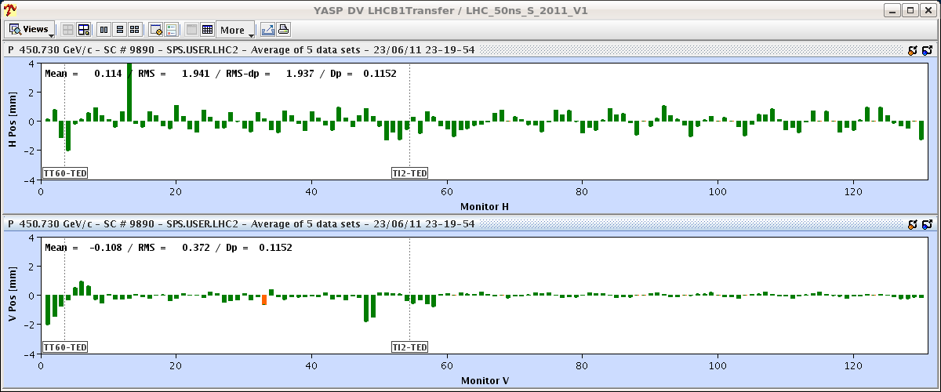
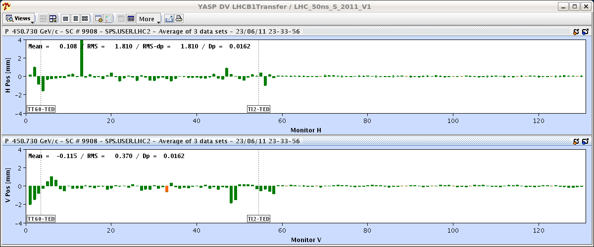
TI2 steering
Before
After

Slide 4
Overnight
Loss maps at injection.
Loss maps in collisions (H, V, dp/p < 0).
All loss maps look good.
RF problems during night.
Klystron arc 1B2.
Filament current on 2B1.
Quench heater discharging in A18.R2 (S23).
Injection for physics – too high losses.
Steering at end of line.

Slide 5
Today
Move to 1236 bunches.

