Slide 1
Monday day
Cryo recovery delayed – oil filters clogged again. One of the compressors vibrates and is noisy, possible cause of the clogging.
We run with the last compressor in Pt8 until the TS.
Cryo conditions came eventually back at 19:00.
Access during the day:
New BLMs for MKI UFOs (MD and regular OP).
Collimator cooling Pt2 (increased water flow).
Some additional TI2 transfer line checks.

Slide 2
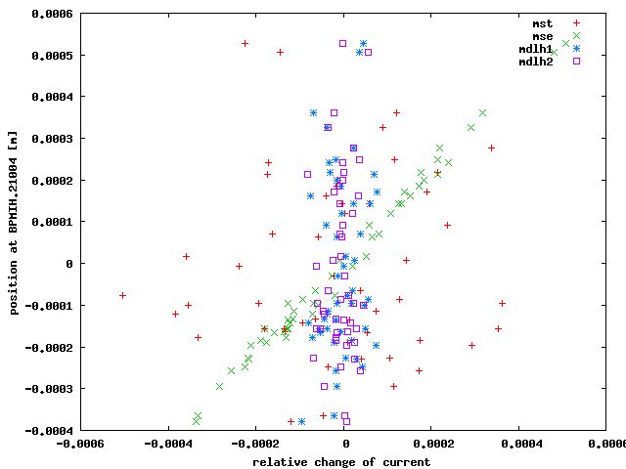
MSE correlation
Simulations of the observed PC ripple/noise (from logging) point to the extraction septum MSE as source.
‘Logic’ as this is by far the strongest magnet string (~10 mrad).
Verena, Lene

Slide 3
Monday evening
21:00: first injections. Q’ negative in V (-2 to -3) but stable.
Steering on average trajectories with 12 bunches. Small corrections (TI2 H+V, TI8 H).
Fluctuations of ~0.5 mm observed on the B1 injection oscillations – consistent with observations over the WE.
23:00 Filling 1092b. ADT OK.
Very good for TI8 – correction did its job.
Frustration over TI2 – after the correction exercise the average trajectory is different (again). One injection out of tolerance – we masked out that shot.
We need a 12b filling scheme with more injections, ~20.

Slide 4
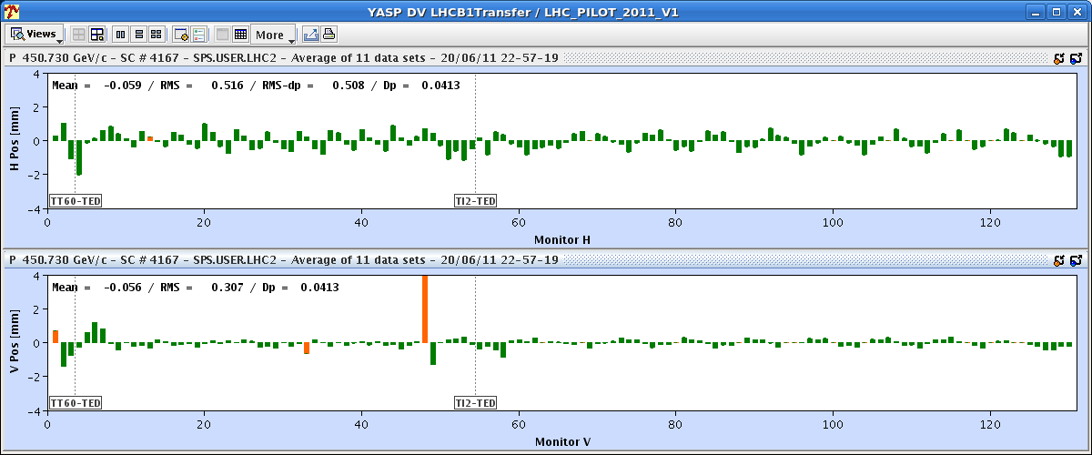
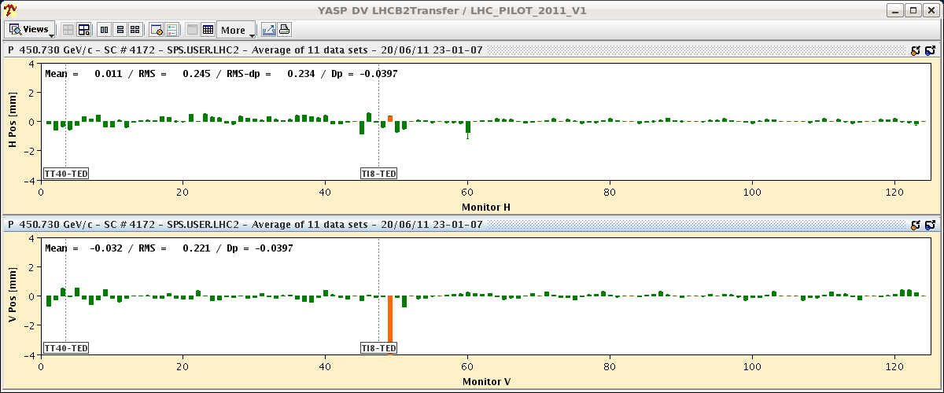
TI2 and TI8 averaged trajectories
During filling…

Slide 5
Ouf !
00:15: Stable beams fill 1883, 1.1E33 cm-2s-1.
Today:
Keep this fill until some time in the afternoon.
Refill with 1236b.

