Slide 1
LHC Status Thu Morning 16-June
Bernhard Holzer, Gianluigi Arduini et al
Tentative Planning:
Luminosity
Access: installing low pass filter at RF couplers
Thu evening / Fri Morning
SPS intervention: 400kV cable repair: EDF
Thu afternoon
CMS van der Meer scan
Beginning of next fill

Slide 2
just a collection of technical problems
15. June

Slide 3
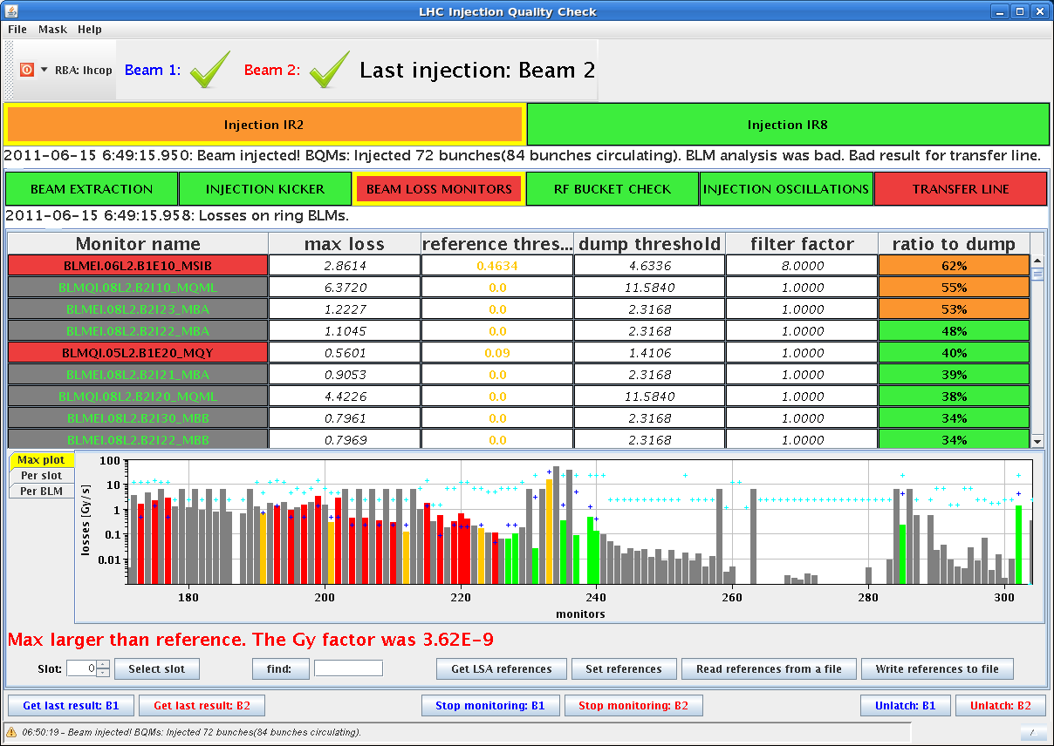
Tue Night / Wed Morning
15. June
Tue Late:
22:37h Beam Dump:
Electrical Distribution, trip of sector 81 after a
problem on 400V distribution in RR13
02:49h
We can not close the machine. The SR5 beam imminent warning
is not ok. Apparently TI has a problem reading alarms that
include beam imminent warning in SR5, there is a piquet
working on it.
06:11h Set up injection:
Beam Losses during injection
72 bunch transfer
-> 60% loss threshold !!

Slide 4
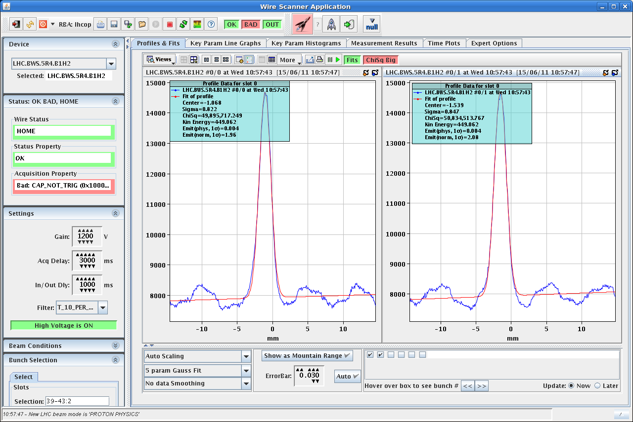
Wed Morning
15. June
07:00h ... 10:00h Set up Injection “We are quite happy with beam1!”
10:10h injection for physics
11:02h Dump Power converter fault 400 V distribution
Access required to repair 400V supply at point 1
in parallel:
Access for ATLAS, ALICE, CRYO (Point 6)
RF (low pass filters)
UPS in US85, CV in PM45
fire detecton point 3

Slide 5
Wed Afternoon
15. June
16:30 h fire detection ok ... for the moment
18:40 h 400V problem ... not really ok !!
The two previous trips (last night and this morning)
were caused by a measurement of about 10 A,
but the measurements they did now in the tunnel gave
only 0.2/0.3 A: the problem could not be reproduced.
18:55 h Problem to restart the machine:
Cannot move the LHC access key. no beam imminent
warning in pt 5.
21:19 h Fire detection piquet's changed 2 relays out of 3
in pt 5 ... he could not solve the problem,
but he forced the relay by hand. We can carry on
for now, but the problem will come back at the next
access. He'll follow it up with the experts tomorrow.

Slide 6
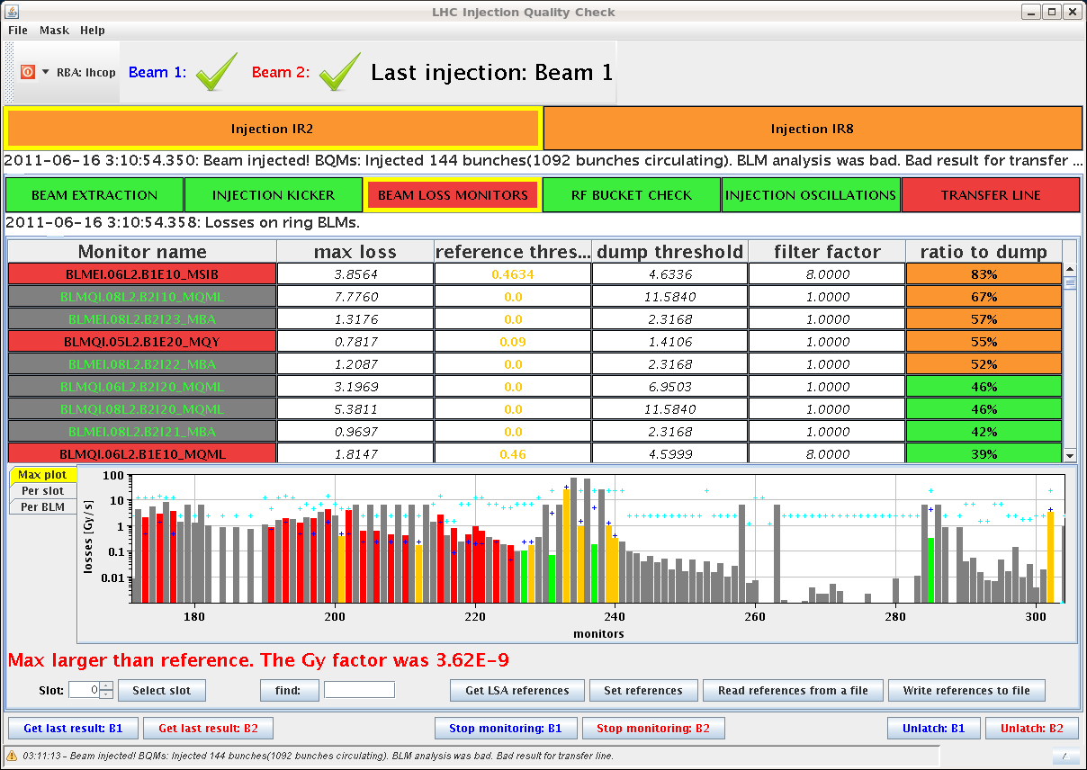
Wed Afternoon
15. June
21:38 h Injection probe beam
22:20 h Injection Physics Beam
Injection of 12 bunches show losses at 5% at MSI ...
this would cause problems when injecting higher
intensities, trying to improve
03:12 h All bunches in, very difficult injection,
especially for beam 1 with a lot of requests stopped
at SPS because of satellites
83 %
loss threshold

Slide 7
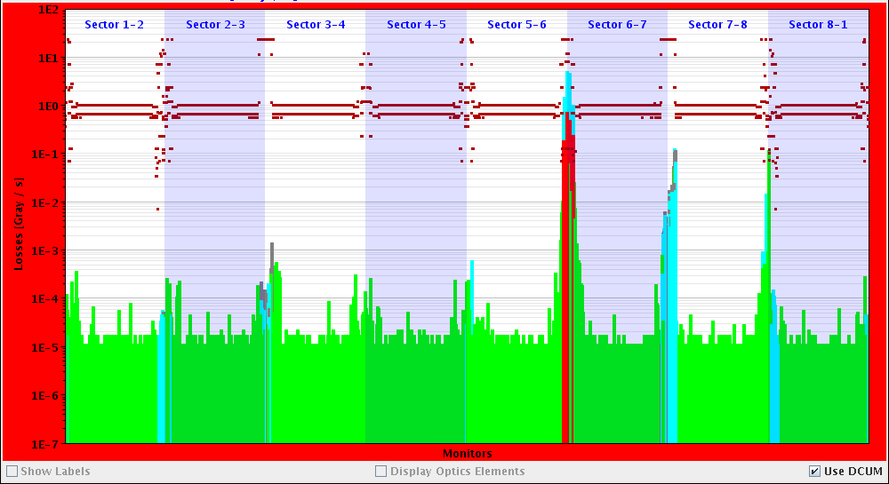
Wed Night / Thu Morning
03:12 h Injection, complete, Ramp
... and UFO in 1L8
04:36 h Restart: Injection Probe Beam
Again: problems due to injection losses:
87 % losses on MSI at first injection of 72 bunches!
06:46 h start ramp

Slide 8
Resume:
Problems at injection: optimisation very difficult,
beam dumps due to high losses in beam 1
400V problem unclear
sirene problem in point 5 unsolved
Access: installing low pass filter at RF couplers
Thu evening / Fri Morning
SPS intervention: 400kV cable repair: EDF
Thu afternoon
CMS van der Meer scan
beginning of next fill

