Slide 1
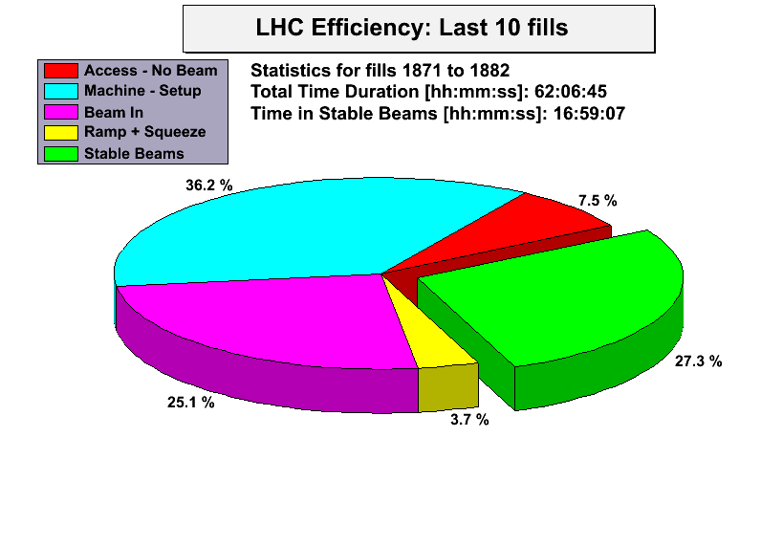
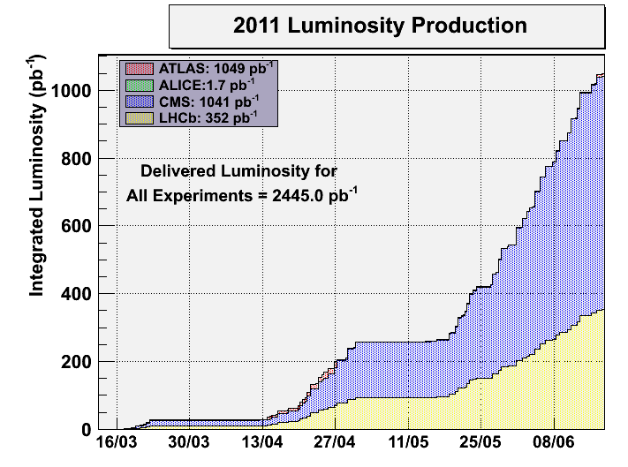
LHC Status Mo Morning 20-June
Bernhard Holzer, Gianluigi Arduini et al
The Week
7 runs

Slide 2
LHC Status Run Statistics 13-20June
The week
Fill | delivered Luminosity | run length | Reason for Dump
1866 | 1306 | 0:20h | RF
1867 | 29342 | 8:26h | RF
1868 | 46929 | 15:09h | 400V distribution
1871 | 23770 | 7:30h | Main Quads 81
1873 | 3326 | 0:54h | BIS
1875 | 25291 | 7:50h | Undulator
1880 | 3172 | 0:50h | BIS
Main Delays: Cryo
injection oscillations / losses

Slide 3
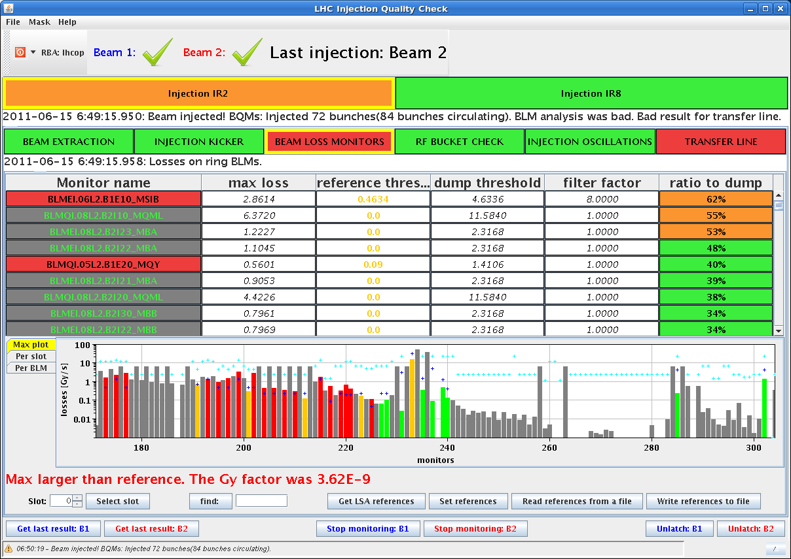
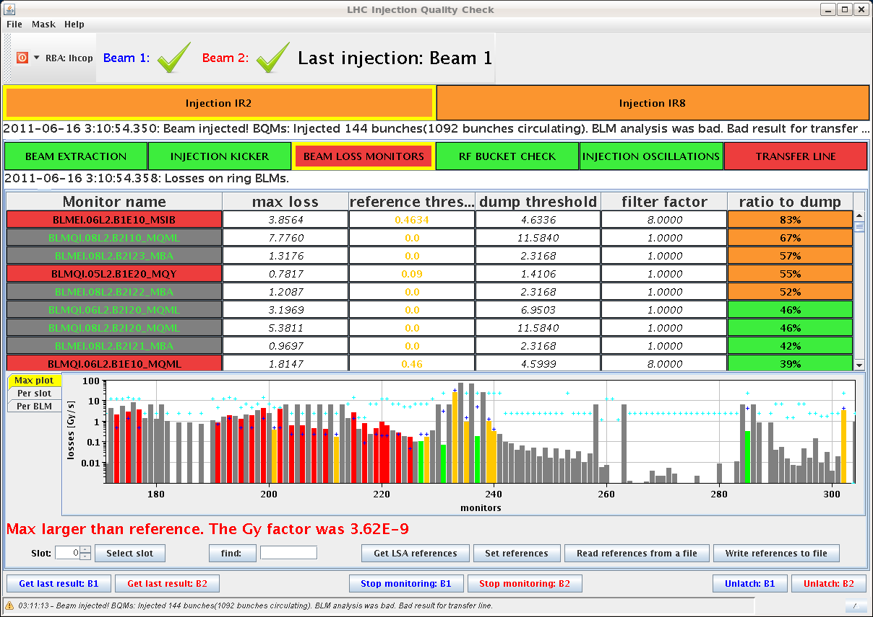
The ( technical ) problems of the week:
Tuesday
22:37 Trip of sector 81 due to 400V problem in RR13 (occured twice)
... checked & no problem found ???
02:30 Beam Imminent Warning in point 5 not OK (SR5) ➔ changed relay
Beam Losses during injection
difficult & time consuming optimisation
Wednesday

Slide 4
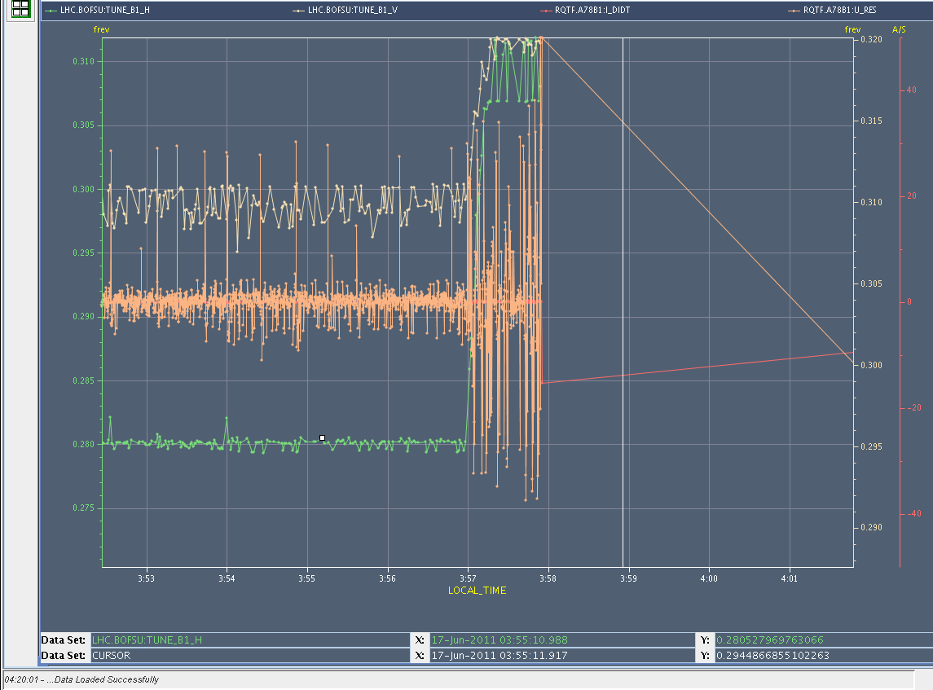
The Week: Thursday
02:06 Beam dump: BIC
03:56 Beam lost at the very beginning of the squeeze due to trip of RQTF.A78B1
tune B1v
tune B1h

Slide 5
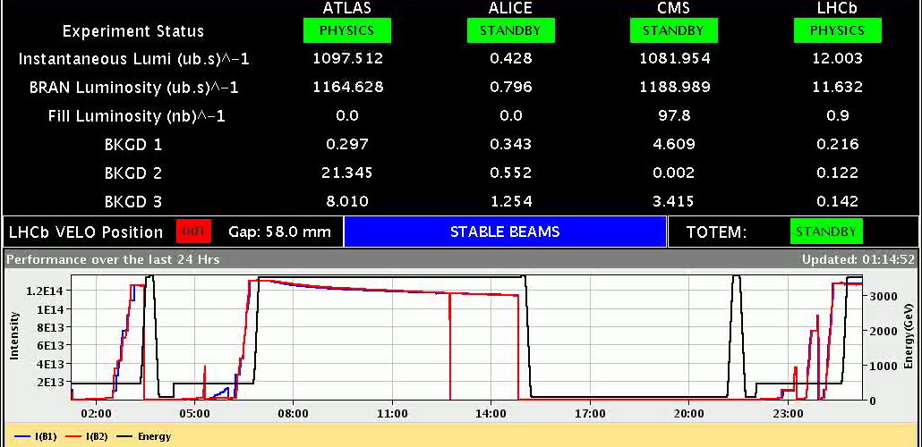
Thu Night / Fri Morning
17. June
02:06h dump triggered by BLM on Q4.L6, could be a UFO, but signature not clear
+ This dump most likely came from the BIS.
+ a glitch propagated UA87-SR7-TZ76-UA67 in the A permit loop
+ the glitch was long enough to cause the generator A to switch off. Random glitches occur, at the same time. It’s the first time we’ve observed a glitch long enough to cause us to stop like this, it could be an indication of degradation of an optical component in SR7 or UA87 (Ben)

Slide 6
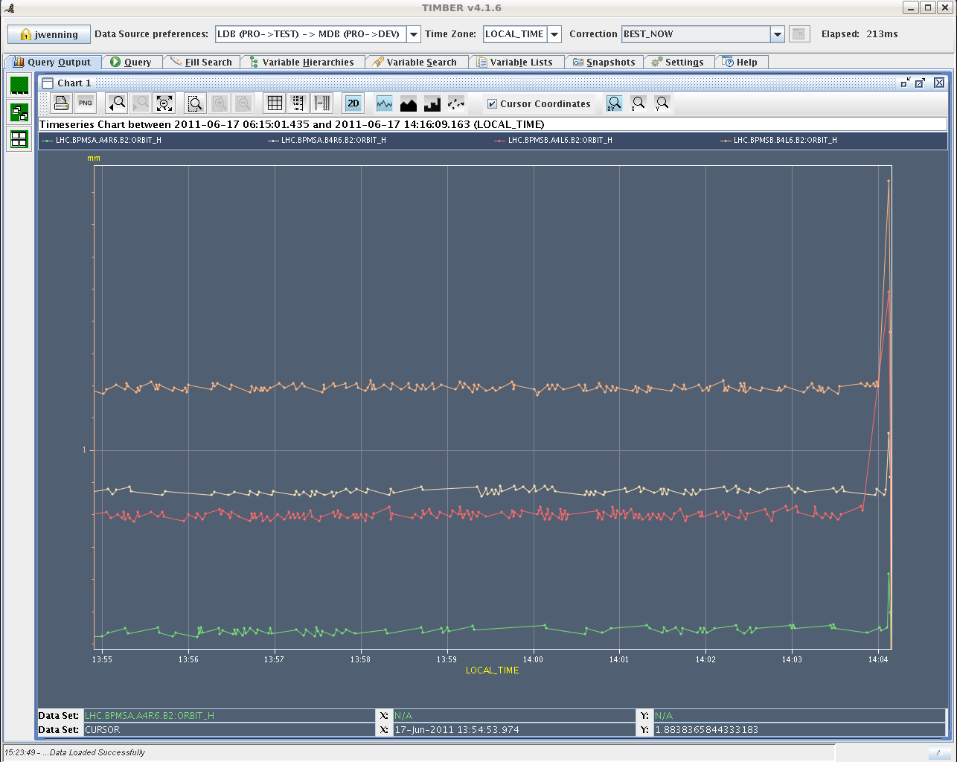
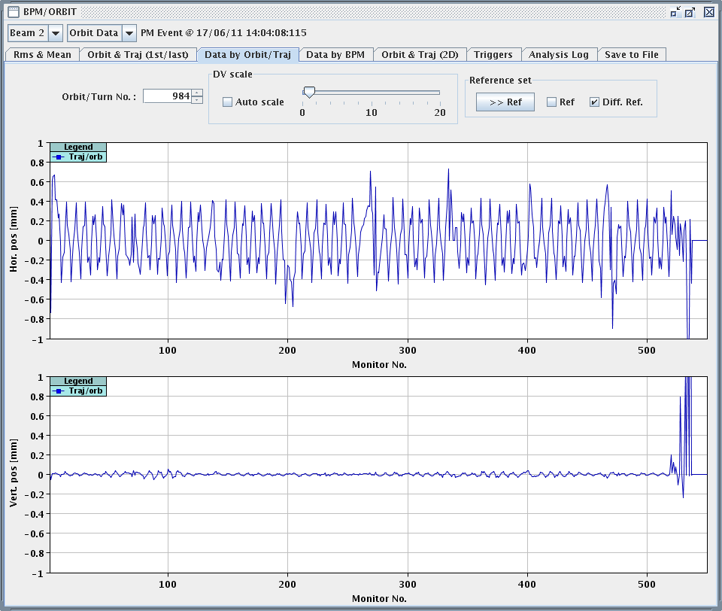
17. June
Fri Morning
06:15h stable beams
08:31h start preparation of VdM scan in IP5 ... ± 3 σ
14:04h Beam Dump: SIS dumped because the beam position at the TCDQ was out
of tolerance for BOTH redundant BPMs.
The undulator tripped approximately 1.3 seconds before the dump by SIS, it
is possible that during the current decay, some imbalance in the undulator
lead to the H orbit excursion.
BPM.b4l6.B2
BPM.a4l6.B2

Slide 7
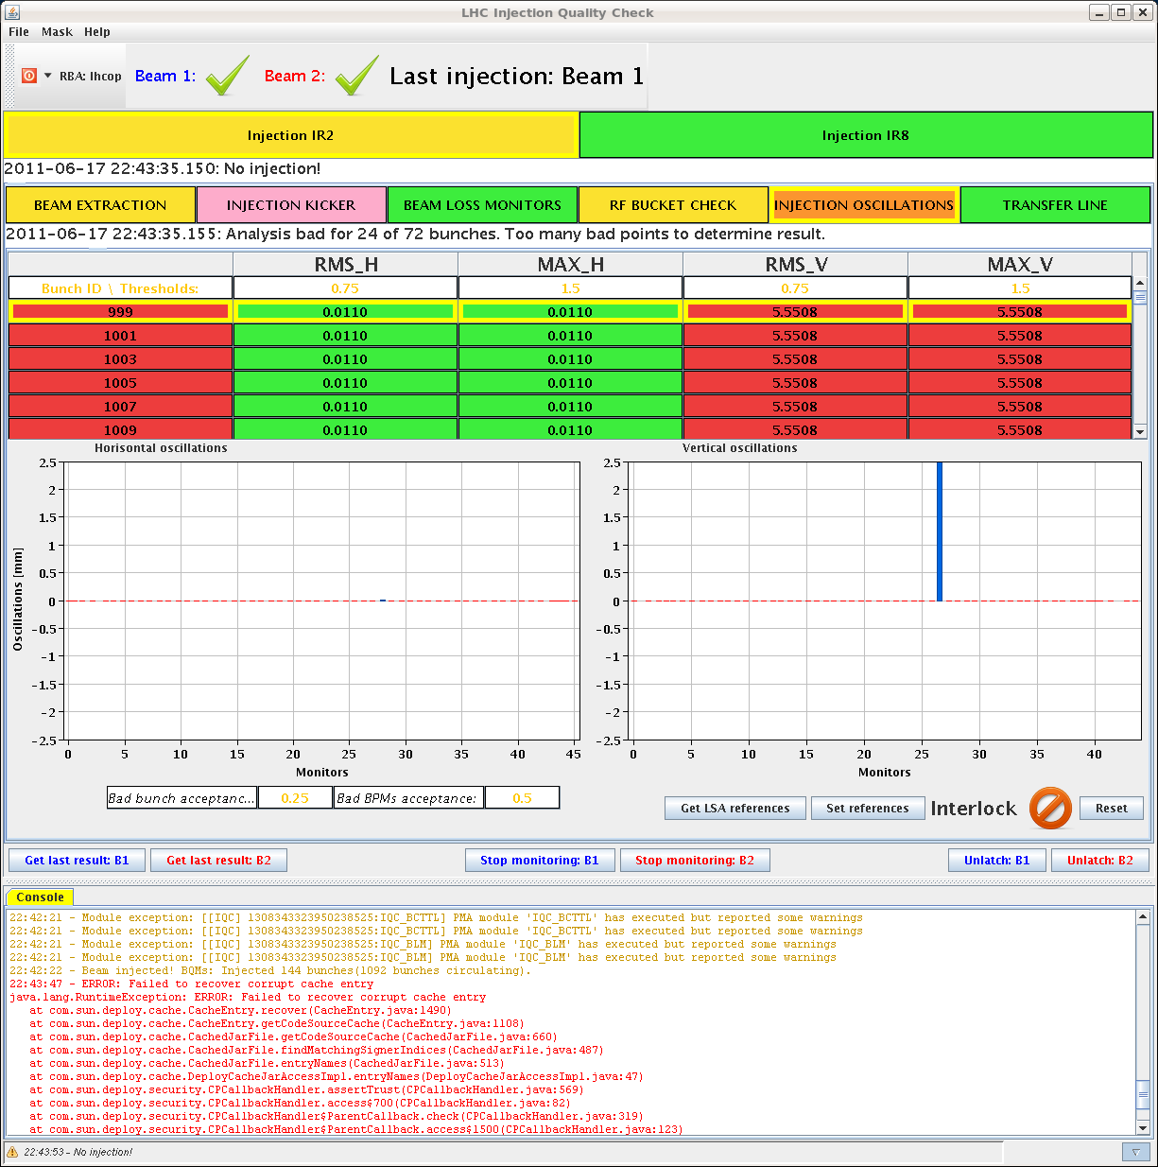
Fri Afternoon
17. June
15:20 h Short access needed for RF (coupler window
interlock), and for QPS (to check the QPS control
unit of the undulator)
18:16 h RF interlock test: An RF External Veto interlock was
provoked on each of the 16 cavities. A beam
interlock was correctly observed in each case.
19:02 h Restart the machine:
problem with H1B2 of ADT. Gate Control failure on
HV power supply. Needs piquet intervention at SR4
20:13 h Restart the machine:
20:49 h Dual power supply in TT60 is down
22:00 h Injection for physics ... but
IQC cash appears to be
corrupted.

Slide 8
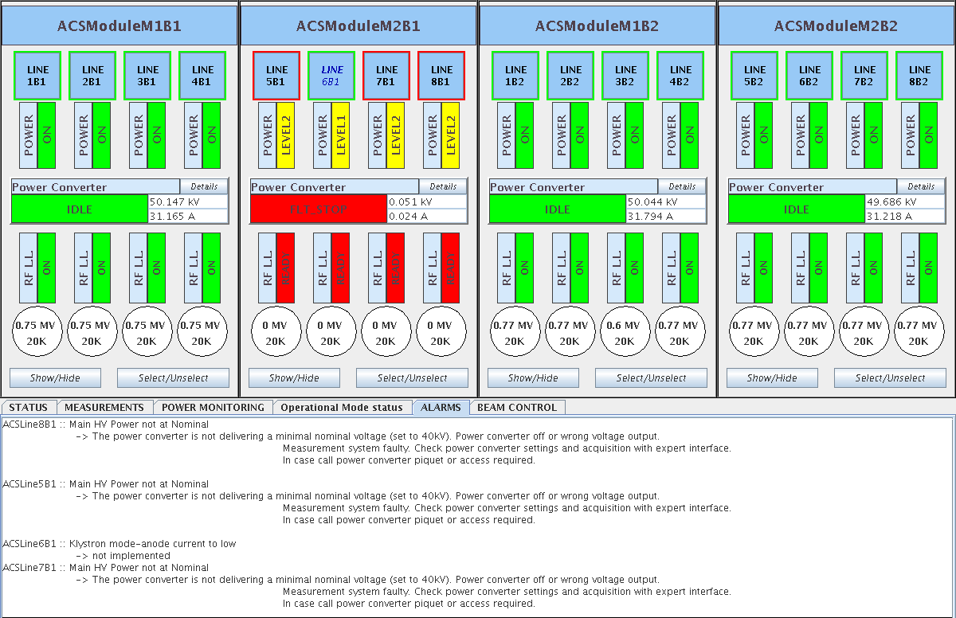
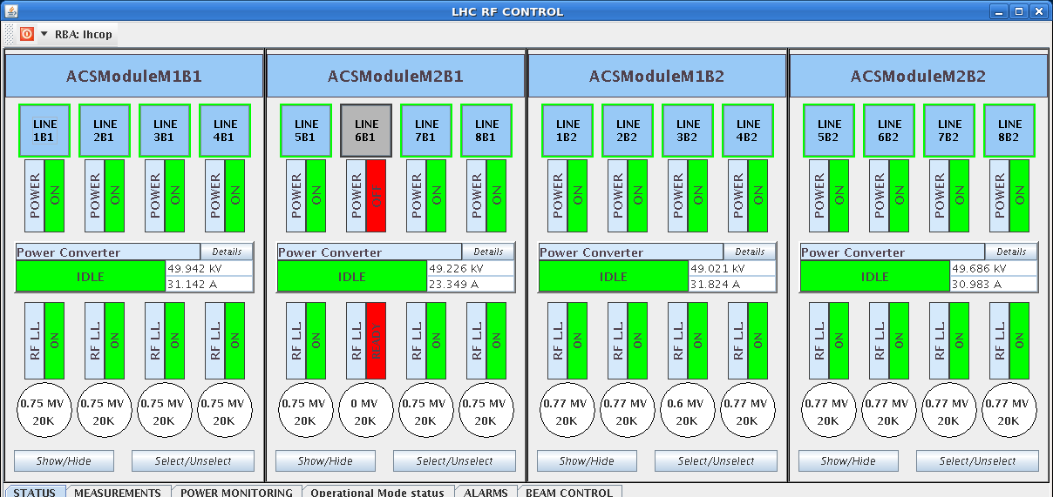
Fri Night
17. June
23:00 h Injection for physics
00:02 h Dump Classification: RF power fault module ACSM2B1
Calling RF power piquet
... It looks like a problem
on the electronics rather than
the klystron itself.
Phillippe: We have switched 6B1 off, detuned the cavity
and kept the coupler at low (20k) loaded Q in physics.

Slide 9
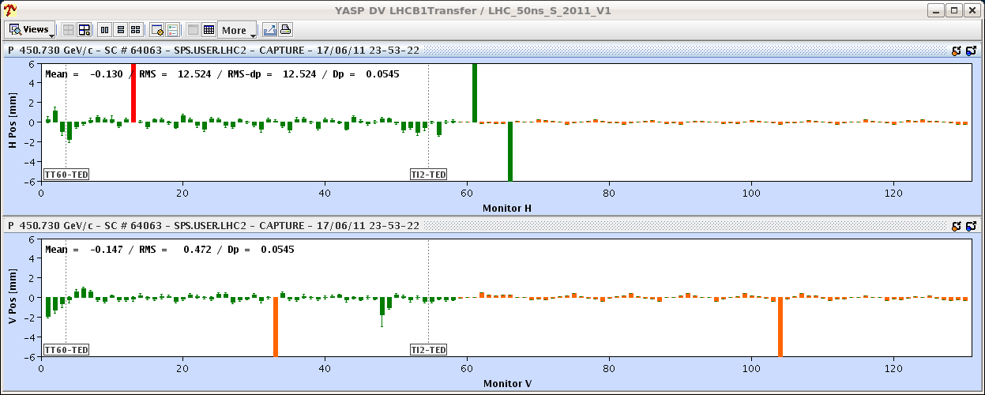
Fri Night
17. June
in addition to all this ...
00:02 h Inj oscillations b1...
??? problems with unstable orbit correctors in the TL ???
01:22 h Alarm for ADT. In fact, looking back at the afternoon
logbook, it is the same module that tripped then.

Slide 10
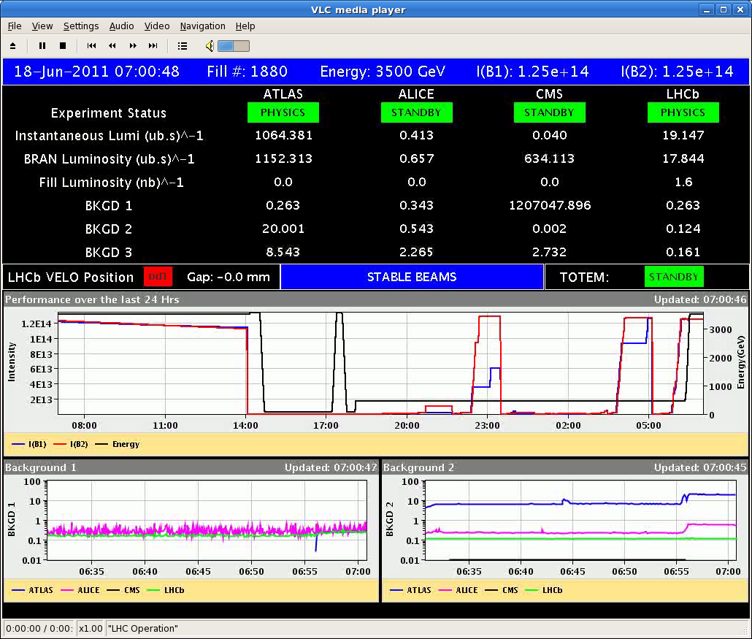
Fri Night / Sat Morning
07:00h ramp, squeeze, lumi
undulator / beam orbit
RF power
BIS
07:48h Dump ... BIS
Access: RF repair, BIS check & repair
12:50h Restart: The SPS is measuring huge emittances (and
not stable).

Slide 11
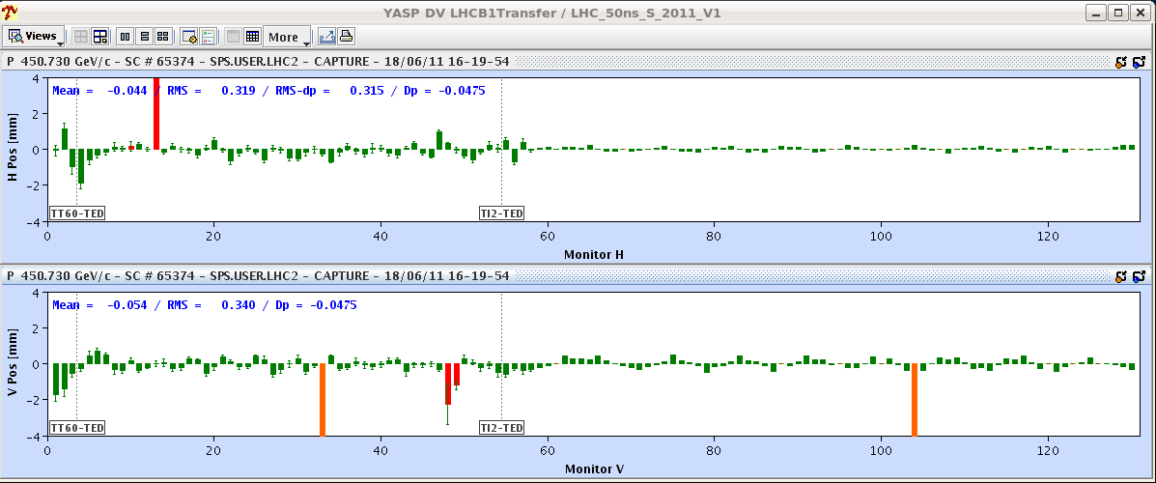
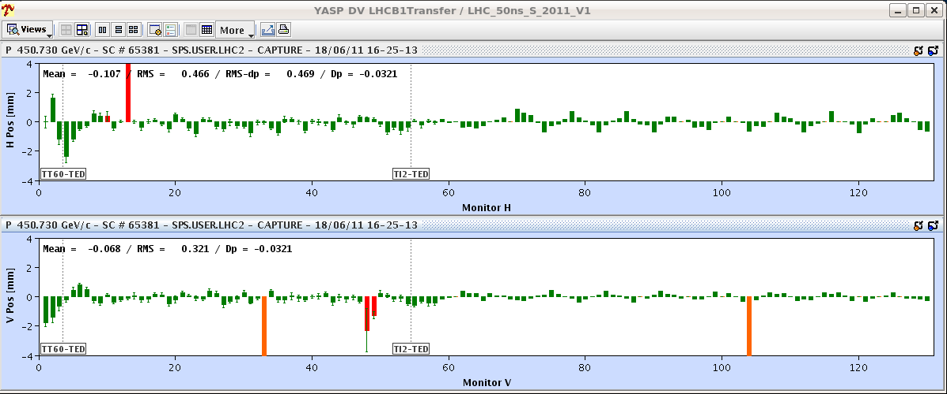
Sat Afternoon
18. June
15:00h Restart
Testing injection oscillations
... as it should be
... as it happens sometimes
“The oscillations point to corrector MCIAH.208 but leave an initial oscillation starting
before the entrance into TT60. The peaks in TI2 reach close to 0.5 mm, which corresponds to ~ 0.7 mm in the LHC ... eating up to 50% of the 1.5 mm injection oscillation budget.”
(Joerg)

Slide 12
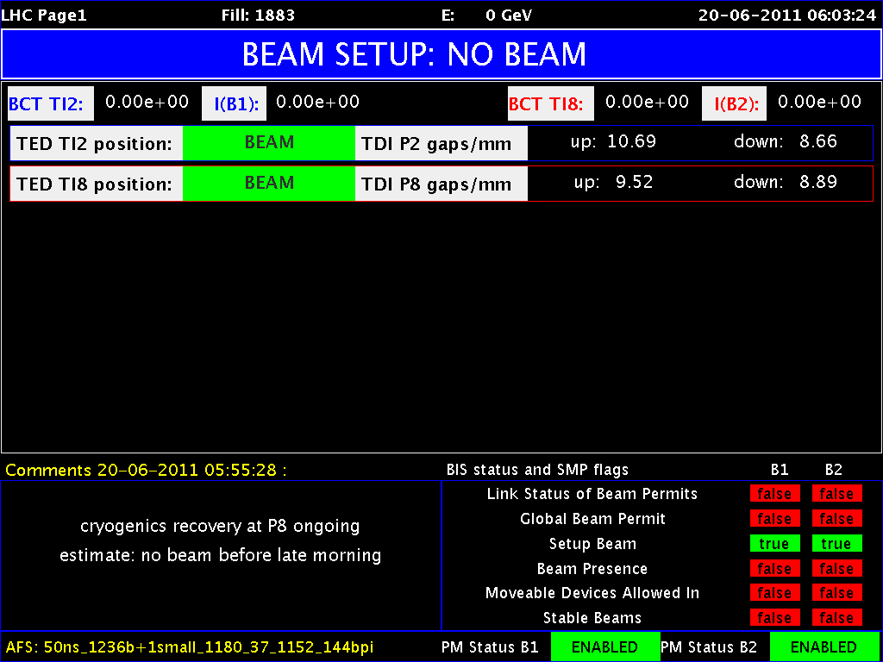
Sat Morning – Mon Morning
17:36h
cryo lost PT8
... since then: recovering from cryo problem

Slide 13
The Week:
Main issues:
RF-input coupler electronics connected to Dump
RF- Klystron / Electronics trip ... new threshold
ADT problems ... fixed
spontaneous loss of BIC ... checked and fixed
400V distribution ???
Cryo Problem: recovering
Injection Oscillations ... ???

