Slide 1
Sat 18/6 – Sun 19/6
07:48 Beam dump due to spurious interlock from BIS
08:30 access BIC repair. RF intervention in parallel.
13:00 Intervention on BIC finished (replacement of optical fiber receiver in point 8)
13:00-15:00 Large emittance beam in the SPS. Tuning of the machine
15:00-17:00: check of injection
17:00 - ongoing: Cryo problem in point 8
In the shadow:
Access for: TOTEM, ALICE, CMS. Loss of patrol PM56 (PAD)
Damper intervention

Slide 2
RF
End of RF intervention: The problem with 6B1 was traced to the electronics of the monitoring of the Mod Anode current. This is a LEP heritage: It would detect a klystron instability where the electrons would return backward in the tube, from the output cavity back to the grid (backscattered electrons). This never happened with the LHC klystrons because they are driven far from saturation (150 kW for 220 kW max). This interlock was kept however as it also monitors the cathode heating current. Over the last 24 h the cathode heating is normal. So it was decided to increase the threshold for the Mod Anode current. Cavity 6B1 back in operation. Voltages and coupler positions returned to normal. RF Beam dump conditions back to normal: Any klystron trip will dump the beam. OK to increase intensity. David et Philippe

Slide 3
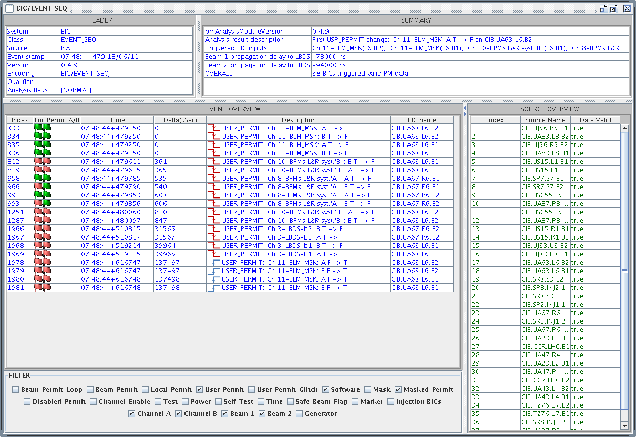
Beam dumps due to BIC (E. Carlier, B. Puccio, B. Todd)
3 of these cases
Sun 18/6 at 07:48:44
Global beam permit B2-A T->F: 07:48:44+479156
Dump request B2 TSU-A: 07:48:44+479153 (BIS fast)
Dump trigger: 07:48:44+479193
Dump request B2 TSU-B: 07:48:44+479194 (BETS fast)
First BLM trigger:
07:48:44+479250
i.e. after the beam dump
No LBDS internal fault

Slide 4
Beam dumps due to BIC (B. Puccio, B. Todd)
a glitch propagated UA87-SR7-TZ76-UA67 in the A permit loop for Beam 2
The glitch was long enough to cause the generator A to switch off.
Replaced optical receiver for the optical fiber in point 8 (most likely source of the problem)
Expert following the behaviour of BIS after the intervention

Slide 5
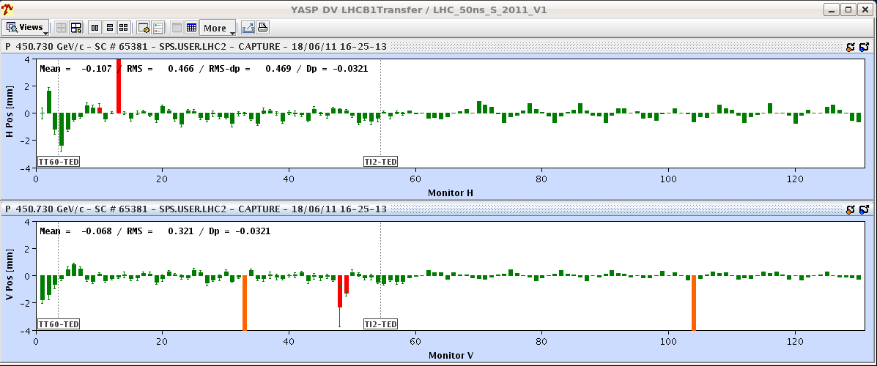
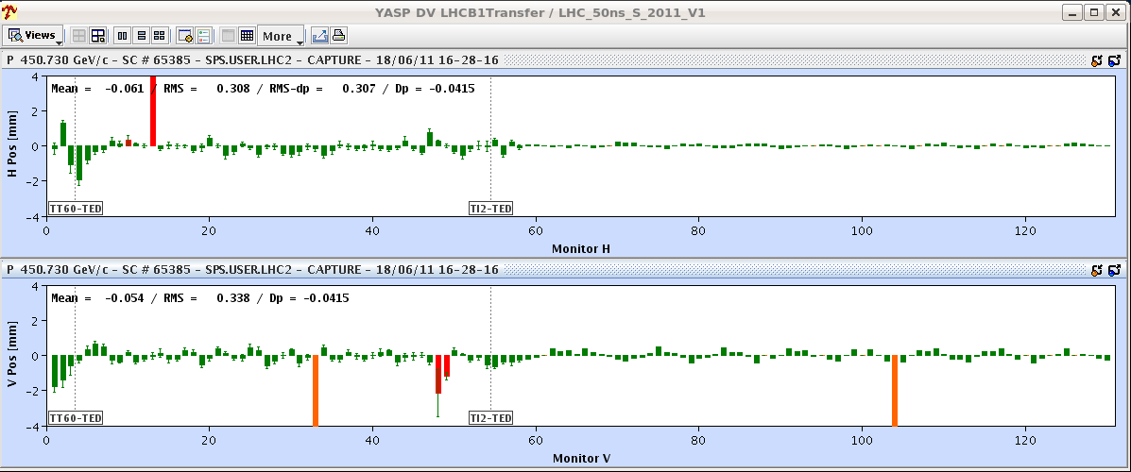
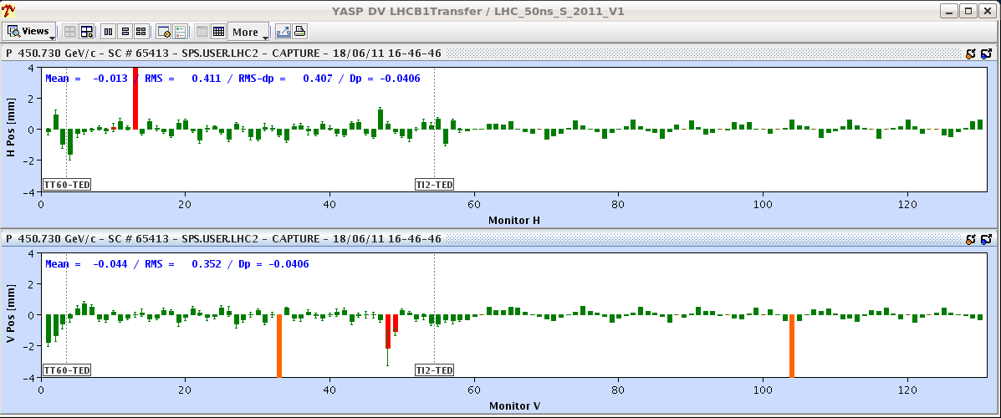
Injection (V. Kain)

Slide 6
Injection (V. Kain)
Beam 1: 1 injection out of 9 was with bigger oscillations. Origin not clear yet. Correction for beam 1 mostly occurring at MCIAH.20804 (could be also upstream)➔ analysis ongoing
Also, beam 2 is jittering a bit.
The way around it is to have enough margin and correct only with enough statistics.
e.g.: use the 12b injection scheme, check the proposed corrections. If the same correction corresponds to MOST of the injections, then send it and check with the remaining injections.

Slide 7
Cryogenics problem
Filters on one warm compressor in point 8 starting to clog. Decided to switch to “spare” warm compressor on Friday afternoon.
Saturday: Filters of the “spare” warm compressor starting to give signs of clogging
Call in maintenance team to clean filters of the “main” compressor.
Done and restarted successfully
During the switch off of the “spare” compressor reduction of the oil pressure leading to a stop of the installation

Slide 8
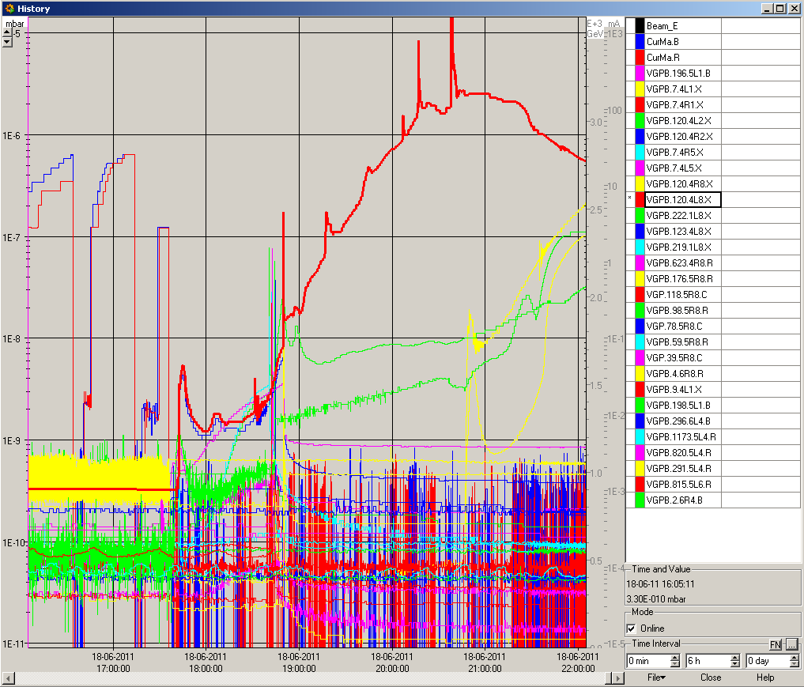
Vacuum
Keeping an eye on vacuum. We have preventively closed the vacuum valves in point 8 and 1.
Cryo team keeping beam screen temperature higher than cold mass
Might need “bake-out” of the beam screen. Follow-up with vacuum expert.

Slide 9
Plan
Cryo recovery: not before 22:00
Restart this evening.

