Slide 1
Weekend: Sat 11th – Mon 13th
Reasonably smooth running
Saturday:
PS vacuum leak on wire scanner. No beam from ~8:30
Lost beams in LHC 13:00, beam back in PS around 21:00
Access for UPS in shadow
RB.81 tripped again – cooling problem on thyristor bridge
Beam back in LHC around 23:00
Fills lost to:
PLC DFB-cyro matching section L1
D2.L1 bus bar quench – controls electronics
Collimator controls – power supply
RF voltage interlock – restarting tripped klystron

Slide 2
Last night
Fill 1867 has been dumped after ~ 9 hours in STABLE BEAMS due to a trip of RF module.
During the ramp down, we had another trip of RCBV31.L5B1. EPC piquet confirmed that we can reset and go on.
Access was needed for QPS piquet to do a reset on 2 crates in sector 23 and 67 (QPS_OK lost earlier in the afternoon).
In parallel, access was given to RF to change the power supply of RF module M1B1 was changed.
Ready for beam, but another access required ABT (Nicola Magnin) to fix scope (MKD waveforms – IPOC)
Back in stable beams for 7:30

Slide 3
RF observation from Saturday morning
Observation of beam induced voltage/power following the two klystron trips:
03:18 3B1 just at end ramp, 1.26E14 p total, 1.19 ns, we observed 0.94 MV beam induced and 153 kW. Abort gap population not measurable.
07:15 2B1 after 4 hours physics, 1.19E14 total, 1.23 ns, we observed 0.8 MV induced and 118 kW. Abort gap population peaks at 5E9
Now extrapolating to 1236b, 1.2E11 per bunch, we will get ~ 212 kW (using 3B1 data) and 183 kW (using 2B1 data) beam induced power. MAXIMUM until we condition the couplers further.
Philippe Baudrenghien

Slide 4
Frying LHCb
Record luminosity in LHCb on Sunday > 6e32
Orbit corrections where performed in both horizontal and vertical planes before optimization.
SVD 200 correctors, both planes
These corrections separated the beam in the horizontal plane and reduced the separation in the vertical plane.
When optimizing in the horizontal plane which brought the beams together in this plane, reaped the havoc of having the reduced vertical separation.
The next fill also saw high luminosity with just the orbit corrections – coordinators not fast enough.

Slide 5
Look back on week 23
Mike Lamont, Jan Uythoven

Slide 6
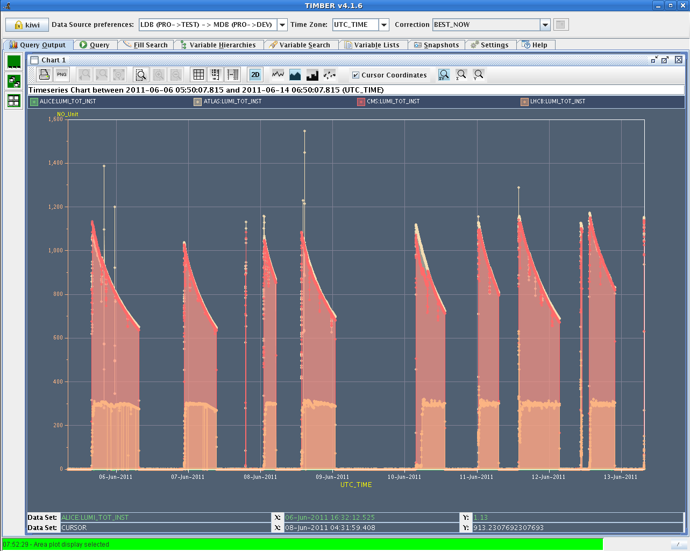

Slide 7
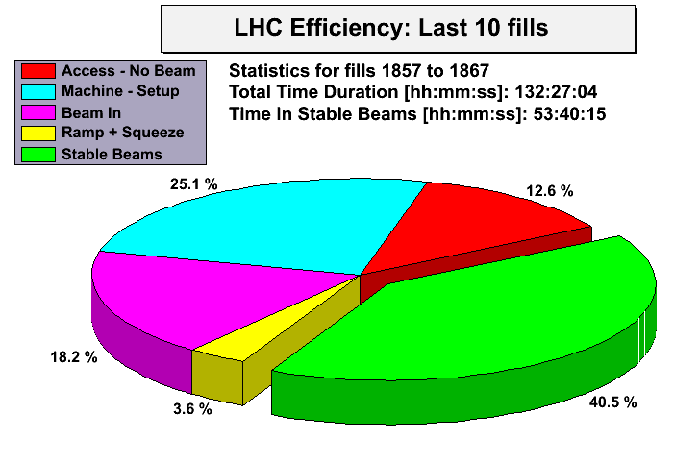

Slide 8
Week 23
Date | Fill number | Time in stable beams | Int. lumi [pb⁻¹] | Cause of dump
Mon 6th | 1854 | 9m | .59 | trip of RQ6.L2
Mon-Tues | 1855 | 14h21m | 41.3 | RTQX2.R1 - FGC
Tue-Wed | 1856 | 10h50m | 31.0 | Alice dipole trip
Wed | 1858 | 0 |  | Big UFO IP2
Wed-Thu | 1859 | 3h56m | 13.4 | Electrical glitch
Thu | 1862 | 11h12m | 32.4 | Trip RSQSX 400 V PS
Thu - Sat | 1863 | 9h43 | 30.8 | PLC DFB-cyro MS L1
Sat - Sun | 1864 | 6h48 | 23.1 | D2.L1 bus bar quench
Sun - Mon | 1865 | 13h36m | 42.6 | Collimator controls
Mon | 1866 | 20m | 1.3 | RF Total Voltage Intlk B1
Mon 14th | 1867 | 8h14m | 28.8 | RF module trip
Mon 14th | 1868

Slide 9
Week Summary
Weeks results:
Highest luminosity per fill: 46.61 pb⁻¹
Highest luminosity in 1 day: 56.33 pb⁻¹
Production in a week: 229.64 pb⁻¹
Number of programmed dumps: 0
Average bunch intensity: 1.2e11 (slightly lowered)
Typical luminosity: 1.1e33 (slightly lowered)
Number of bunches/beam: 1092 (from week 21)
Number of stable beams: 11
Average length stable beams: 4.2 h (mostly short fills)
> 1fb⁻¹ total if you count last year

Slide 10
Main time outs
Tuesday | Access for QPS + ...mixed bag of problems Patrol lost x 2, problem with PAD, BIW MKD power supply
Friday am | Access required - power converter, QPS, Beam dump Friday morning - access - cleaning list before long weekend Leading into…
Friday pm | Injection - change LHCB polarity Q'' measurement. Problem with RF frequency program Problem with SPS main power supply cooling Q'' measurement while waiting for SPS
Saturday | PS vacuum leak on wire scanner. Lost beams at 13:00, beam back in PS around 21:00
Plus more smaller problems than you can shake a stick at

Slide 11
Operational development
What we learnt this week

Slide 12
Bunch length control in the ramp
Implementation, deployment and testing of new functionality for controlled blow-up in the ramp
Followed by the Monte Carlo approach (Philippe, Themistoklis, Michael, Delphine)

Slide 13
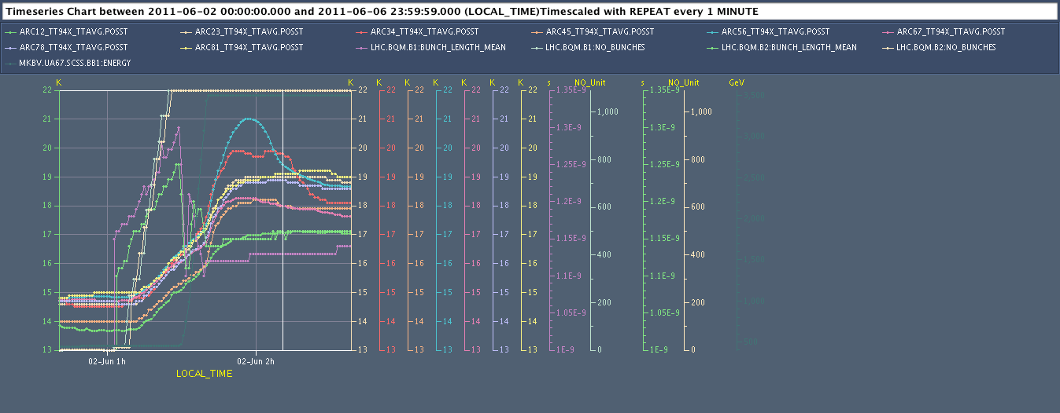
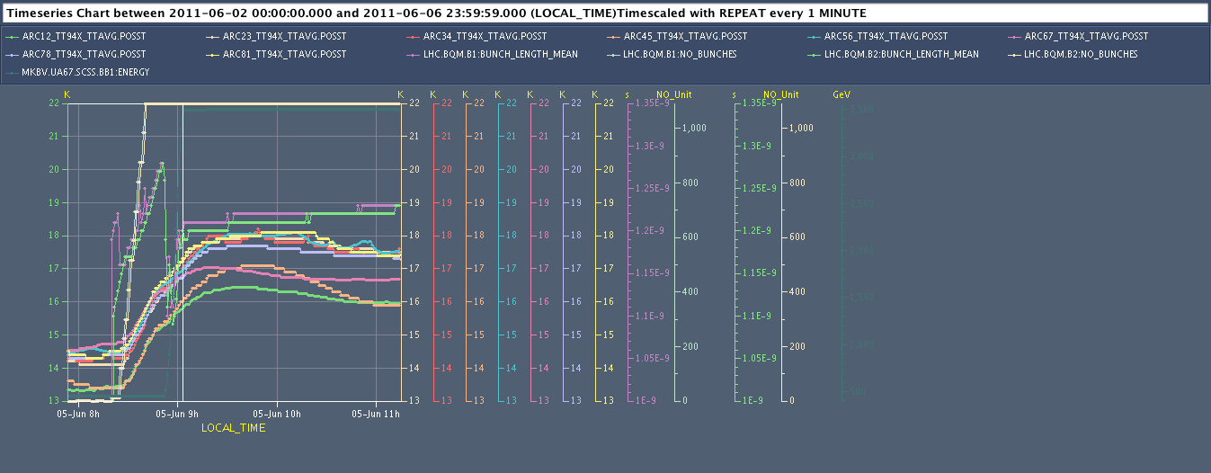
Too low bunch length => direct impact on image current heat loads!
Injection
18K
Bunch L B1
Ramp
ARCs 34 & 56 mostly penalised
Injection
Longer bunch length => lower heat loads
18K
Very homogeneous behaviour of all arcs
Ramp
Serge Claudet

Slide 14
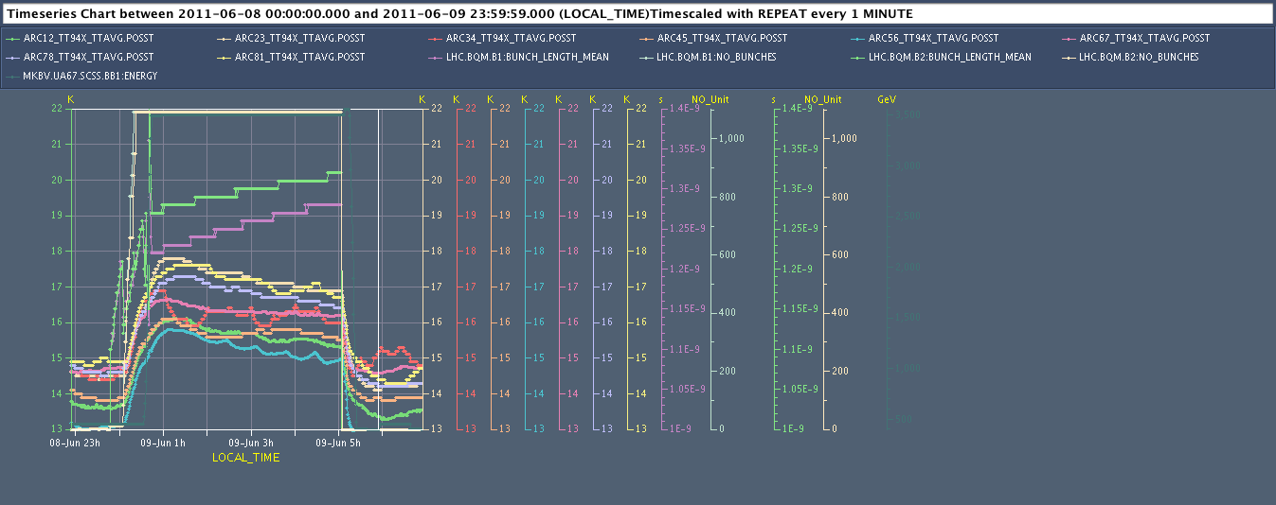
Cryogenics – beam screen heat load
Injection
Longer bunch length on purpose => lower heat loads confirmed
18K
∆T
Appreciated as well by collimators and kickers !!!
Ramp
Temperature increase (Peak - before injection) for 1092 bunchs:
Maxi: +4.5K (1836, 1.12ns-1.14ns)
Avg: +3.6 K
Mini: + 2.6K (1859, 1.22ns-1.27ns)
(always about 2.0K for injection, rest for ramp effect)
Serge Claudet

Slide 15
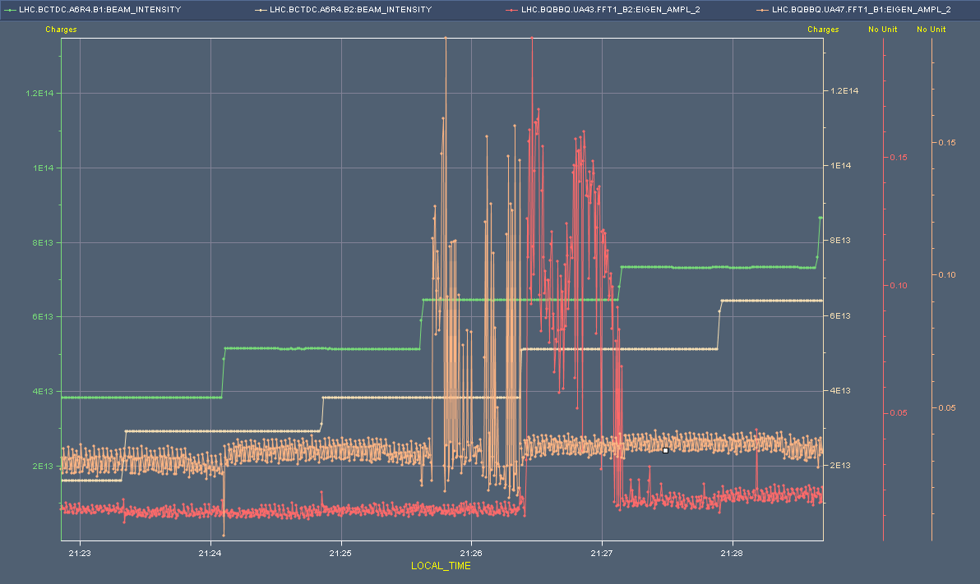
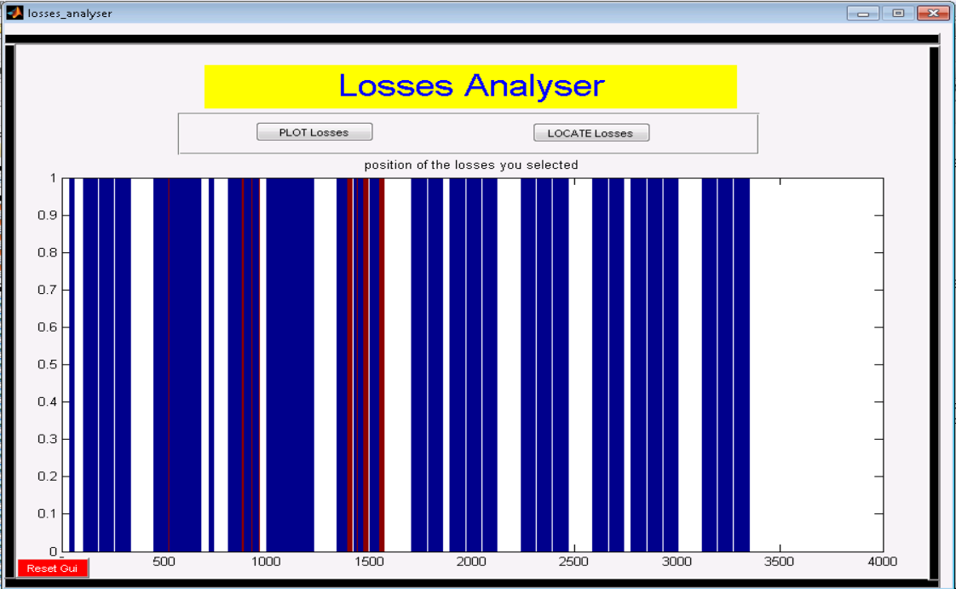
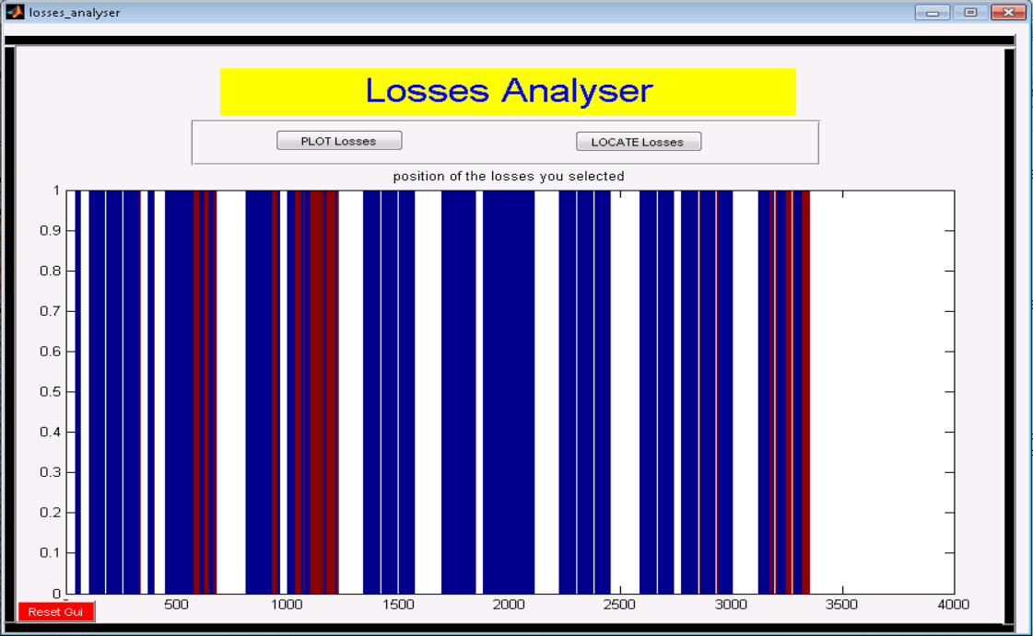
Blow-up at injection

Slide 16
Observations
Selected trains
Select bunches within PS train of 36
Perhaps reflecting individual booster ring(s)
Emittances look OK
Coupled bunch instability ruled out (Elias Metral)
Density modulation in phase space driving instability in LHC?
Coherent signal on BBQ
Clearly visible on BSRT
Both planes – stronger in vertical
Bunches go through ramp & squeeze without problem
Blow-up evidenced by poorer lifetime and lower luminosity in stable beams
Introduce some non-linearities with the Octupoles

Slide 17
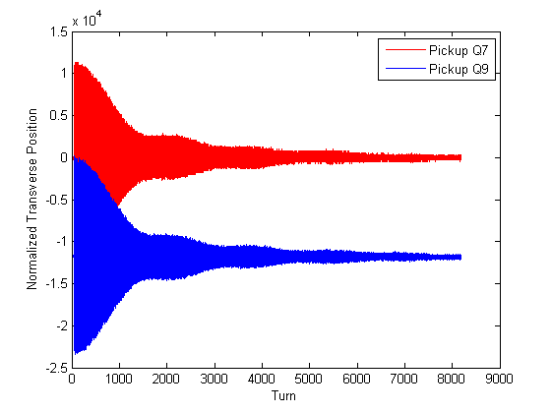
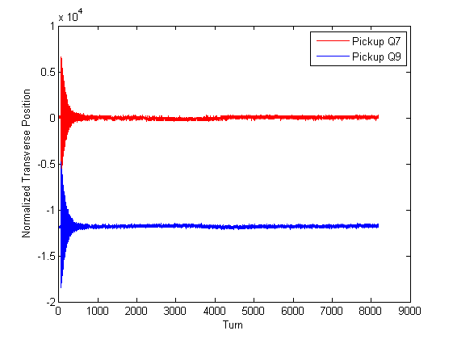
Octupoles@450 GeV
Wolfgang Hofle
INDIV beam at nominal intensity
emittances: ranged from 1.5 to 2.5 μm
Check filamentation without damper, with octupoles on and off
Method: disable damper for first 2000 turns
Octupole polarities: de-focusing for OF & OD
Additional de-coherence already seen 2010 with high bunch intensity → tune spread associated with space charge (image space charge)
damper off
damper on
22.04.2010

Slide 18
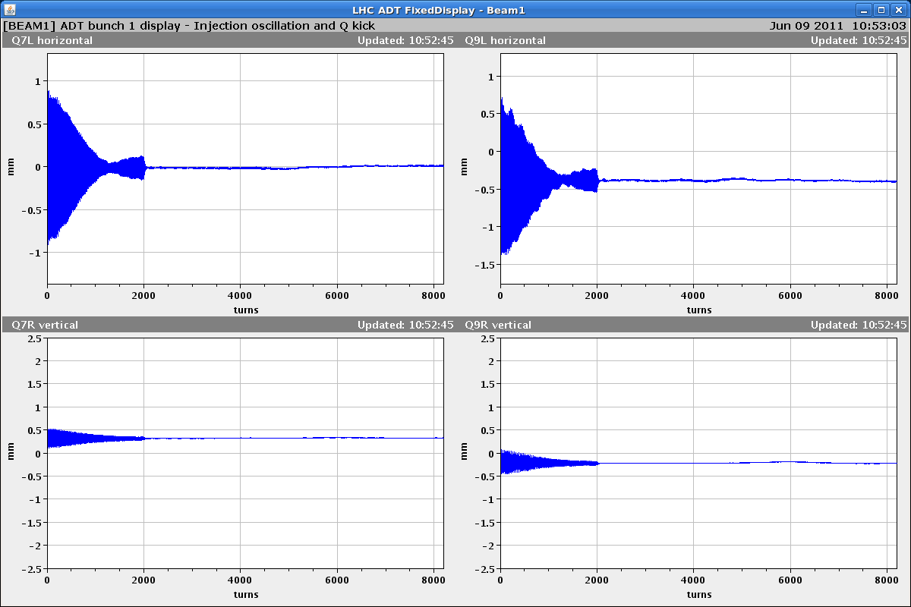
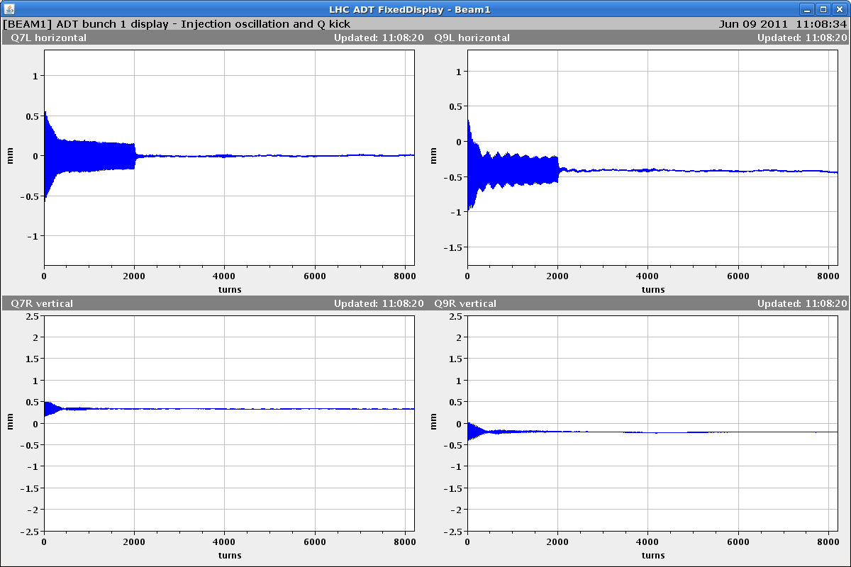
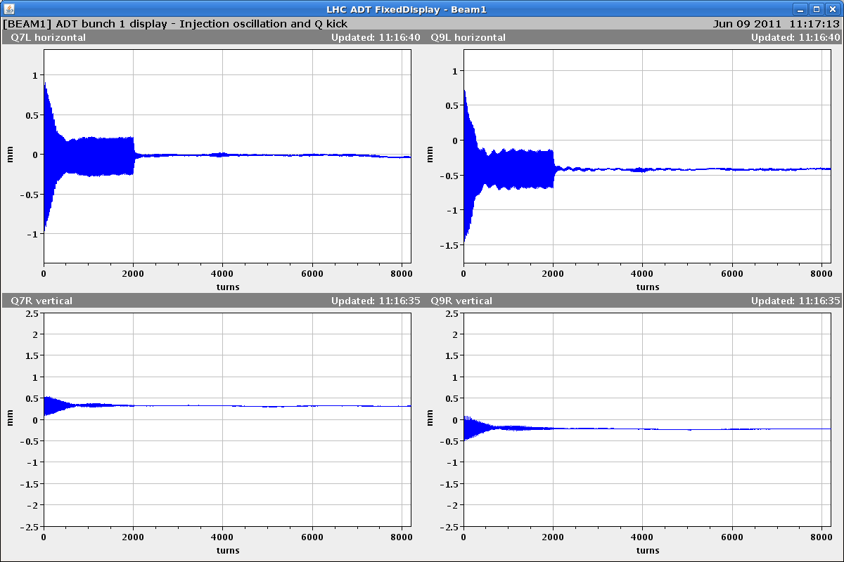
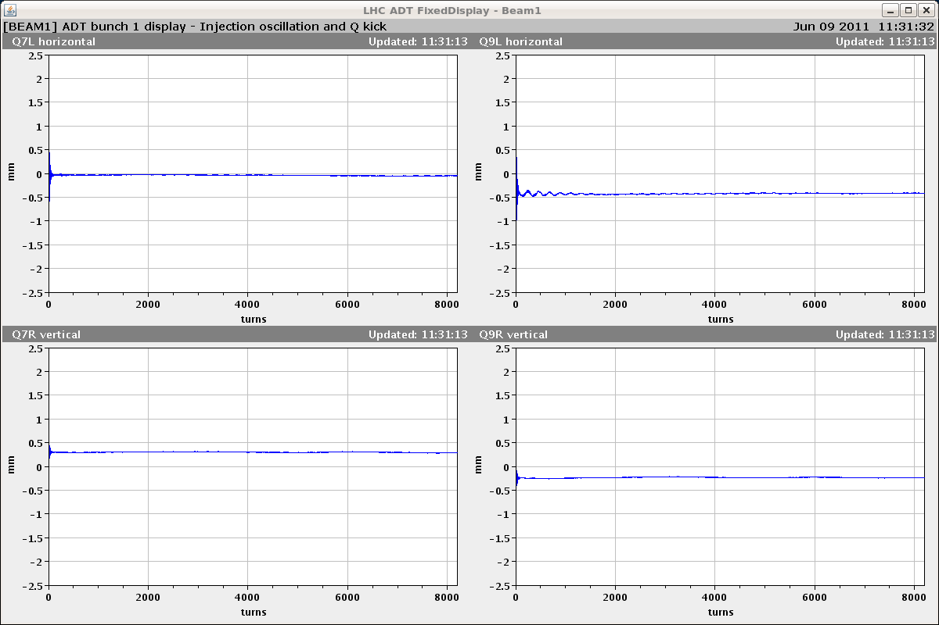
Beam 1
0 A
13 A
6.5 A
6.5 A
damper ON
horizontal
vertical
damper always switched on at turn 2000

Slide 19
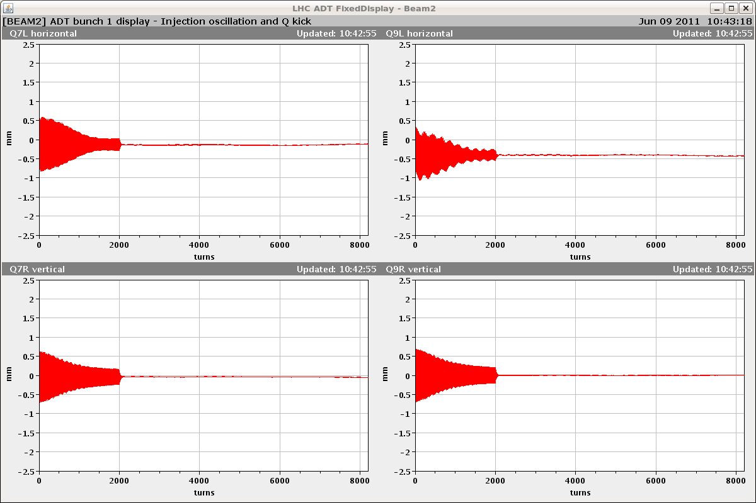
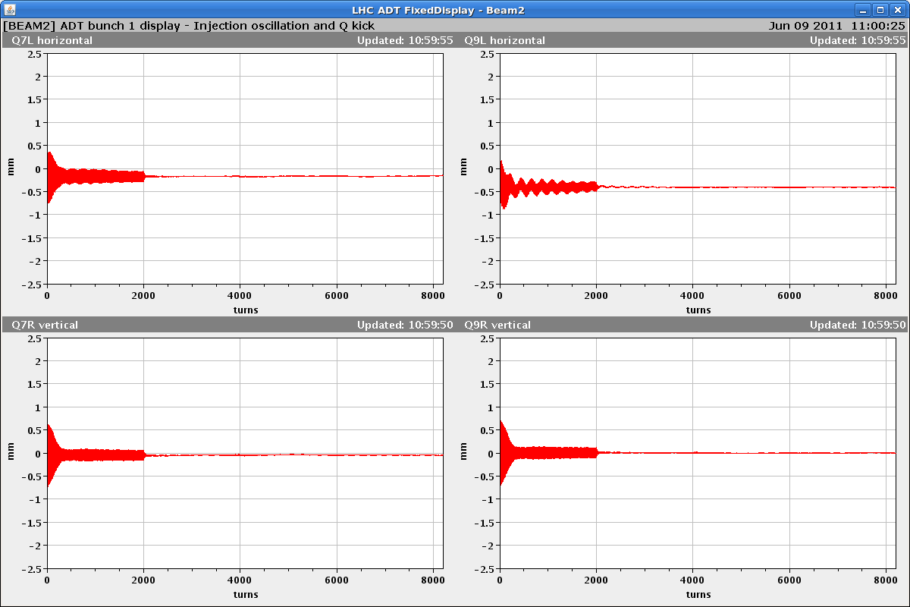
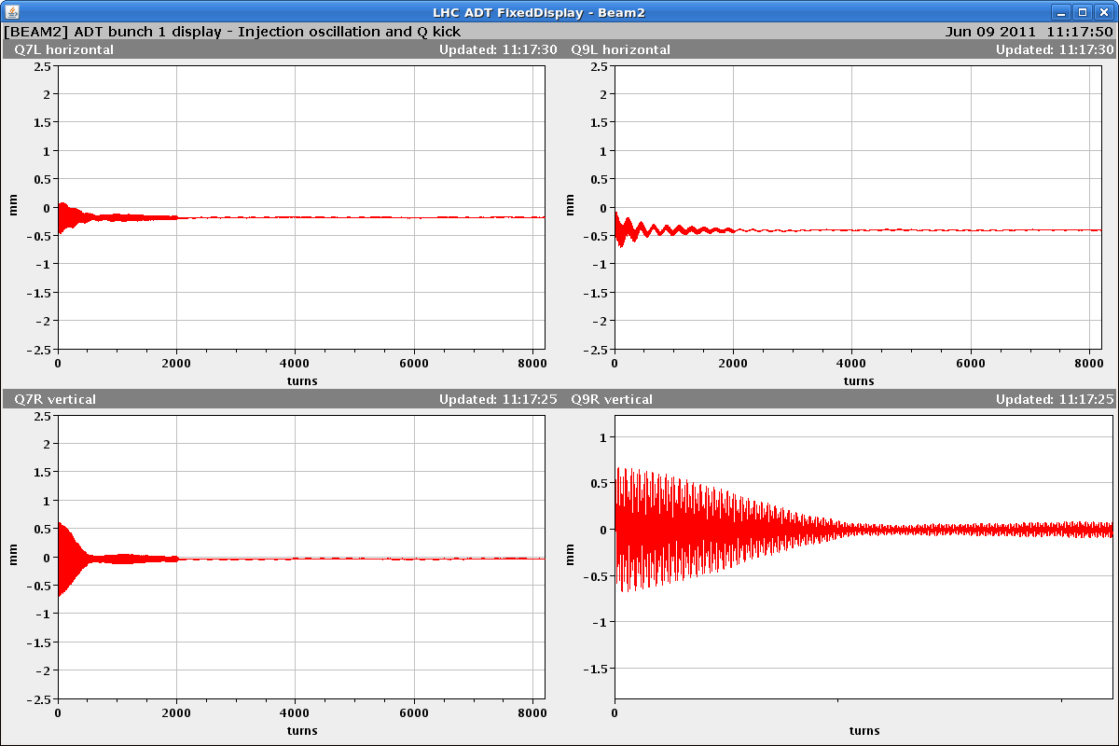
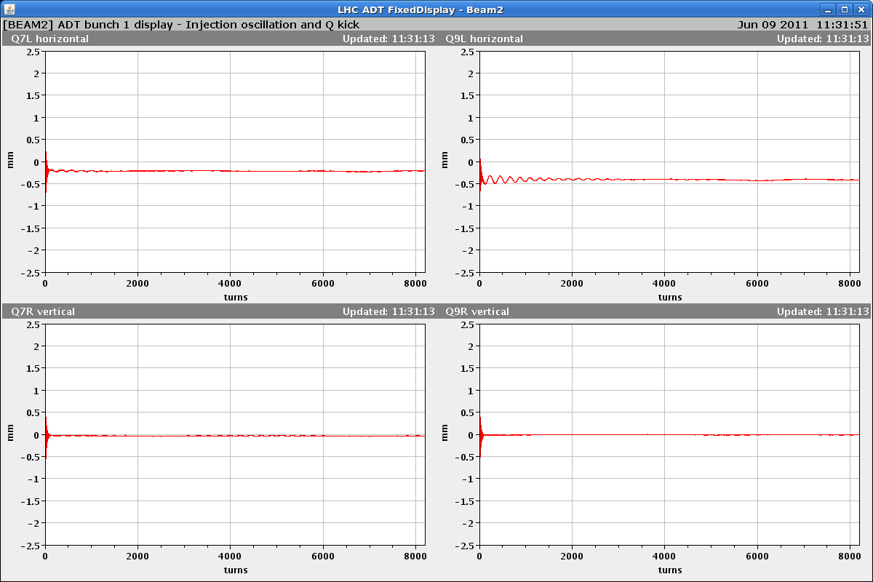
Beam 2
0 A
13 A
6.5 A
6.5 A
damper ON
horizontal
vertical
damper always switched on at turn 2000

Slide 20
Octupoles - observations
De-coherence time clear shorter with octupoles as expected
6.5 A in OF/OD decreases de-coherence time but leaves plenty of time for transverse damper to damp injection oscillations
Note presence of linear hyper stable beam core which doesn’t appear to filament.
Octupoles now on at injection and in first part of ramp
It works – 5 fills – no sign of blow-up

Slide 21
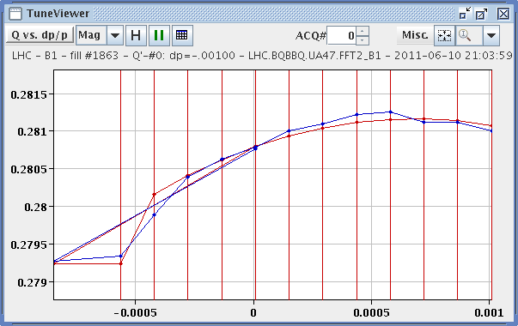
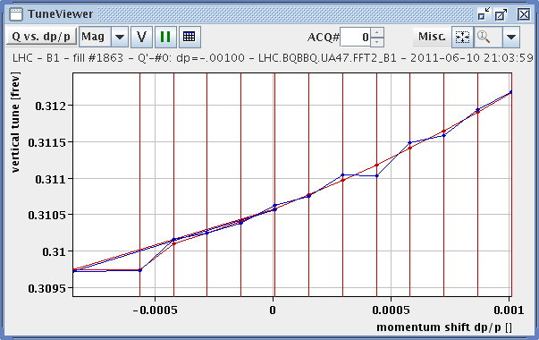
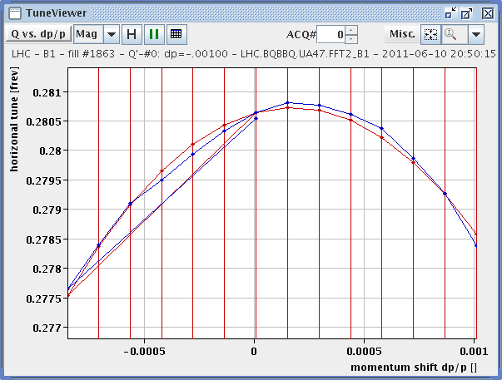
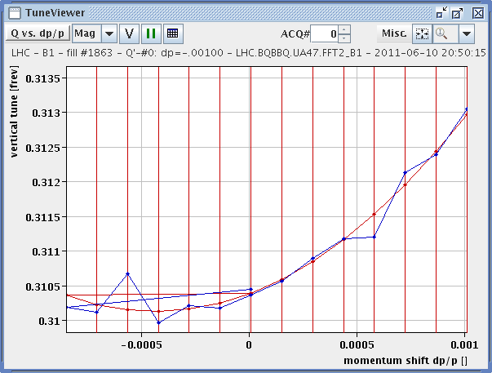
Non-linear chromaticity
F. Schmidt, R. Steinhagen, W. Holfe et al
Vertical – octupoles off
Horizontal – octupoles off
Vertical – octupoles on
Horizontal – octupoles on

Slide 22
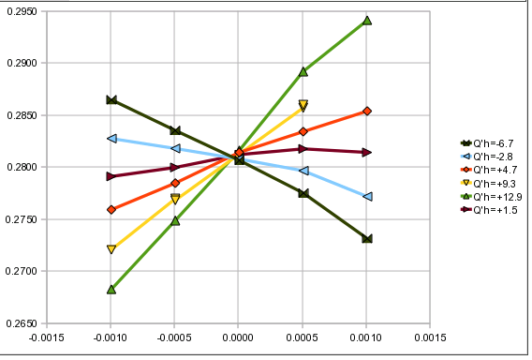
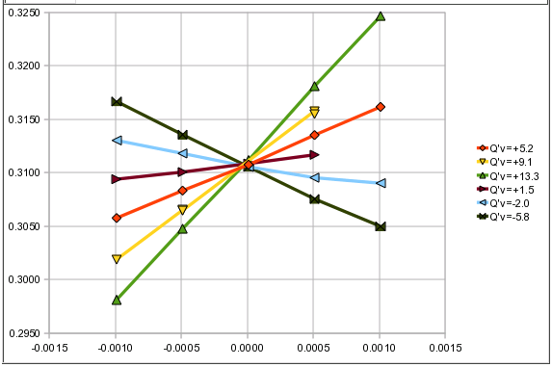
Central frequency measurement
Chromaticity measurements by varying RF frequency for different chromaticity settings
V
H
Q_{v}
Q_{H}
df
df

Slide 23
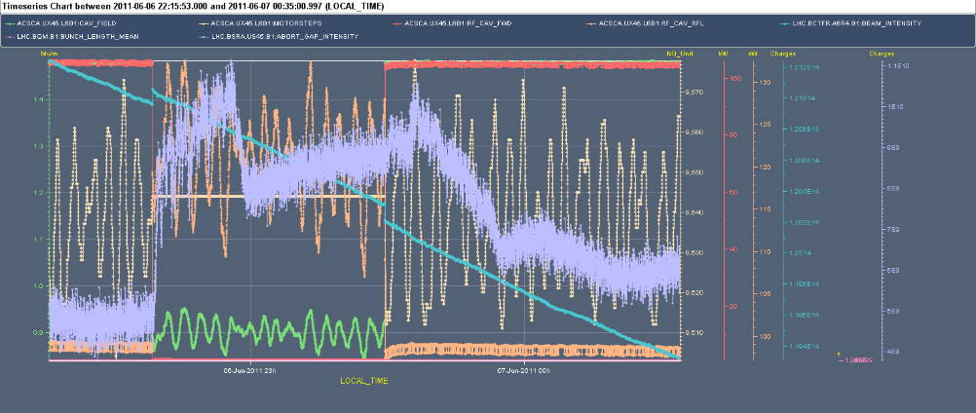
RF test: Switching off one cavity
Switching off cavity B1, followed by B2. Study reflected power and debunching
After ramp: B1 @ 1.2 ns, B2 @ 1.1 ns
For the RF transients, there is barely any difference compared to the measurement done with 912 bunches on May 28th at the beginning of the fill (0.9 MV and 115 kW). At the time we had almost the same total intensity (1.1E14).
The B1 abort gap increase was double that of B2, and this may be related to the lack of B2 longitudinal blow up during the ramp
Philippe B.

Slide 24
Incoming
rMPP have given go ahead for the next step in number of bunches but the restricted RF RF protection panel would like us to hold until the cavities are fully conditioned
Been holding steady at or around 1.2e11 protons per bunch – possibility to gently push bunch intensity.

Slide 25
