Slide 1
Tuesday
Fill lost #1855 at 7:28 due to the trip of RQX.R1. This was traced to a software bug in the FGC…
The Class 51 (LHC_PC) FGC software has been upgraded from V387 to V390. This new version has a patch for the two I_MEAS fault trips seen recently in operation (on Friday June 3rd, 13:00 and Tuesday June 7th, 07:28)
Pierre Dejoue, Quentin King

Slide 2
Tuesday morning
End of the ramp-down
fault on the TCL.5L1.B2, and had to call the STI piquet, who found a broken resolver. This was fixed in about half an hour.
QPS crate was lost and required an access before ramping. Abandon attempt to measure Q’ on flat bottom
Access was organized for 10 am
QPS (S12 and S56)
Experiments who had requested 2 hours.
Pending RB cable inspections in P4 and P2 done;
the new version of the FGC software deployed
MKD power supply for B2 replaced
new version of Post Mortem server has been released + tested
Re-deployed BQBBQLHC FESA process on all continuous and on-demand systems.
During the QPS access in P5 the patrol was lost in two access sectors due to a malfunctioning switch in the PAD.

Slide 3
Tuesday – early afternoon
The access team started to work on the PAD while the other interventions were still ongoing, their initial hypothesis was that the PAD door synchronization had to be retuned. Later on they found the faulty switch.
In the meanwhile the SPS announced that they would not be able to deliver beam between 1 and 2 pm due to a scheduled intervention of EDF.
It was then decided to postpone the replacement of the PAD switch, which required one hour, in order to try and inject 12 bunches for the test ramp with the new longitudinal blowup settings, before the intervention in the SPS.
Tried to close the machine, after the patrols. But there was a problem with the sirens in P2 (same as Sunday night), and TI had to call the piquets to fix it.
Also, another quench heater had discharged in S56, so we could not switch on the RB. At this point we called the access team back and let them repair the switch in parallel with the access for QPS. The intervention on the PAD dropped the patrol for the second time.
At the end of the shift the patrol is being re done, after that we should be ready to recycle the machine.

Slide 4
Tuesday afternoon
16:50 Pre-cycle started
17:00 problem with energy tracking on MKD power supply for B2 that was replaced this morning.
Back in to replace replaced beam dump power supply

Slide 5
Injection kicker temperatures
SoftStart with the MKIs at 54 degrees this morning. Mike Barnes analysed the data and the delays are fine.
For this reason we will increase the interlock temperature from 55 to 60 degrees.
Would be good to get a measurement with beam sometime - this would mean injecting a pilot in inject and dump for maybe 1 hour as soon as possible after the end of a long fill, and checking for any systematic on the injected trajectory.

Slide 6
Tuesday evening
20:15 Beam back
22:30 #1856 Stable beam
In the presence of a full blown German film crew…
Ratty old fill – just over 1e33
Some blow-up at 450 GeV but decided to go with anyway …
- B1 blow up in V on 2nd, 3rd, 5th 108b injection; - B2 blow up in V on 2nd, 4th and last 108b injection.

Slide 7
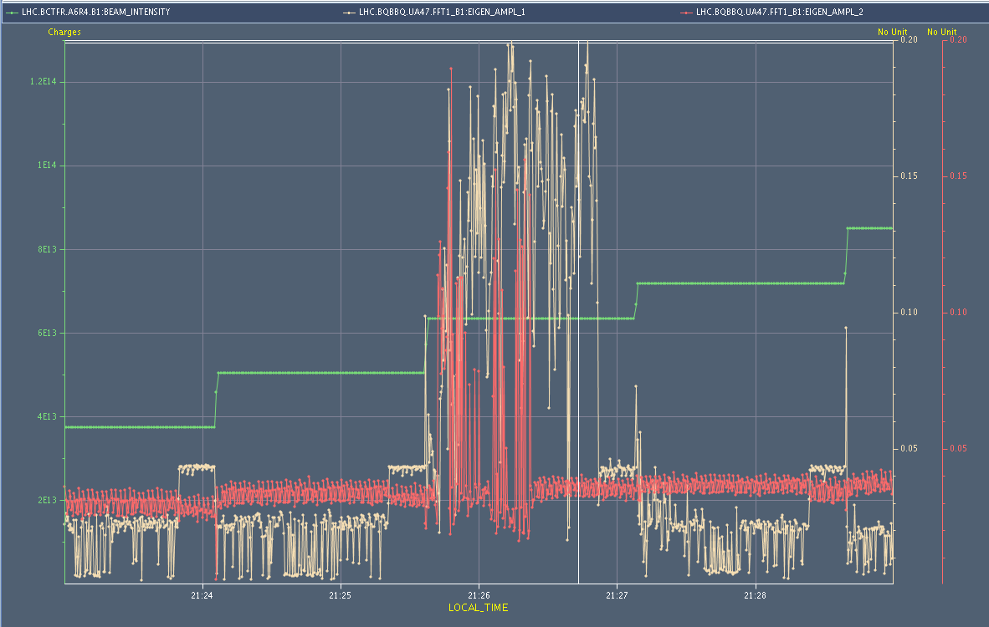
BBQ amplitude during injection
Clear visible on BSRT as well

Slide 8
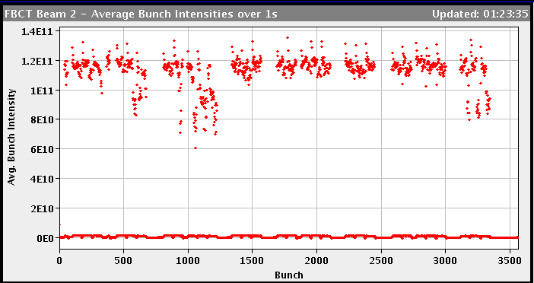
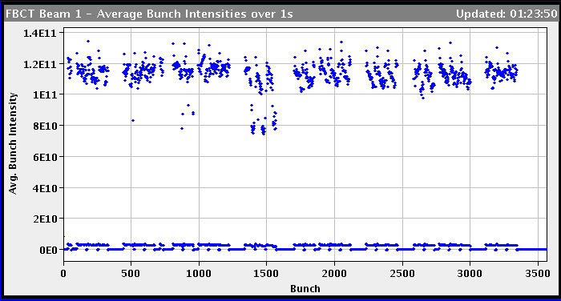
bunch intensities

Slide 9
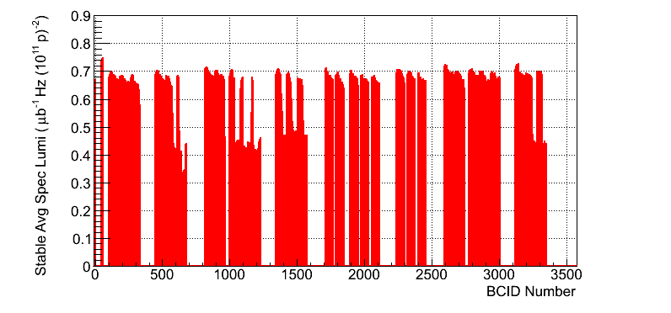
Specific luminosity

Slide 10
Incoming
Dump early afternoon
Test ramp for RF blow-up (12 nominal bunches)
Re-fill for physics
144 bunch injection
no 12 observation bunches
Outstanding
TCLs
Q’’
Q’ decay following long fill

