Slide 1
Friday day
00:51 Fill #1862 Beams lost to inner triplet skew quad power converter fault.
Delivered lumi 33 pb-1
Access required for repair RQSX3.L1 converter
Problem with QPS controller (old) MQ.24.R5
06:00 Pre-cycle
Access required - beam dump, adc card
Friday morning - access - cleaning list before long weekend
13:00 Injection - change LHCB polarity – no issue
14:35 Start Q'' measurement. Problem with the RF frequency program
16:30 Problem with SPS main power supply cooling
20:15 Pilot in for Q'' measurement, while waiting for SPS
22:15 SPS back

Slide 2
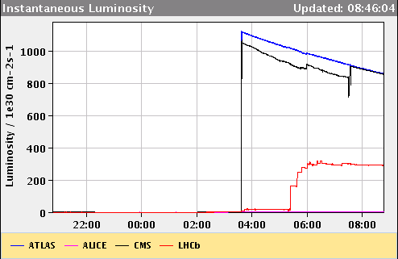
Friday night
22:15 SPS back, but RB.A81 trip due to a bridge cooling problem
Access required EPC and CV piquets
Dump resistors strange as well: call MP3 piquet
At the same tertiary collimators of IP1 & IP8 went into interlock
00:50 Cycling
01:40 Injecting
03:40 Stable beams fill #1863.
Initial lumi 1.1e33
“Optimise all” gave CMS an initial lower lumi, corrected at 7:30
Vacuum leak PS at bellow of wire scanner, will not be back until late afternoon…..

Slide 3
Access
- experiments (LHCb, ALICE and ATLAS) - BLM repair in TD62 - BI in UX451 for Schottky and filter on FBCT - RF team - LBDS for changing a card for MKB - QPS for a heater discharging in MB9L5
Parallel to foreseen EDF intervention affecting the SPS

Slide 4
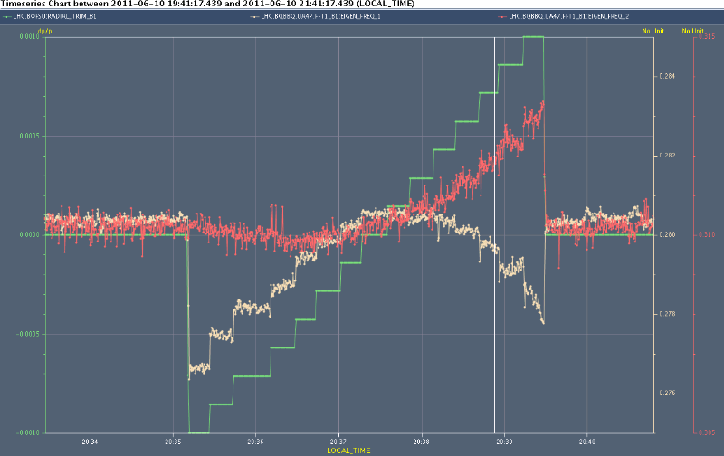
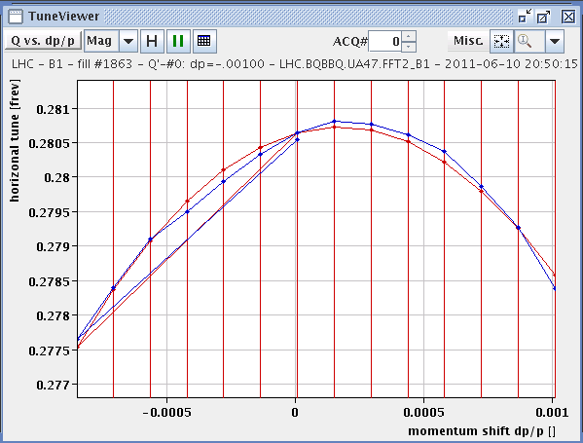
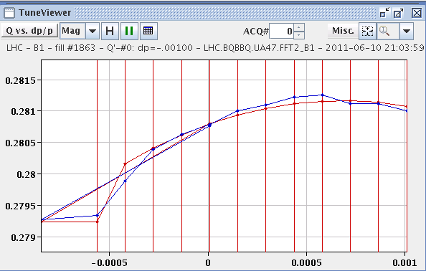
Q’’ - while waiting for SPS power converter problem(s) to be solved
With and without octupole at injection
Desired dp/p = 0.002; losses so reduce frequency swing
Oct on
Oct off

Slide 5
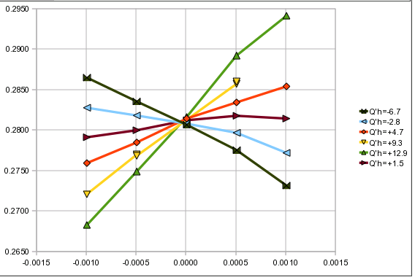
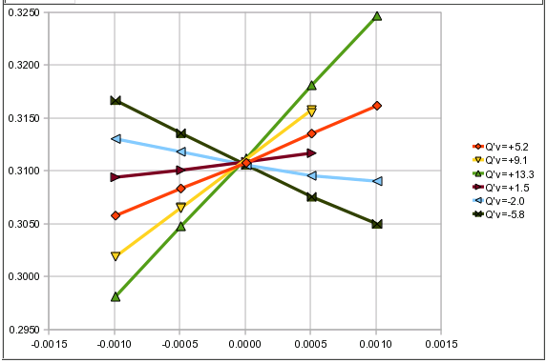
Central frequency measurement
Chromaticity measurements by varying RF frequency for different chromaticity settings
Cross at the central frequency
We are running at the central frequency
Q_{H}
Q_{v}
df
df
H
V

Slide 6
Plan
Physics 1092 x 1092 bunches, trains 144 bunches
If another good couple of fills: +144 bunches
rMPP approval procedure OK
Outstanding
End of fill: TCL adjustment
Q’ decay following long fill

