Slide 1
Monday 30.05.
01:00 Injection for physics fill #1816
02:00 Stable beams fill #1816, luminosity ~1.2x1033 cm-2s-1
11:08 Beams dumped. QPS trigger on detector of RCBXH2.L1.
Circuit detector stalled prior to the event (cause no clear but radiation not excluded even likely) and automatically RESET by watchdog.
The trip occurred during the RESET.
12:01 – 13:17 CMS access.
13:43 Injection of 2 nominal bunches per beam.
15:39 Beams in collisions, optics squeezed, RP at proposed physics settings.
15:43 Beams dumped when switching off the RF for asynchronous dump test. New SIS interlock on RF voltage was not masked.

Slide 2
Monday 30.05.
16:31 Injection of probe beam.
16:53 No further beam from PS.
Cannot do asynchronous dump test with probe beam (orbit effects).
Parasitic MD to approach integer resonance. Reached 0.03…
18:49 Beam back from PS.
19:32 Ramp with 2 nominal bunches.
20:10 Adjust mode. Squeeze done.
20:20 Beams dump FMCM: electrical glitch due to storm.
20:40 Another glitch: we tripped the RD34.LR3
21:41 Injection.
22:07 Ramp
22:58 Collision, squeeze done, RP’s in, RF off for debunching.
23:10 Asynchronous dump test.

Slide 3
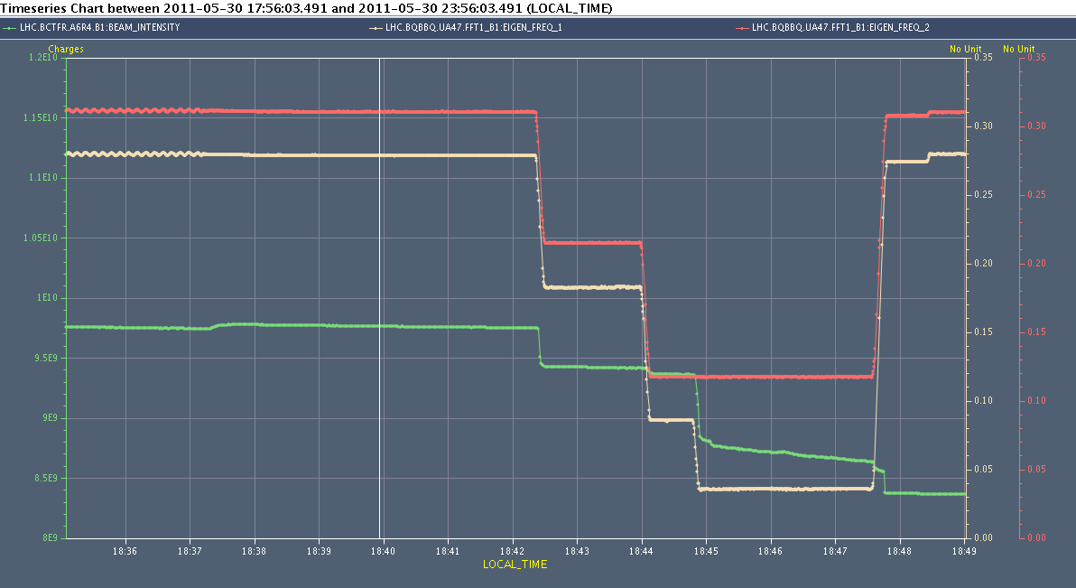
Parasitic MD: Integer Resonance
QV
QH
Beam Intensity
➔ Integer resonance is very narrow!

Slide 4
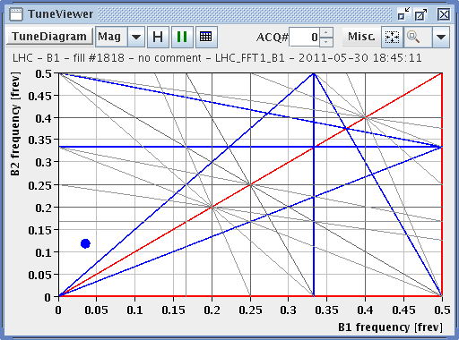
Parasitic MD: Integer Resonance

Slide 5
Parasitic MD: Integer Resonance

Slide 6
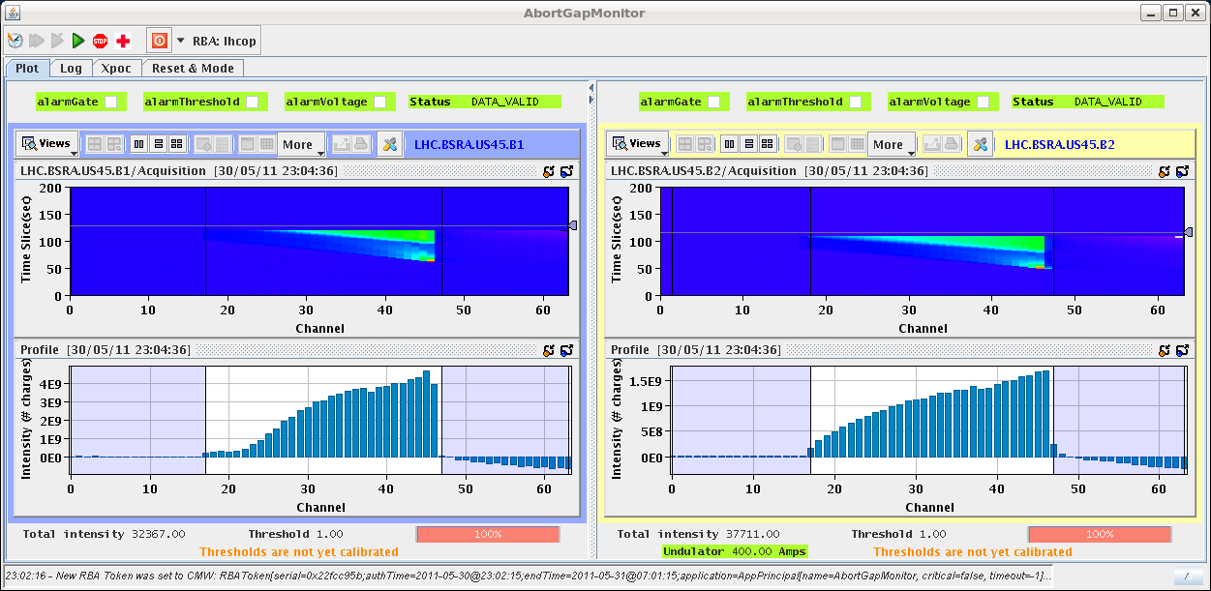
Abort Gap Population

Slide 7
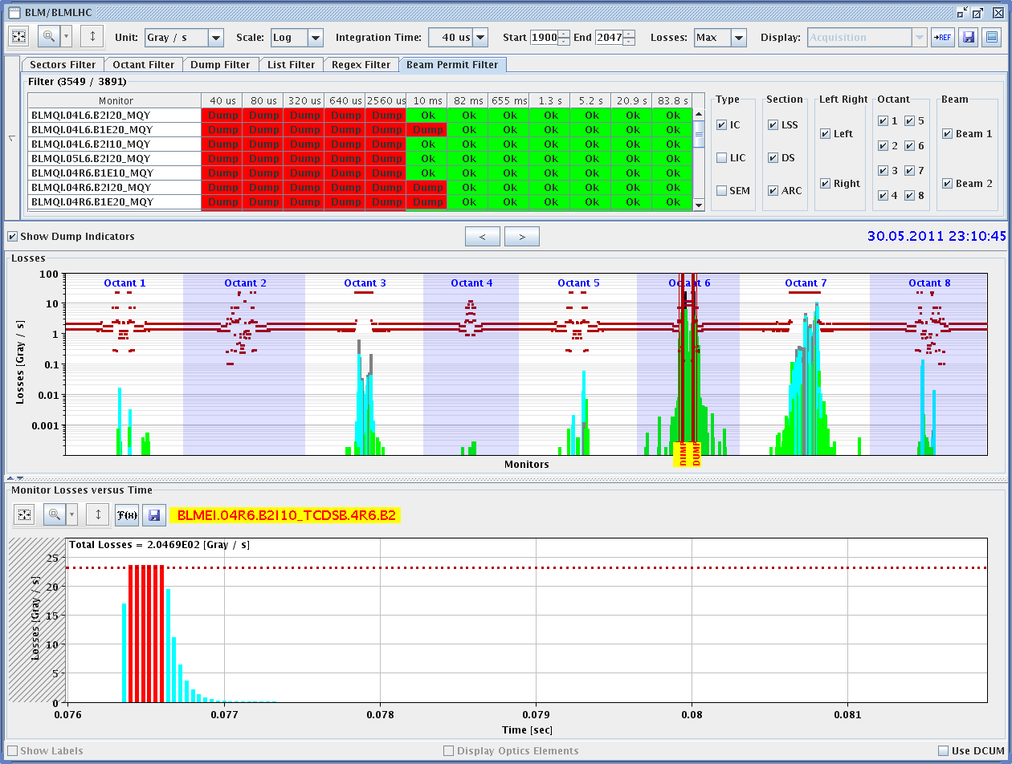
Losses: To be analyzed in detail…

Slide 8
Tuesday 31.05.
01:47 Injection
02:25 Emittance blowup. 450 GeV beams in LHC dumped. Booster optimizing.
03:36 Injection 1092b.
05:55 Stable beams #1822.
06:22 Beam dump. UFO.
07:16 Injection for physics fill, 1092b.

Slide 9
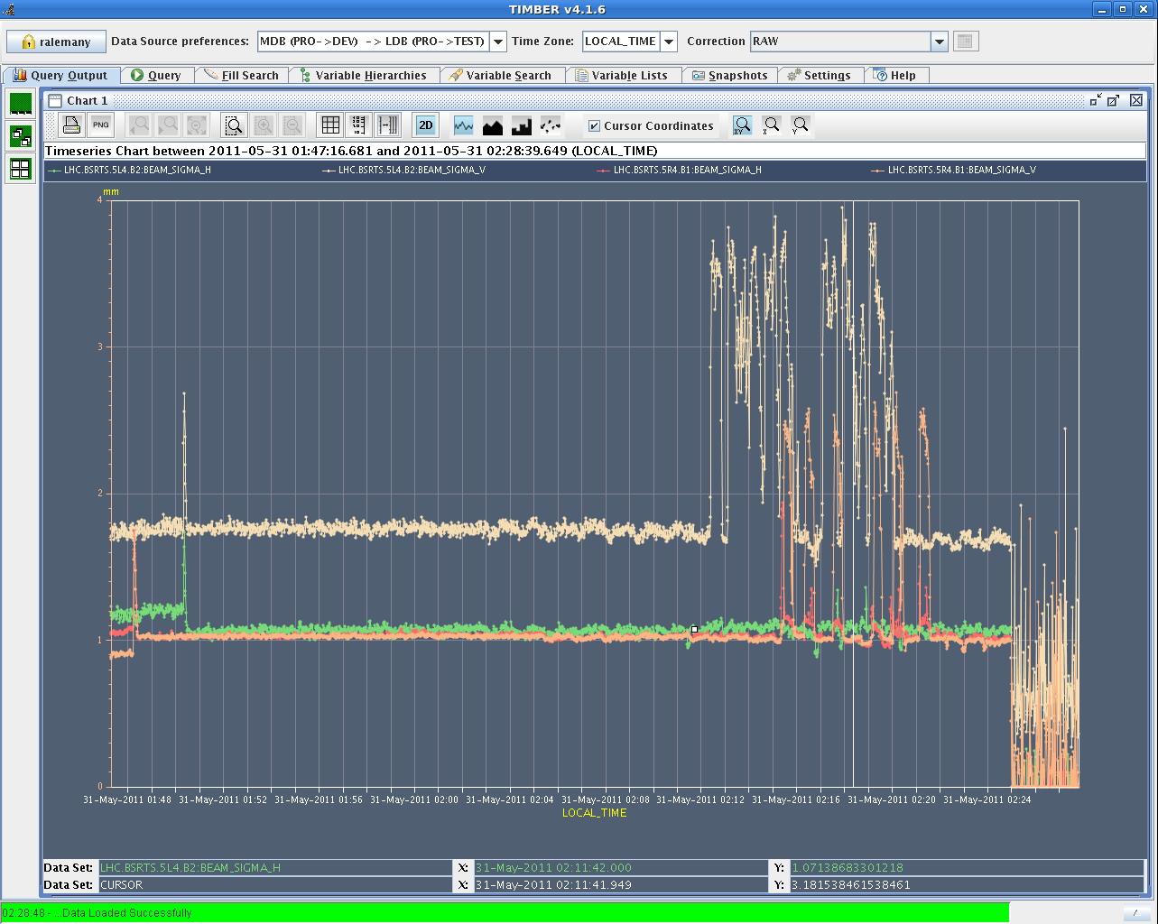
Emittance Blowup B1/B2 V
To be understood…
Real 100% emittance growth
or instrumental effect?

Slide 10
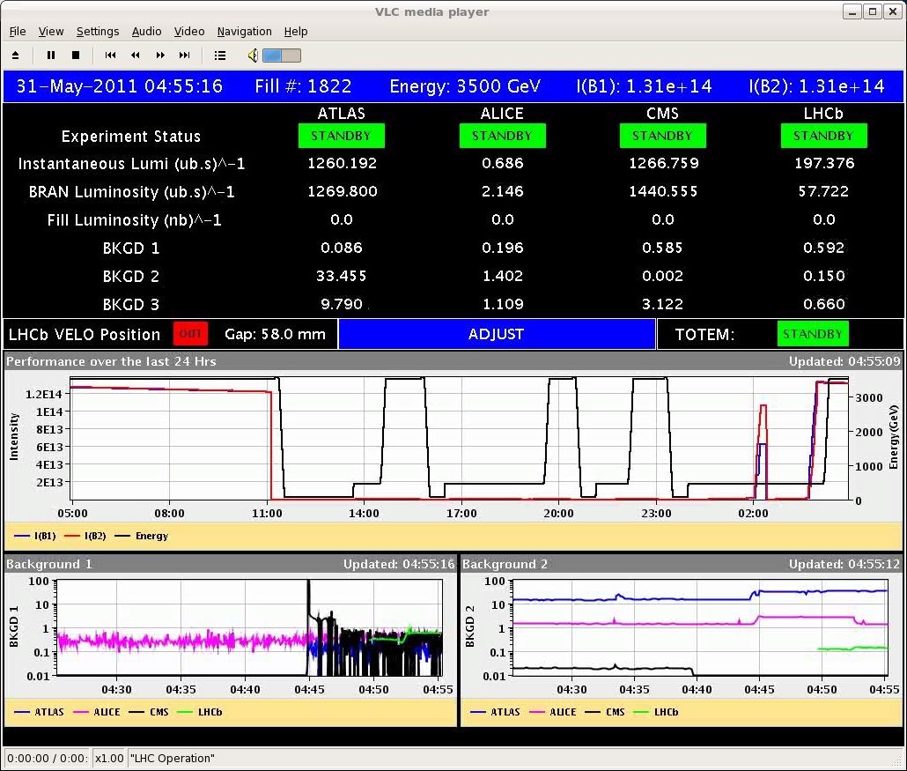
Physics 1092b

Slide 11
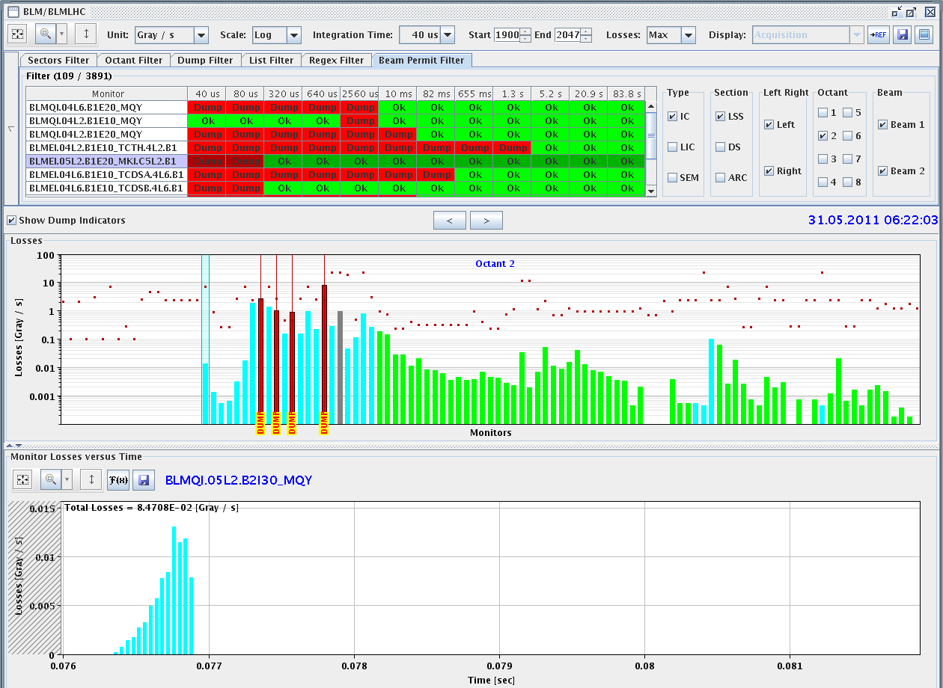
UFO: Q5 or IR2 injection kicker?

Slide 12
Incoming
Tuesday am | Physics with 1092 bunches per beam In shadow: SPS intervention End of fill: Move in physics debris collimators (TCL)
Tuesday pm | Test of 144b injection? Injectors being set up, then decide...
Tuesday night – Wednesday | Luminosity production
...
Goal of the week: Produce > 250 pb-1

