Slide 1
LHC Status Sat Morning 5-June
Bernhard Holzer, Ralph Assmann et al
Tentative Planning: Luminosity
Status & Overview:
Sat 00:00h recovering from Undulator trip
00:15h BEAM MODE > Injection Probe Beam
01:40h ramp, squeeze, lumi
07:56h Dump, QPS trigger
FIP communication fault on the RB.A12

Slide 2
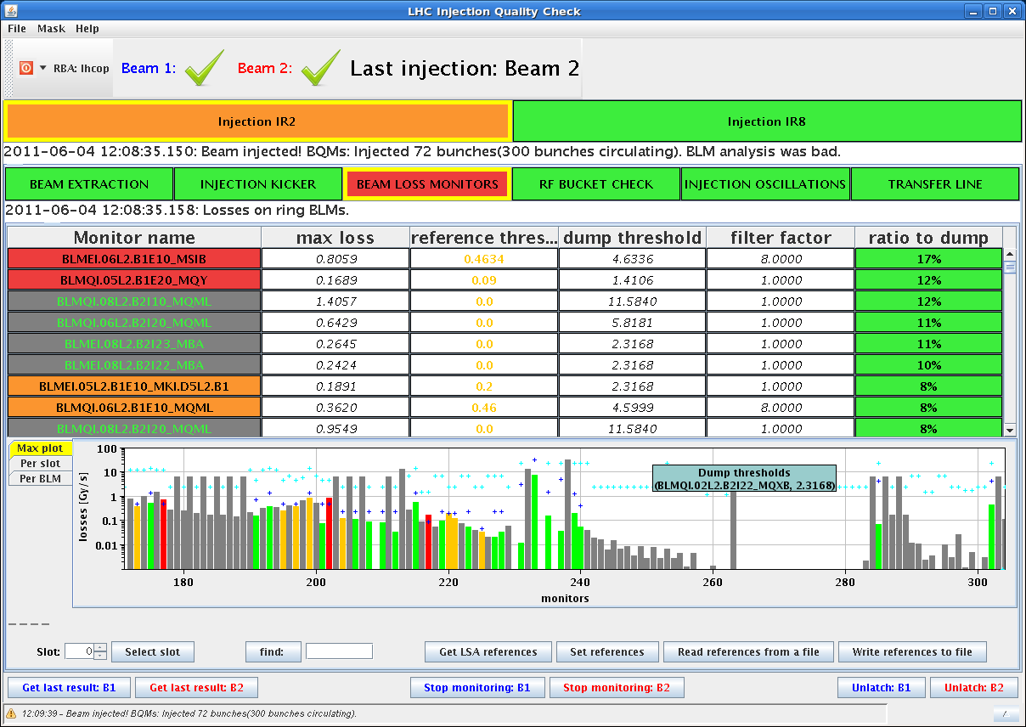
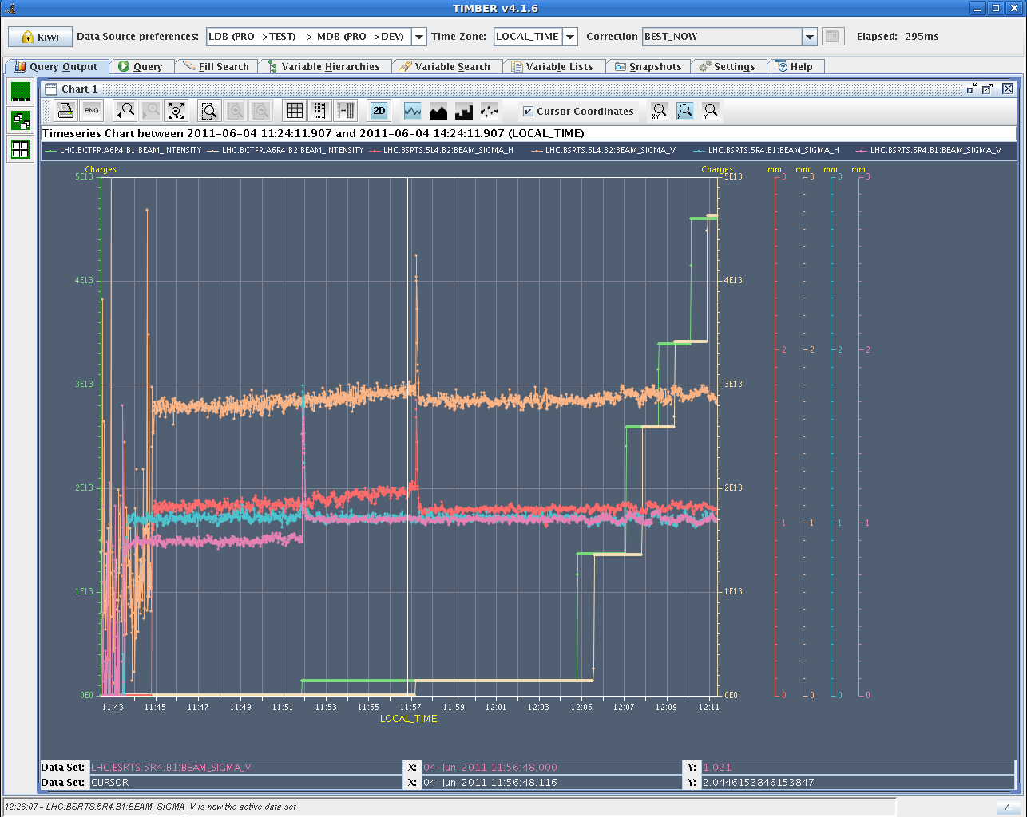
Sat morning
4. June
11:26h Injection for physics
... as decided: single bunch intensity
limited to ≈ 1.2*10¹¹
Emittances ok
beam 2 v
beam 2 h
beam 1 h
beam 1 v

Slide 3
Sat Morning
4. June
13:24h Ramp, Squeeze, Lumi
beam quality: One b2 108b injection suffered more than the rest.
That 7th injection had bunches blown up in V since
flat bottom.
intensities
emittance
!! it’s the same beam as on the last slide !!

Slide 4
Sat Afternoon
4. June
16:19h Dump, Power converter fault(s) RCBXV3.L1,
needs to be changed (aux power supply)
19:00h injection, ramp,
20:20h Dump, UFO, on the MKI in pt 2.
21:10h injection
22:44h ramp, squeeze, lumi, Collected 2.5 pb^-1.
Apparently the beams from the injectors had not been good quality. A funny orbit correction during the ramp had been introduced.

Slide 5
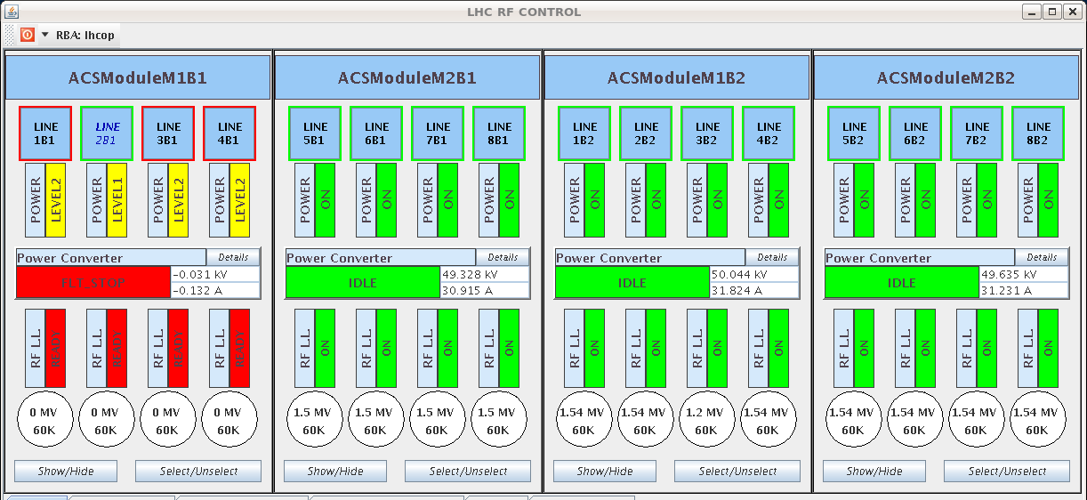
Sat Night / Sun Morning
5. June
00:15 h RF module M1B1 tripped.
Software interlock on voltage triggered.

Slide 6
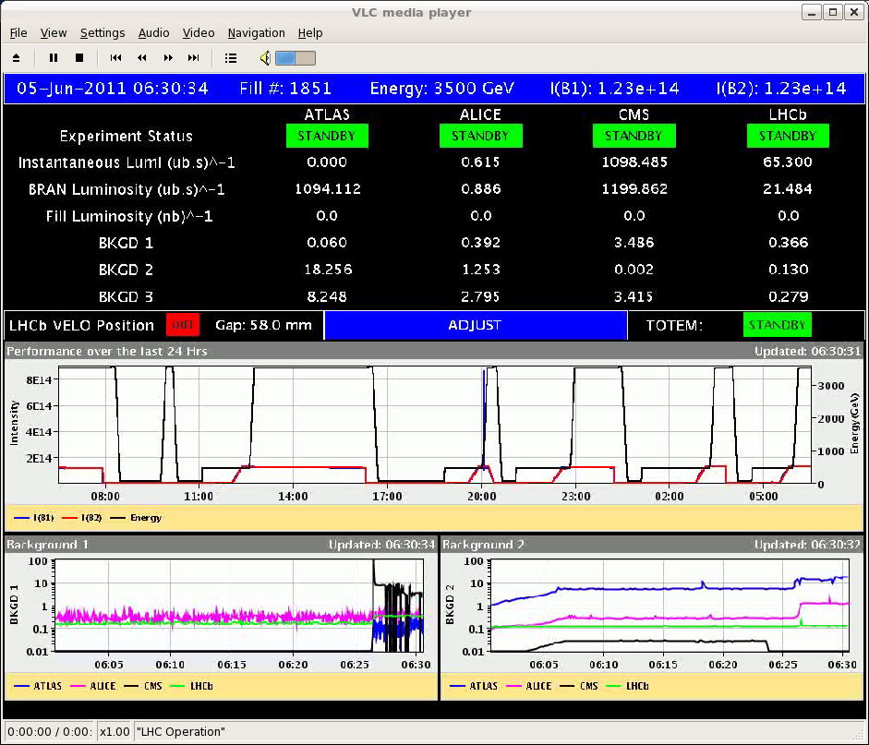
Sat Night / Sun Morning
5. June
01:43 h Injection, Ramp, Squeeze
03:48 h LHCb magnet tripped.
04:13 h Injection, Ramp, Squeeze, Lumi
06:56 h
UFO (Fast Beam Losses, at MKI point 2.)

Slide 7
Sat Night / Sun Morning
Shift summary:
....what a night.
*) Put fill 1848 into physics.
Lost it due to a trip of RF module M1B1 after
45minutes.
*) Put fill 1849 into collisions
and lost it before declaring stable beams due to an
unexplained trip of the LHCb dipole.
*) Brought fill 1851 into physics and lost if after 26
minutes in stable beams due to an UFO at the MKI at
point 2.

Slide 8
Overview
5. June
Ufo
MKI pt 2
LHCb
QPS,
RB12
RF trip
Ufo
Power Converter

Slide 9
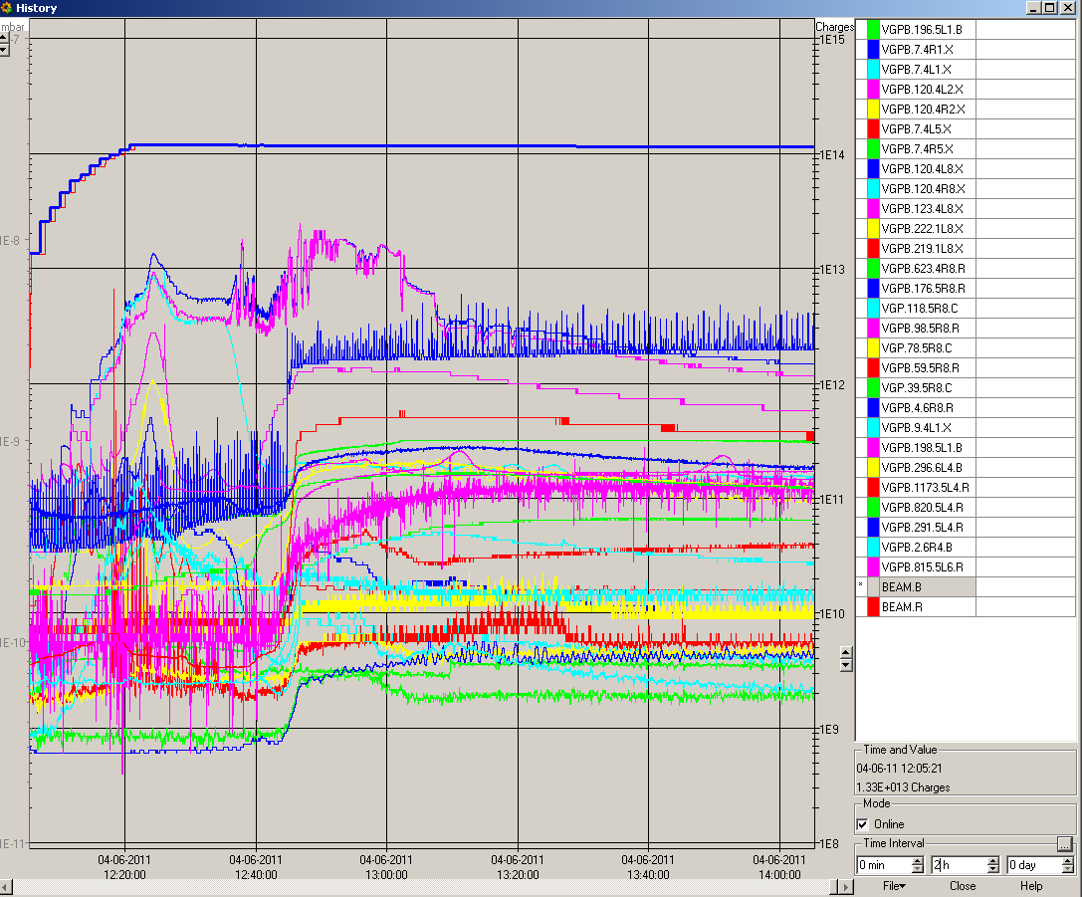
Miscealeanous:
4. June
RQ6.L7B1 tripped during pre cycle
Coupler calibration for Q=80k: Have calibrated couplers 3B1,4B1,6B1,8B1 to operate at Q=80k in the future...For this value of Q we need 78 kW for 1.5 MV.
Still to be calibrated: 3B2 and 4B2
Vacuum at Injection: (11:26h )
looks much better now

Slide 10
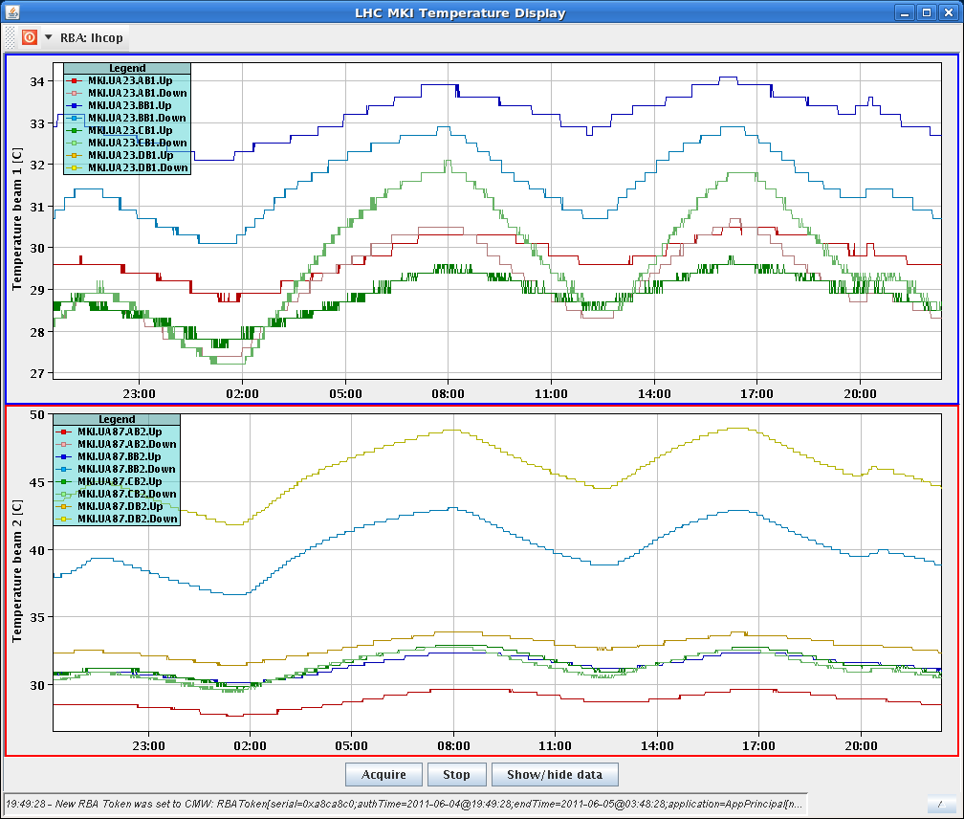
Miscealeanous:
Temperature Injection Kickers
34 ⁰
50 ⁰
Increased 4 monitoring factors for BLMs at the MKIs by a factor of two to help the UFO dumps
An access request was lodged by LHCb. They need 3 hrs access

