Slide 1
LHC Status Fri Morning 3-June
Bernhard Holzer, Ralph Assmann et al
Tentative Planning
Luminosity
Goal: Produce > 250 pb-1 in one week (- 9 min)

Slide 2
Wed Night / Thu Morning
2. June
00:31h BEAM MODE > Injection Probe Beam
02:03h BEAM MODE changed to STABLE BEAMS, Luminosity
15 hours run

Slide 3
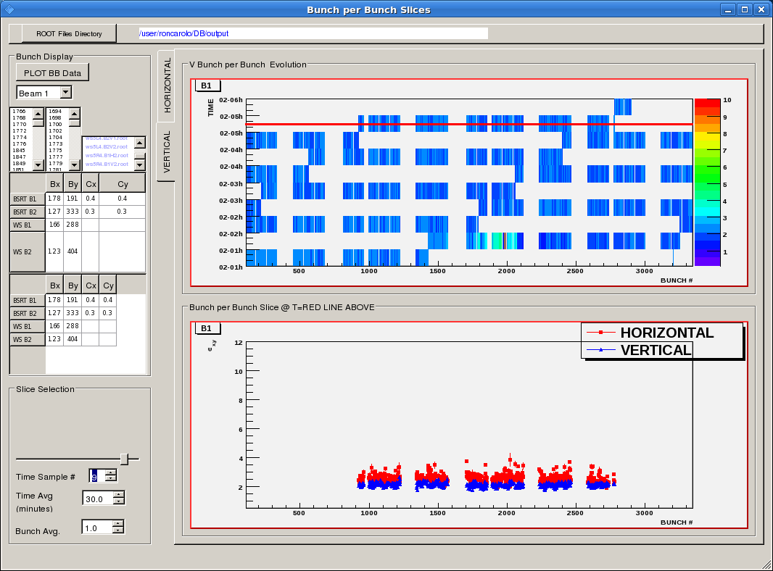
Thu morning
2. June
05:00h Emittances during the fill ... comme il faut !

Slide 4
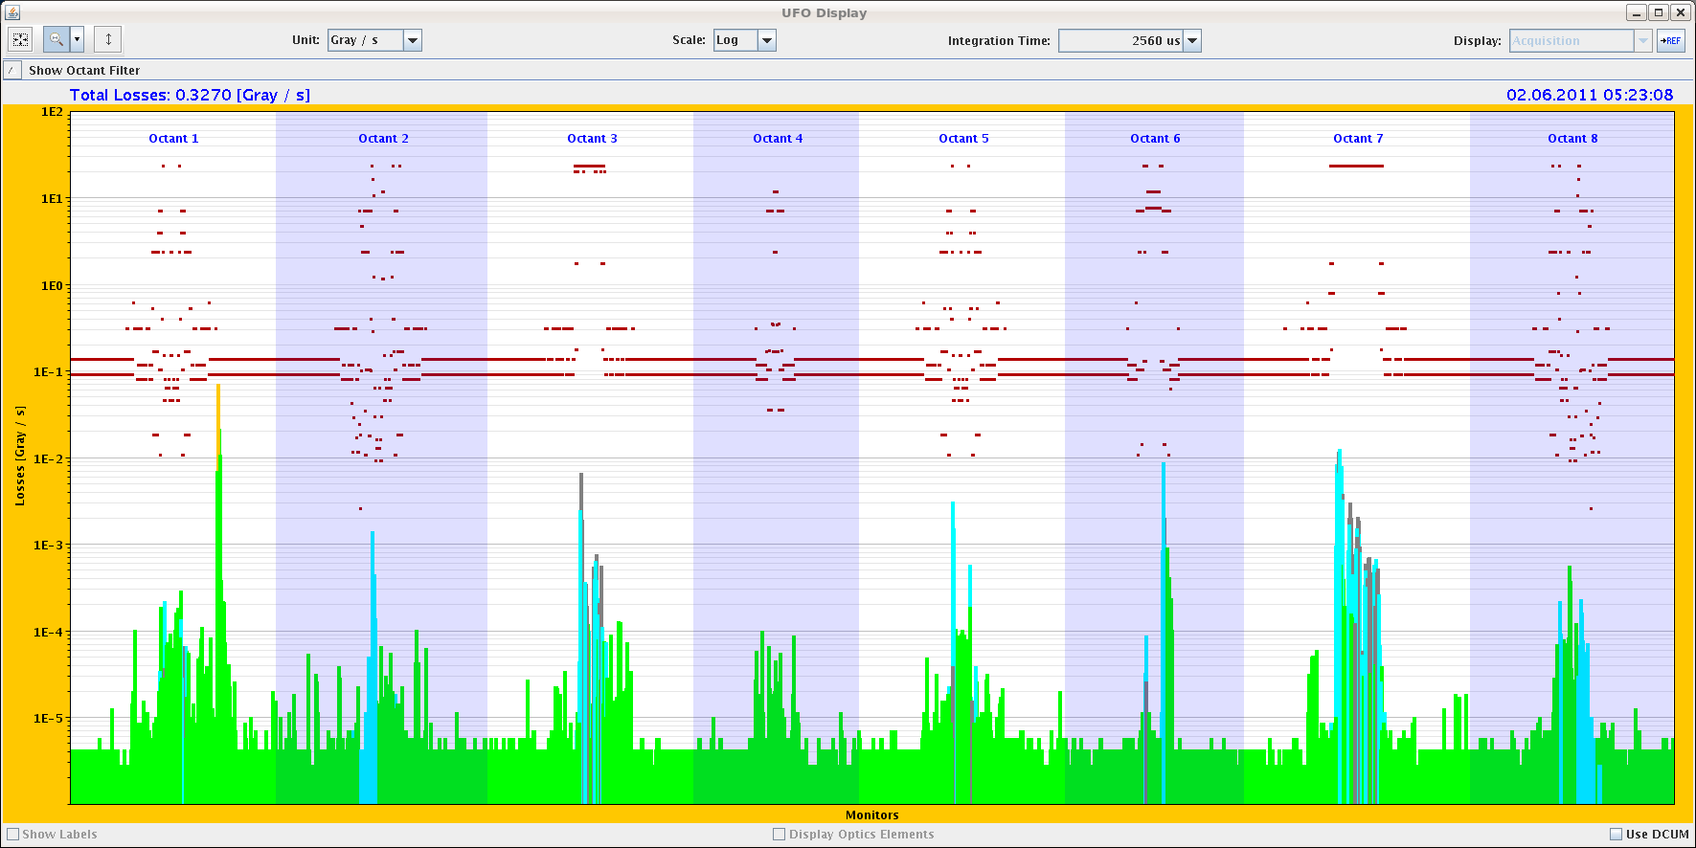
Thu Morning
2. June
06:52h
UFO at ~50%!

Slide 5
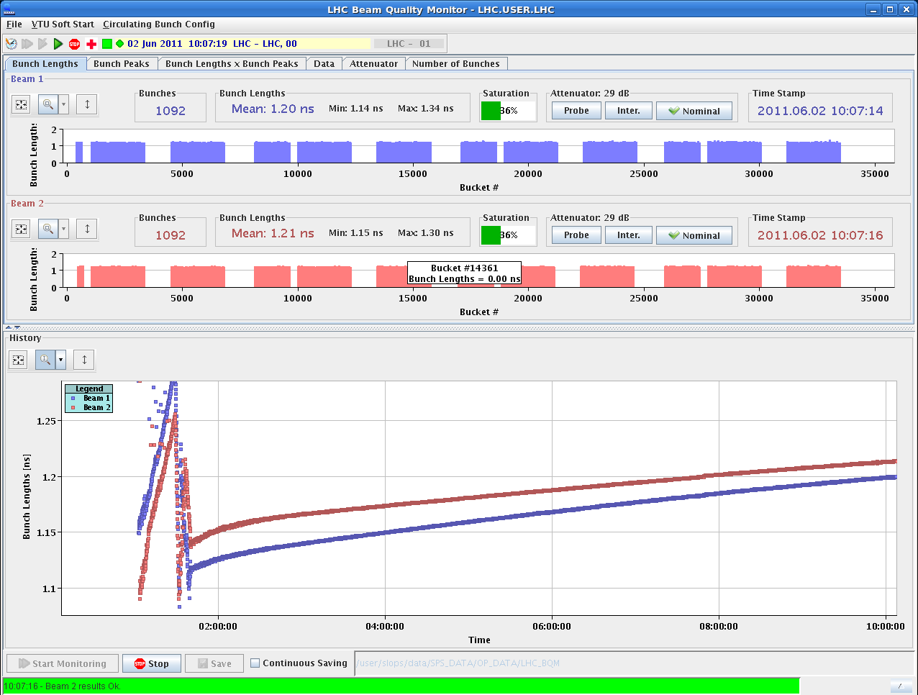
Thu Morning
2. June
10:04h Bunch length observations: Blow-Up during ramp:
end-up with 1.12 ns B1 and 1.15 ns B2
Bunch lengthening during Physics: ~8 ps/hour OK
1.2 ns
1.15 ns

Slide 6
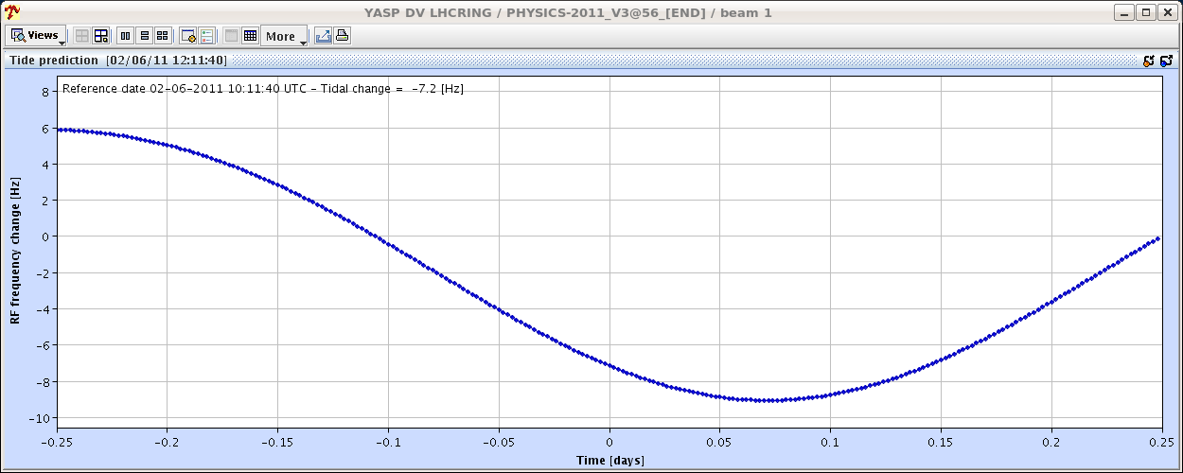
Thu Morning
2. June
For the fun of it ...
15:00 h Shift Summary
Did few orbit corrections (mostly to follow the tides)
and lumi scans.

Slide 7
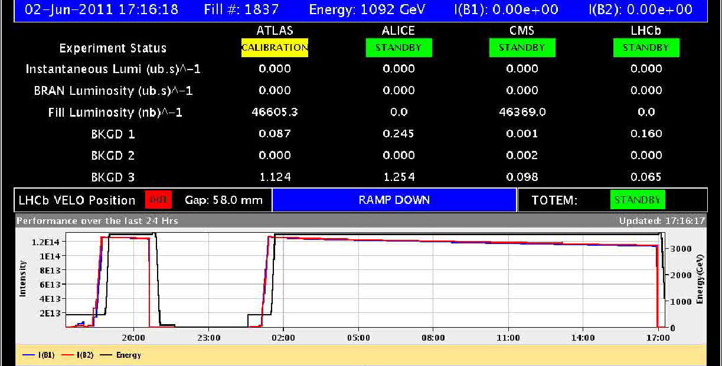
Thu Late
2. June
17:00 h integrated Luminosity in this run: 46 pb ⁻¹
Shift Summary: Dumped fill 1837 after about 15 h of stable beams......and should not have dumped it.

Slide 8
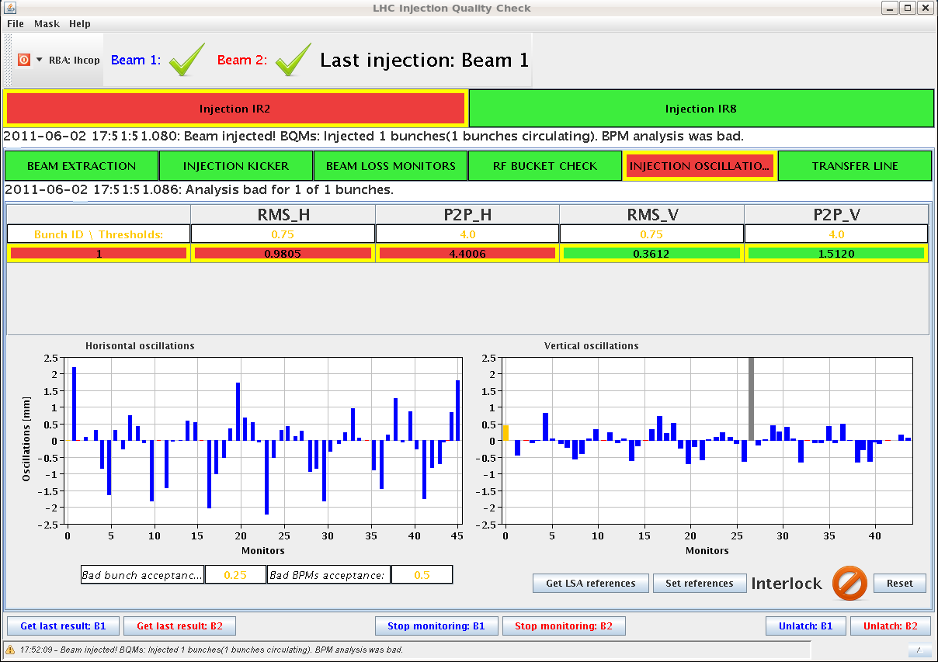
Thu Late
2. June
17:50 h INJECTION PHYSICS BEAM
... a bit problematic this time
bad orbit in the LHC
find negative chroma at start injection.
2mm ---
-2mm ---

Slide 9
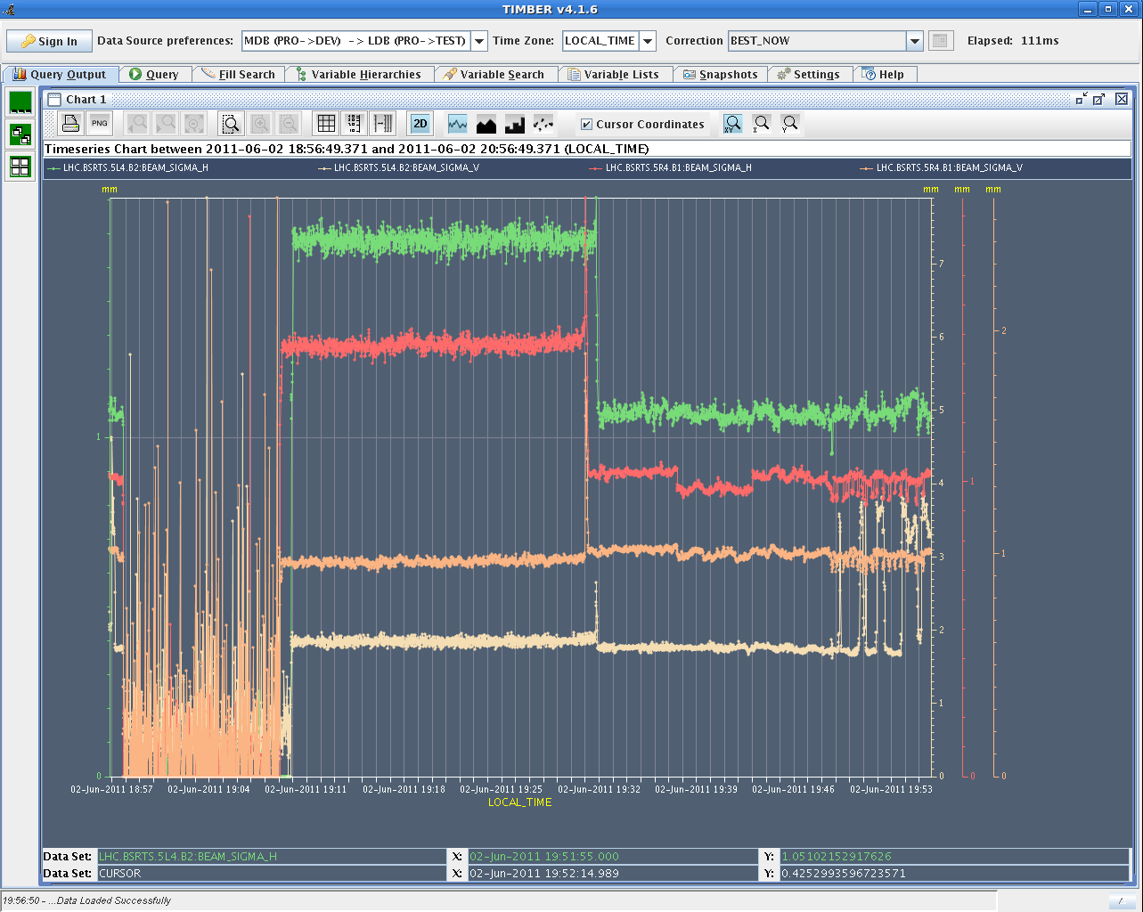
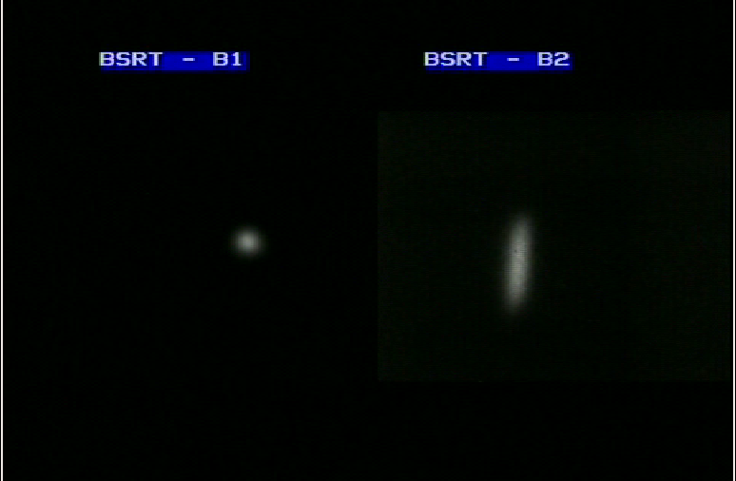
Thu Late
2. June
18:50 h We lost all of a sudden lots on a couple of bunches...
dump & refill
19:50 h ...we are again
blown up - beam 2 V
beam 2 h
beam 1 h
beam 1 v
beam 2 v
dump & refill

Slide 10
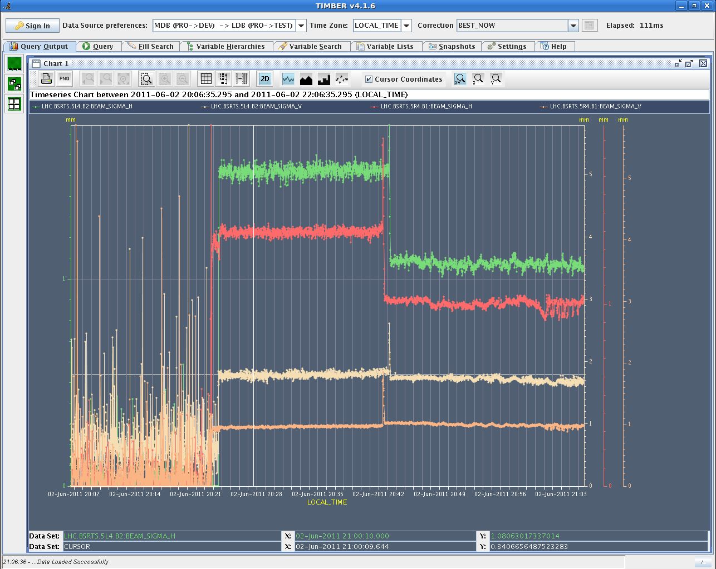
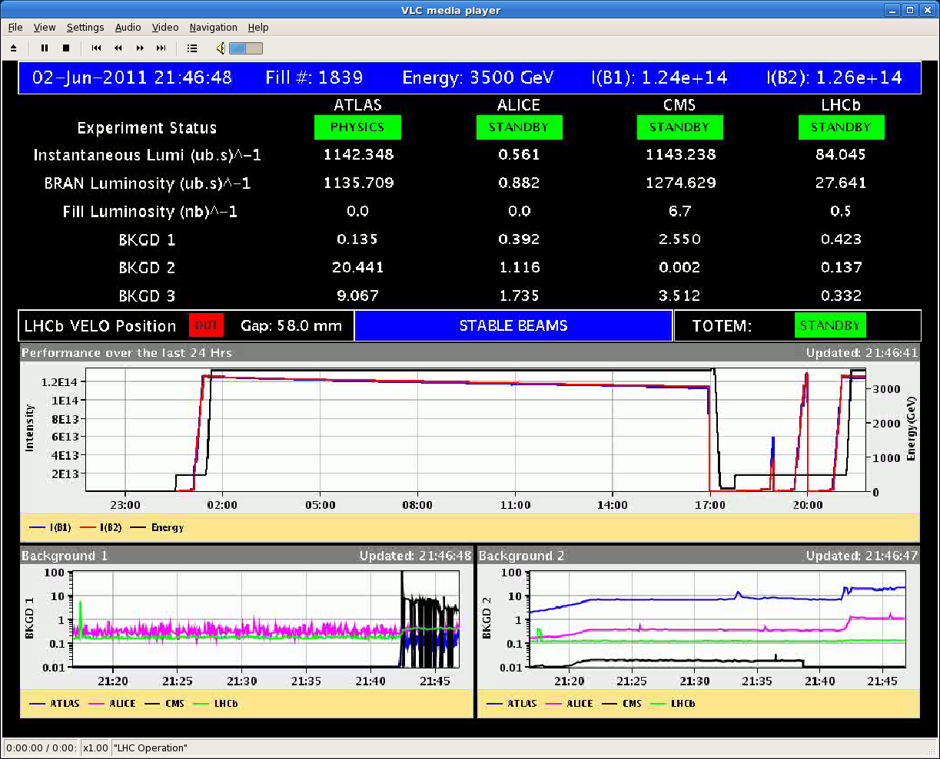
Thu Late
2. June
21:06 h new injection, ramp,
squeeze,
21:40 h luminosity
bunch emittances ok now
21:46 h Dump: LHCb triggered. We detected a UFO in the triplet before the dump time.
Length of lumi fill = 4 minutes

Slide 11
Thu Night
2.-3. June
23:06 h new injection, ramp,
squeeze, ...
00:28 h QPS trigger RQTF.A23B2, dump
could it be a problem of u_RES passing the
threshold. To be confirmed...
01:17 h ...no beam from booster
04:05 h new injection
nicely distributed
bunch intensities
05:55 h lumi

Slide 12
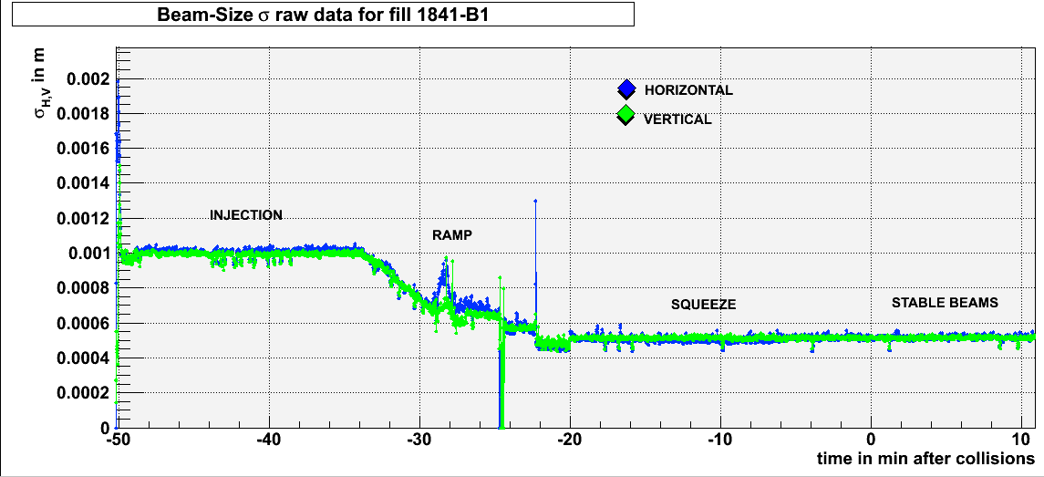
Thu Night / Fri Morning
2-3.. June
Beam size evolution (as given by BSRT w/o correction)
last 24 hours:
scheduled dump
dump: ufo
lumi
beam losses
at injection
dump: qps

