Slide 1
LHC Status Mon Morning 23-Mai
Bernhard Holzer, Gianluigi Arduini et al
Tentative Planning
Fri | set up for 768 x 768 bunches: quality of 108 bunch train transfer test IP6 BPM’s ramp, squeeze, lumi with 768 x 768 out of 108 trains
Sat | injection 912 x 912 and lumi
Sun | injection 912 x 912 and lumi

Slide 2
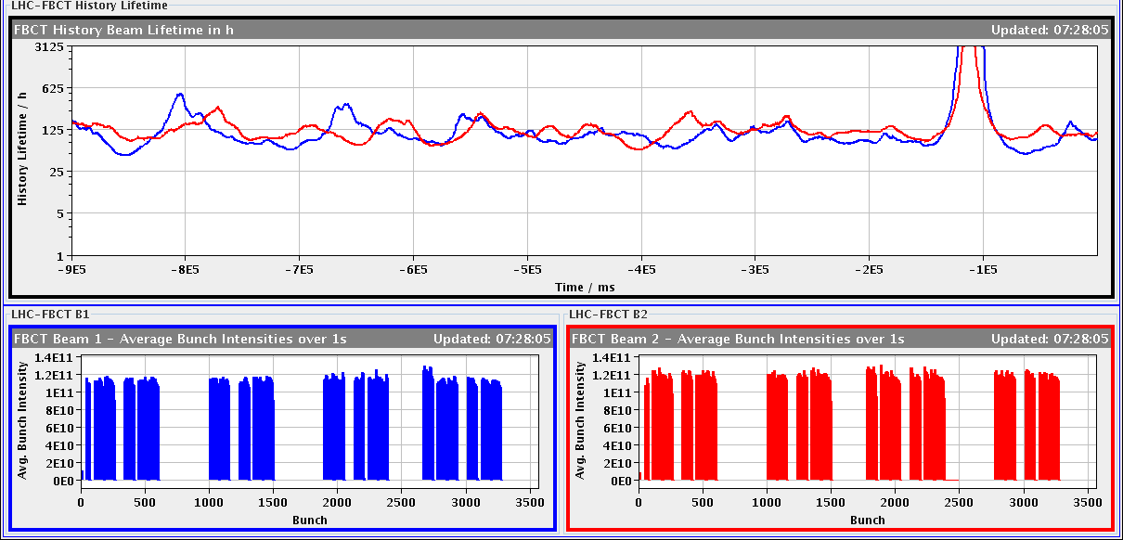
Fri morning
07:43h stable beam since 8 hours dump, 768 x 768 out of 72 trains
07:44h beam dump, cryogenics conditions lost for arc in S81
- beams dumped, problem with arc-DFB valves
09:09h cryogenics need an access
The cryogenics loss in S81 was very likely produced by a
single event upset.

Slide 3
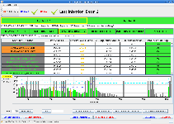
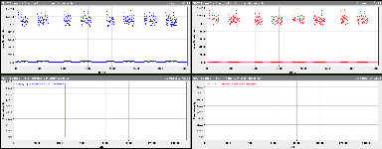
Fri morning
12:48h injection probe, dedicated dump of both probes together for XPOC checks. Check of new XPOC release OK. New release should avoid the filling pattern errors seen since the last Technicial Stop, to be confiremd by the dumps over the coming days.
13:00h injection physics beam,
check injection conditions
72b - injection looks good
108b -injection looks good
(... considerable scraping in SPS)
14:00h machine full (768 x 768)
IP6-BPM interlock test by
Jan Beams dumped by
changing the threshold on
the interlocked BPMS at
point 6 for Machine
Protection Test.

Slide 4
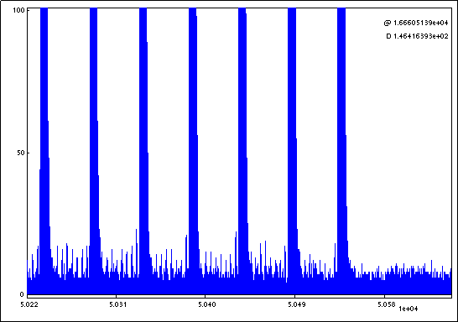
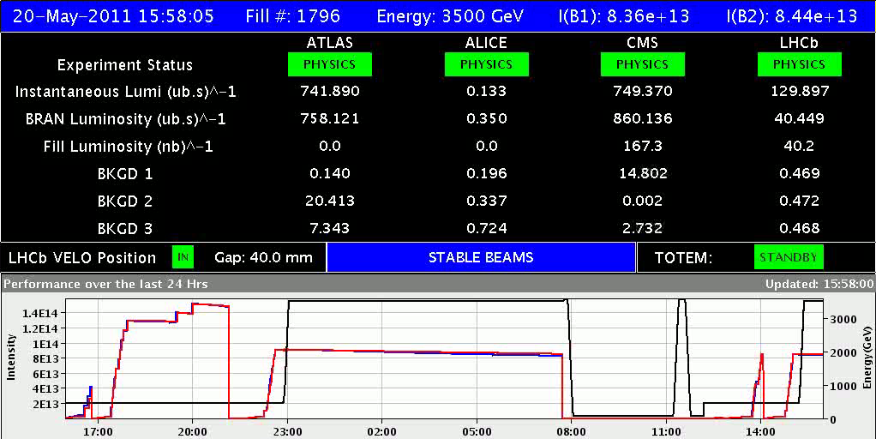
Fri Late
14:30h
injecting for PHYSICS 768 x 768 out of 108 trains
Few satellites inside the train. Less than 0.5%. No substantial satellites following the train
15:52h ramp, squeeze, lumi

Slide 5
Fri Late
16:46h
Beam Dump, Dump Classification: QPS trigger
Lost sector 81 and CS AR81,
Q10.L1 quenched, according to cryo.
no particular losses detected –
There was a weird oscillation and the U_RES exceeded
the threshold...
the cause for the noise at 16:44 is not fully
understood.
20:16h
22:30h start precycle
01:30h uuups
too many bunches in the filling scheme!!!!
We did a refresh list and after reloading THE SAME
filling scheme that was loaded previously
the right filling scheme appeared

Slide 6
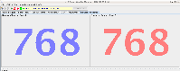
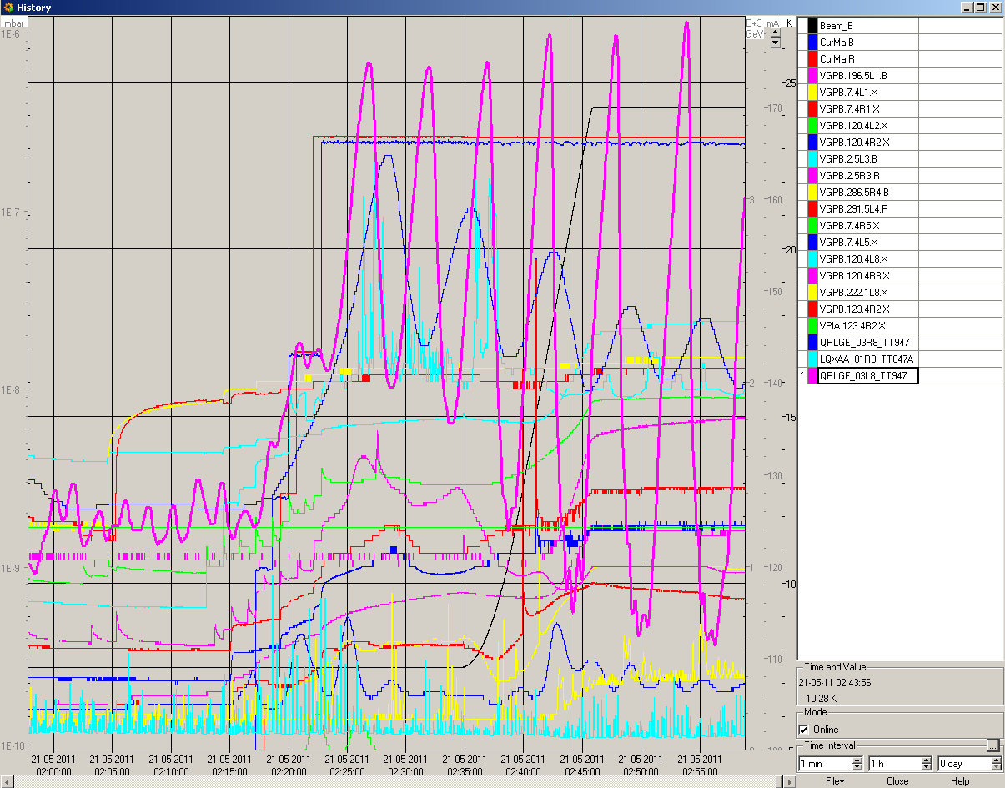
Fri night / Sat morning
02:25h dump, refill for physics
02:58h vacuum activity during
ramp and squeeze
beam screen temperature)

Slide 7
Fri night / Sat morning
03:08h luminosity
history:
interlock test
wrong fill pattern
“quench” q10.l1
lumi
cryo lost in S81
Tentative Planning 15 hours stable beams in 768 x 768
go to 912 x 912 out of 108 trains
MPP ... ??

Slide 8
Sat 21/5 (Gianluigi slides)
12:00 End of STABLE BEAMS 1798: 18.8 pb-1 in 9 h
12:00-14:00: RF tests – study of transient during klystron switch off
14:00-18:00: ramp down and access for ATLAS and QPS controller reset.
OK from rMPP to go ahead with 912 bunches
20:34 STABLE BEAMS #1799 - 912 bunches/train - Initial luminosity 8.5x10³² cm⁻²s^{-1.} More than 10¹⁴ p/beam in collision
07:00 Beam dump: end of STABLE BEAMS #1799: 25 pb⁻¹. Record integrated luminosity in 24 hours: 33.33 pb⁻¹

Slide 9
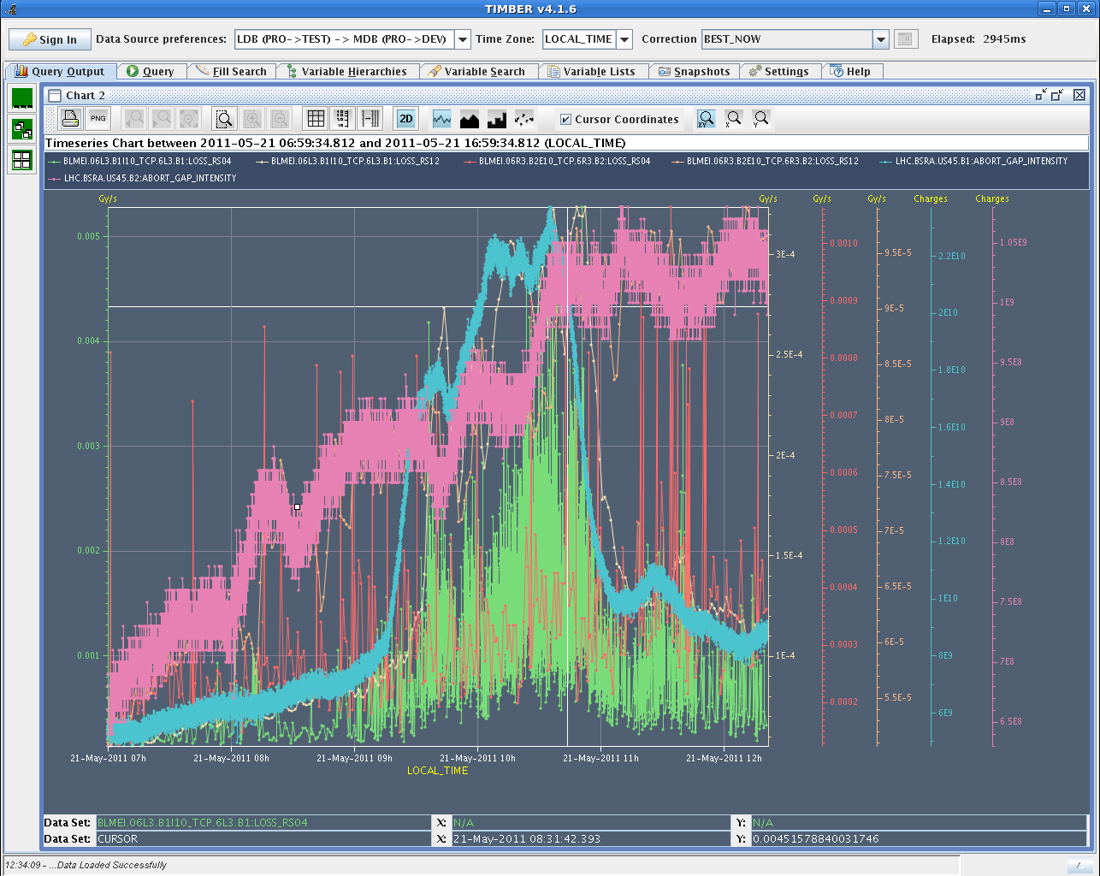
Abort gap population during fill 1798Sat 21/5 (Gianluigi slides)
for B1, there has been a 2h long period (9:00-11:00) during which some unexplained debunching took place.
No correlation with RF activity or others. We will monitor next fills.
Calibration for B1 and B2 abort gap population data to be verified

Slide 10
Transients at RF OFF on 1 klystron (P. Badrenghien)
RFOFF on one cavity per beam, with 768b (8.3E13) at 3.5 TeV, after a long physics period (Fill 1798). Bunch length ~ 1.25 ns before RF OFF. Cavity Q=60k. Beam induced voltage is measured at 0.6-0.65 MV in the cavity (1B1 and 1B2) The CW power extracted from the beam thru interaction with the idling cavity is measured at 65-70 kW. However, at the exact time of RF OFF, we observe a short (10 microsec long) peak in RF power measured around 700 kW on 1B1. This peak was expected. Transient acquisition on 1B2 is not usable. Extrapolating to 912b we would expect 0.8 MV and 100 kW CW for an idling cavity. That is no problem. The few microsec long power spike will almost reach 1 MW. The theory is that the spike does not last long enough to cause damage... That will be re-evaluated by the LHC RF team on Monday.

Slide 11
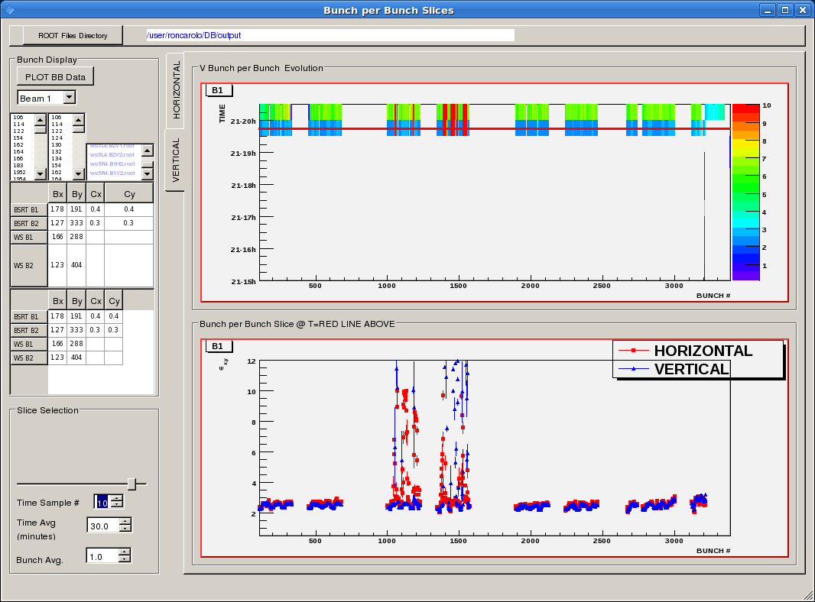
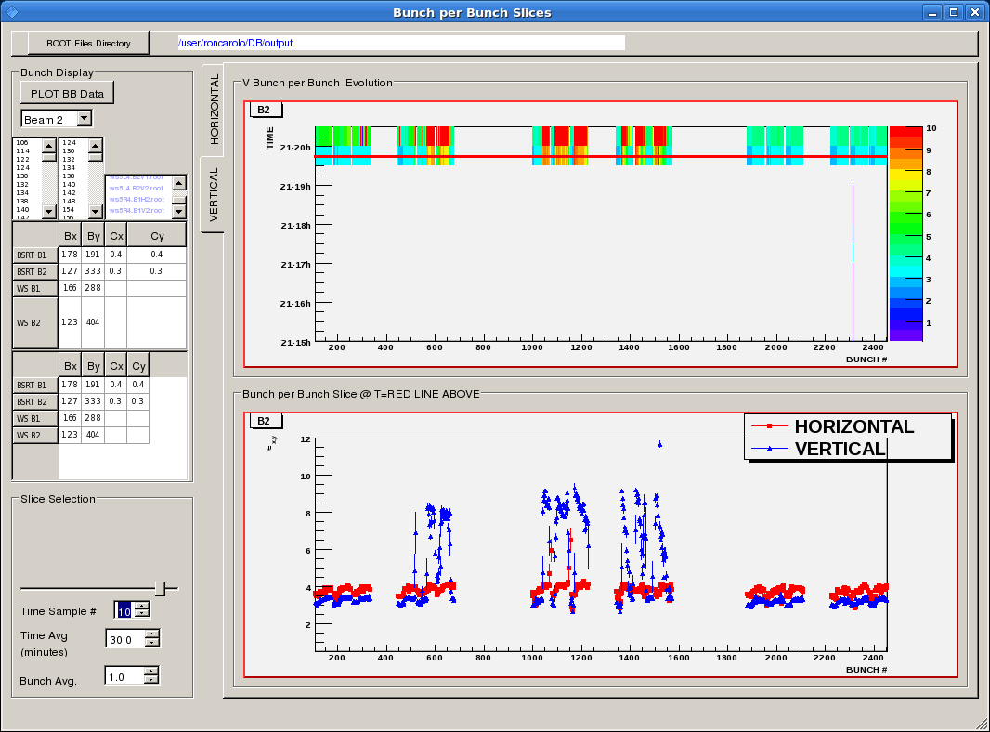
Filling with 912 bunches

Slide 12
Not a record fill…
specific luminosity

Slide 13
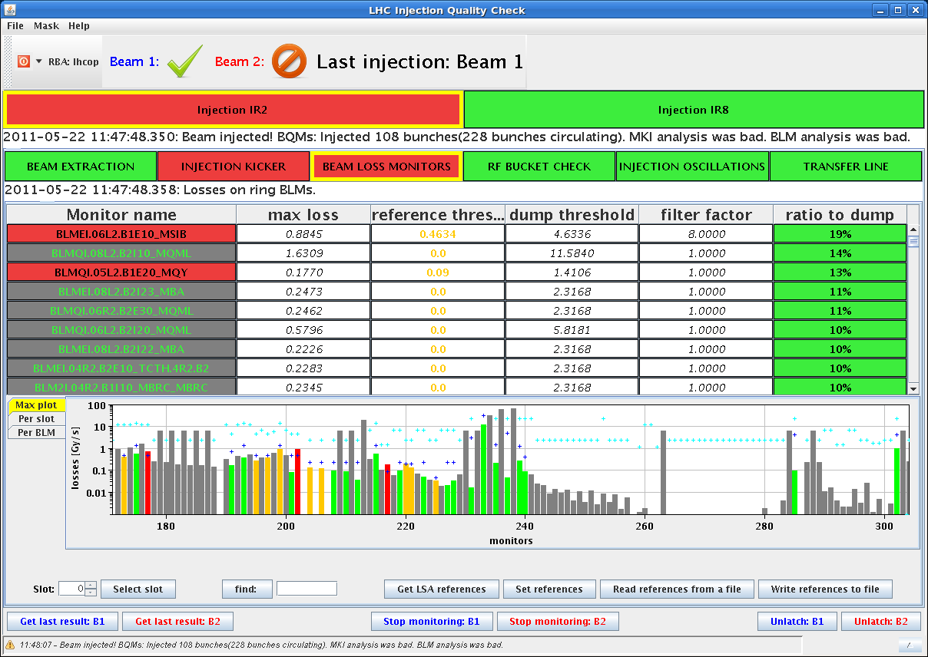
Sun morning
07:10h Programmed Dump, precycle, injection of new beam
09:05h Lost RB A67 and RB A81, and consequently the beams
(glitch from EDF)
10:35h injection physics beam
108 bunch trains
losses tolerable,
chroma nicely constant

Slide 14
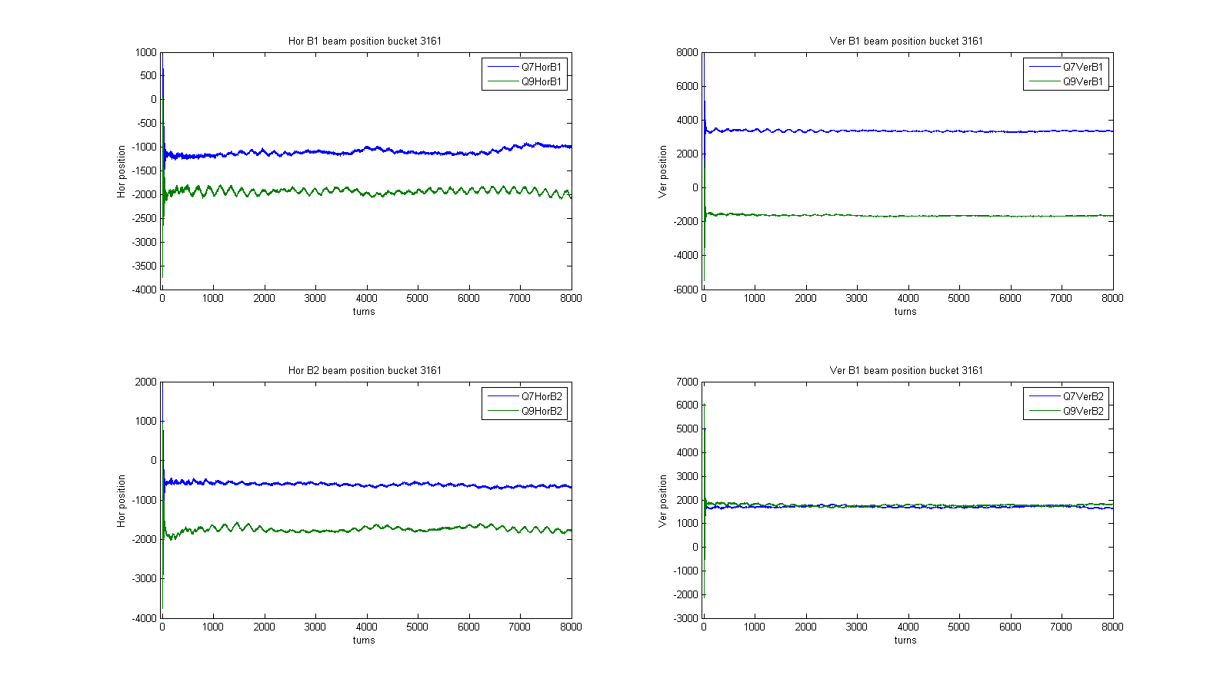
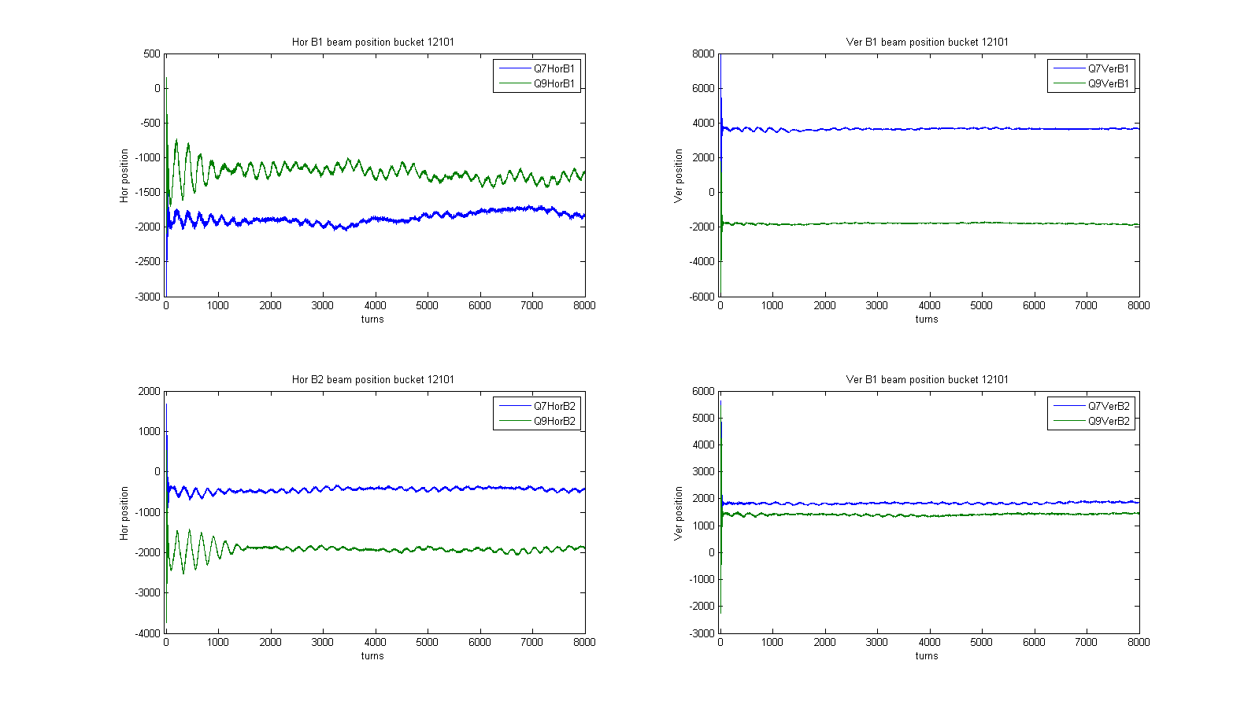
Sun morning
Injection orbit corrected at ADT pick ups: saved as new injection reference orbit
Injection oscillations: measured for every batch transfer (Daniel Valuch)
first 108 train
third 108 train

Slide 15
Sun morning
13:28h inject 912 x 912, ramp, squeeze, luminosity

Slide 16
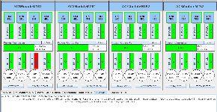
Sun afternoon
15:06h RF trip, ALICE solenoid tripped
Mean orbit was still ok in the last 1000 turns
before the dump
Alice's solenoid tripped about 2 minutes before the dump
From at the end of the shift: the two events are probably not correlated! ??

Slide 17
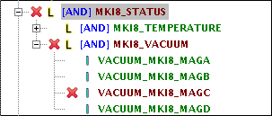
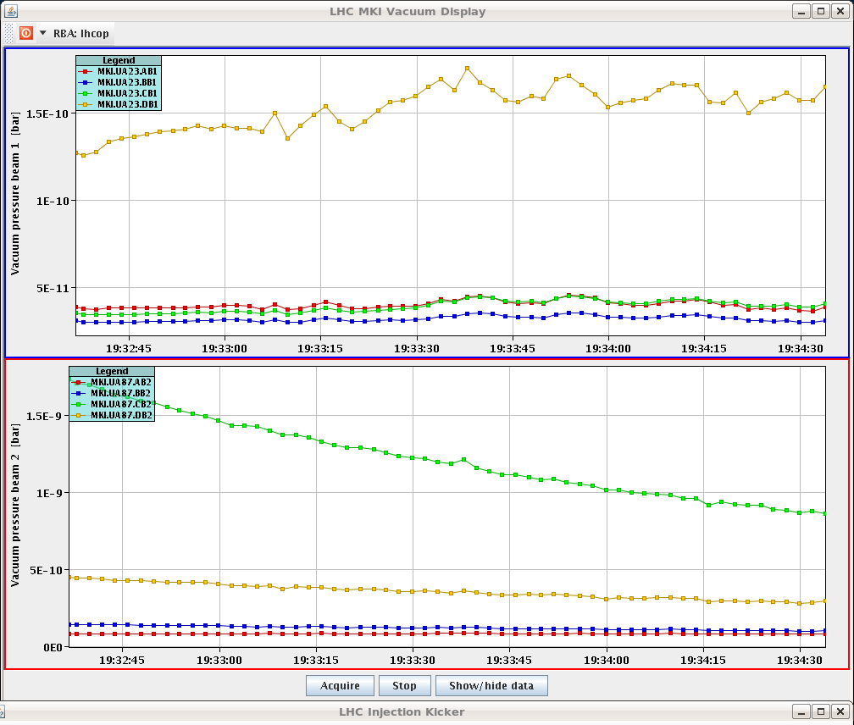
Sun late
18:28h restart: BEAM MODE changed to INJECTION PROBE BEAM
Vacuum for MKI b2 preventing us to inject the last
shot of b2. Had a handful of UFOs at the time, even
if small. Also in pt 8.
10⁻¹⁰
10⁻⁹

Slide 18
Sun late
19:43h injection complete
not an easy ramp: had very funny initial chromas (-10/+10).
quite a bit of debunched beam lost in pt 3 at the start of the ramp - lifetime lower than yesterday.
Quite high losses in pt 6
Blow up at about 850 GeV on B1V mostly
It took quite some time to find Alice. CMS was completely off in h, LHCb also quite a bit.
20:40h collisions

Slide 19
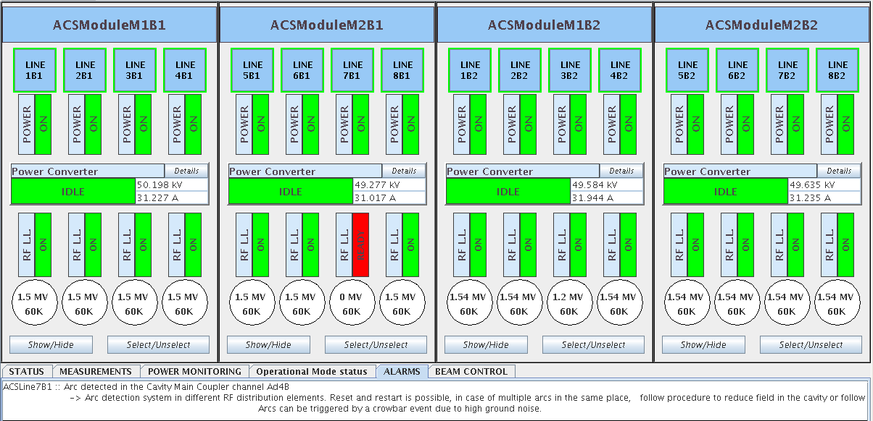
Sun late
21:27h
Dump: RF fault

Slide 20
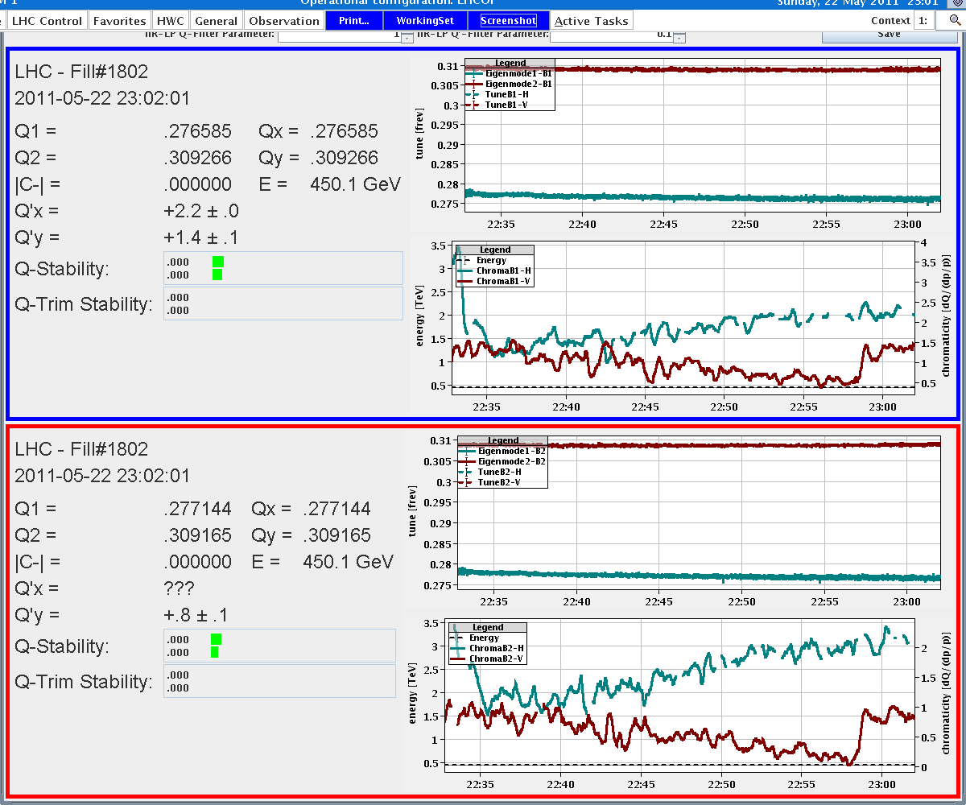
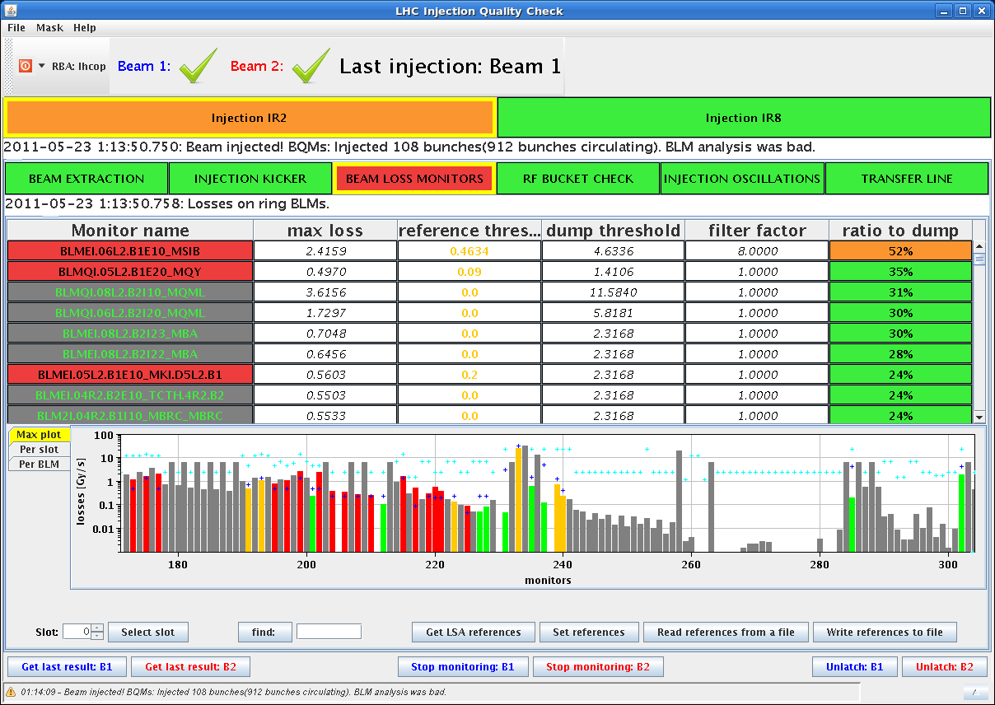
Sun night
22:17h
restart
miscellaneous technicalities:
* FIDEL is not in good shape tonight
* we had 2 crashes of the OFSU since
the beginning of the shift and the
reconnect do not work.
* we do not have a proper measurement
of the chroma for B2H, we estimate it is the same than beam 1!
* high losses in the last beam 1
injection 52%
* vacuum interlock for last
injection of beam 2, as in the
previous fill

Slide 21
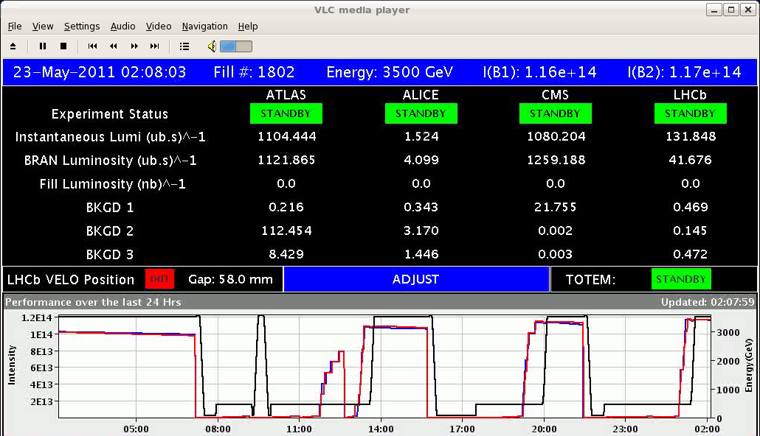
Sun night
01:24h injection complete
good collision rate before optimizing
... and finally we got it.
than’x to the shift crew

Slide 22
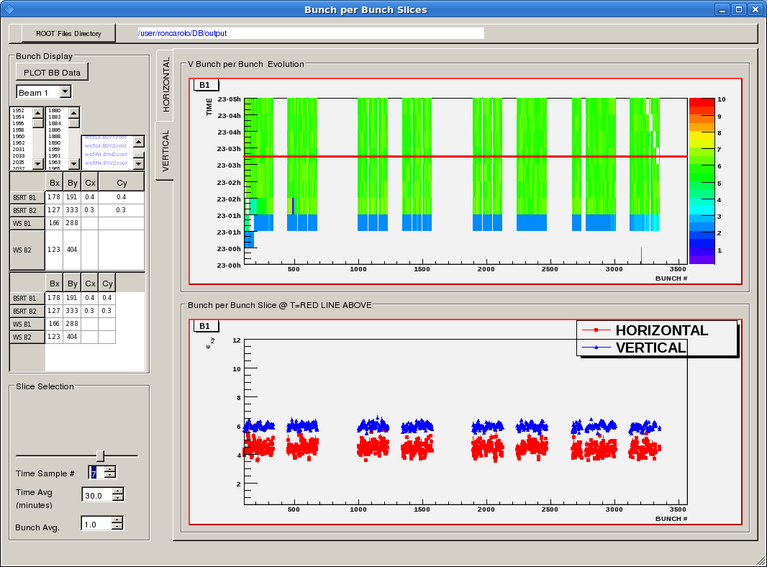
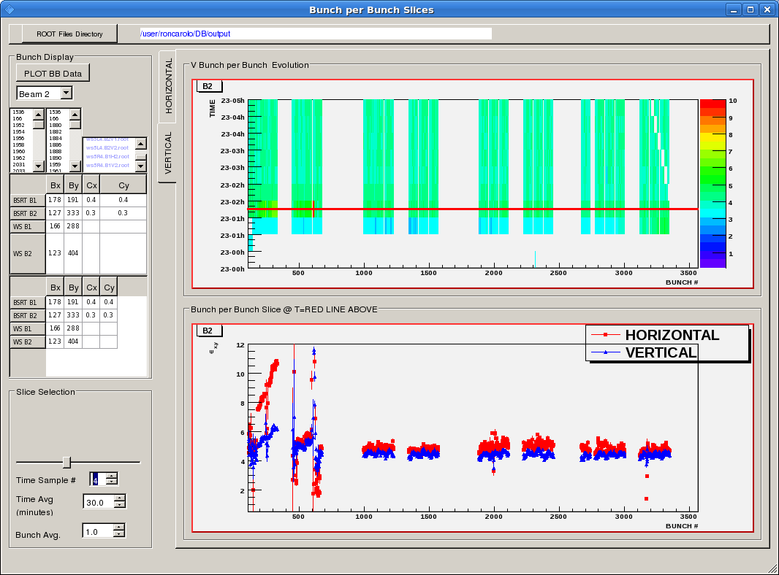
Sun night
emittances beam 1
emittances beam 2

Slide 23
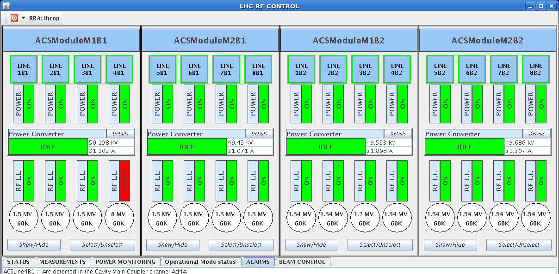
Sun night
05:25h trip of RF cavity
a "radiation-induced" detection .. ?
(arcs in the main couplers ?)

