Slide 1
Thu 19/5
06:00 - 11:00 Investigations from vacuum and cryogenics
11:20 Trip of sector 67 (QPS)
11:20 - 15:00 Access for QPS intervention and recover
15:00-17:00 Setting-up of injection with 108 bunches
17:00-20:00 Injection of large number of bunches (verification of vacuum, cryogenics and RF in parallel)
20:00 1308 bunch/beam injected
21:20 Beam dump due to vacuum spike close to D1.R2
23:35 STABLE BEAMS 1795: Initial luminosity: 7.7x10³² cm⁻²s⁻¹ – delivered so far ~ 18 pb⁻¹ in 8 h
Beam dump due to cryo control card for current leads

Slide 2
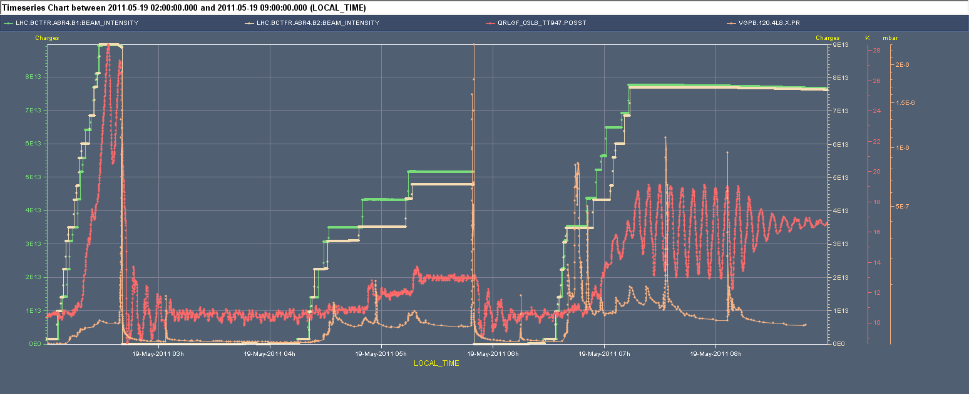
Vacuum and cryo behaviour - triplets
Large fluctuations observed in the BS temperature of triplet L8 + gas condensation on the beam screen during technical stop/cryo stop in point 8 can explain these observations ➔ adjustment of regulation

Slide 3
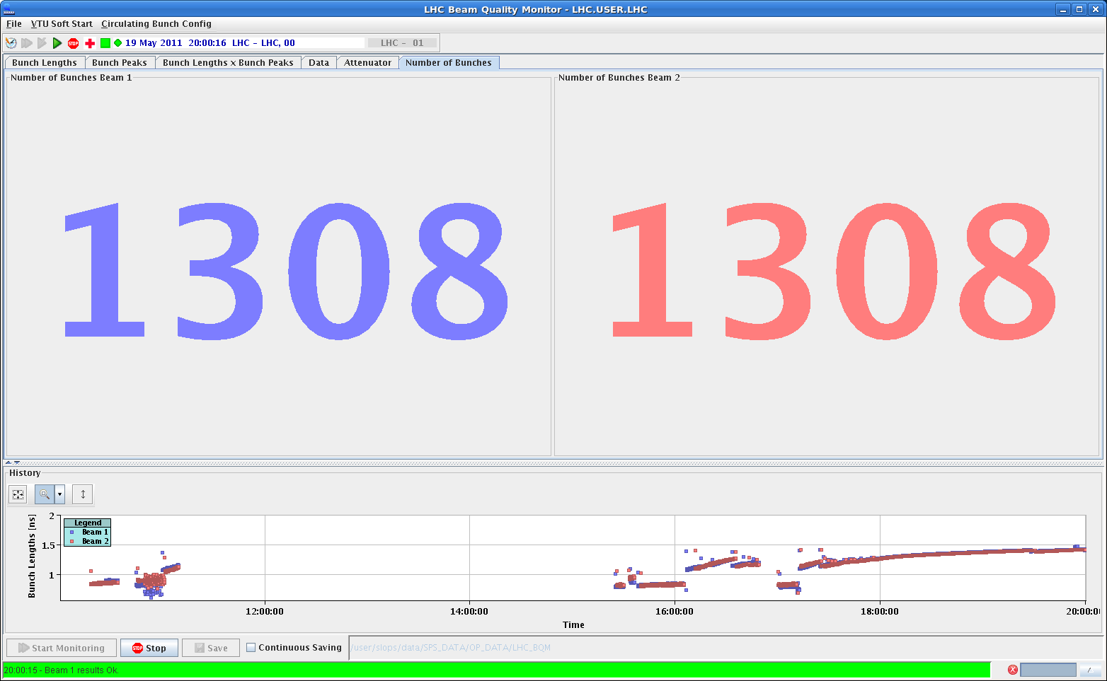
Filling with trains of 108 bunches
While RF, cryo, vacuum monitoring
1.5x10¹⁴ p in the machine ~half nominal intensity

Slide 4
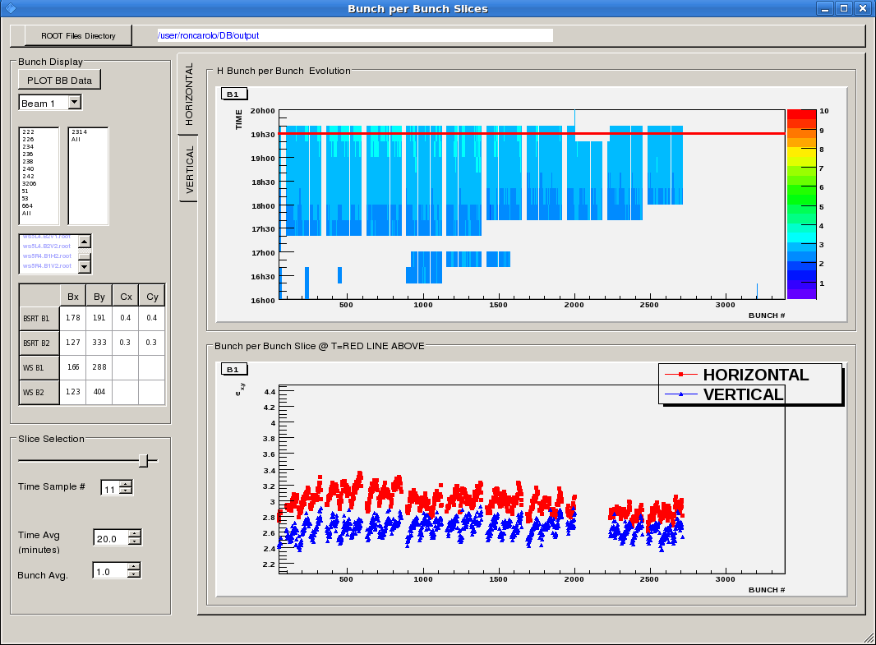
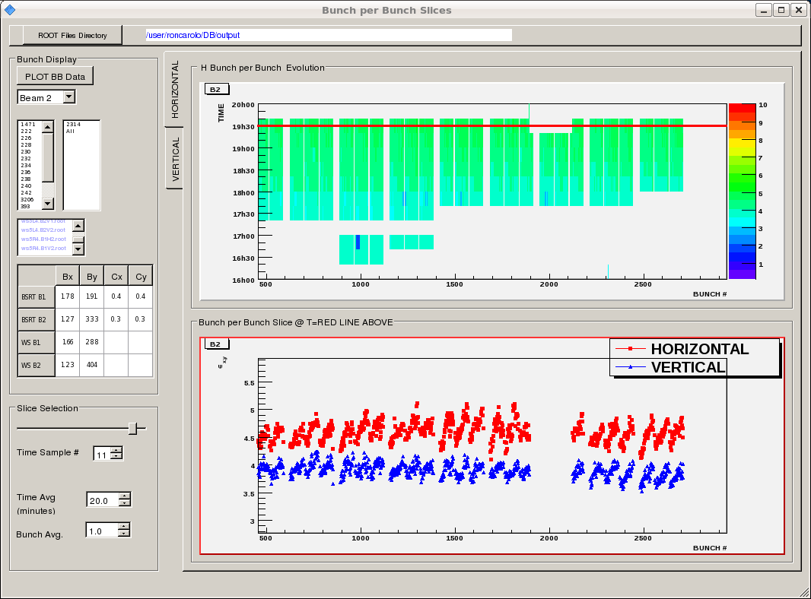
Emittances with 1200 bunches

Slide 5
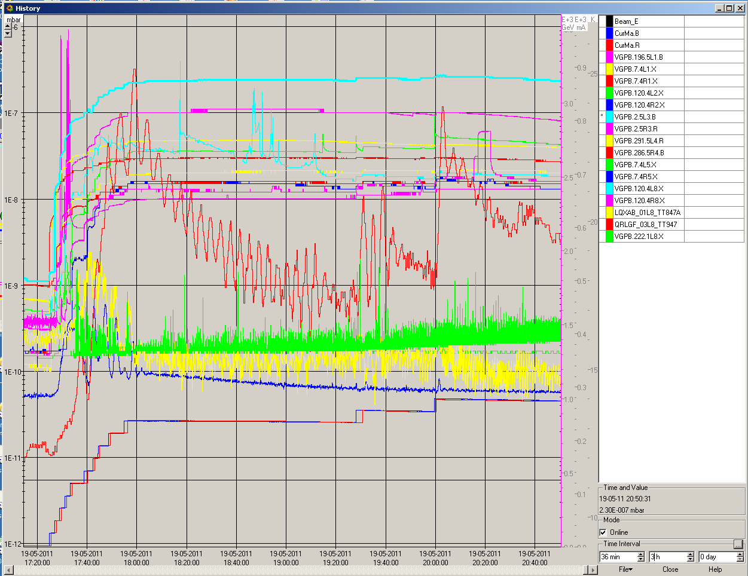
Filling with trains of 108 bunches
Vacuum evolution during filling. Still some activity

Slide 6
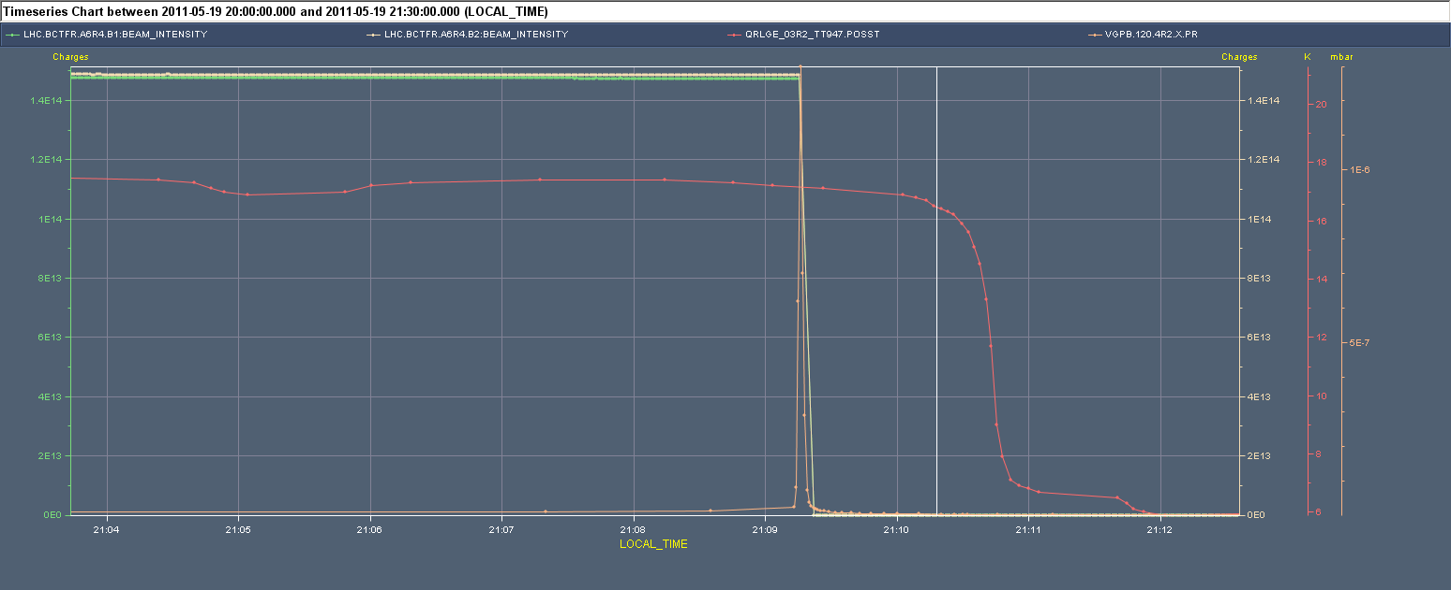
Filling with trains of 108 bunches
During temperature scan on BS triplet L8. Vacuum spike in point 2R (triplet) remains unexplained. Not all is related to BS temperature.

Slide 8
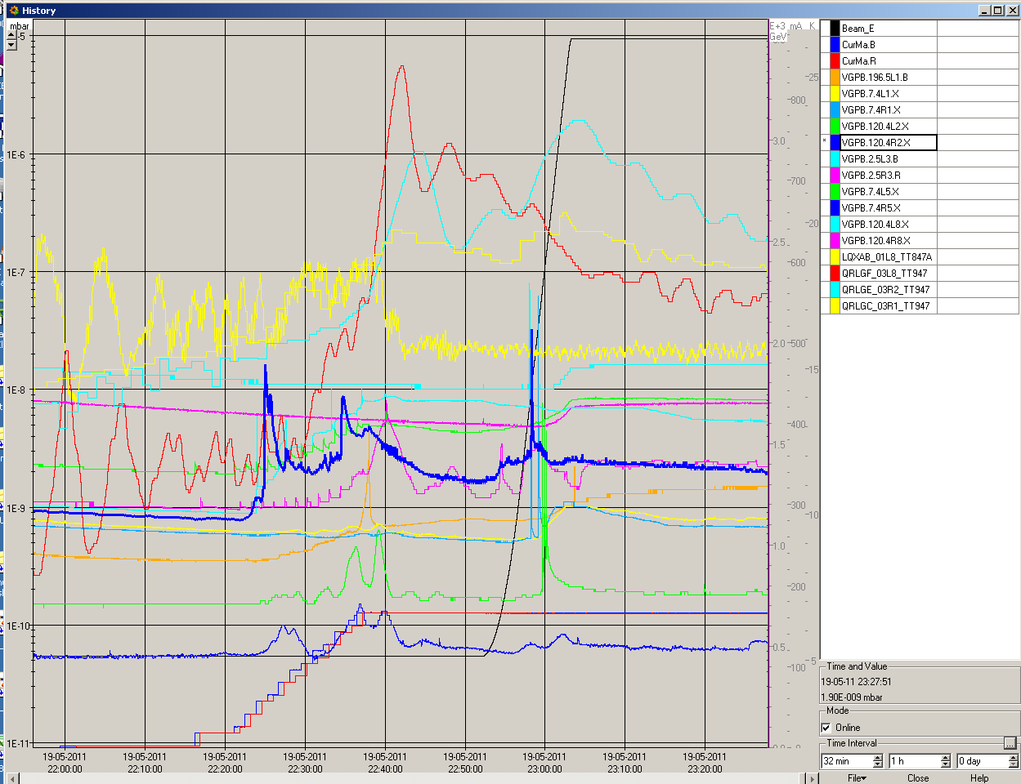
Vacuum activity during the ramp

Slide 9
Others
- FIDEL: It was found that for the FIDEL there were two issues ( both being looked at by Marek) - The first is that the scaling of the powering history as extracted from the logging and used as input to the FIDEL calculations might be not very accurate, and so may cause the fidel predictions to be different that the actual b3 value. This can be observed as chroma drift. - The second is that an expired RBAC token can prevent the trimming at injection (but not the continued FIDEL calulations). - The BLM monitoring factor on BLMQI.06L2.B2I20_MQML has been increased from 0.3 to 1.0 in order to allow for injection losses for the 108 and 144 bunch injection.

Slide 10
Plan
Phase loop firmware update and FGC RBAC time-out extension during ramp down
~14:00 Verification of phase loop functionality
PM: injection verification with 108 bunches + LSS6 BPM verification with 108 filling pattern
Evening physics with 768 bunches (108 bunches train)

Slide 11
Plan (WE)
Tomorrow during the morning: go to 912 bunches
Hopefully lot of physics with 912 bunches

