Slide 1
Thursday 12th May - recovery from TS
18:30: cryo back in whole ring, also for RF cavities.
Preparing to power. Problem with quench loop S23. Access to fix it.
23:00: beam 1 cavities will not be ready for the night –more conditioning required overnight.
Beam 1: Cav 1-4 ready at injection settings Cav 5-8 need further conditioning overnight (mainly 5B1 but the whole module must be either conditioning or operational)
Beam 2: All cavities OK and beam can be injected in ring 2.
HWC tests on S56.

Slide 2
Friday
02:12 RD3.LR4. Lost cryogenics in MS. HTS quench at 763 A (3.5 TeV = 2750 A)
Original quench trigger seems to come from the HTS voltage on LD2 of DFBMK increasing proportionally to the current and reaching 3 mV
Ramp starts at 2h11m25s. The CV is at 0% and starts to open at about 2h12m24s when the HTS voltage is already above 2 mV. After the quench, the CV opens to 100%.
TT891A gives 50+-2 K up to the quench. After the quench, the temperature shoots up to 127 K.
Small fast signal on U_RES_B1 of about 170 mV, probably correlated to the switch opening or the heater firing (with timing error). Heater firing is ok.
Plotting U_HTS and TT891 over the last few days, we see that the temperature was around 100K and U_HTS=0 during the technical stop until 12 may 0h00. Cryo restarted cooling and at the same time U_HTS is jumping from -1.6 mV to +1.6 mV, and then becomes stable zero again at 18h00 on May 12.
Seems that temperature reading and cryo valve regulation are correct but that there is a problem with the voltage reading
Arjan Verweij

Slide 3
Friday
05:00 Pre-cycle of RD3.LR4. OK this time.
7:45 Beam in & out – synchro loop way off – needed recalibration
FBCT, IQC, OFB, ADT, Injection handshake (DIP TI2(8)-SETUP signals missing) …
Lost cryo Pt 8 (PLC/communication) around 11:30.
Rest of the day
Access, Cryo intervention on D3 valve & T control,
RF conditioning – all OK.
D3 seems OK. Current lead voltage problem was fixed by a reset.

Slide 4
Saturday
14:10 Cryogenics back [26 hours 40 minutes]
Pre-cycle
15:30 Beam 2 in
Interlock on TCLIB.6R2.B1. Alessandro Masi found a broken sensor, it would dump at random - disabled it
15:45 Lost sectors 12 and 23 – AUG TI2
First BIC input Triggered: First USR_PERMIT change: Ch 14-FMCM_RBXWTV.L2: A T -> F on CIB.UA27.R2.B2
RP, Fire brigade and EL piquet into TI2 via BA7
AUGs shunted – restricted access for the moment
Recovery – power converters, QPS etc.
19:15 Start pre-cycle
20:15 Beam back

Slide 5
Saturday night
21:10 Start ramp – pilots
Tune feedback off in ramp -> lifetime dip at start of squeeze
Briefly into collisions
22:50 Sector 78 off for DFB level adjustment (CM loss during manipulation) – finished at midnight
01:06 start ramp - two nominal bunches
01:13 Lost beams...LBDS self-trigger
MKD analysis XPOC faulty for beam 1
Access required in point 6 to exchange the faulty power trigger power supply
P.Burkel & W.Senaj wrestling with software among other things

Slide 6
Sunday morning/afternoon
05:10 Beam back in
06:50 Colliding – two nominal
Atlas collision point off…
07:20 Stable beams
08:40 Change ADJUST for loss maps
Re-fill for Van der Meer scans which then lasted all day…
Beams finally dumped 23:30

Slide 7
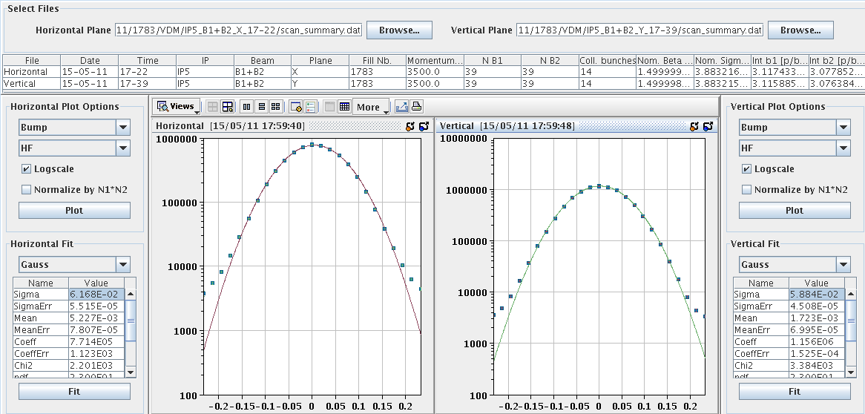
VdM example – one of many

Slide 8
Monday morning
Verena & Markus
Prepared for injection of 50 ns beams. The injectors had to re-establish beam quality. Many parameters had changed. The scraping and trajectory were not optimum either yet. Dumped the beams immediately at the first 12 bunch injection.
Steered the lines and adjusted the scraping. Injection is good now up to 72 bunches.
The rest of the night we spent figuring out the problem with beam 1 36 bunch injection.
We lost each time after a couple of 100 ms. Only one out of 4 BPMs in point 6 triggered in the vertical plane. But it had not triggered for 12 bunches. We suspected a problem with this pickup. It was the same which had had problems with the bunch count before.

Slide 9
Monday morning
When disabling this pickup (by changing its interlocking configuration) and still losing the beam, we figured out the real problem from the BLM post mortem and damper pickups.
The damper had been driving beam 1 V unstable. The fine delay settings had been lost during the technical stop. The expert sorted it out and everything was fine afterwards.
We filled the machine with 228 bunches. During the ramp we lost the fill due to an electrical network perturbation which tripped S81 and RB56.

Slide 10
RF
Measurements done when re-starting the cavities on Thursday evening showed that the 380 MHz reference Beam2 had drifted by ~ 8 degree (60 ps). We do not know why (aging, temp,humidity...?).
This reference is common to all 8 cavities B2. The drift has two effects: It reduces the stability margin of the RF fdbk (not much... the margin is 60 deg) AND it displaces the collision point. I have re-adjusted all beam 2 cavities by 8 degrees. That should be completely transparent EXCEPT that it should rotate the IP by... 8 mm. As these 8 mm are the amount of displacement noticed by the experiment, I prefer NOT to change the IP point until we have IP data with the new setting.
Philippe Baudrenghien

Slide 11
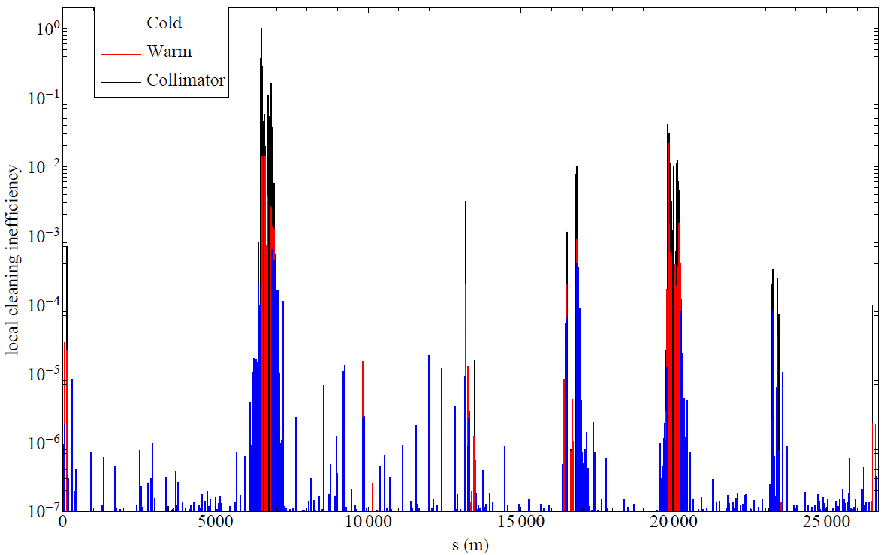
lossmap_B1B2_negOffMoment085844_B1dominating
Daniel Wollmann

Slide 12
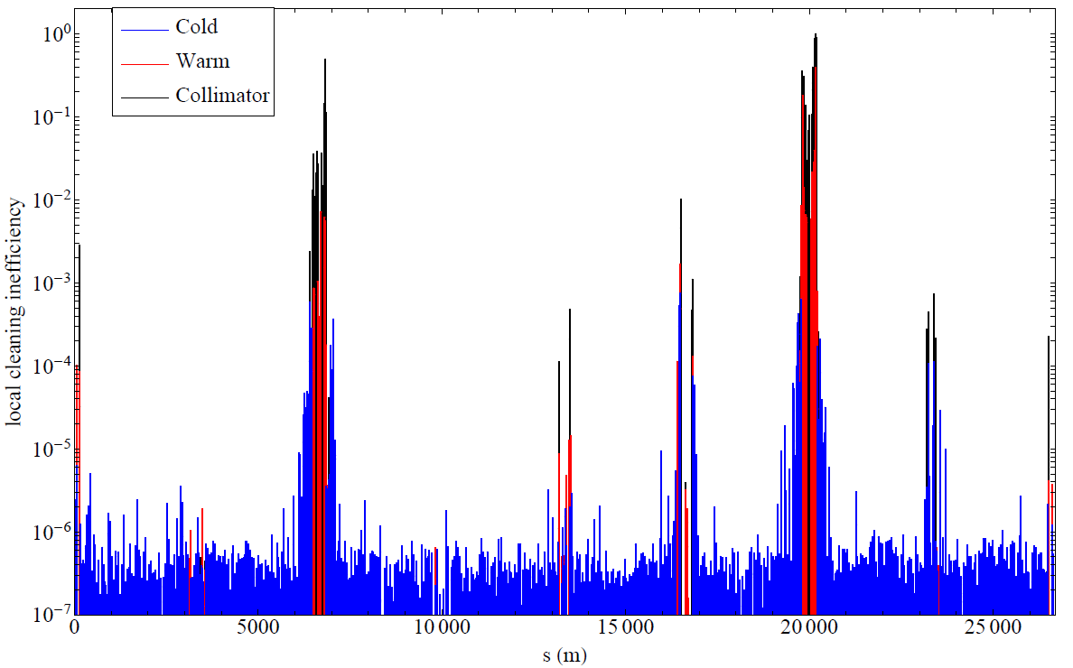
lossmap_B1B2_negOffMoment085844_B2dominating
Daniel Wollmann

Slide 13
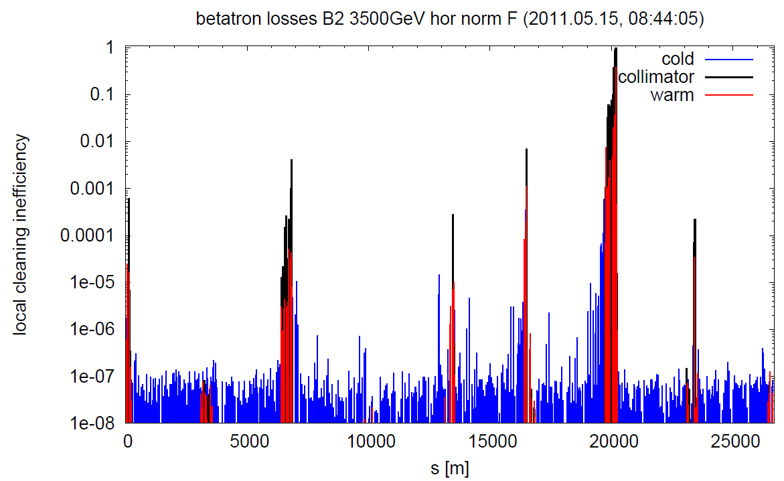
lossmap_B1B2_negOffMoment085844_B2dominating.
- B2 hor 084405 (Q8L7: 5.96e-4)
- B2 ver 084758 (Q8L7: 2.55e-4)
- B1 hor 085238 (Q8R7: 4.59e-4)
- B1 ver 085456 (Q8R7: 3.60e-4)
- B1+B2 RF +500Hz 085844 (Q8R3: 5.21e-04)
Cleaning and hierarchy are ok in all cases.
Leakage into TCTs is below 1e-3/2e-3 for B2/B1 transverse losses and 3e-3 for the off-momentum (for B2 dominating it's the TCTV in IR1 and B1 dominating it's the TCTV in IR5).
Daniel Wollmann

Slide 14
Miscellaneous
XPOC
Expert reset required every time – vacuum readings & filling pattern
Fidel:
the chromaticities - not very stable.
"calculate Fidel ramp settings" did not prepare b3 correctly in the ramp function. Manual incorporation required.

Slide 15
Still to do
Abort Gap Keeper checks - Jan/Etienne – 1 hour
Set-up of TCDIs in TI2 – Bren & co. - 1 shift
MKI eCloud solenoid tests – 1 hour at injection, 1 hour at 3.5 TeV
LHCb 768b slow (30 – 45 minutes) luminosity scan between 1e32 and 3.5e32
Set-up of the damper with optimized gain for higher frequencies, Wolfgang Hofle – 1 shift (should wait for a while)
Full set of loss maps at injection – Daniel Wollmann
No Alice polarity reversal (yet)
~200b@50 ns and 400b@50 ns on the way back to 768b
TOTEM/Alpha set-up – to be scheduled

Slide 16
This week
So far 3 fills with 768 bunches for a total of 8 hours
Need to have another couple of good fills (~12 hours each) at least before next step to 912b
Usual rMPP sign-off before step-up
912 bunches requires 108 bunches per injection
Set-up of 108 bunch injection and operational use with 912 bunches – so far only tried once during scrubbing
The following 3 steps (1056/1200/1380) require 144 bunches/injection
144 injection set-up
Inject up to 1200 and then up to 1380 bunches (trains of 144 bunches) and monitor RF, heat loads, vacuum (2-3 shifts). Experimental magnets will be ON. Anti-ecloud solenoids ON around MKI2 and MKI8.

