Slide 1
MD Wed – Sat
Status 6.5.2011, 08:00
Day | Time | MD
Wed | 06:00 | UPS repair, ATS optics checks w/o beam
 | 12:00 | Cycle, test ATS optics w/o beam
 | 16:00 | 0.45 TeV: BPM offset determination for triplet BPMs
Thu | 00:00 | 0.45 TeV: Alignment TCDQ/TDI and injection losses (other beam)
 | 08:00 | 0.45 → 3.5 TeV: RF single-bunch instabilities
 | 14:00 | Ramp down, cycle.
 | 16:00 | 0.45 → 3.5 TeV: 90 m optics unsqueeze
Fri | 00:00 | Ramp down, cycle
 | 02:00 | 0.45 → 3.5 TeV: Cross calibration of BSRT/WS/BGI
 | 10:00 | Ramp down, cycle
 | 12:00 | 0.45 TeV: Collision tunes at injection + ramp down, cycle
 | 20:00 | 0.45 TeV: Beam-beam limit
Sat | 04:00 | 0.45 TeV: Investigation on CODs

Slide 2
MD Sat – Mon
Status 6.5.2011, 08:00
Day | Time | MD
Sat | 10:00 | 0.45 TeV: ATS (including cycle to new injection settings)
 | 20:00 | 0.45 – 3.5 TeV: Nominal collimation, single bunch tune shift
 | 04:00 | Ramp down, cycle
Sun | 06:00 | 0.45 TeV: RF multi-bunch instabilities
 | 10:00 | 0.45 → 3.5 TeV: Coupled-bunch instability rise times
 | 18:00 | Ramp down, cycle
 | 20:00 | 0.45 → 3.5 TeV: Quench test in the DS of IR7
Mon | 06:00 | Technical Stop
Lost | 6h | 3.5 TeV: Tune scan – beam-beam optimization, lifetime, losses

Slide 3
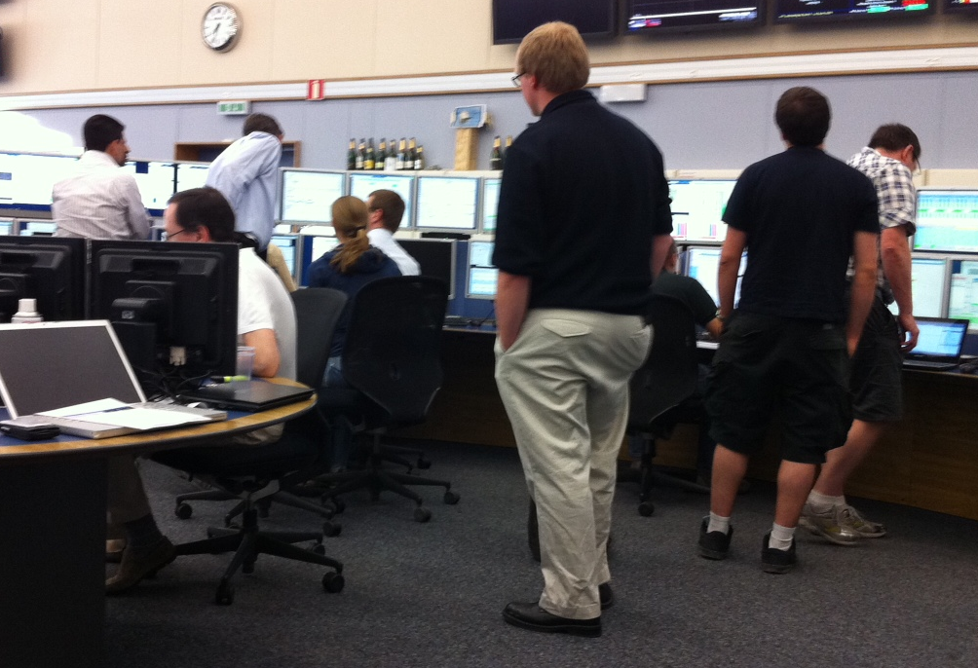
Getting busy…

Slide 4
90 m Unsqueeze (Helmut et al)
The goal of this MD was to demonstrate the feasibility of a simultaneous un-squeeze of IPs 1 and 5 with an external tune compensation using the main quadrupoles.
  The un-squeeze from the end of ramp optics at 11m to 90m is done in many intermediate steps.
  This first test with beam has been done with a flat machine in all IPs and safe beams (1.2e10p per beam). Collimators were not ramped. The un-squeeze was carried out stopping at 12 intermediate matched optics. The whole test worked well and smoothly and we reached the 90m optics essentially without beam losses.
  Orbit and tune feedbacks were kept ON for all the beta* changes and only stopped for measurements. We needed a few coupling measurements and corrections (3 for B2 and 2 for B1), all then incorpotrated into the functions for the next test. Chromaticity was also adjusted but in general remained well under control. Three time we stopped for orbit adjustment (transfer of real-time trims into the LSA settings).

Slide 5
90 m Unsqueeze (Helmut et al)
Everything worked as expected.
  We found a few minor hiccups with the software, all addressed online.
Measurements from the beta-beat team with the AC dipole were carried out at flat-top, at 30m and (more extensively) at 90m.
Note that, in order to protect predicted aperture bottlenecks at about 12 sigma’s for the 90m optics), primary collimators were closed to 10 sigma’s as a safety measure prior to the AC dipole measurements.

Slide 6
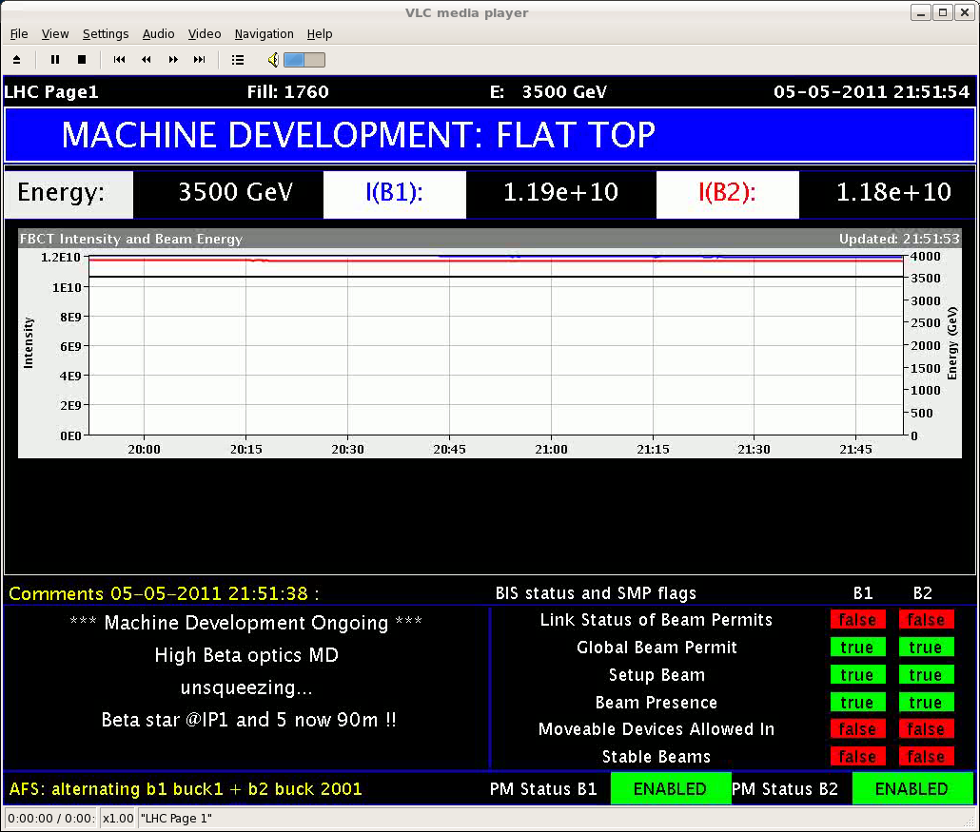
Page 1 – No losses essentially

Slide 7
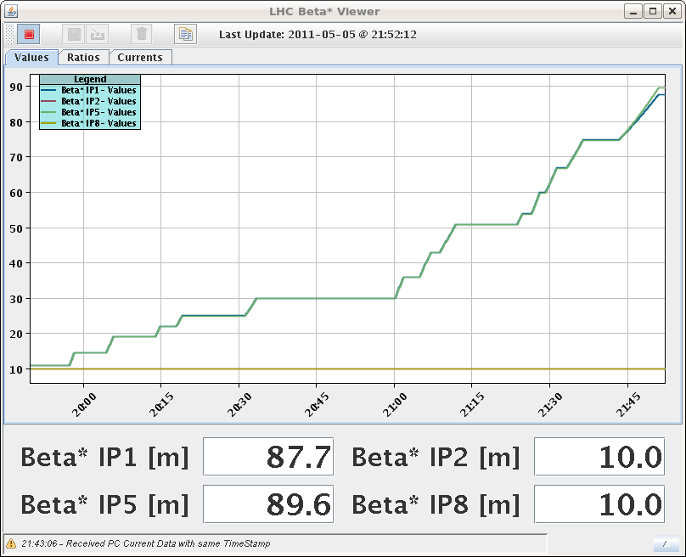
Beta*

Slide 8
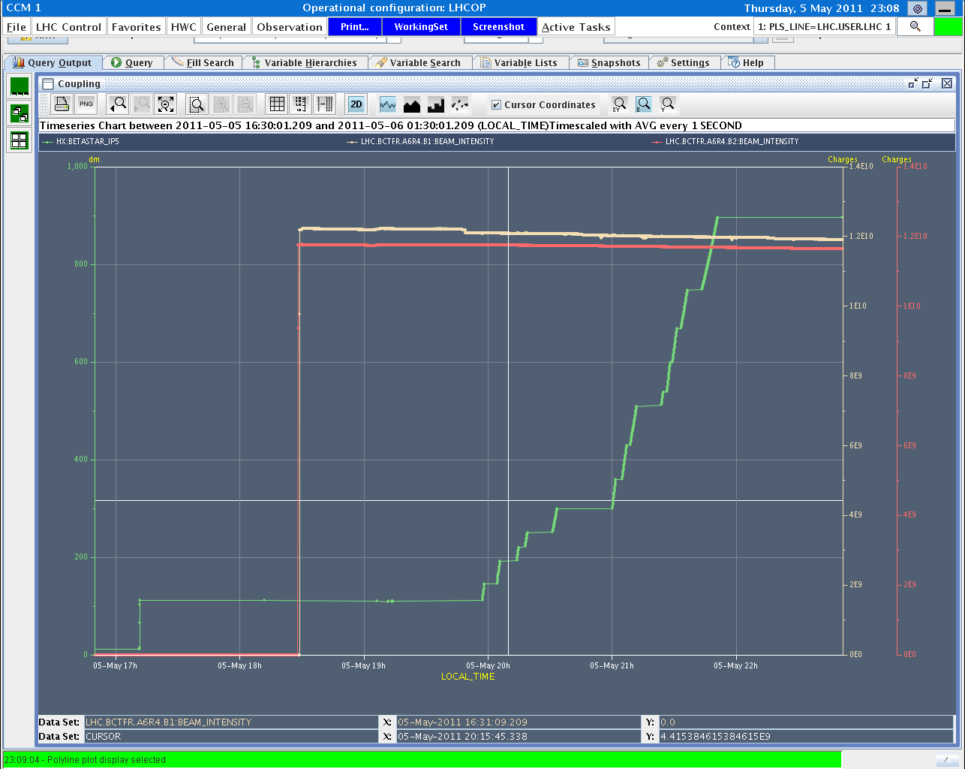
90 m: Another Summary

Slide 9
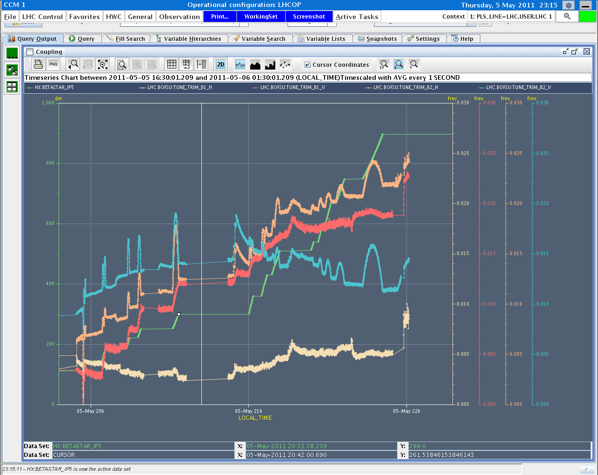
Tune Trims

Slide 10
Beta Beat for 90 m (Helmut, Rogelio et al)
At flattop local and global coupling corrections were applied. The first result show that the local jumps in IP1,IP2,IP5 and IP8 are reduced. Detailed analysis will be carried out to confirm.
Beta-beat measurements were done at 30m and 90m betastar at IP1 and IP5.
Beta-beat for beam1H is ~25% and ~20% for beam1V at 90m.
Beta-beat for beam2 is ~30% at 90m.

Slide 11
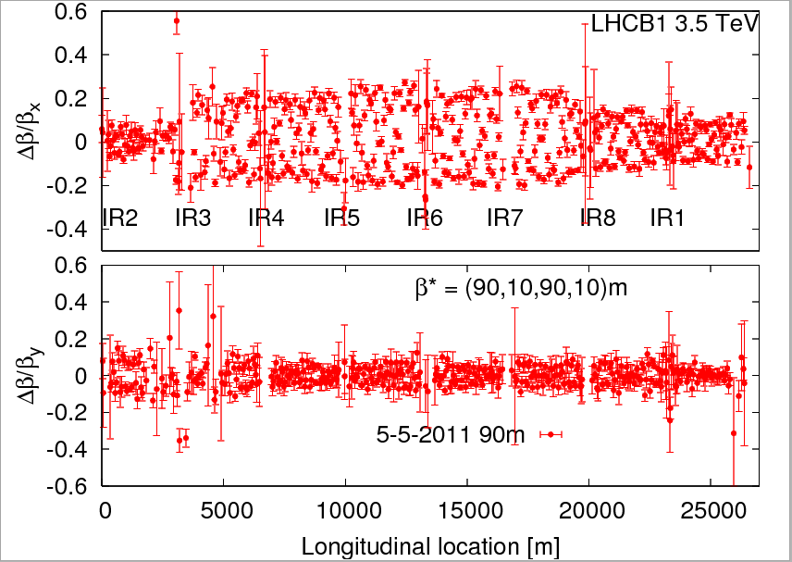
90m Beta Beat

Slide 12
Cross-Calibration BSRT/WS/BGI (Frederico et al)
Program completed at 450 GeV
B1 lost at ramp → ramp and 3.5 TeV data for B2 only.
To be analyzed offline.
Continuing until 10h00.

