Slide 1
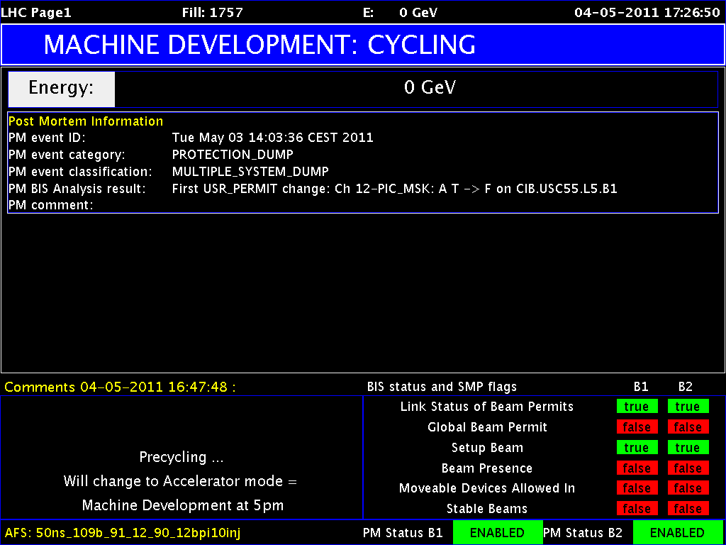
1st LHC MD Period Started

Slide 2
MD Wed – Sat
Status 3.5.2011, 09:30
Day | Time | MD
Wed | 06:00 | UPS repair, ATS optics checks w/o beam
 | 12:00 | Cycle, test ATS optics w/o beam
 | 16:00 | 0.45 TeV: BPM offset determination for triplet BPMs
Thu | 00:00 | 0.45 TeV: Alignment TCDQ/TDI and injection losses (other beam)
 | 08:00 | 0.45 → 3.5 TeV: RF single-bunch instabilities
 | 14:00 | Ramp down, cycle.
 | 16:00 | 0.45 → 3.5 TeV: 90 m optics unsqueeze
Fri | 00:00 | Ramp down, cycle
 | 02:00 | 0.45 → 3.5 TeV: Cross calibration of BSRT/WS/BGI
 | 10:00 | Ramp down, cycle
 | 12:00 | 0.45 TeV: Collision tunes at injection + ramp down, cycle
 | 20:00 | 0.45 TeV: Beam-beam limit
Sat | 04:00 | 0.45 TeV: Investigation on CODs

Slide 3
MD Sat – Mon
Status 3.5.2011, 09:30
Day | Time | MD
Sat | 10:00 | 0.45 TeV: ATS (including cycle to new injection settings)
 | 20:00 | 0.45 – 3.5 TeV: Nominal collimation, single bunch tune shift
 | 04:00 | Ramp down, cycle
Sun | 06:00 | 0.45 TeV: RF multi-bunch instabilities
 | 10:00 | 0.45 → 3.5 TeV: Coupled-bunch instability rise times
 | 18:00 | Ramp down, cycle
 | 20:00 | 0.45 → 3.5 TeV: Quench test in the DS of IR7
Mon | 06:00 | Technical Stop
Lost | 6h | 3.5 TeV: Tune scan – beam-beam optimization, lifetime, losses

Slide 4
0.45 TeV: BPM offset determination for triplet BPMs I
MD was successful (Jorg, Kajetan, Tobias)
lot's of good data was collected.
The MD started eventually around 18:00, but the first 2 hours were spent to correct the beam parameters and to decide on how to handle the missing RQTF on B1. Finally the circuit was masked at the BIS level (PIC maskable) and the MD could proceed.
When trying to flatten the orbit, 2 dumps were generated with the probes due to the fact that the injection protection was not re-centered like the TCTs around a flat orbit. We therefore kept on the Xing in IR2 (and also in IR8).
If any other MD requires a fully flat machine, the beam must be injected with Xing, then the injection protection retracted and finally only the Xing in IR2 can be ramped down.
In the end we had about 3 1/2 hours of efficient MD time.

Slide 5
0.45 TeV: BPM offset determination for triplet BPMs II
We took data from four quadrupoles:
Q6.L5B2
Q6.L7B2
Q9.R6B2
QX1.L5
Preliminary analysis was done for Q6.L5B2 and Q9.R6B2 vertical:
For Q6.L5B2 we found a very good alignment of the BPM with the quadrupole, while we found that the beam was off-center by -0.2mm, as indicated by the BPM.
The preliminary analysis for Q9.R6B2 indicates an offset between quadrupole and BPM of 0.2mm, while the beam was really off-center by about 1.5 mm!

Slide 6
K-Modulation Result I

Slide 7
K-Modulation Result II

Slide 8
Summary of TCDQ angle alignment and TI8 shielding MD I
TI8 shielding studies (Chiara, Wolfgang, Annika):
B2
use probe bunch
opened all TCDIs to +/-15 mm
for one after the other close left jaw to 3 sig across zero to dump beam on this jaw
take 3 shots per collimator
analysis to check shielding effect offline
Completed successfully.

Slide 9
Summary of TCDQ angle alignment and TI8 shielding MD II
TCDQ angle alignment (Chiara, Wolfgang)
B1
use probe bunch
TCDQ maximum angle corresponding to 2mm discrepancy between up and downstream corner ==> 300 urad, due to LVDT noise we could apply 250 urad as a maximum angle.
measure angle of TCDQ
apply angle on jaw
move jaw into the beam until the beam is completely lost
repeat for different angles (0, +/-125urad, +250urad)
the minimum in jaw position (from beam centre) gives the correct angle
Stopped by problem with an SPS kicker. Not complete.

