Slide 1
Tuesday 3rd May
7:30 Access in the SPS to replace injection kicker magnet terminating resistor after radiation cool down overnight
9:45 probes injected in the LHC but some SPS problems
11:45 Filling for physics fill #1756
13:45 Stable beams
14:03 Beam dumped due to Uninterruptable Power Supply (UPS) problem point 5 (EBS 11/56)
UPS problem point 5
20:15 External company on site to fix faulty UPS
Smoke alarm due to UPS fault and search lost
Presently waiting for additional, external UPS experts to arrive
04/05/2011

Slide 2
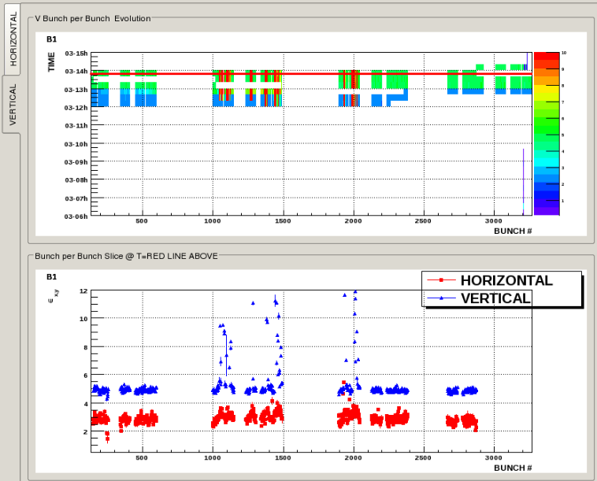
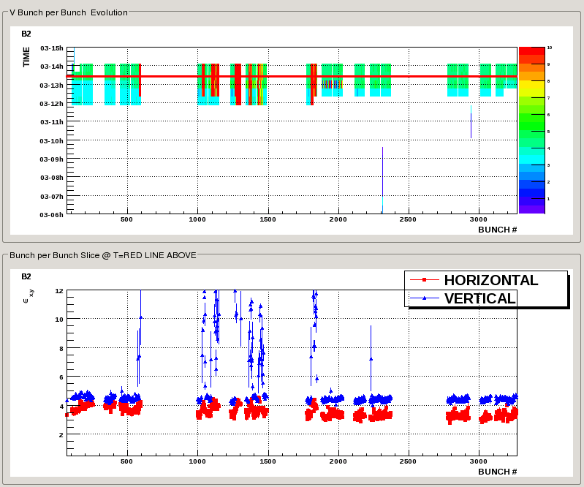
Fill #1756
Injection not very clean, oscillations and losses in the transfer line
Some bunches vertically blown up (see below)
Lumi’s around 730 Hz/ub
Max values Atlas 725, CMS 730 Hz/ub
Atlas corrected published lumi downwards, now agrees with CMS
Only lasted 18 minutes – dump UPS
Bunch sizes before dump:

Slide 3
UPS broken in UJ56
Fault at 14:03
Decided not to continue while shunting out with other UPS
External company required
20:15 External piquet on site
Tried elements from UPS in IP4 to fix broken UPS IP5
04:00.... Did not work
Waiting for more experts to arrive at 9 am
More news asap

Slide 4
Plan
6:00 Start of MD period
Until Monday morning, when the TS will start
First MD of Werner cancelled
Will pick up the MD program with a working machine as soon as possible

