Slide 1
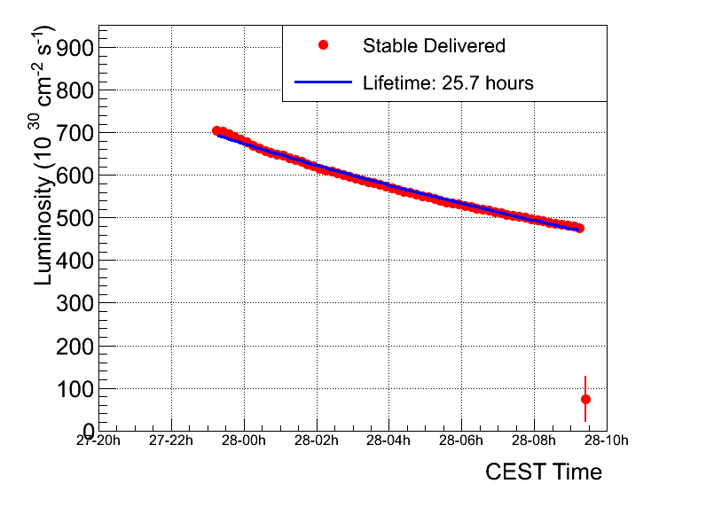
Fill 1743
Peak luminosity | ~6.7 e32
Integratated lumi | ~20 pb-1
Stable beams | 10 hours 2 minutes
Colliding bunches | 598
Average emittance from lumi | 2.6 micron

Slide 2
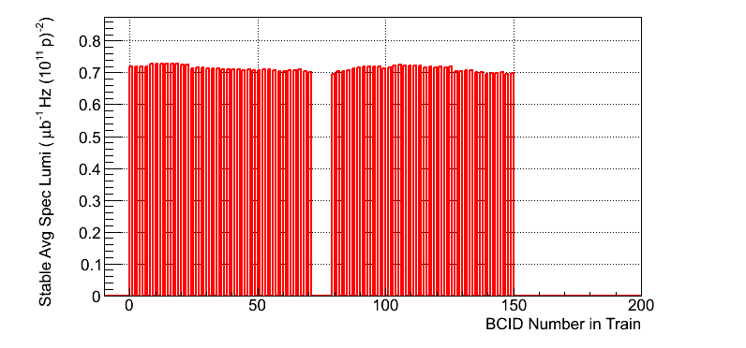
Specific luminosities

Slide 3
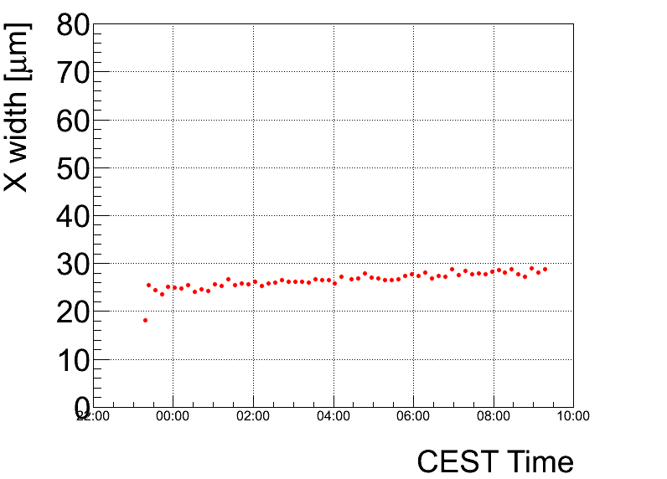
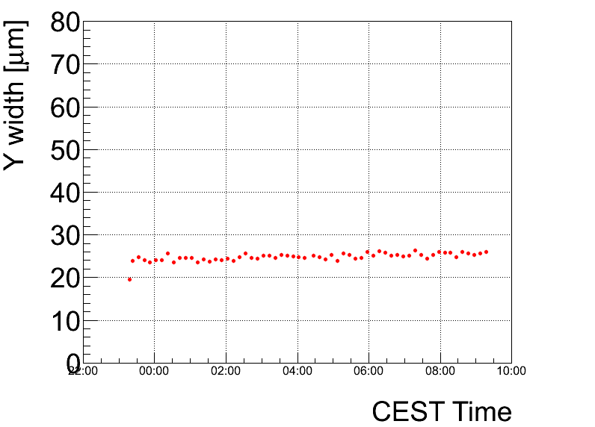
Beam spot

Slide 4
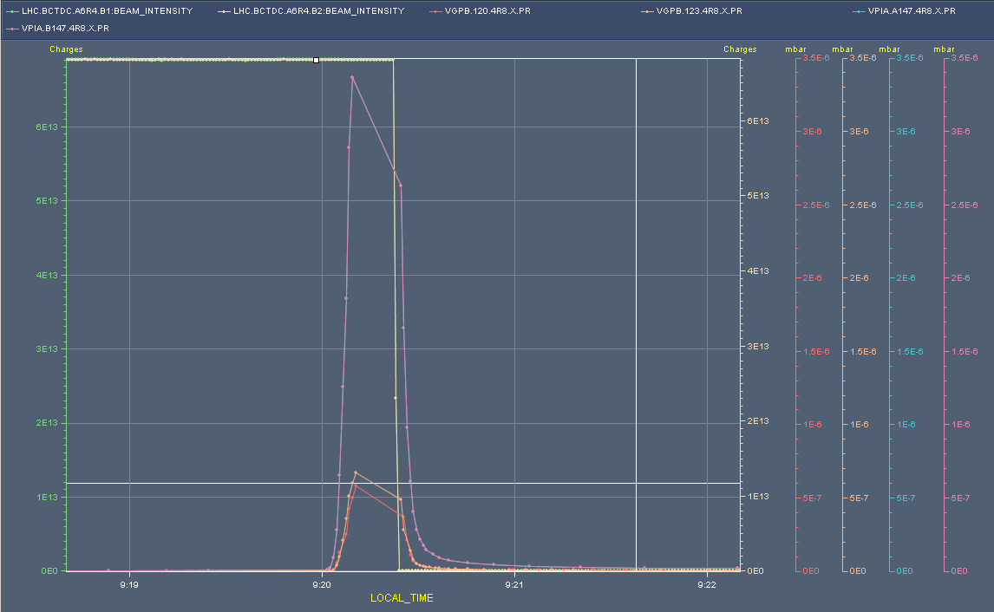
Thursday morning
Fill lost to slow beam loss on vacuum pressure bump R8

Slide 5
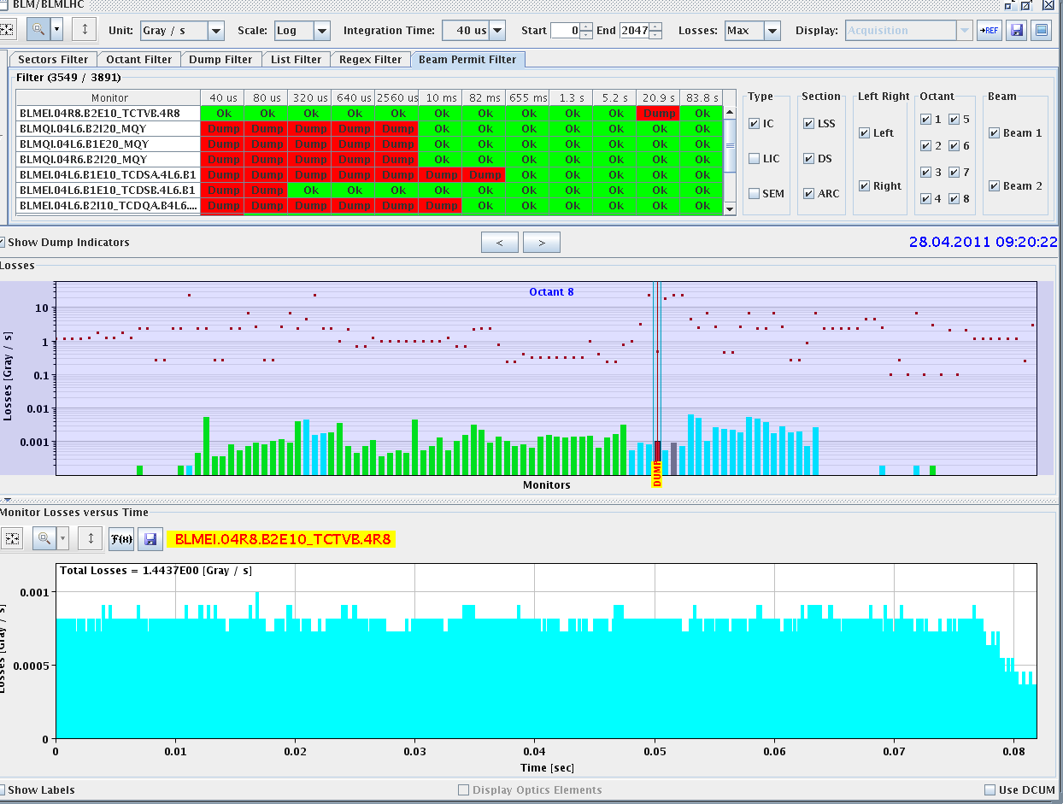
Dumped on long running sum TCTVb.4R8
LHCb confirms that it was a real event, their BCM had a similar signature as the losses on the TCTVb.

Slide 6
Vacuum layout R8

Slide 7
Thursday continued
After dump, access required for:
SEU on QPS controller on RB 34
quench heater power supply in S81
14:00 Beam back
15:23 Start ramp
16:15 Stable beams – 1744
44% UFO BLMQI.30L1.B1
Went up to 51% of dump threshold on TCTVB R8... Clear vacuum spike. Event seen on the BRAN on R8!
Orbit has a very different reading in IP7 from before - temperature effect.
Performance not brilliant - blown-up trailing bunches, trailing trains…

Slide 8
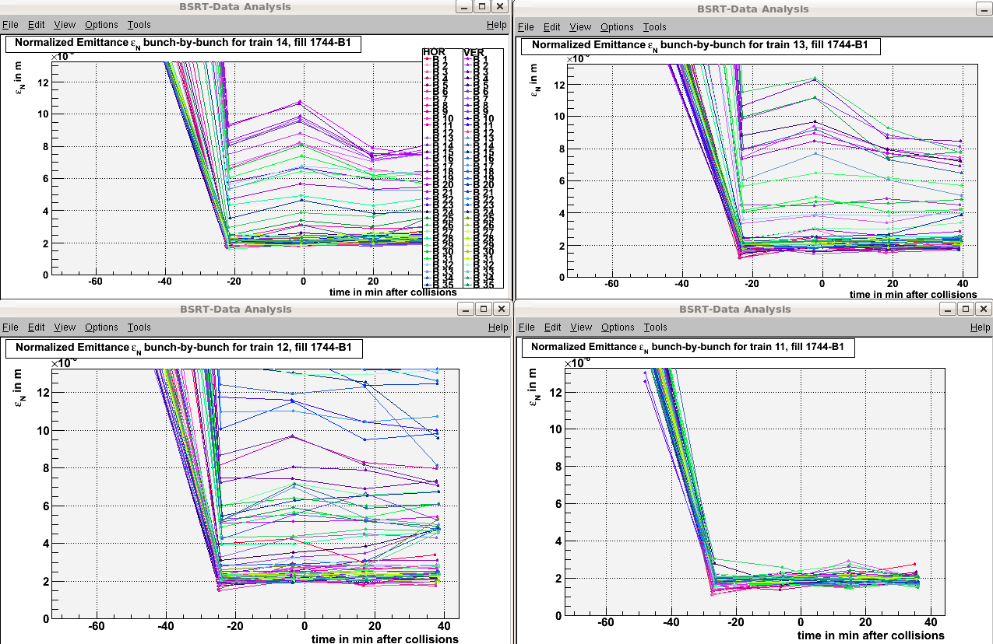
Emittances
Reyes Alemany

Slide 9
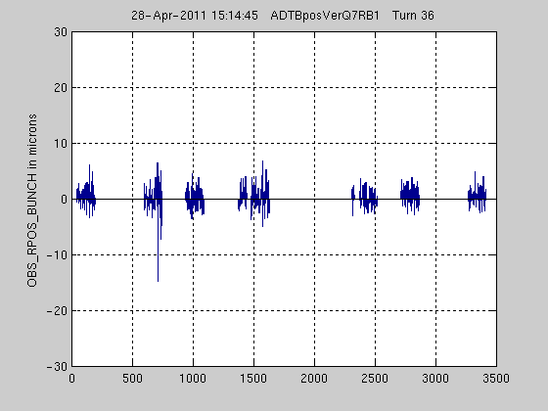
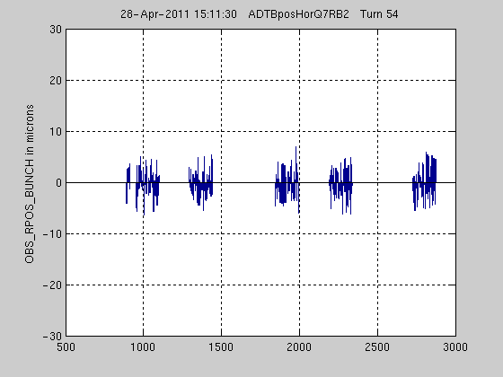
Bunch instabilities seen by ADT pick ups

Slide 10
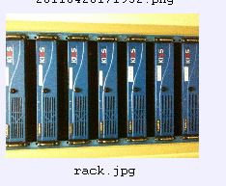
Thursday continued
16:59 #1744 Beams dumped
Communication problem: RF, TCDQ,
SIS says no
The faulty FrontEnd is cfc-ccr-ctlxtim whose powersupply is tripping the whole barrette. The FrontEnd first line team is changing this crate now.
Pierre Charrue
plus some cleaning up afterwards

Slide 11
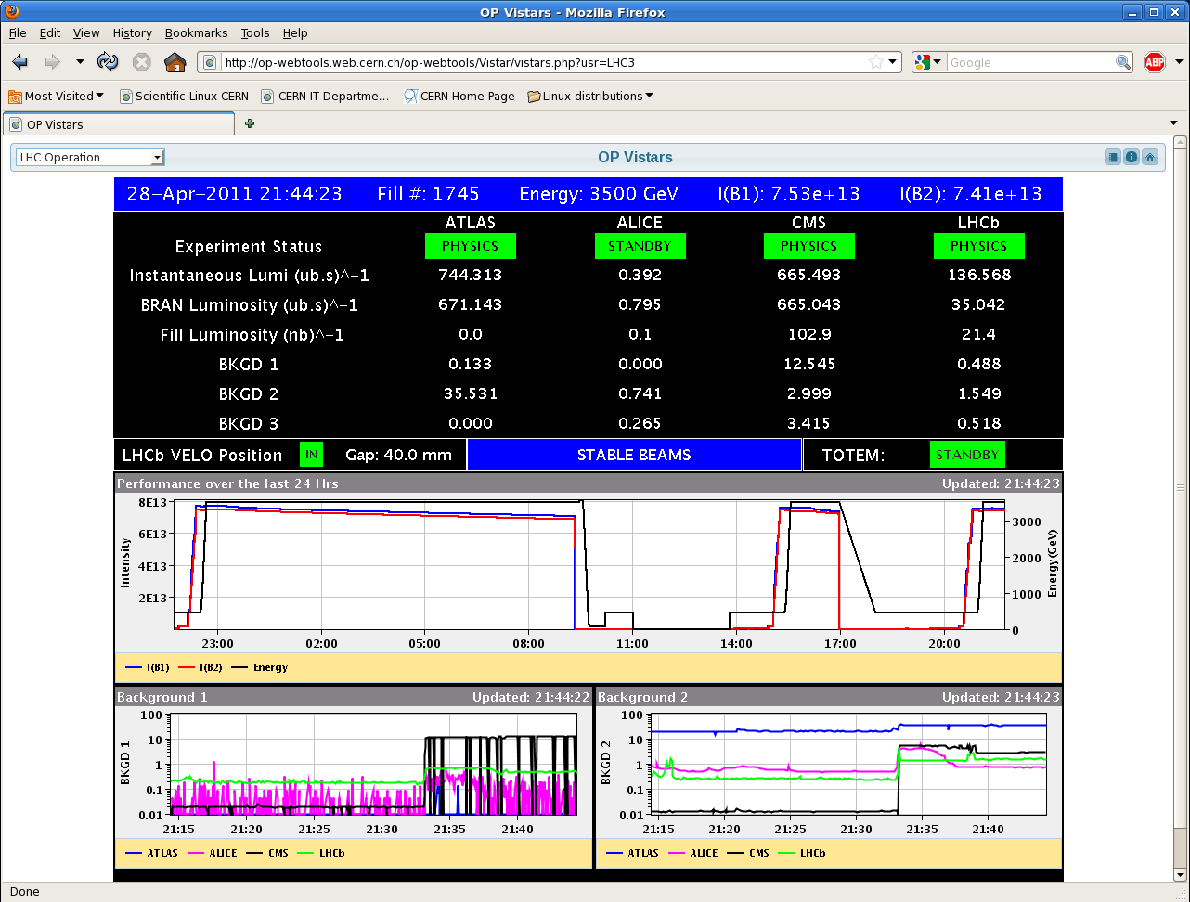
Fill 1745
20:57 Start ramp
21:41 Stable beams

Slide 12
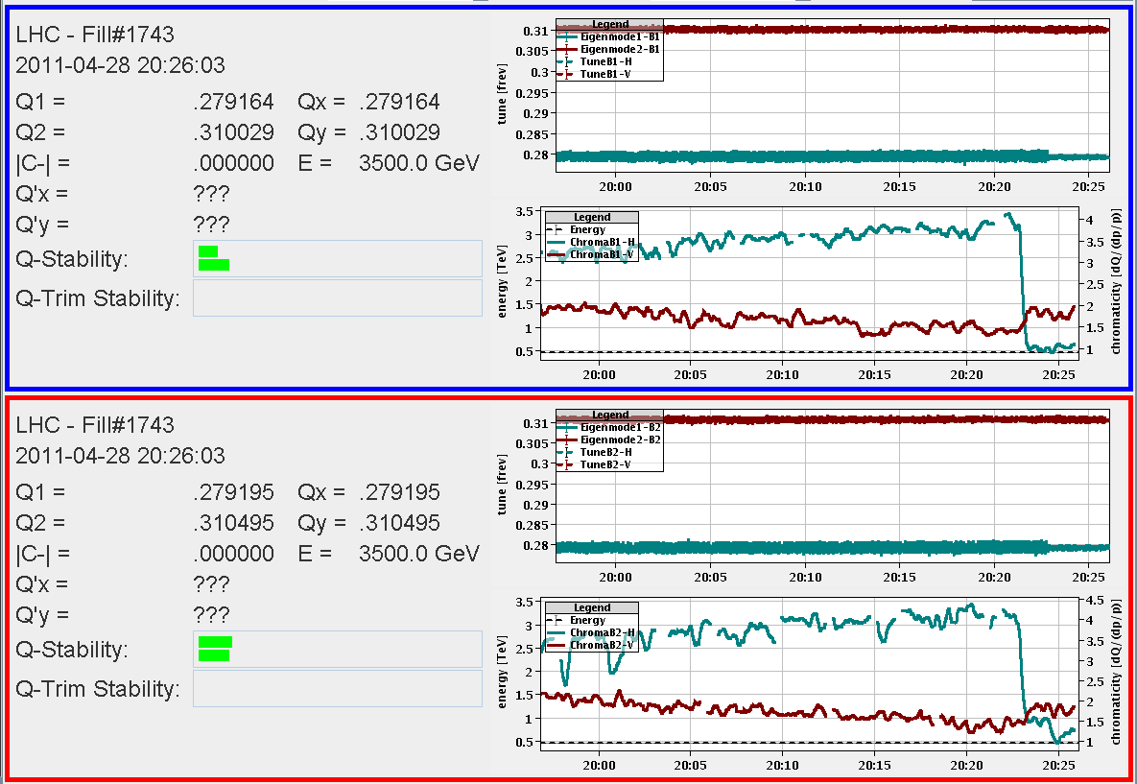
450 GeV - tactics

Slide 13
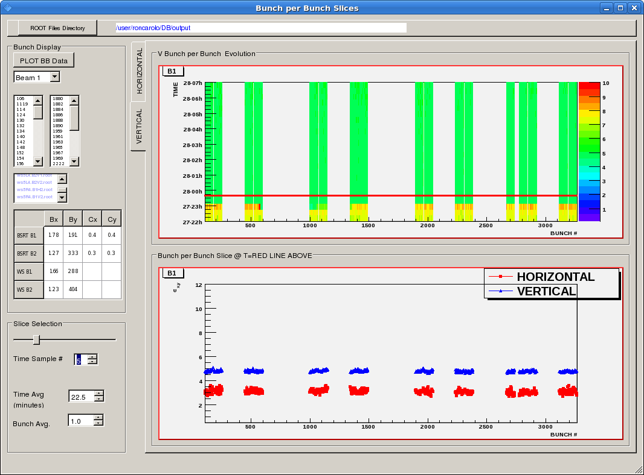
BSRT in stable beams

Slide 14
Night shift summary
Nothing to report: 8 hours of stable beams - Walter & Eric

Slide 15
Incoming
Stable beams this morning
Access
QPS controller reset (SEU)
AGK checks – 2 hours with beam at 450
before next step-up
624 again
Seek approval for next step (768 bunches)

