Slide 1
Weekend – brief resume
Lost ramp for physics around 2:30 Saturday
Vacuum spike - R2.
Short fill overnight Friday to Saturday (1748) lost to trip of ROD.A12B1
Access for power converter repair
Saturday early afternoon: Stable beams (1749)
Lost to BLM communication problem ~16 hours later
Sunday morning: access for QPS controller reset, vacuum pump repair - inner triplet L5
Thanks to Mirko & Louis, Verena & Ron, Giula & GHH for holding it together over the weekend!

Slide 2
Last night
Set-up for 768 bunches
Lost first go at top of ramp with MKI UFO L2
Into stable beams 19:00 Sunday
20:30 lost to collimator position interlock on TCTs point 1 beam 1. SEE strongly suspected
Communication lost on QPS controller for MB.A32L4 - access
Precycled and stayed forever at injection, first to verify the chroma (FIDEL corrections made it very stable) and afterwards for a PSB problem. Finally decided to fill despite the fact that the beam was not perfect as the piquet + the experts could not do better.

Slide 3
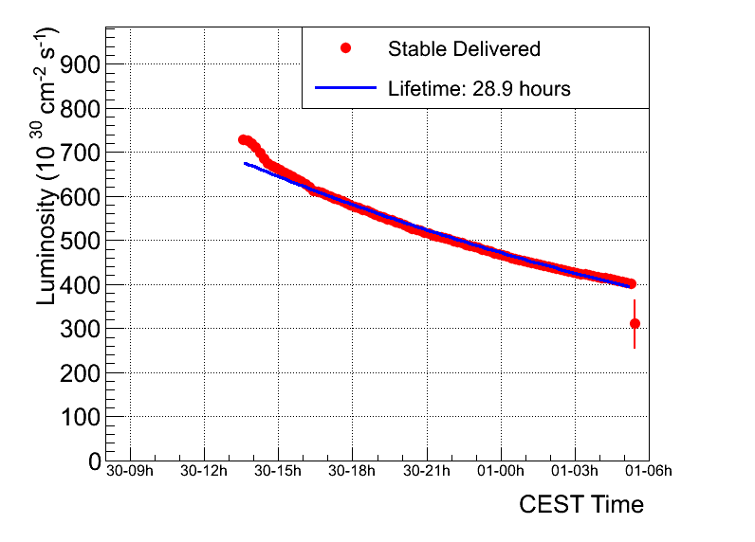
Fill 1749 – overnight Saturday to Sunday
Peak luminosity | ~6.9 e32
Integrated luminosity | ~29.7 pb-1
Stable beams | 15 hours 53 minutes
Colliding bunches | 598
Average emittance from luminosity | ~2.5 micron

Slide 4
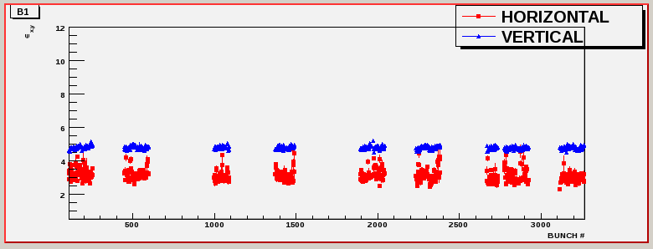
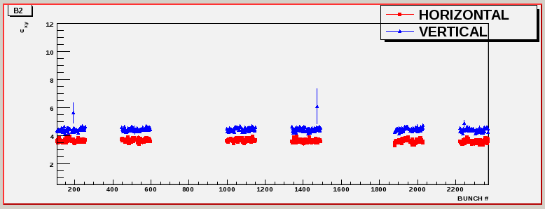

Slide 5
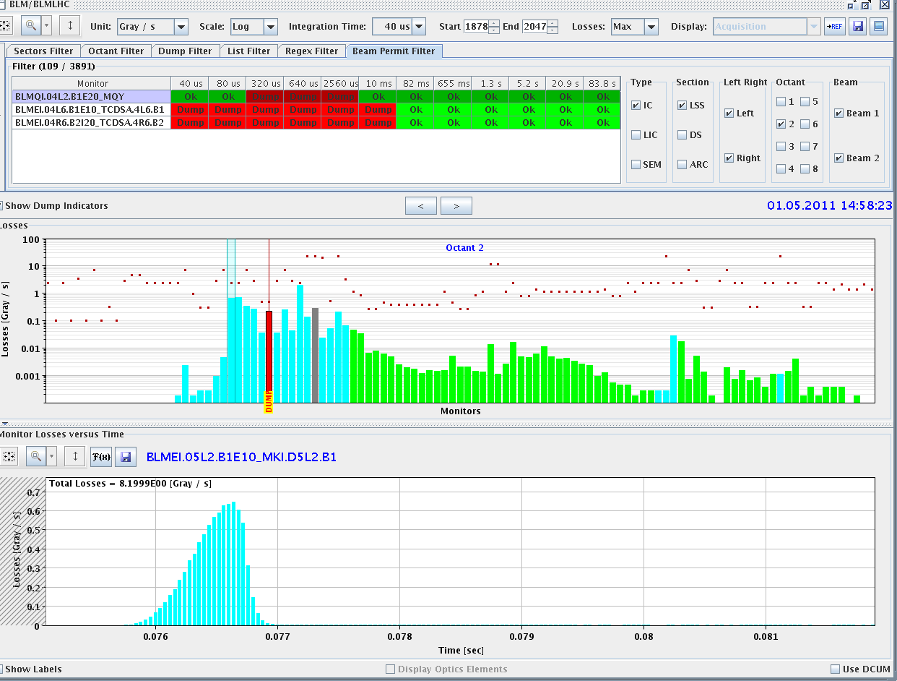
UFO – L2

Slide 6
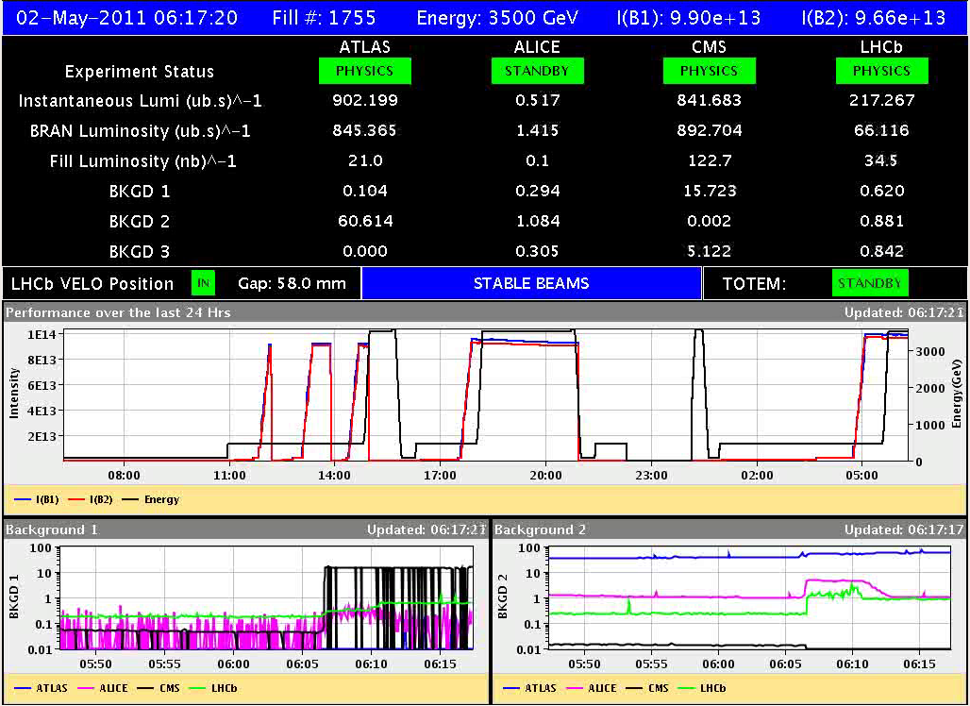
“Not bad in the end”
Giulia Papotti

Slide 7
Brief Summary week 17

Slide 8
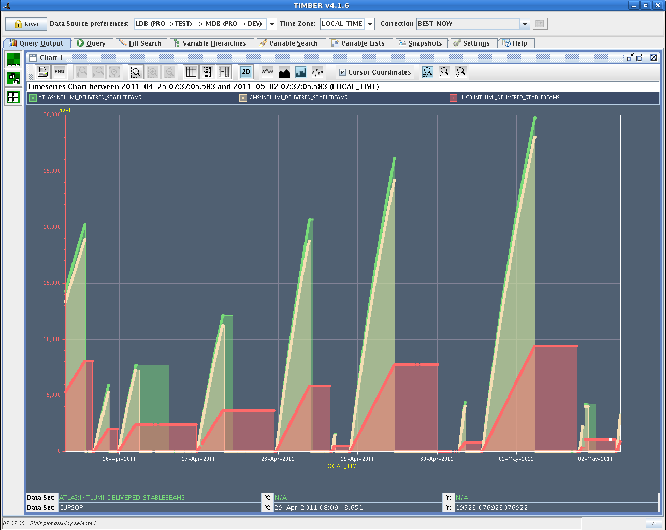
Delivered lumi over the last 7 days

Slide 9
W17 physics fills – Monday to Thursday
FN | Stable beams | Peak [e32] | Int Lumi | EOF reason
1735 | 16h 34m | 4.85 | 20.2 | OP dump
1736 | 7h 4m | 4.27 | 5.9 | Slow loss in all of IR8, high vacuum spikes to 1E-6
1737 | 5h 7m | 4.71 | 7.5 | anticipating loss of cryo maintain.
1739 | 7h 44m | 5.2 | 12.1 | Loss of cryo in S78 (and later 81) due to fault on cooling of turbine.
1743 | 10h 2m | 7.05 | 20.6 | Beam Loss due to vacuum spike in IR8, triggering the BLM TCTVB.4R8 - 20 s RS

Slide 10
W17 physics fills – Thursday to Monday
FN | Stable beams | Peak [e32] | Int Lumi | EOF reason
1744 | 43m | 6.11 | 1.5 | Fuse blew in the FE ctlxtim in a CCR rack,
1745 | 13h 22m | 7.19 | 26.0 | OP dump
1748 | 1h 49m | 7.21 | 4.3 | Octupole circuit ROD.A12B1 tripped due to fault in the auxiliary power supply.
1749 | 15h 53m | 7.29 | 29.7 | BLM comms.
1750/3 | 1h 29 | 8.37 | 4.2 | TCT position interlock
1755 | Still in | 8.84

Slide 11
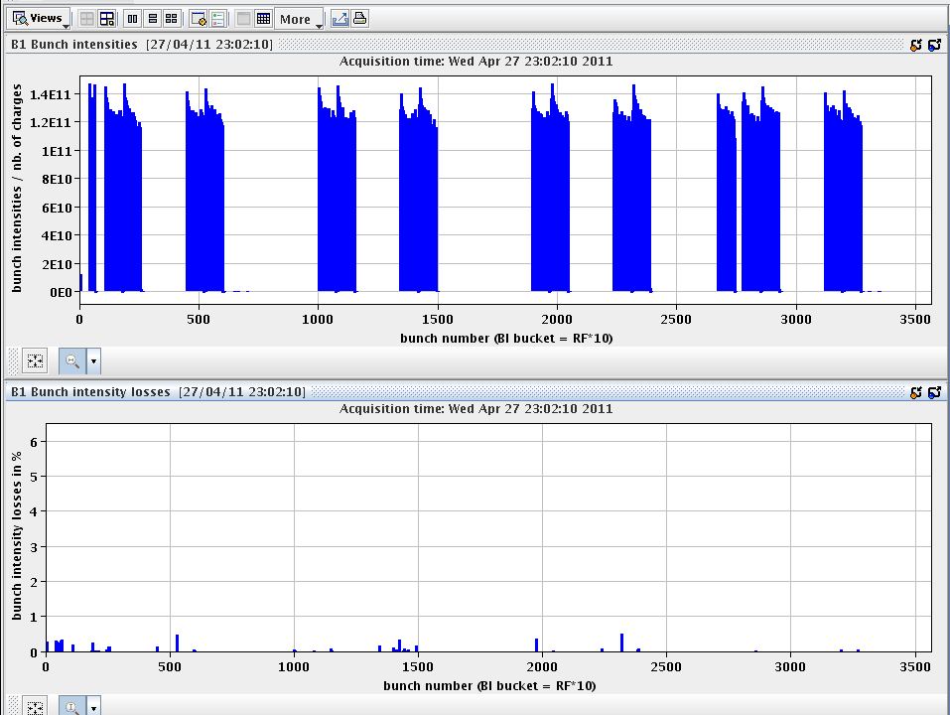
losses on ramp

Slide 12
bunch intensity distribution
bunch emittance
distribution after 6h run

Slide 13
Timeouts
Energy extraction S34
Cryogenics
Compressor stop – quick recovery
Access for filter de-ice
Turbine cooling fault
Atlas
Power glitch...ALICE both magnets, ATLAS both magnets and RF tripped. Lost 6 sectors and the undulator R4.
QPS controller resets…

Slide 14
Issues
Dynamic b3 correction
Transverse CBI at 450 GeV
Energy extraction – S34
Vacuum R2 and R8
AGK
PM25 – sensitive - patrol lost*N
BPM front-end memory
Flying blind in the ramp
Plenty of problems with communication/DIP servers: energy plots on page 1

Slide 15
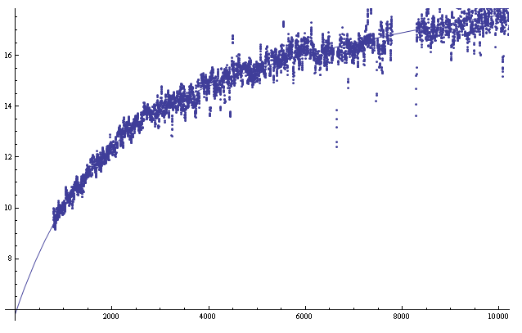
Dynamic b3 correction
Chromaticity swing at injection

Slide 16
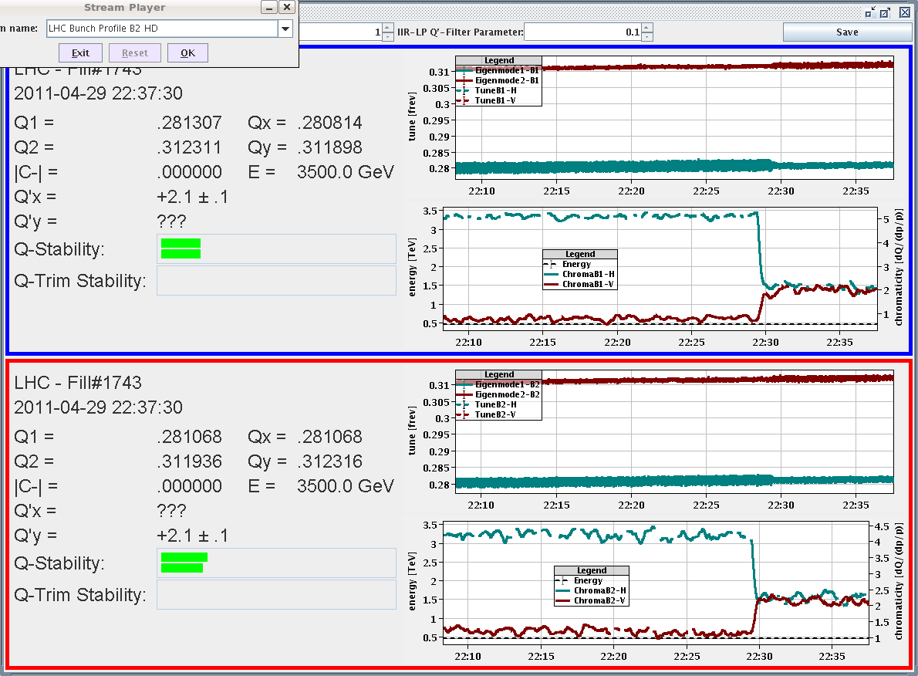
Chromaticity at 450 GeV
Marek Strzelczyk

Slide 17
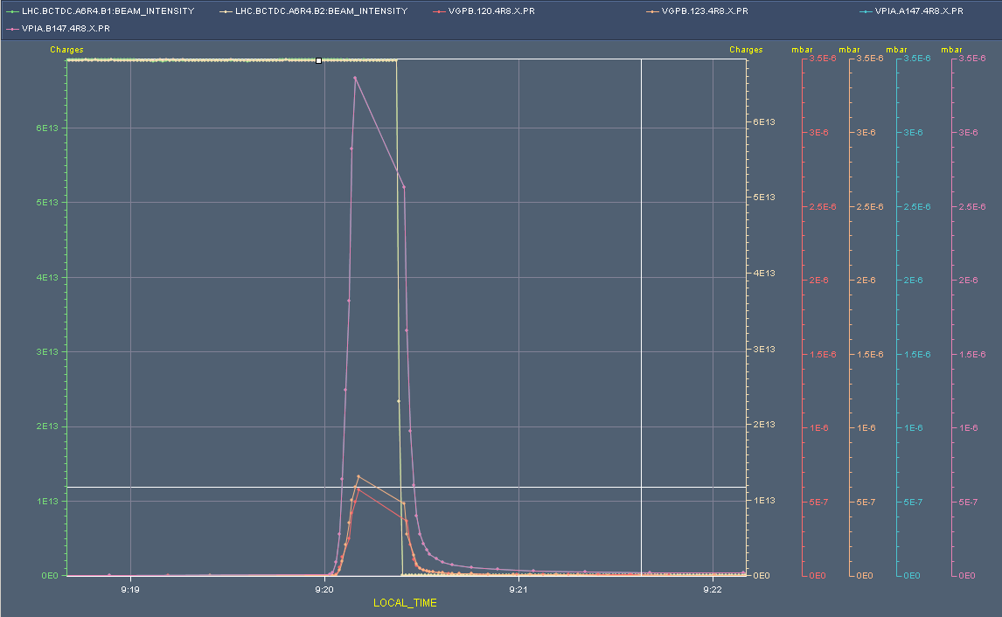
Thursday morning
Fill lost to slow beam loss on vacuum pressure bump R8

Slide 18
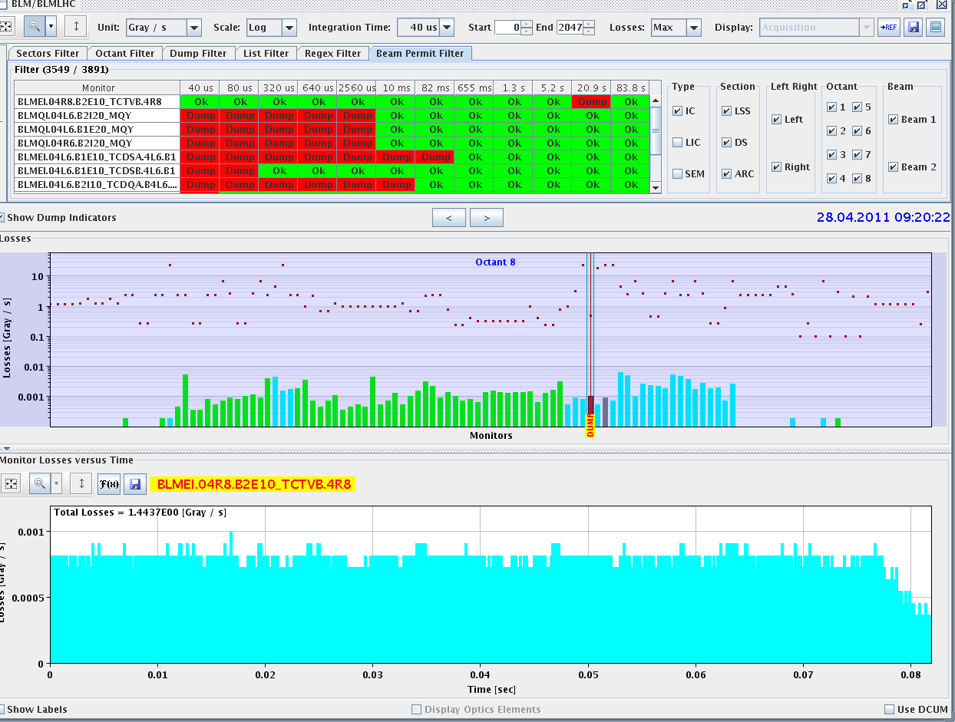
Dumped on long running sum TCTVb.4R8
LHCb confirms that it was a real event, their BCM had a similar signature as the losses on the TCTVb.

Slide 19
Vacuum layout R8 & R2
Interlock level increase to 2e-6 in all triplets Switched on the solenoids in point 2.
Giuseppe Bregliozzi Giulia Lanza

Slide 20
AGK check
Following 72 bunches straight onto the TDI
Conclusion: AGK for B2 (which had the missing pre-pulse on 27/04/2011) seems to be fine and has a margin of 5 * 2.5 ns = 12.5 ns which should be sufficient for the system to be reliable. No changes relative to initial set-up on 11/03/2011.
Etienne Carlier, Jan Uythoven

Slide 21
SEUs
QPS controllers – regular access
The collimator system for these two TCTs has rebooted by itself – strongly suspect SEE.
See Roberto Losito

Slide 22
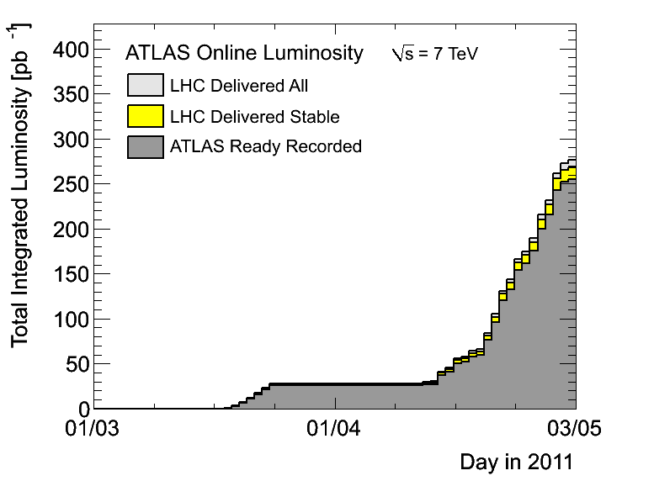
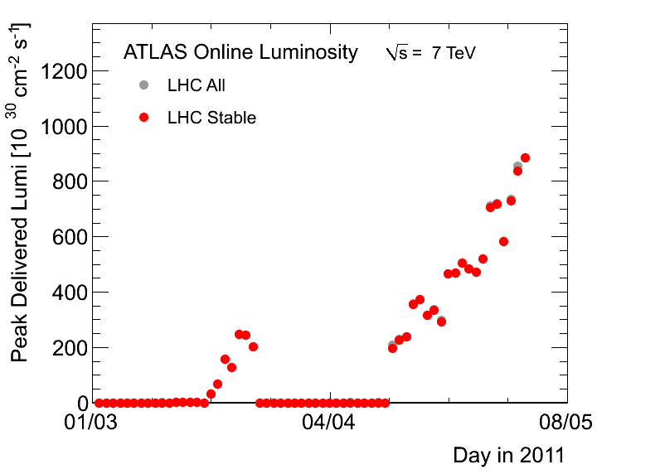
Conclusions
on the back of excellent availability, great machine performance
Number of issues – SEEs being probably the one with the potential to hit availability…

