Slide 1
Thursday 21/4
07:30: End of fill #1727. Beam dumped. ALICE compensator magnet fault. Delivered ~6.7 pb⁻¹ in 7.5 h.
11:30 Stable beam #1728. 480 bunches/beam. Initial luminosity up to ~4.0x10³² cm⁻² s⁻¹.
20:10 End of physics #1728 - 9.7 pb⁻¹ in 8.6 h. 15.2 pb⁻¹ in 24 hours
23:55 STABLE BEAMS #1729 - 4.8(ATLAS)/4.4(CMS)x10³² cm⁻²s⁻¹ WORLD RECORD IN PEAK LUMINOSITY IN A HADRON COLLIDER
06:55 Beam dump (LHCb movement – stable beam flag glitch?). End of physics #1729 - ~9pb⁻¹ after 7 hours. We have now ~87.8 pb⁻¹

Slide 2
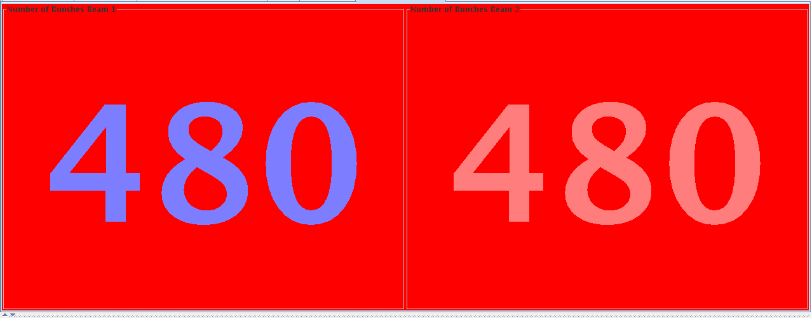
#1728

Slide 3
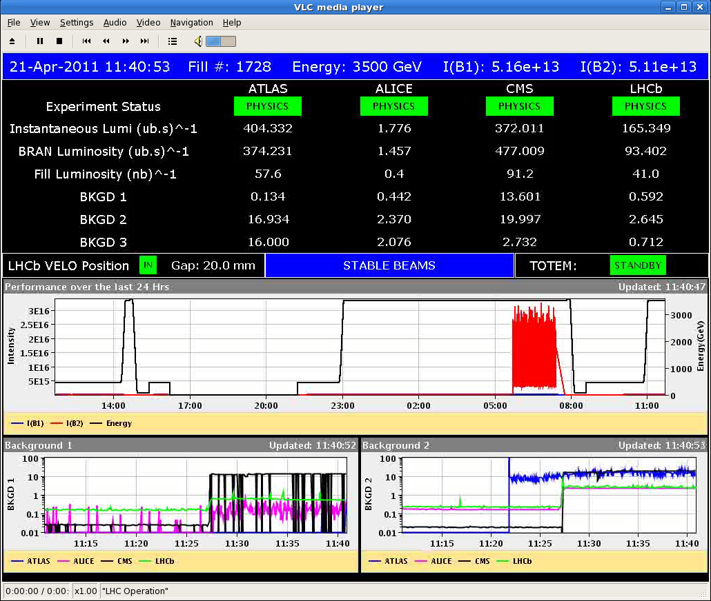
#1728
ATLAS just on the edge

Slide 4
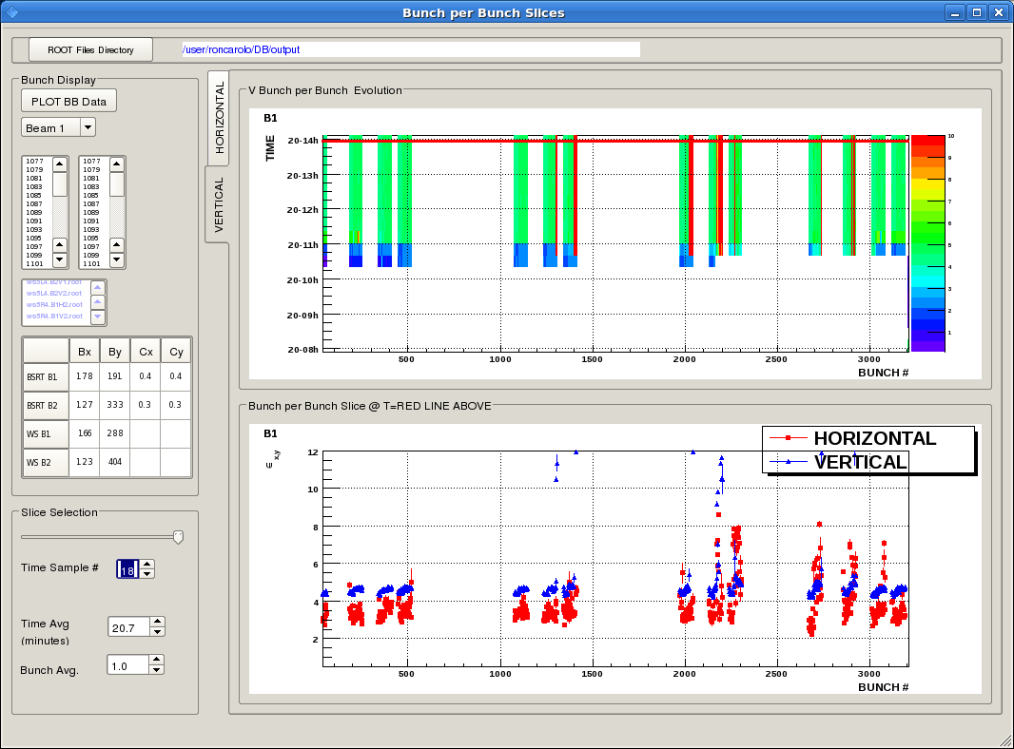
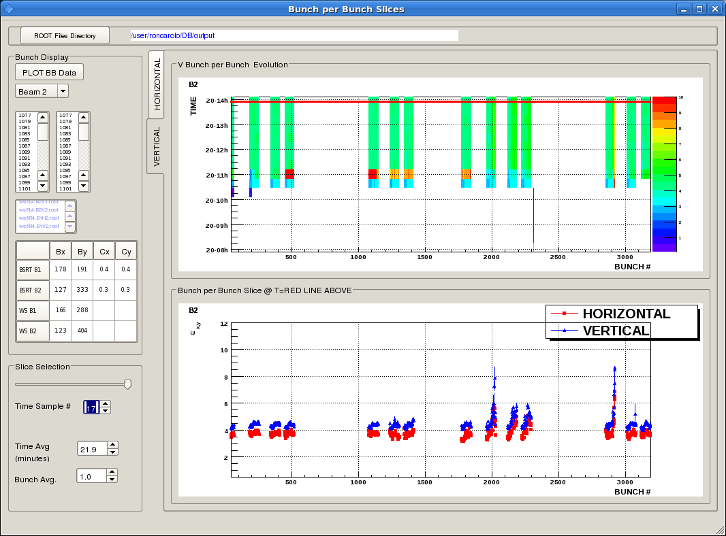
#1728
Still blow-up observed in some of the trains (H & V), particularly Beam 2. Responsible for marginal performance. Bunch intensities on the low side.
Most of the blow-up observed at injection energy

Slide 5
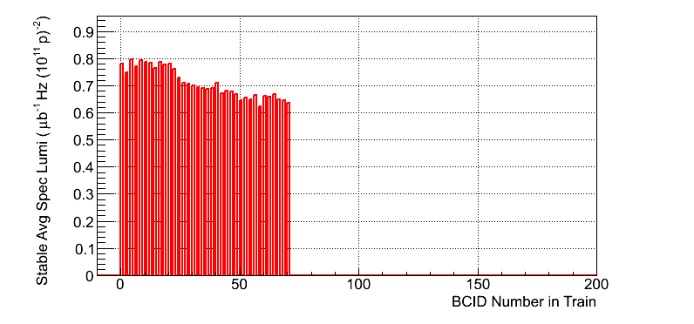
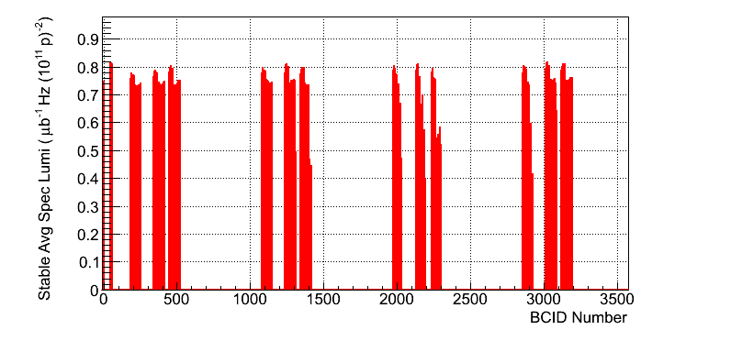
#1728
Blow-up from BSRT consistent with ATLAS observations

Slide 6
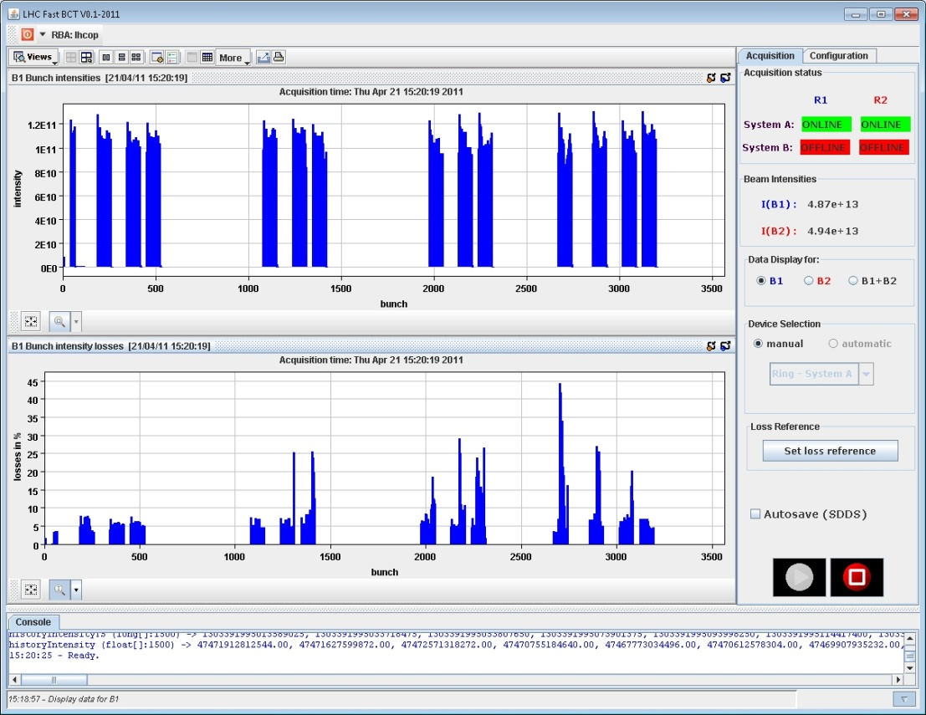
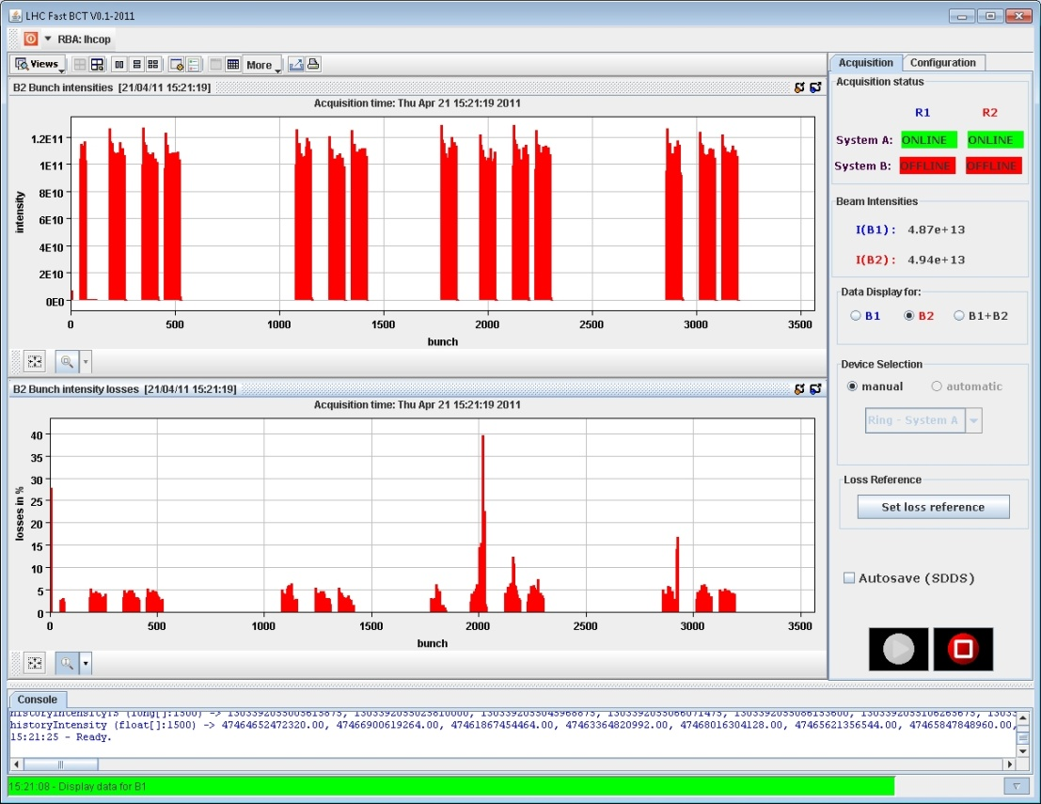
#1728
Losses mostly affecting Beam 1

Slide 7
Fermilab is watching us….
Accelerator Division World Records
World Records
Antiproton Beam Energy: 980 GeV, Now. In the Tevatron
Initial Luminosity: 4.024 E32 [1/cm**2 sec], 16 April 2010, Store #7747. This was a Recycler shot and another WORLD RECORD
Beam power in a DC Electron Beam: 7.8 MW, 9 April 2006. Generated by the Recycler
The ISR achieved an initial proton-proton colliding beam luminosity of 1.4E32 [1/(cm**2 sec)] at 31 GeV in 1982. They now have the second highest luminosity for a hadron collider in history
LHC Initial Luminosity World Record? 22 Apr 2011 We are awaiting official word from CERN as to whether or not fill number 1728 has set new world record for initial luminosity at a hadron collider.
See notes on the progress of the LHC, below.

Slide 8
#1729
Minimized chromaticity at injection (difficult as Q’H is increasing and Q’V decreasing with time) ➔ large negative chromaticity at the end of the fill ➔ dump and re-fill
Chromaticity set to <2 in both planes
Damper V gain increased from 0.18 to 0.25
Doubled Damper H gain during the ramp

Slide 9
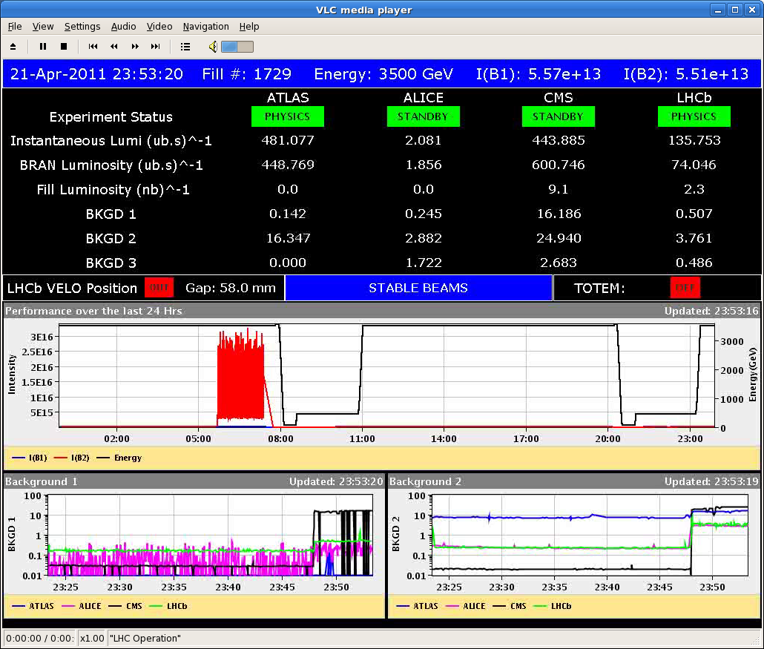
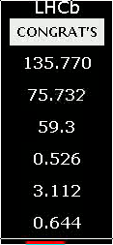
#1729
This time no doubt: LHC has achieved the highest peak luminosity for an Hadron collider.

Slide 10
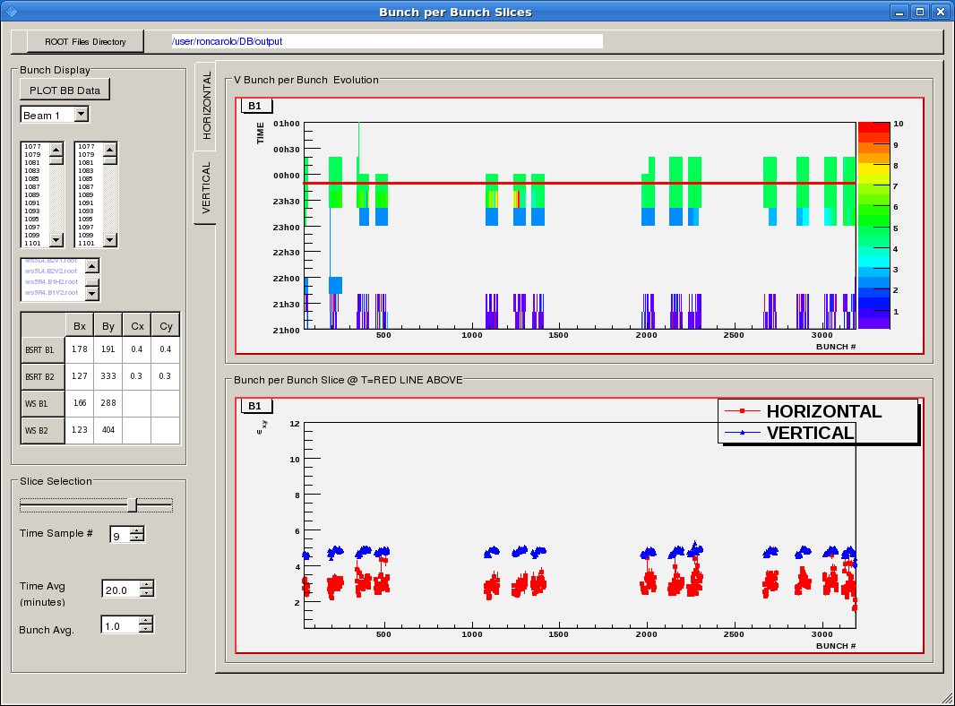
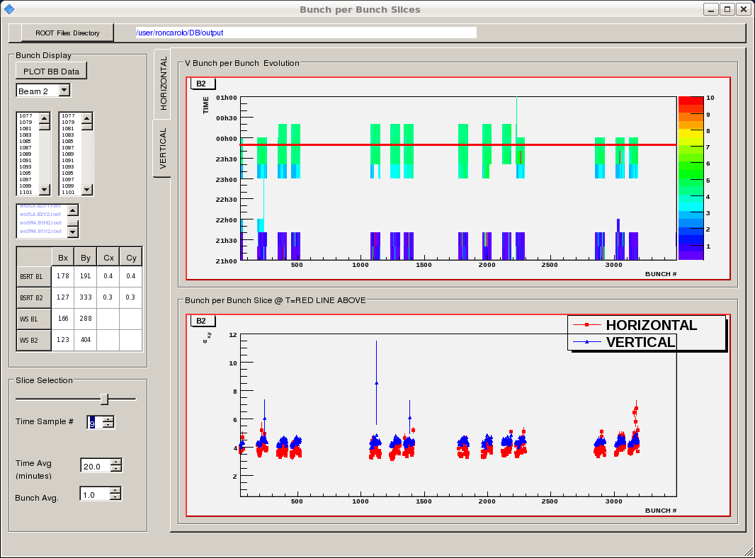
#1729
Much better beam quality! Emittance consistent with ~2.5-2.6 μm in collision
Very clean ramp and squeeze

Slide 11
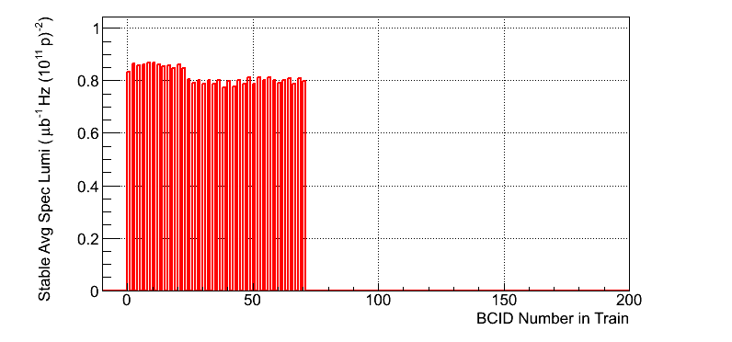
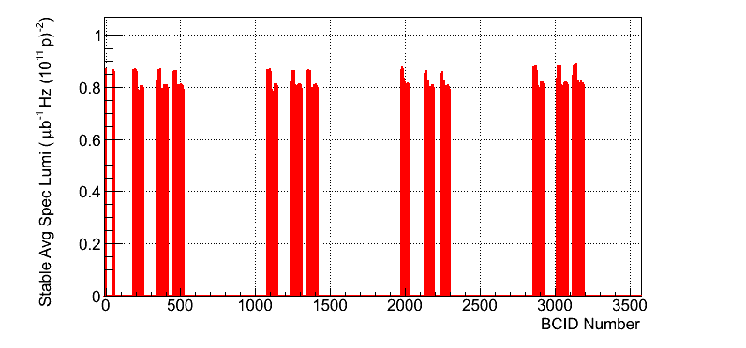
#1729
Much better beam quality!
Very clean ramp and squeeze. Nice distribution in specific lumi

Slide 12
Plan
Fill for physics with 336 bunches and trains of 72 bunches
Night: fill for physics with 480 bunches (trains of 36 bunches)

