Slide 1
Friday 14.04
00:00 machine setup for luminosity run. Better b-to-b stability from injectors.
01:58 stable run with 228 bunches
11:00 luminosity leveling in IP8 tested successfully
12:11 dump by EIC, precycle, injection & ramp.
In stable beams: 10h13
15:49 stable run 228 bunches. 1 UFO at 60% of dump.
19:18 Beam dump power conv. (PIC) RCBCH10.L4B2.
In stable beams: 3h29
20:45 Access for PC
22:08 Injection
00:20 Stable beams. 228b.
05:15 Beam dump from electrical perturbation.
In stable beams: 4h55

Slide 2
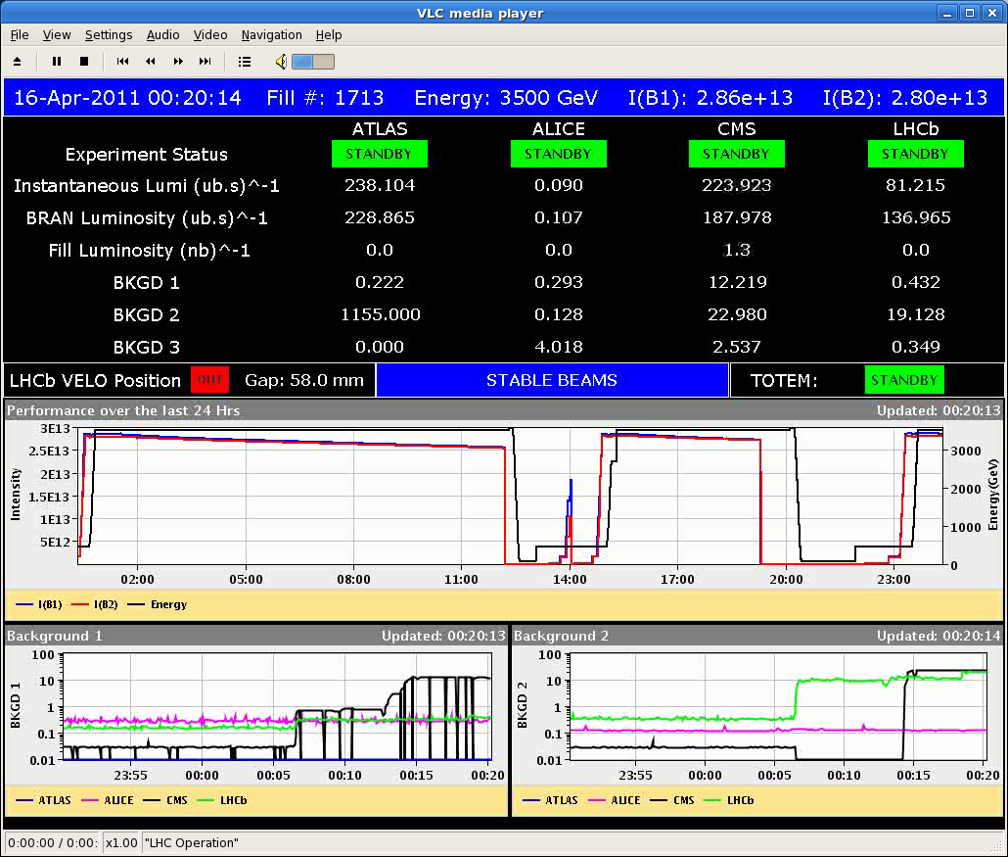
Start Stable Beams #1713

Slide 3
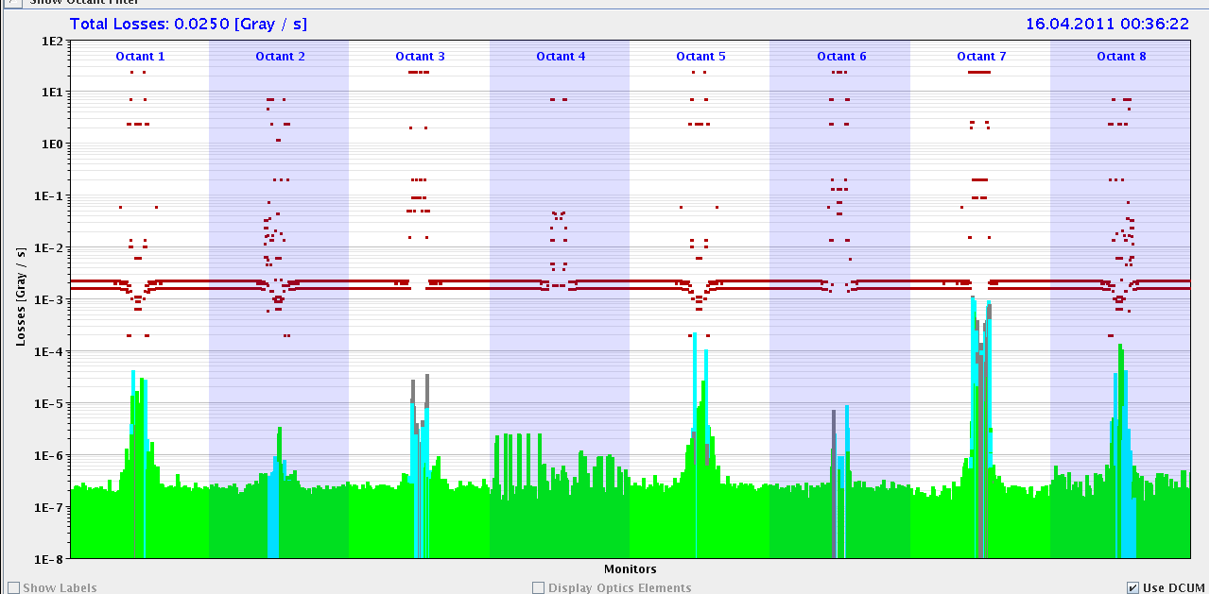
Normal losses in collisions

Slide 4
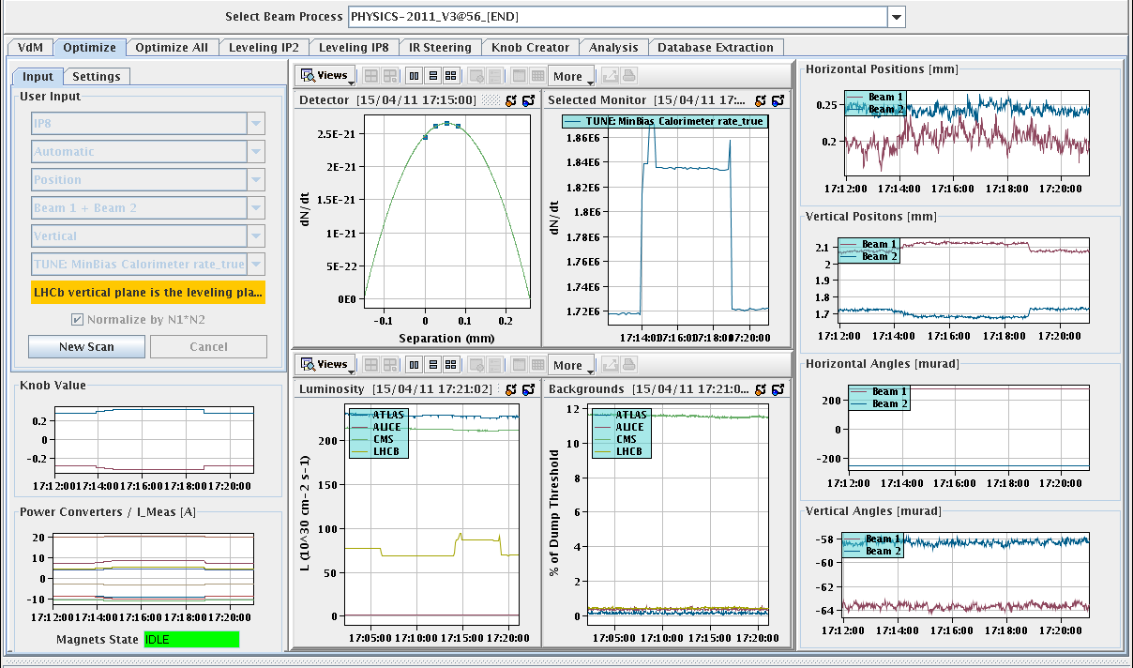
Lumi leveling test

Slide 5
Saturday 15.04
08:00 Electrical perturbation in IR2 ongoing.
Started last Thursday 04:00 in the morning. Transparent at that time until now.
Now it trips compensator (IR2)
IR2 compensator (active filter) must be disconnected.
EIC checked with EPC that switch off can be done with LHC powering up.
Integrated lumi (2011): > 40 pb⁻¹
Highest lumi per day…

Slide 6
Incoming
In stable beams for 228b and 50ns: 18.6 hours + 3 fills
No issues for these three fills. Only normal beam losses.
+ 1st 50 ns fill in stable beams on Wednesday: 1.7 hours
Were qualified for 300b with 75 ns…
Discuss next step…
336b
start with 72b inj scheme, if problems drop back to 36b inj
Saturday | Switch to 336b?
Sunday | Physics 336b

