Slide 1
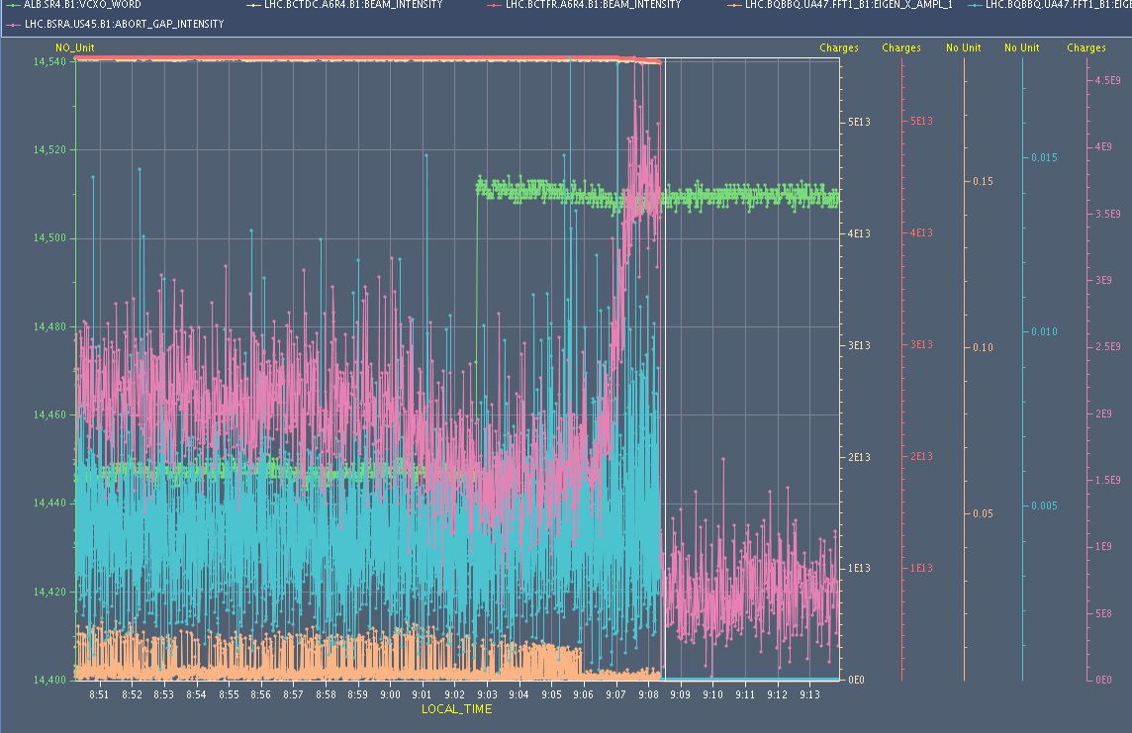
LHC Status Wed Morning 13-April
R. Assmann, B. Holzer et al

Slide 2
Tentative Plan for
Monday / Tuesday
✔
?

Slide 3
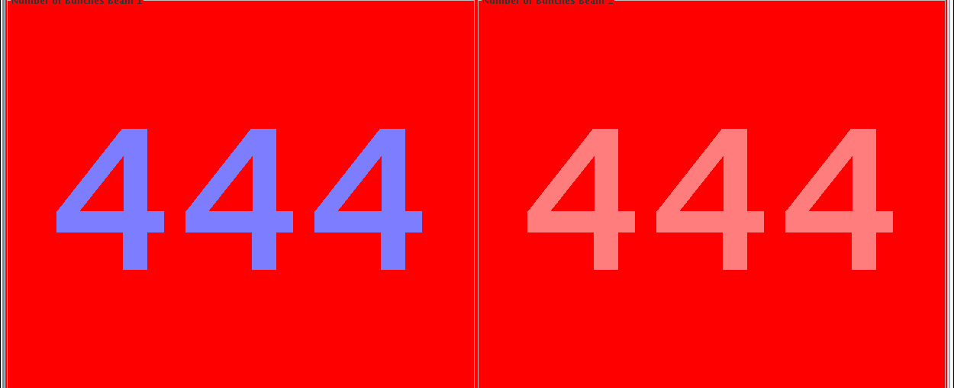
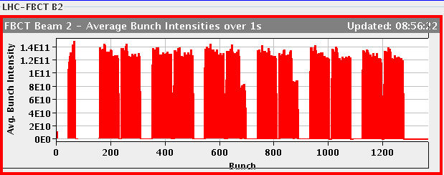
Tue Morning: Restart after tech. Problems
Main techniccal issues:
Access system: e-stopper relais
Fire detection system
Access door got a new dump due to an access door in P4 which opened by itself.
QPS quench heaters
Restart: injection setup

Slide 4
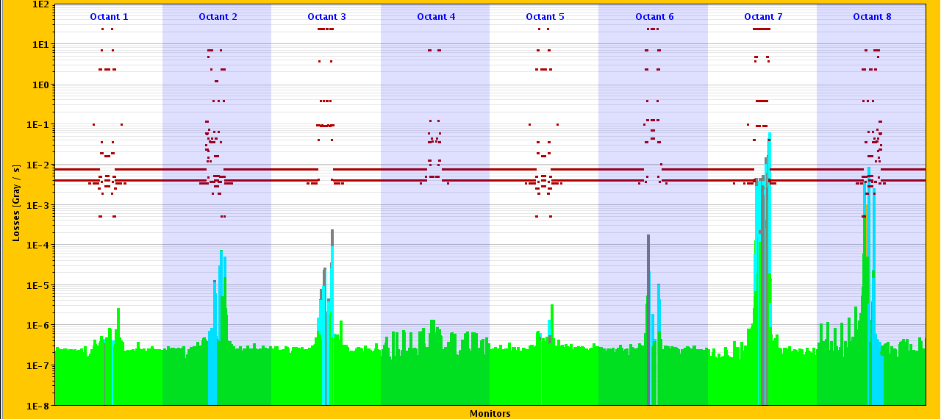
Tue Morning: e-cloud checks
RF frequency trimmed by +10Hz
+/- 10 Hz
but ...
beams dumped - high losses in IP7

Slide 5
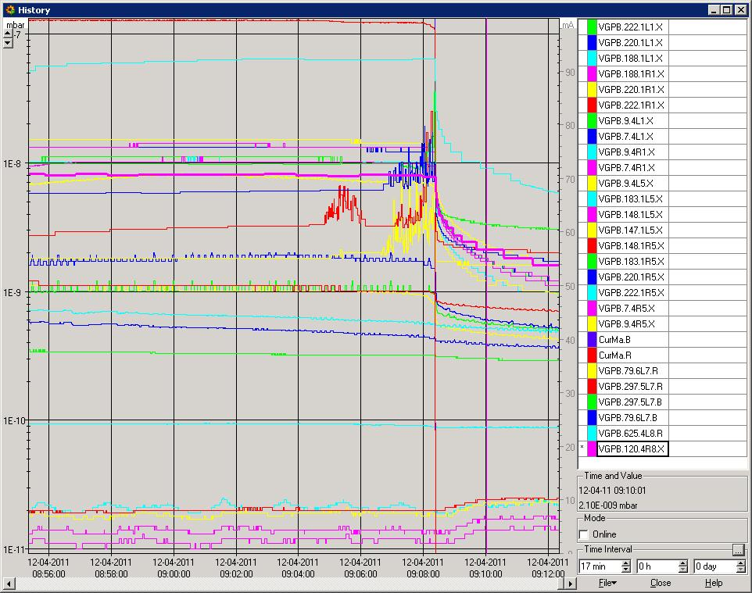
Tue Morning: the 10 Hz problem
e-cloud ?
IR 7
beams dumped - high losses in IP7
LSS 5 / 1

Slide 6
Tue Morning: the 10 Hz problem
b1
loss pattern:
b2
Loss occuring ~5 minutes after the frequency trim
The lossess affect initially B2 then B1 again and finally B2
The first loss is affecting all bunches while the second only some of the bunches of the tail of the trains
No sign of instability is observed either in the BBQ nor from the damper pick-ups Losses at TCPs are consistent with an increase in abort gap population

Slide 7
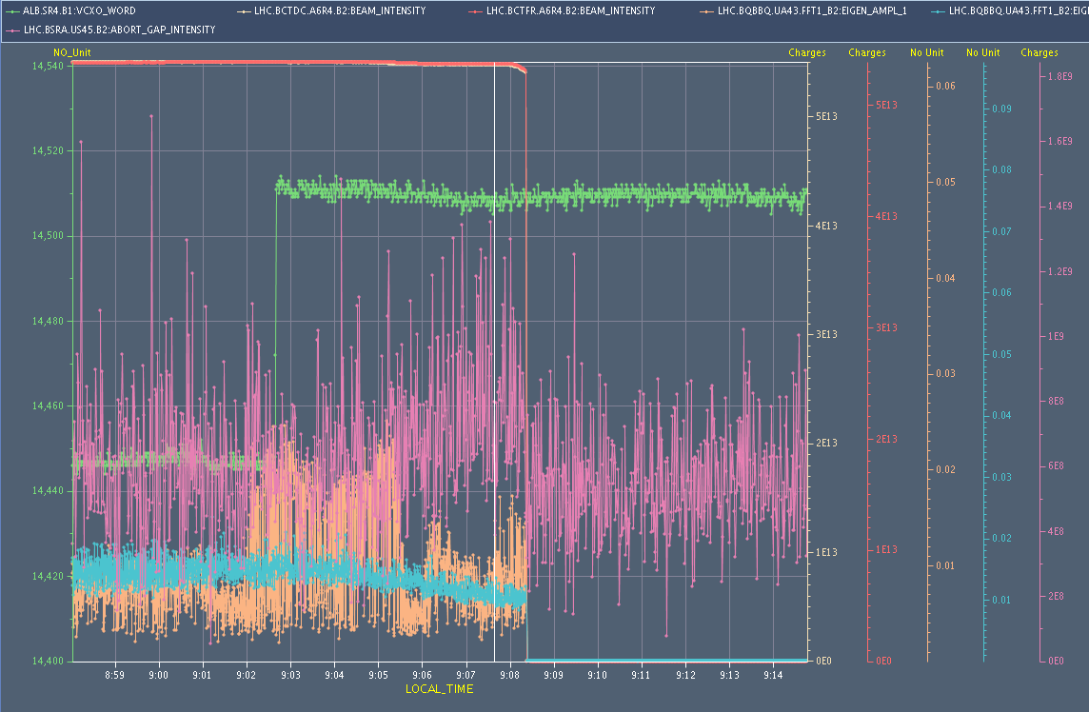
Tue Morning: the 10 Hz problem
en detail: b2
beam current
frequency
abort gap intensity
bbq amplitude y
bbq amplitude y

Slide 8
Tue Morning: the 10 Hz problem
en detail: b1
beam current
frequency
abort gap intensity
bbq amplitude y
bbq amplitude y

Slide 9
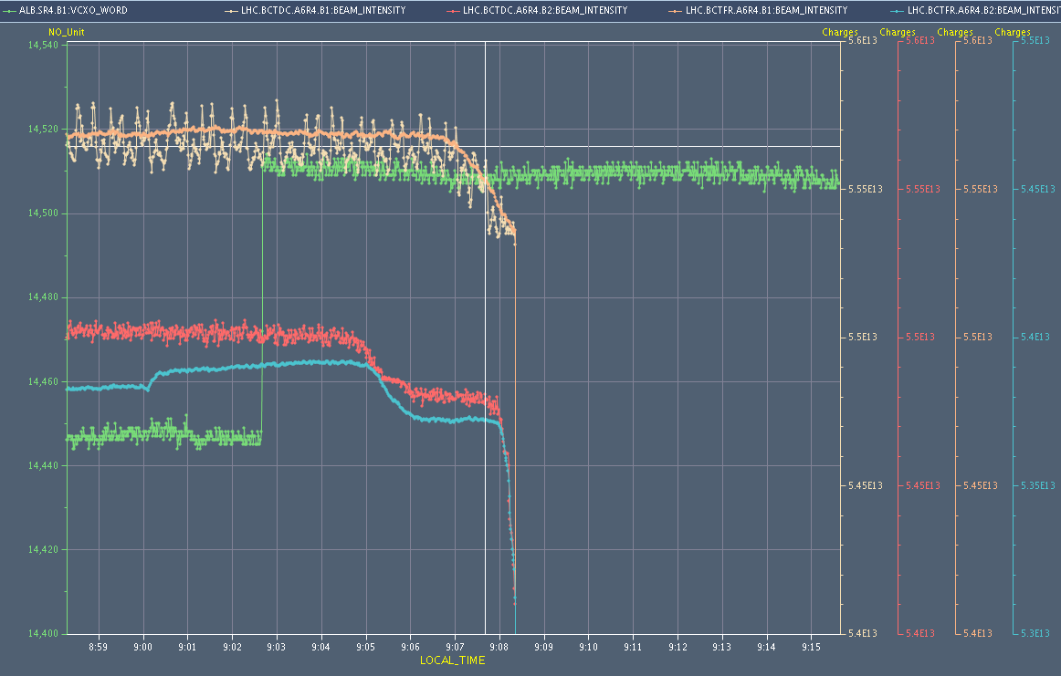
Tue Morning: the 10 Hz problem
en detail: b1
beam current b1
frequency
beam current b2

Slide 10
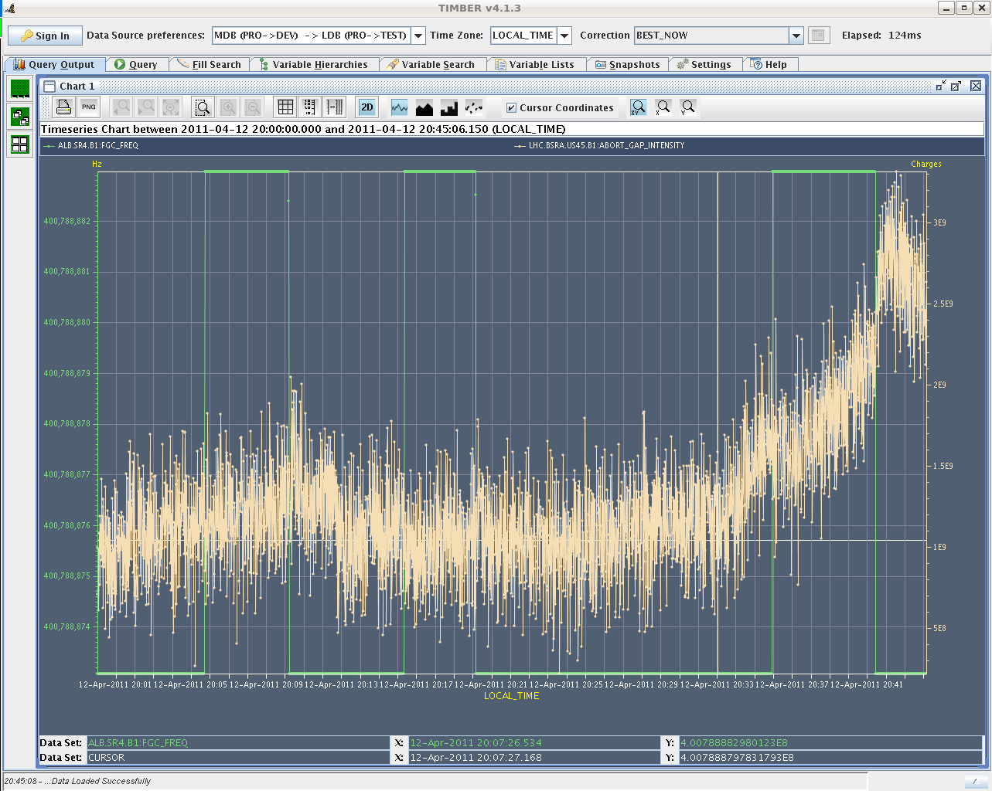
Tue Morning: the 10 Hz problem
da capo:
48 bunches in... rimmed again + 10 Hz.
Nothing happening. No additional losses.
228 bunches circulating.
Switching off abort gap cleaning.
Trimmed +10 Hz. Nothing happening.
Abort gap population went up when
reverting frequency trim.
Sent another 10 Hz
(total + 20 Hz off).
Another step in the abort gap
population.

Slide 11
Tue Late: Restart after tech. Problems
And again: technical issues:
BLM intervention status: Identified high voltage supply fault on the whole arc of R4
21:30h Ventilation door interlock for injection.
-> Access
... Access finished, door had been really open.
0:31-3:30h Piquet working on PSB LLRF.

Slide 12
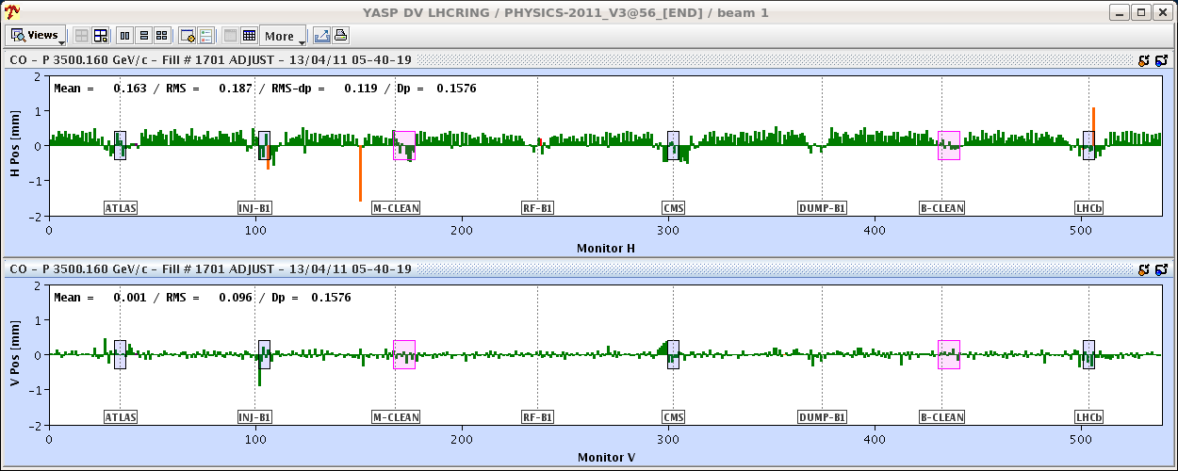
Tue Night:
scrubbing checks
1.) Restart after technical Problems
inject 2 nominal & 1 pilot per beam
precycle,
inject 36 bunches.
ramp & squeeze: test the + /- 10 Hz problem bunches ?
how much space do we have in the basic beam parameters
tune, orbit, chroma, coupling etc
Trimmed QV & QH +0.003 for both beams.
Trimmed RF by -20 Hz (at nominal tunes).

Slide 13
Wed Morning:
2.) Test Ramp to 3.5 TeV:
48 bunches: inject and ramp 48 bunches in both beams, ramp, squeeze, collisions ... observe vacuum, rf, cryo load etc
check for beam robustness:apply + / - 20 Hz change tune by + / - 0.003 in both beams scan
3.) 200 bunches: inject ,ramp, squeeze, collisions ... observe vacuum, rf, cryo load etc
check for beam robustness:
1 hour for the experiments
4.) rescrubbing,
inject 1020 bunches ,go on scrubbing at 450 GeV observe vacuum & cryo load
✔
✔

