Slide 1
Wednesday 6th April
Injection of 50 ns up to 108 bunches (3 x 36).
OK - ~40-50% of dump level.
Beam not so stable in the SPS with 3x36.
Beam1 drifting… magnetic cross-talk from Hiradmat?
Morning: scrubbing with trains of 36 bunches up to 300 b
Afternoon: scrubbing with trains of 36 bunches up to 400 b
Short access at 06:00 for RF.
Fix an interlock cabling error (vacuum gauge).
Intensity limit increased to 600 bunches for the night.
Temporary reference orbit defined for trains to bridge systematic offset problem (→ see later).

Slide 2
Wednesday 6th April - night
RB S81 trip at 23:40 with 408+300 bunches (trains of 36). Access needed.
‘Bridge cooling..
After access ventilation door UL86 status indicates OPEN.
New access to check it. It was closed – switch problem.
SIS interlock had to be masked – no more protection for this door.
04:00 beam back.
06:30 408+336 bunches (trains of 36). Beam dumped due to cryo in AR45.
Problem on a temperature sensor.
07:15 RB S45 trip during pre-cycle.
QPS…

Slide 3
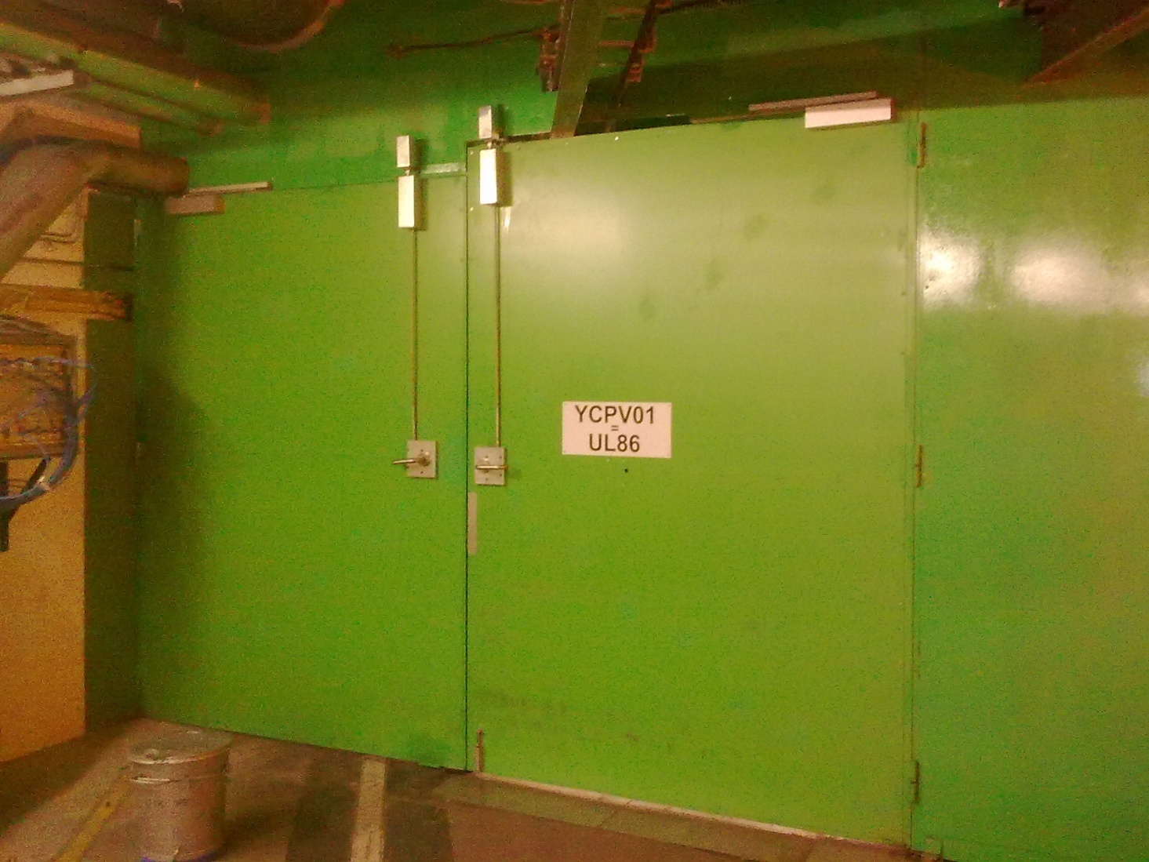
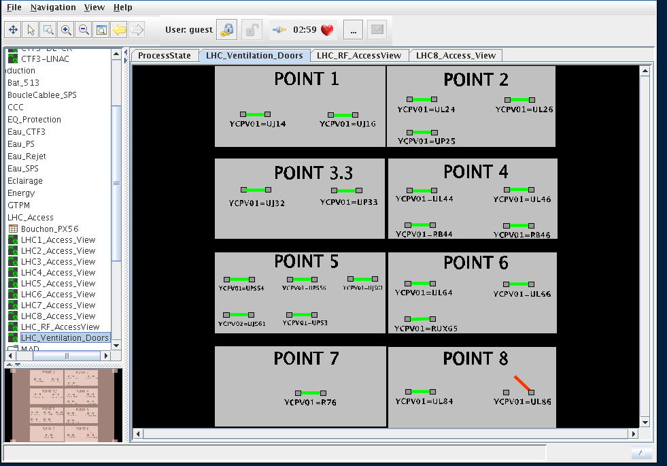

Slide 4
5 ns satellites in trains of 36

Slide 5
Losses with 300 bunches

Slide 6
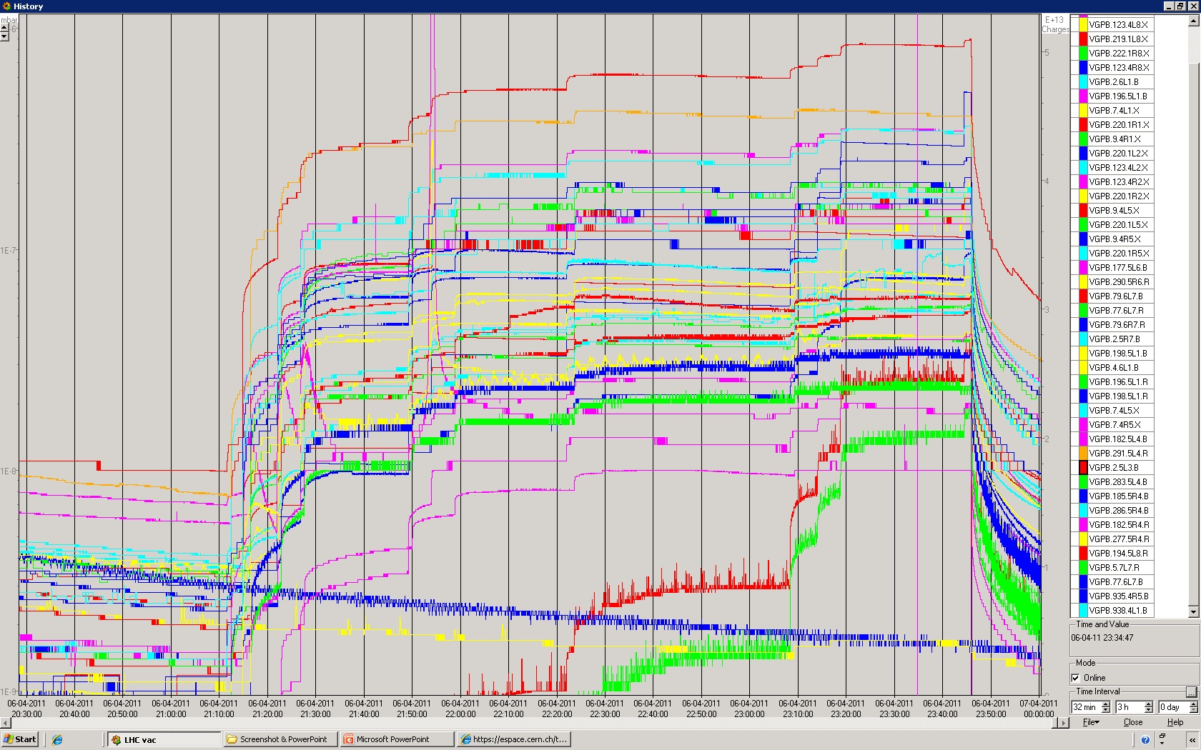
Vacuum – up to 408 bunches

Slide 7
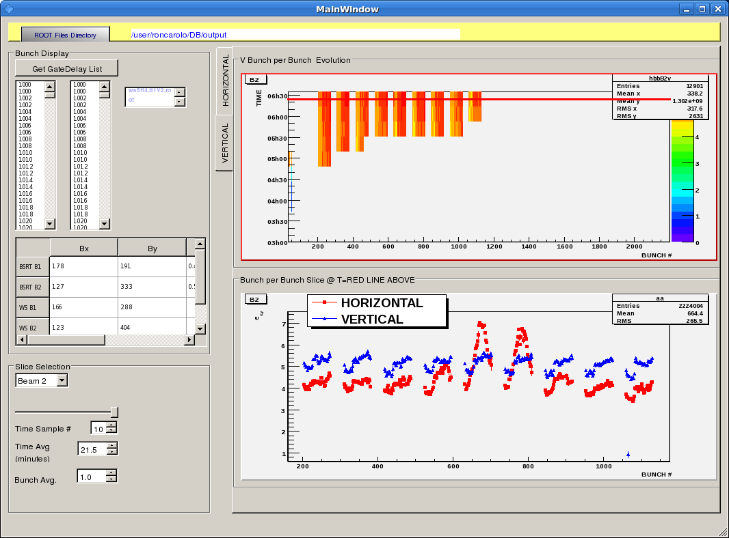
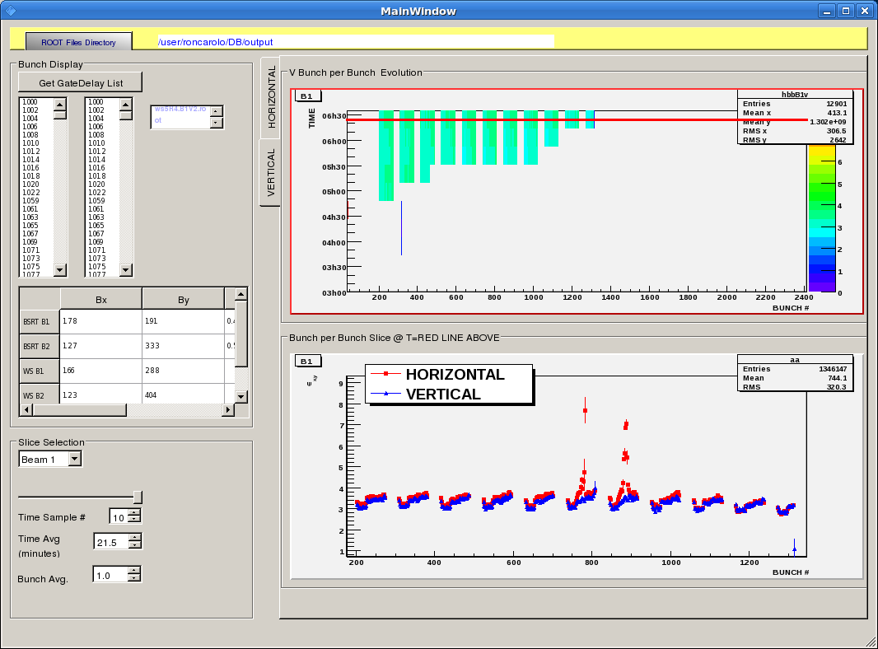
Emittances for last fill (408+336)

Slide 8
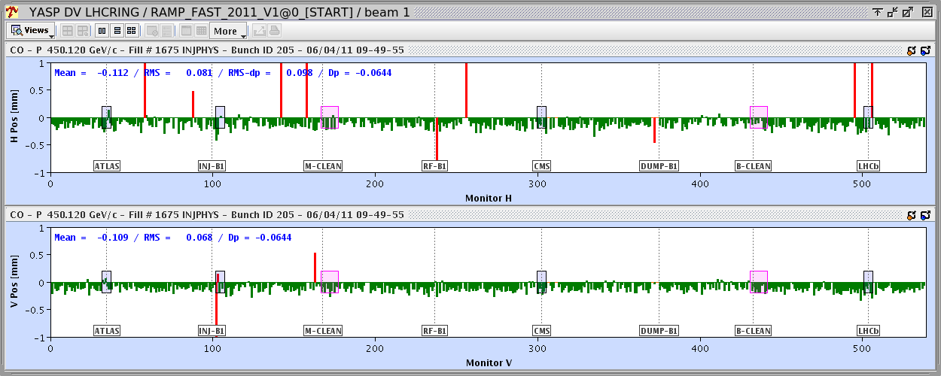
Position shifts
Recent observation of systematic BPM shifts could be traced to a filling pattern dependent shift (ADC).
Orbit is different for first bunch of train and bunches with large spacing (reset effect).
Orbit shift for second bunch in train wrt first : ~ -0.12 mm

Slide 9
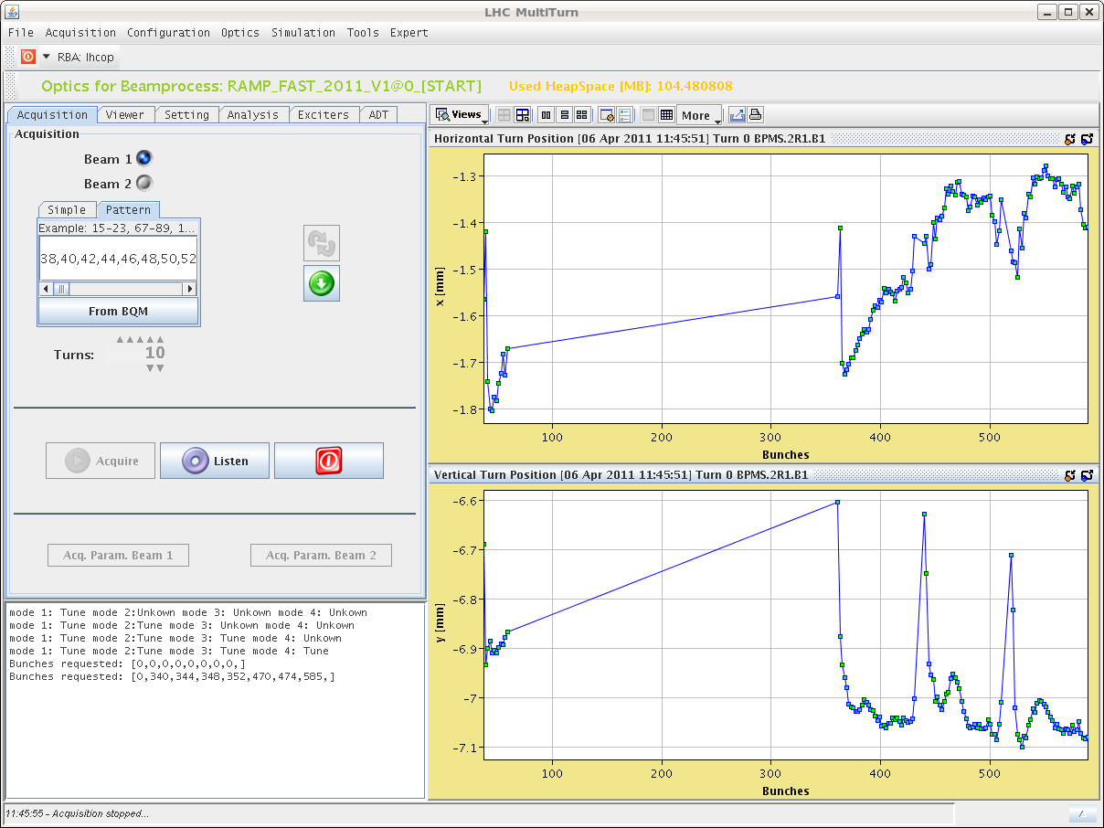
Position shift
Affects mostly first bunch, structure in train not clear, depends on the BPM.
Does not seem to be coherent /coming from the beam (betatron oscillation) - tbc
3 trains of 36

Slide 10
Today
Injection setup with 50 ns up to 144 b.
Orbit measurements single bunches – trains (tbc).
Scrubbing up to 600.

