Slide 1
Status 02/04
The real funny part of a TS:
Trying to restart

Slide 2
Status 01/04: Friday Morning
Pending issues from the technical stop:
Cryo recovery in Sector 45:
Cryo RF OK at 09:00 + RF conditioning + Access in UX45
Sector 45 OK by midday ➔ pre-cycle
LBDS: issues with generator MKB.B2. Seems now OK. Access this morning in UA. LBDS should be OK by mid-morning
SPS: after installation of scraper vacuum recovering and possibility to pulse kickers in the area by midday.
Over night test of the circuits where power converters have been replaced, pre-cycle etc.
This morning will continue with the tests
Hoping for beam at the beginning of the afternoon (low intensity)

Slide 3
Status 02/04
... just a selection
Friday morning: Hardware debugging
waiting for Cryo ok in 4/5
vacuum valve VVGSH.3.6R4.B is still in undefined state
run the available PCs once through the nominal cycle
RB.A34 has a QPS problem. Access is needed to fix it.
preparing access to P6 (kicker experts for MKB problem)
12:01 RSF2.A56B2 tripped while setting it to STANDBY
12:01 RQTD.A45B1 tripped as well
13:04 access to fix the power module of RQTD.A45B1
13:12 loaded the ramp into the collimators and got an error for several of them

Slide 4
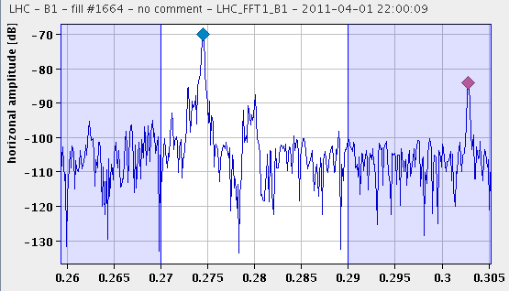
Status 02/04
Friday Late: Test Procedures
16:30 LHC SEQ: ramp started
SPS Quad realignment
17:24 trip of ROD.A34B1 and ROF.A34B1 during ramp down.
17:44 error when loading the TCDQ settings for the ramp:
The rampdown failed to load due to out of limit error on RCBV30.L4B1:
got again a timing event to set all PIC sector access in CLOSED mode
21:59 Finally: Tune, first B1 and B2 injection.

Slide 5
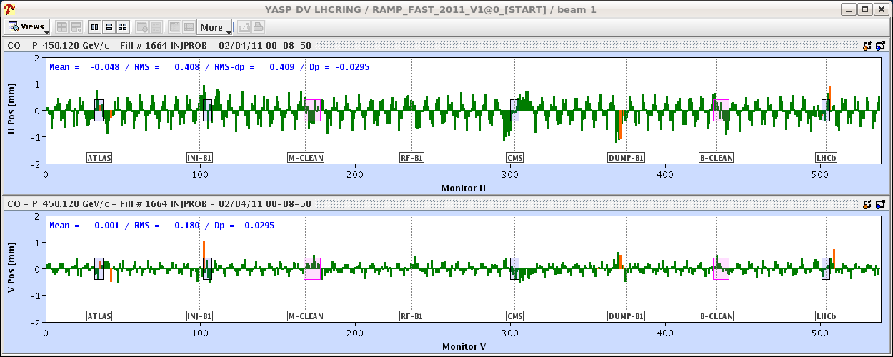
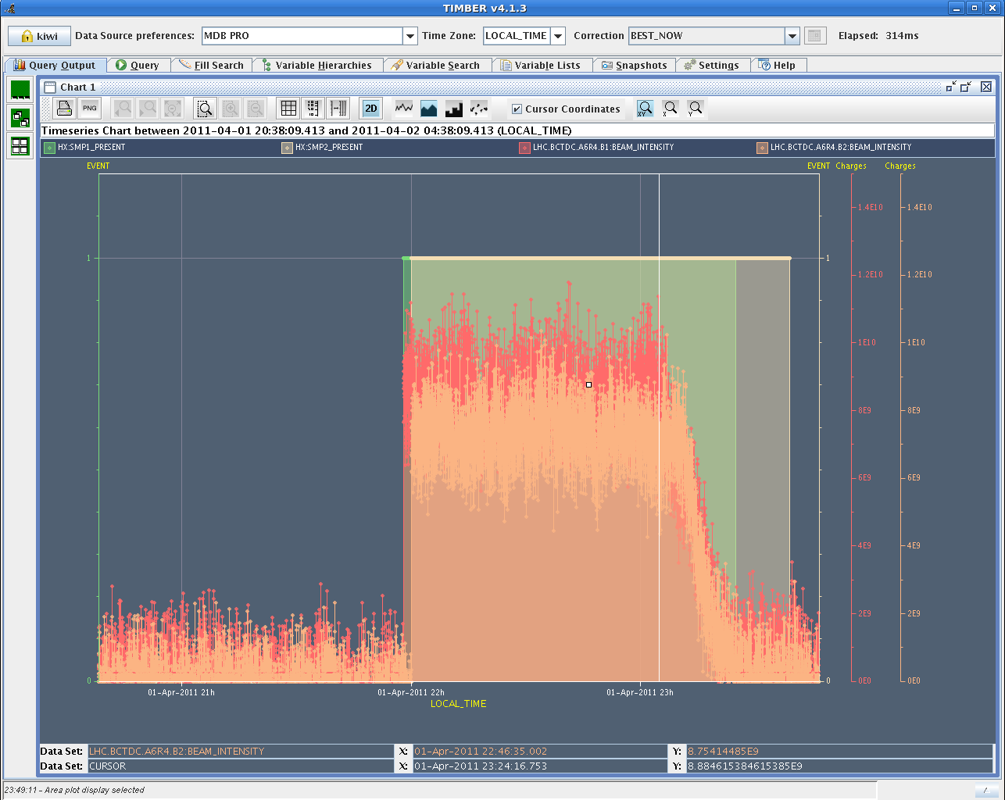
Status 02/04
Friday Night: Beam ... partially
23:03 There seems to be some periodic fluctuation on the orbit alignment
solution (?) all we have done is removed RCBV30.L4B1
Beam Presence thresholds measured

Slide 6
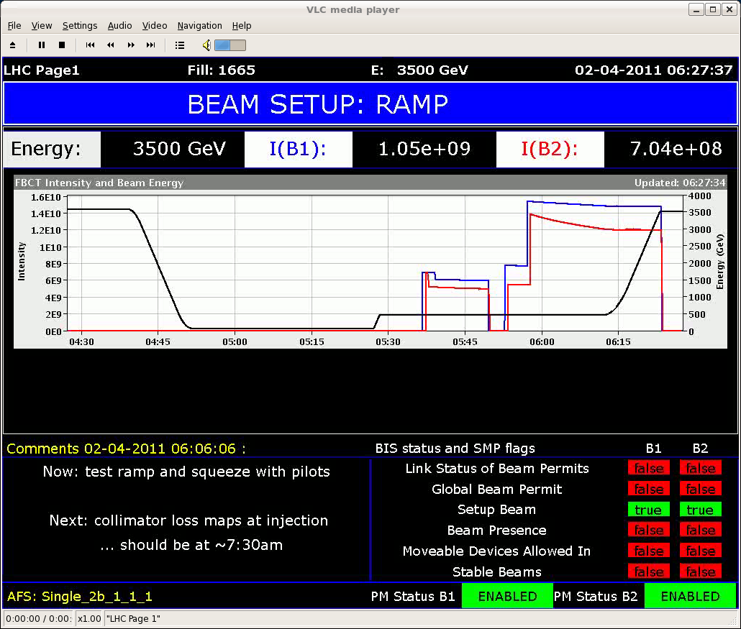
Status 02/04
beams dumped because of the TCDQ B1 and B2.
“dump triggered by TCDQ function just at end of energy ramp ... suspect that there is a problem with the TCDQ ramp function.”
problem not solved yet !

Slide 7
Preliminary plan
Fri | 20:00 | Beam presence flag at injection
 |  | Test dump with pilot at 450 GeV after change of MKD generators
Fri | 21:00 | Aperture check at injection
Sat | 02:00 | Ramp/squeeze/collision with pilot intensities (Single_2b_1_1_1) - chromaticity measurement without tune feedback
Sat | M | Collimator alignment (nominal bunch intensity) at injection and loss maps
Sat | 14:00 | LSS6 BPM tests and injection setting-up with 75 ns beams
Sat | A | Abort gap cleaning - verification of the excitation window: nominal bunches Injection gap cleaning (Delphine is on shift) - part of the night
Sat | N | Ramp/squeeze/collision with pilot intensities (Single_2b_1_1_1) - chromaticity measurement without tune feedback after feedforward
Sun | M | Beta * measurements (pt.2 and 8)
Sun | 14:00 | Injection setting-up with 50 ns beam
Sun | N

