Slide 1
Sat/Sun 26/27th March
Sat 18h20: Stable beams. Fill #1653.
Sun 10h02: Stable beams continued. vdM scans. Length calibrations.
16h59: Beam dump. Delivered 21h 39min of 1.38TeV physics in this fill. Spontaneous LBDS trigger.
18h15: Transfer line reference measurements before technical stop.
19h45: Injection for next 1.38 TeV fill.
21h16: Stable beams. 1.38 TeV.
06h10: Beam dump for technical stop. 34h delivered…

Slide 2
The Long 1.38 TeV; Fill #1654

Slide 3
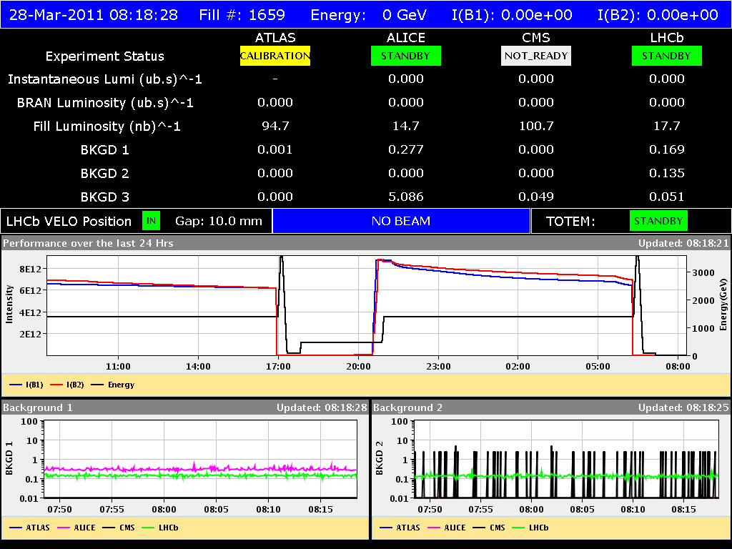
The Other Long Fill…
TL work

Slide 4
TL calibration and reference measurements
quantify effect of each TCDI on the showers seen by the BLMs in the LHC ring during B1 and B2 injections
B1 injection loss studies were made to verify the effect of the installed shielding during the shut down
B2 injection studies were made to take a full reference loss data set before the shielding will be installed during the next TS
opened all TCDI's to +-10mm and moved the left jaw for each TCDI seperately to -3 sigma
we took 3 shots for each setting, for the 2 beams (6 TCDI's per beam)
data analysis will follow
C. Bracco

Slide 5
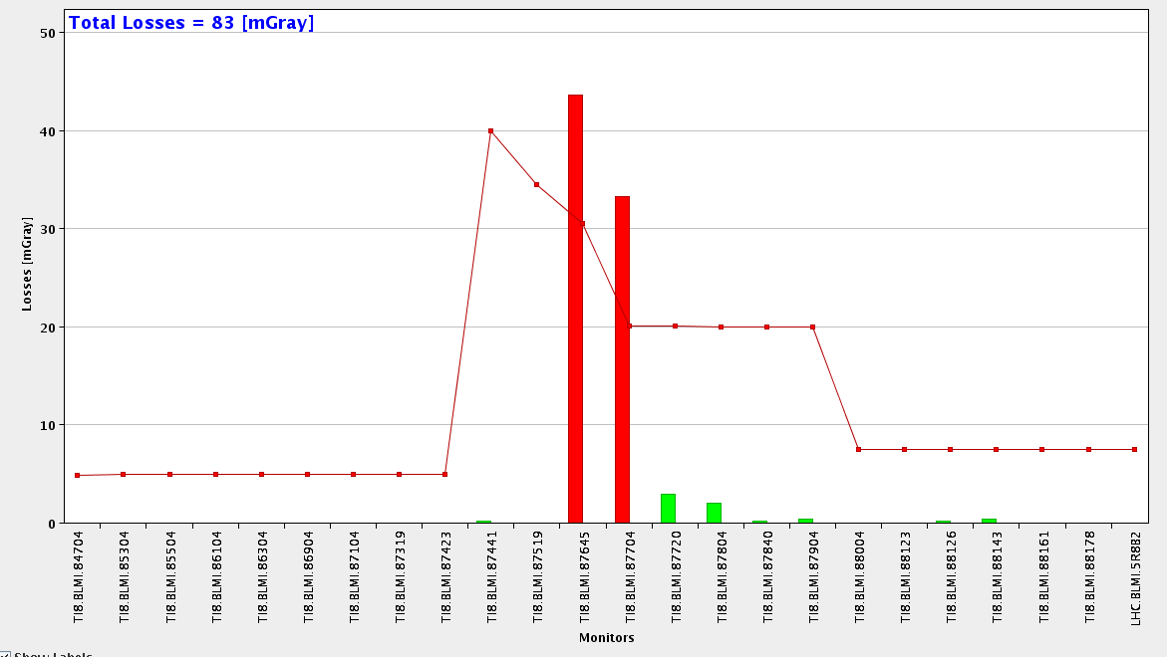
B2 first shot on TCDIV.87645
C. Bracco

Slide 6
1.38 TeV: vdM scan in IP2

Slide 7
The Last Week
Main 3.5 TeV achievements and issues:
Operation with 200b.
Peak luminosity: 2.5e32 (new LHC best)
Fill luminosity: 7.3 pb-1 (new LHC best)
Readiness for 296b.
Losses into dispersion suppressors: IR1 and IR5 SEU’s.
Beam-beam separation tests in IP8: no beam-beam issue.
Main 1.38 TeV achievements and issues:
Commissioned 1.38 TeV: collision orbit, collimation settings.
Delivered requested 34h physics.
Stronger 1.38 TeV beam-beam effects. Controlled with larger emittances.
vdM and length scale calibrations.

Slide 8
The Last Week
Other achievements:
RF voltage interlock increased to 3.5 MV
LHC fast BCT phase tuning
FGC software update
Collimator low-level software updated
New LSA version with better K smoothing in ramp and physics
Update BI-QP fixed display
Abort gap cleaning commissioned
IR6 interlock BPMs reconfiguration and tests for 1.38 TeV
Availability issues:
Controls system (Java Message Server): 11h
Clogged water pipe in power converter RQTL11.R6B1: 9h
BPMS different readings (dump): follow-up needed
Trip RB in 81. Water problem on bridge B (Thyristor bank). 3.5h
Trip RB.in 78. Bridge B + act. filter disabled (Thyristor bank). 10h.

Slide 9
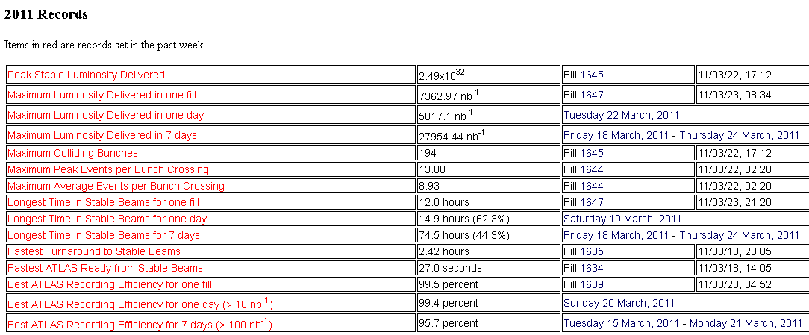
3.5 TeV (from ATLAS...)

Slide 10
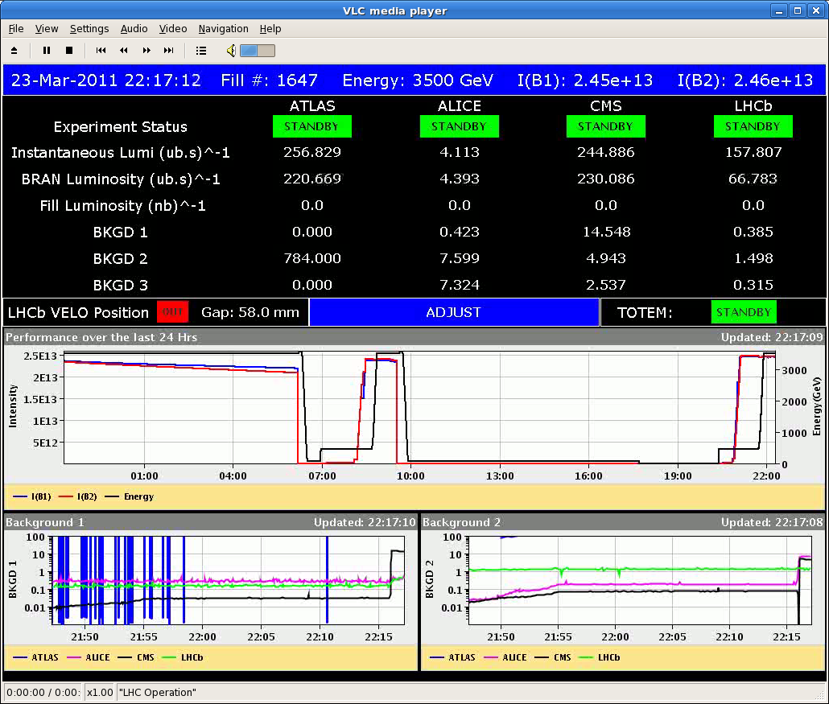
3.5 TeV: Fill 1647

Slide 11
3.5 TeV: Parasitic beam-beam study
Head-on to 2.5 σ separation insteps of 0.5 σ, lumi reduced by factor ~3 for maximum separation.
No effect on lifetime or losses.
No reduction in luminsoity in other IR’s (indicates insignificant emittance growth or none at all)
IR8 Luminosity
W. Herr
T. Pieloni
G. Papotti
Lifetime

Slide 12
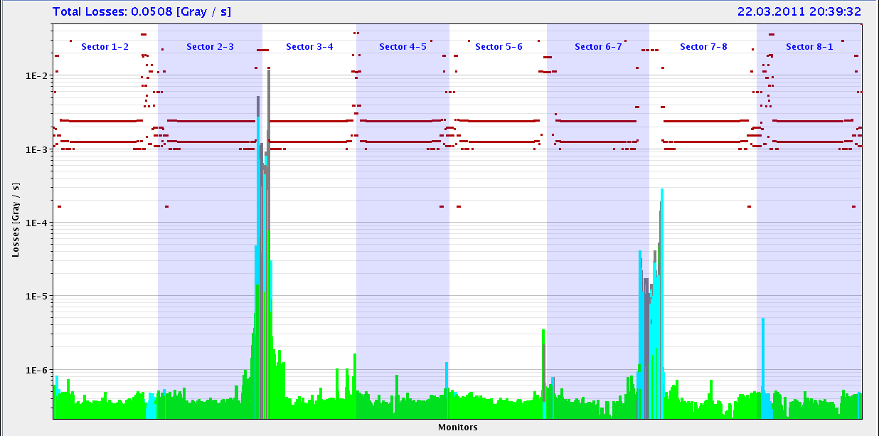
3.5 TeV: Uncaptured Beam Start of Ramp
IR3
IR7
Fill #1645, 200 bunches, 2.4e13 p per beam, peak luminosity 2.5e32

Slide 13
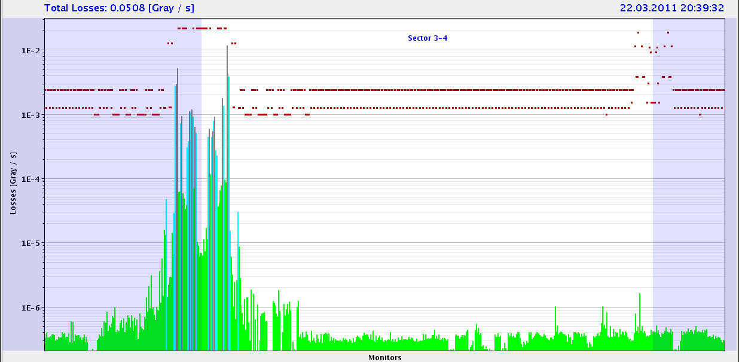
3.5 TeV: Leakage to DS+Arc: Start of Ramp
IR3 DS
Arc
Fill #1645, 200 bunches, 2.4e13 p per beam, peak luminosity 2.5e32

Slide 14
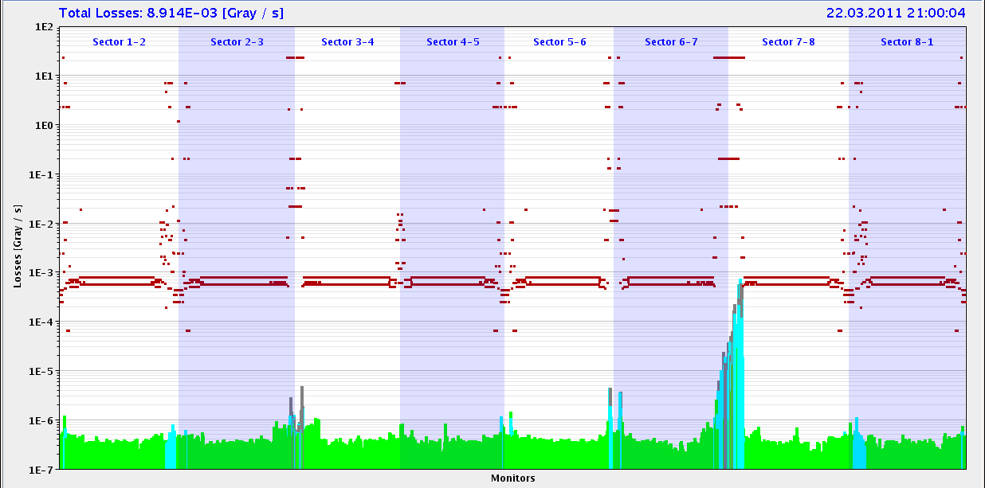
3.5 TeV: Cleaning During Squeeze to 1.5m
IR7
IR3
Fill #1645, 200 bunches, 2.4e13 p per beam, peak luminosity 2.5e32

Slide 15
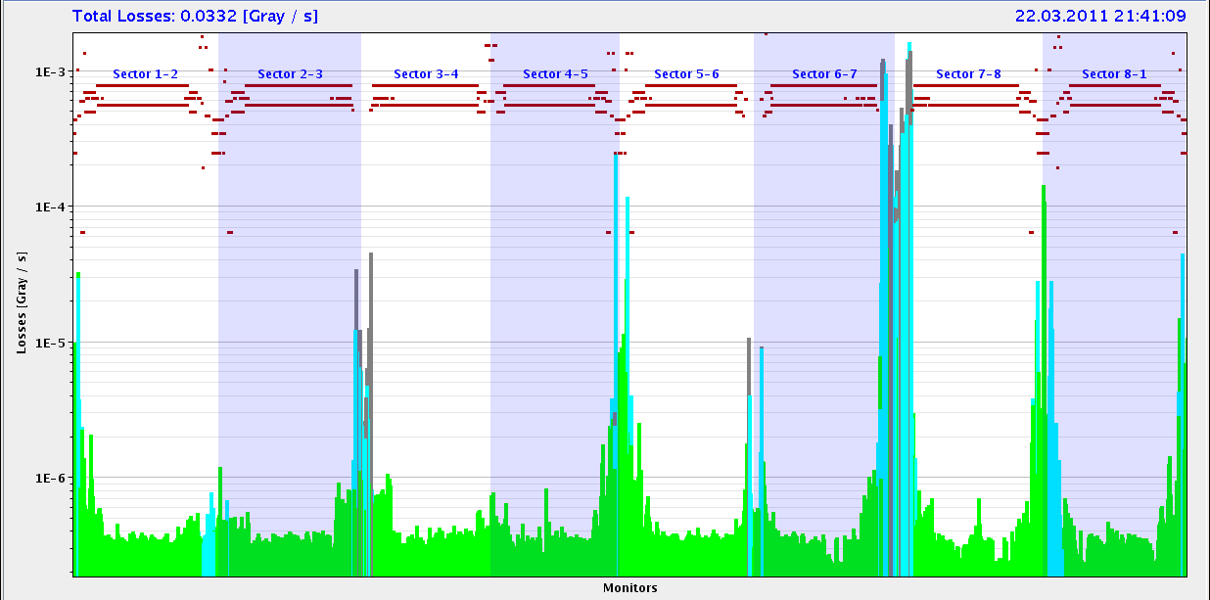
3.5 TeV: Luminosity Operation Collimation
CMS
IR7
LHCb
ATLAS
IR3
IR6
Fill #1645, 200 bunches, 2.4e13 p per beam, peak luminosity 2.5e32

Slide 16
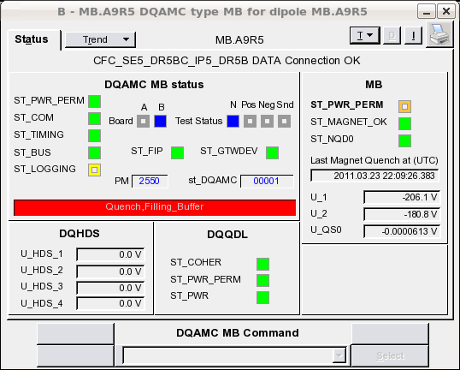
3.5 TeV: SEU in IR1/5 Disp. Suppressors
MB.B8L1
Fill 1647, 24.3.
Luminosity 2.5e32
MB.A9R5

Slide 17
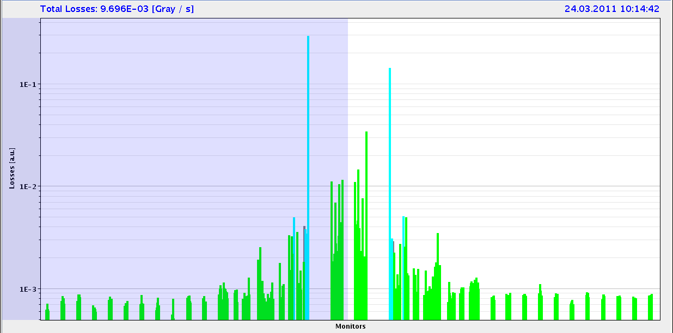
WHY? 3.5 TeV: Losses in DS of IR5 (CMS)
Fill #1647, 200 bunches, 2.4e13 p per beam, peak luminosity 2.5e32

Slide 18
3.5 TeV: Halo Scraping
D. Wollmann
F. Burkart
R. Assmann
S. Redaelli

Slide 19
1.38 TeV: Stable Beams

Slide 20
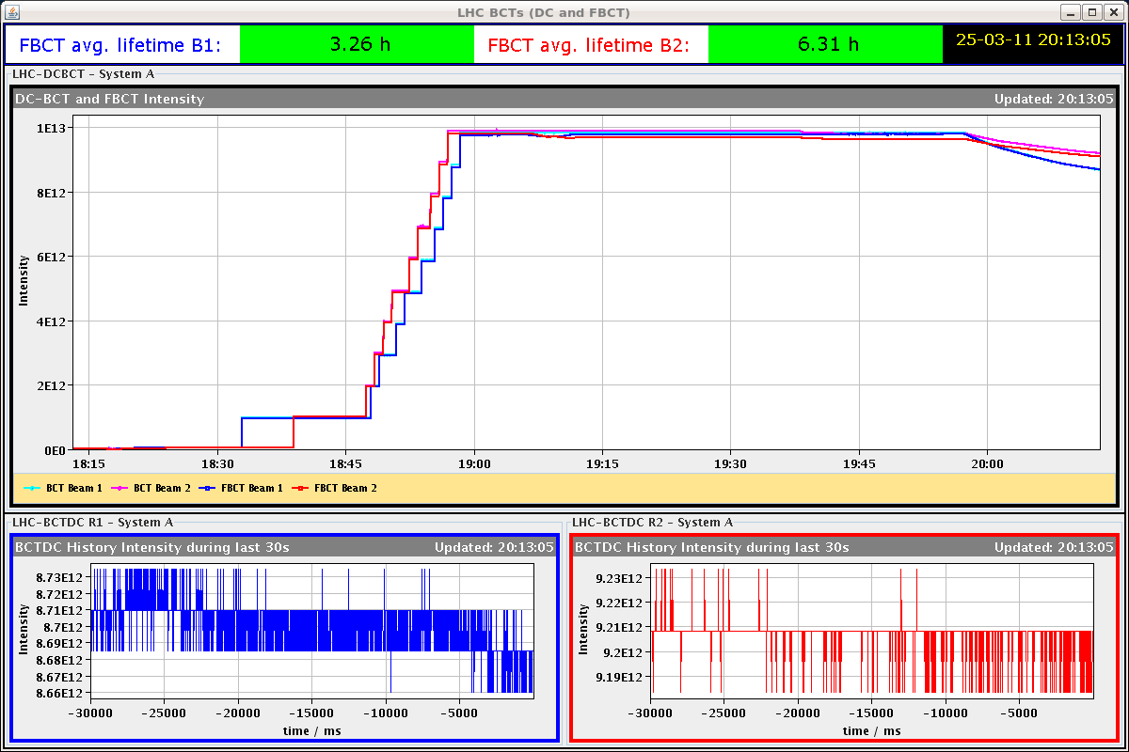
1.38 TeV: See Effect of Collisions

Slide 21
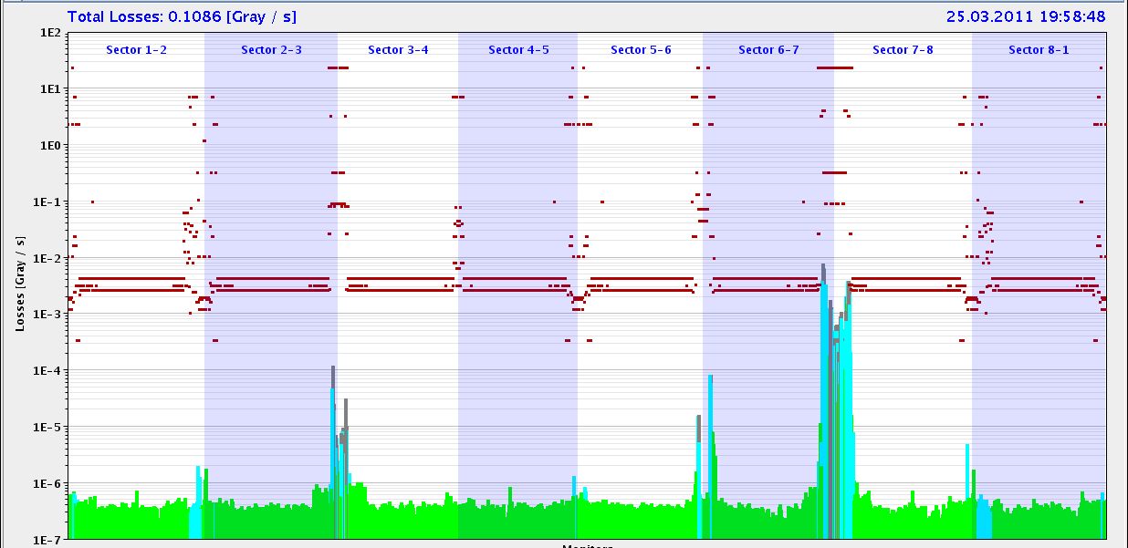
1.38 TeV: Lifetime and Losses

Slide 22
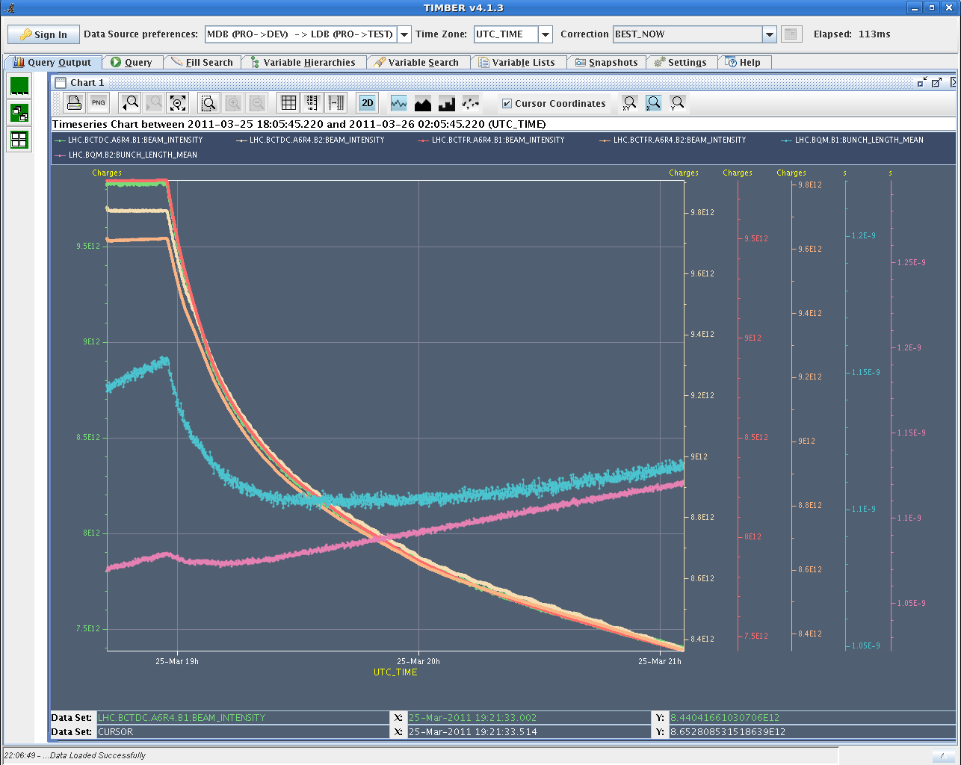
1.38 TeV: Bunch Length (blue, purple)

Slide 23
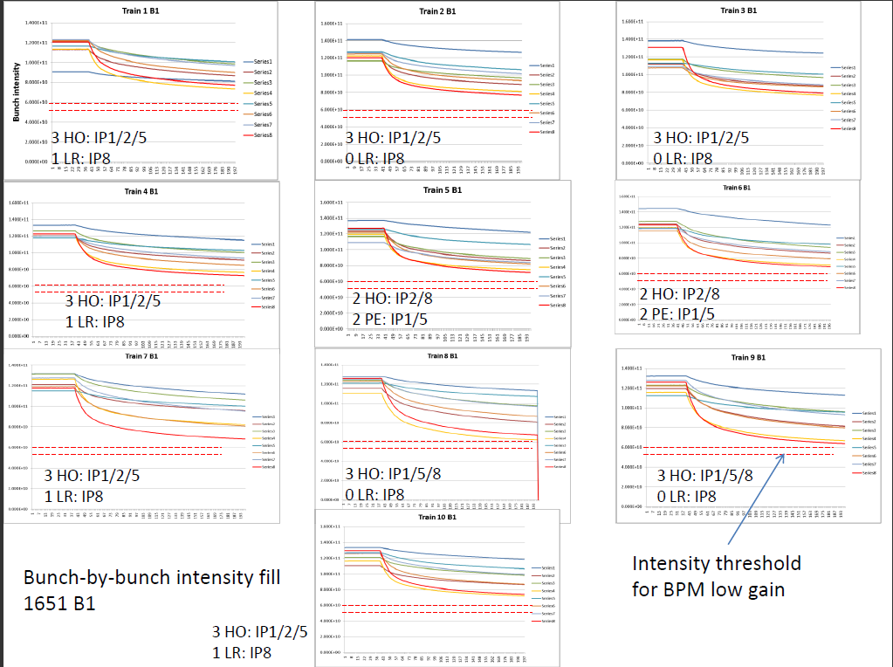
1.38 TeV: Beam-beam fill #1651, b1

Slide 24
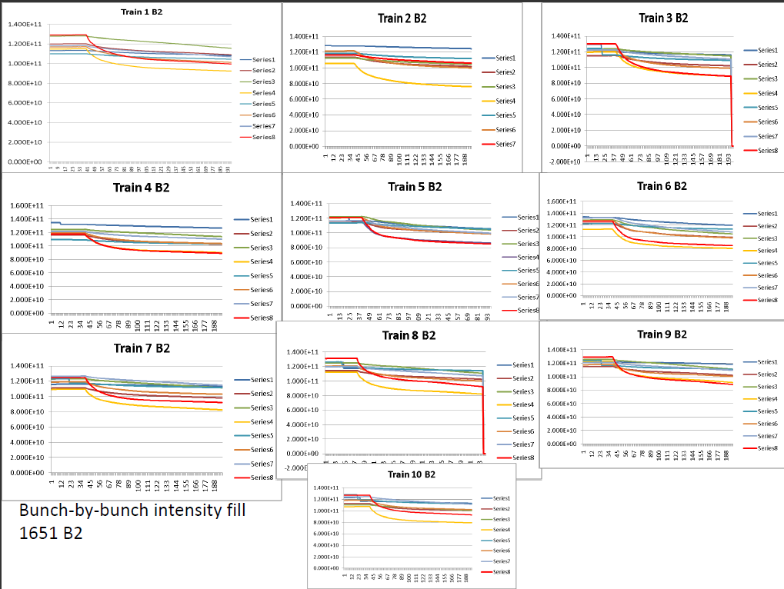
1.38 TeV: Beam-beam fill #1651, b2

Slide 25
1.38 TeV: Why the Interlock?
A single bunch with larger loss rates and low intensity is no problem → collimation takes care of it.
Problem comes from BPM for dump protection:
A BPM is used to verify that local IR6 orbit is in allowed range for a beam dump (dump kick depends on offset in quadrupole).
Interlock checks that every bunch is inside orbit specification.
Interlock due to intensity dependence of BPM readings:
In the region of 4-5e10 p per bunch, the BPM reading diverges.
If all bunches have low intensity → no problem, sensitivity range is switched (only possible for all bunches).
If only one or few bunches have low intensity → BPM reading for these bunches becomes artificially large and triggers interlock.
Interlock due to instrumental effects + single bunch logic.
Known but we could live with it so far due small beam-beam effects at 3.5 TeV

Slide 26
1.38 TeV: Losses in Physics

Slide 27
The Long 1.38 TeV; Fill #1654

Slide 28
Incoming
1.38 TeV done.
Ready for 296 bunches at 3.5 TeV when we return for physics.
Tevatron record luminosity is in reach.
Mon 06:00 | Dump beams for TS
Mon – Thu | Technical stop
Fri | Recovery for scrubbing run or 3.5 TeV physics → to be discussed at LMC

Slide 29
Noted – Per Hagen
Will the “soon to come” fill 1664 be celebrated? with or without crossing angle…

Slide 30
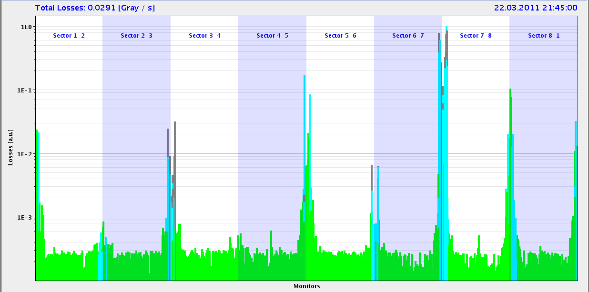
Cleaning During Luminosity Operation
Fill #1645, 200 bunches, 2.4e13 p per beam, peak luminosity 2.5e32

Slide 31
1.38 TeV: Bunch Length and Intensity

Slide 32
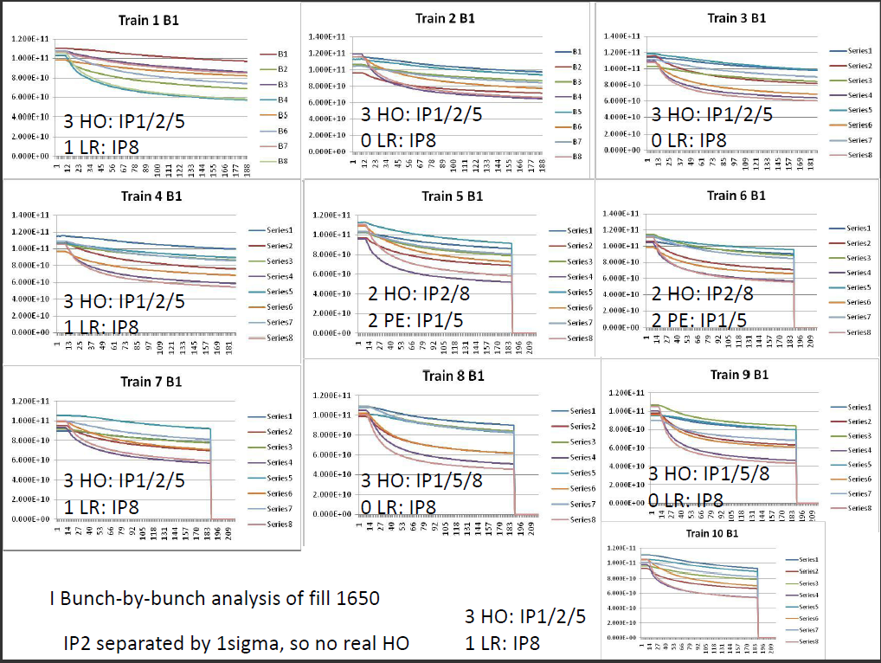
1650
Reyes

