Slide 1
Wednesday 22.3.
06h10: Programmed dump.
07h54: Injection. 200b.
08h39: Ramp.
09h18: Stable beams. 2.4e32 lumi.
09h32: Beam dump due to RQTL11.R6B1 trip. EPC and CV intervention in PM65 → 9 hours. Change of water manifold in PC rack.
Rebooting BLM crates (missing/broken NFS mounts).
New version of LSA with improvements for smoothing (K) in ramp and physics (Greg).
Collimator dry ramp of collimator functions for 1.38 TeV.
PNO.a3 test on RQTL11.R2B2.
QH power supply discharging on dipoles of S45 (C19L5) -> fixed with access.
RF tests on cavity 4B2.

Slide 2
Collimator Settings 1.38 TeV
Usual ramp functions, essentially truncated at 1.38 TeV.
Use of standard energy-dependent gap interlock function!
TCT's end up at 18.5 σ, the TCDQ at 8.5 σ.
Settings after collision:
Close TCT's to 14 σ. Leaves 5.5 sigma margin to TCDQ.
vdM scans:
Assign 2 σ margin at TCT's to vdM scans.
Keep 3.5 σ margin between TCT and TCDQ.
The allowed vdM scan ranges are then (at IP, per beam, 1.38 TeV, injection optics, in nominal beam size):
IR1, IR5: 3.0 σ
IR2, IR8: 3.1 σ
Functions and limits generated and uploaded into controls system.

Slide 3
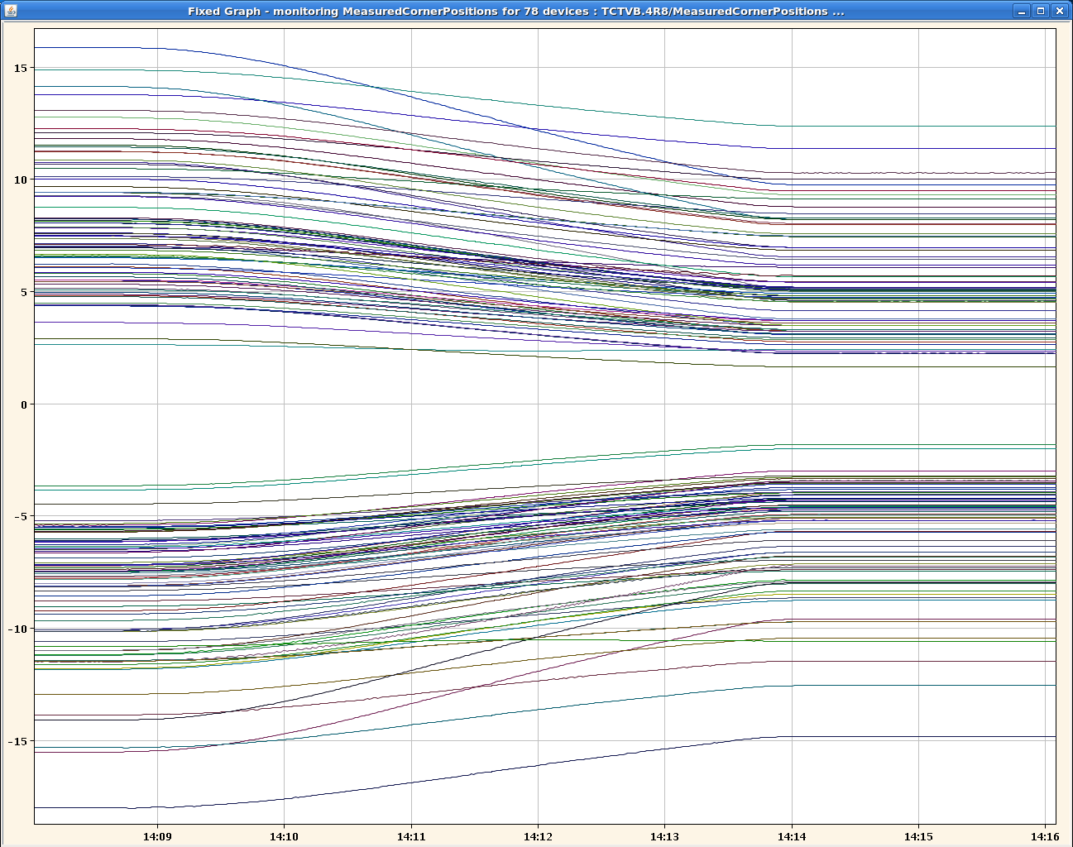
Collimator Dry Ramp 1.38 TeV

Slide 4
Wednesday 22.3.
18h35: Precycle.
20h27: Injection.
21h08: Incorporation problem.
21h42: Ramp.
22h20: Stable beams. 2.57e32 lumi.
RF trip 4B2.
05h30: Parasitic studies on leveling by vertical beam-beam separation in IR8.
Possible in IR8 in stable beams due to small changes at TCT.
Head-on to 2.5 σ separation insteps of 0.5 σ, lumi reduced by factor ~3 for maximum separation.
No effect on lifetime or losses.
No reduction in luminsoity in other IR’s (indicates insignificant emittance growth or none at all)
To be analyzed in detail (bunch by bunch in FBCT)

Slide 5
Parasitic beam-beam study
W. Herr
T. Pieloni
G. Papotti
IR8 Luminosity
Lifetime

Slide 6
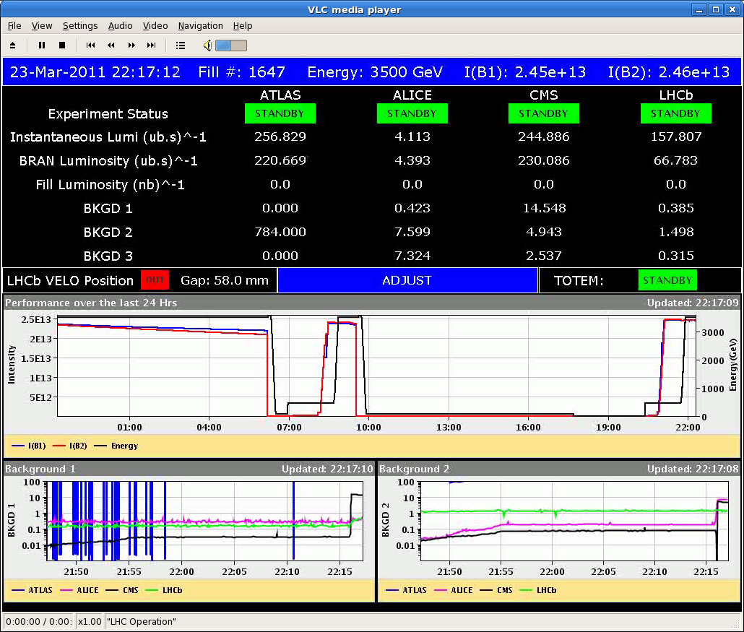
Fill 1647

Slide 7
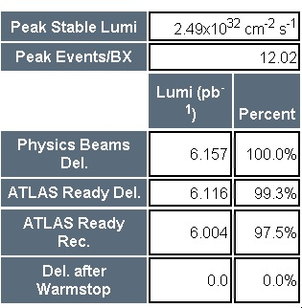
Luminosity in Fill 1647
ATLAS: 6.16 pb-1
CMS: 6.25 pb-1

Slide 8
Incoming
Thurs AM | 1.38 TeV commissioning (after SPS injection kicker is fixed)
Thurs PM | 1.38 TeV stable beams
Fri inter-fill | ADT/AGC
Fri PM/night | 1.38 TeV
Sat | Energy gaps interlock test | 1 h
Sat PM | 1.38 TeV (plus extra ramp for quench test)
Sat night | Back to 3.5 TeV, test ramp, physics
Sun AM/PM | Transfer lines tests | 3 h
 | Aperture measurment TI2/8 | 3h
 | Intensity increase with 75 ns | 2 h
Sun PM/night | Physics continued
Mon 06:00 | Dump beams for TS
Note: no 50 ns nor 25 ns required over the weekend

Slide 9
Outstanding
Injection of 96 bunches (→ weekend)
Timing distribution (→ technical stop)
FGC firmware update
Collimation system controls fix
1.38 TeV setting-up (→ Thursday onwards)
Crossing angle all zero: OK
TCTs to set up & loss maps
Interlock tests for the roman pot (→ parasitic or TS)
RF voltage limit interlock
Longitudinal blow-up (→ if needed)
Wire scanners
Abort gap cleaning (→ with high intensity injection)
Injection gap cleaning (→ with high intensity injection)

