Slide 1
Yesterday’s morning’s controls issues
The JMS brokers went gradually out of memory due to bad clients (slow or too demanding clients). Around midnight the brokers were not able to answer to all requests, ending up in a congestion of the message circulation. The reboots during the night were not successful as there were still some clients 'avalanching' the brokers. This morning we searched for some clients on the CCC consoles and killed a few of them. Then the clean restart of the JMS brokers went ok and since 10h30 this morning the situation is ok. The BPM issue was a side-effect as the client concentrator was in a bad state due to the JMS service not answering correctly and therefore ended up into opening too many subscriptions to the BPM crates, hence crashing the server there. We continue now to monitor the traffic and the memory usage until tomorrow morning. We will also (1) make sure the notification system from DIAMON informs the JMS team well in advance when the memory consumption rises and (2) to detect bad clients.
Pierre Charrue

Slide 2
Yesterday
11:00 Beam back
12:10 Stable beams Fill 1644 136 bunches
Initial luminosity 1.6e32
Afternoon: POPS down…, PS switches back to rotating machine…
Beam quality good from the injectors, even though they had to check all settings for all beams after the switch back to rotating machine in PS.
18:00 beams dumped
19:12 Starting filling for 200 b
just in time injection schedule
just in time approval from rMPP
Brennan checked the BPMD interlock
Over interjected pilot OK - just

Slide 3
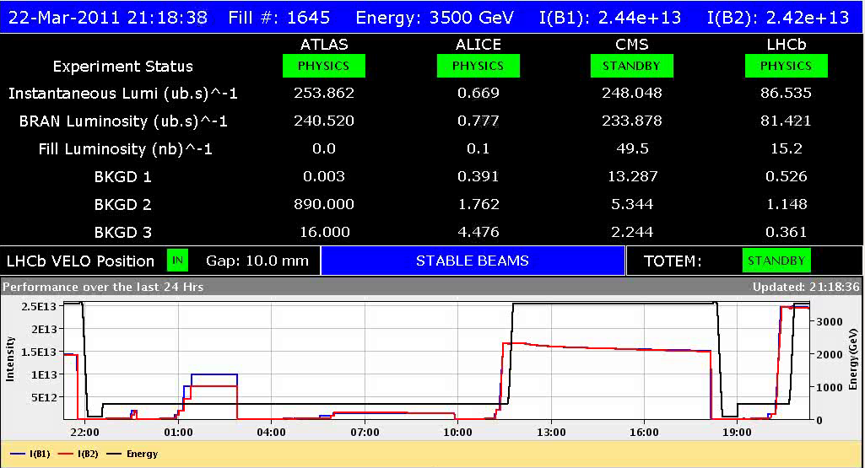
Yesterday evening
21:15 Stable beams fill 1645 200 bunch
initial lumi ~2.5 e32 (emittance ~2.4 micron)

Slide 4
Night shift summary
Held on to the stable beams until the programmed dump at 6:10. Performed only small optimizations in Alice and LHCb. To be noted: - a couple of RF LL line trips (4B2 and 3B2); - RB.A45 has lost a quench heater power supply; - this shift crew gave no access during this full MAN.
Giulia & Lasse

Slide 5
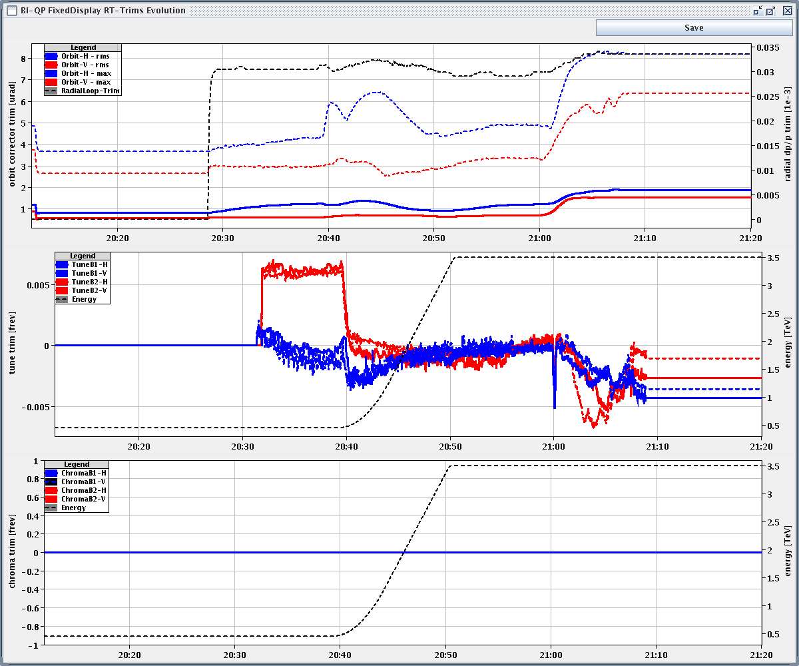
Feed-forward in ramp

Slide 6
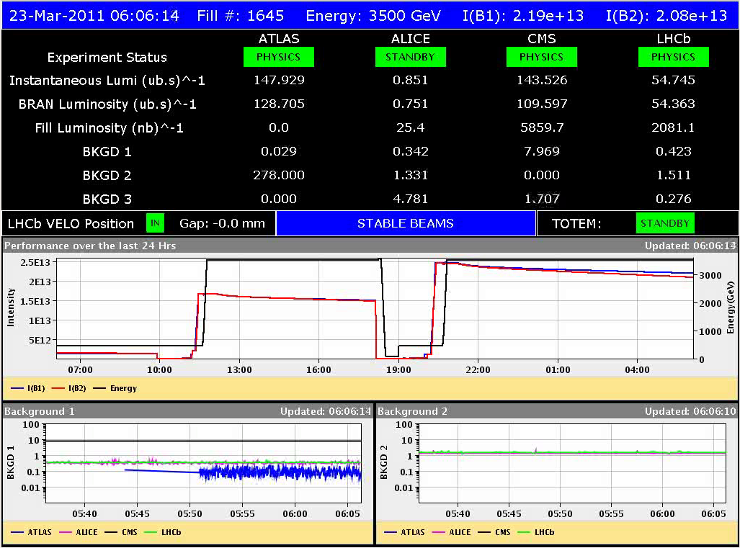
EOF 06:00 this morning

Slide 7
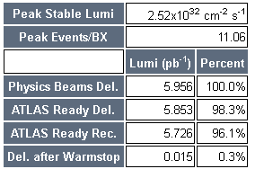
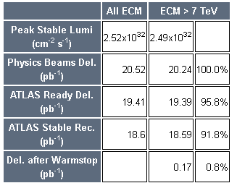
Totals
Total
1645
Thanks Atlas

Slide 8
Incoming
Tues PM | 200b
Weds AM | 200b
Weds PM | 1.38 TeV commissioning
Thurs AM | 1.38 TeV stable beams
Thurs inter-fill | ADT/AGC
Thurs PM/night | 1.38 TeV
Fri AM | CV intervention (tbc) | 4 h
Fri | Energy gaps interlock test | 1 h
Fri PM/Night | 1.38 TeV (plus extra ramp for quench test)
Sat/Sun | Back to 3.5 TeV, test ramp, fill #3
 | Transfer lines tests | 3 h
 | 96*75ns at injection | 8 h
 | First look at 50 ns | 8 h
 | 200 b continued
Mon 06:00 | Dump beams for TS

Slide 9
Outstanding
Injection of 96 bunches (→ weekend)
Timing distribution (→ technical stop)
FGC firmware update
Collimation system controls fix
1.38 TeV setting-up (→ Wednesday onwards)
Crossing angle all zero: OK
TCTs to set up & loss maps
Interlock tests for the roman pot (→ parasitic or TS)
RF voltage limit interlock
Longitudinal blow-up (→ if needed)
Wire scanners
Abort gap cleaning (→ with high intensity injection)
Injection gap cleaning (→ with high intensity injection)

