Slide 1
BLM update
BLM update procedure: - Updated the RT software - Updated the BLETC firmware (ver. 20110221_A) - Changed the firware version in the MASTER tables and generated the LSA settings for both BLETC and BLECS modules. - driven to the electronics. Running the MCS check.
Christos Zamantas, Stephen Jackson

Slide 2
Summary of BLM tests after update
All front-ends and processing modules have been updated to the new version . On the first set of tests, the collection and delivery of the BLM IQC data have been checked and several delays changed to adjust both the freeze of the buffers and the start of collection. Several injection events sent and verified the correctness together with the IQC developers. We mark this issue now as fixed. The second part was dedicated to establish that the MPS functionalities have remained unchanged. Two injections per beam was shot in the TCP collimators and the latency between measuring the loss and issuing a beam dump request match those expected. With the agreement of the CMS BCM coordinator (David Stickland) the operational crate cmsbrmppc2 has been also updated.

Slide 3
Summary of injection Studies
TDI MPS checks finished. Analysis ongoing.
TCDI phase space coverage analysis finished. Protection OK. TI 2 data quality for 1 or 2 phases not good. If time available will check again a couple of phases.
BPM P6 Interlock test
thresholds defined around BPM readings: done yesterday
for both beams one threshold was moved in steps of 0.5mm across the actual reading and a beam dump request was observed on the BIS monitor as expected
test OK

Slide 4
Summary of injection Studies
TDI grazing
both beams
used knob to simulate different MKI strength in sigma at TDI
scanned from 3 to 9 sigma (plus/minus) in steps of one sigma, one calibration shot of 12 sigma (deep into the TDI to have losses concentrated)
preliminary analysis: direct losses only at TDI and TCLI and collimation region (P3 and P7), shower downstream of TDI depending on grazing angle
otherwise losses in the arc are low --> protection from TDI is given
ALICE and LHCb BCMs triggered for >7 sigma
LHCb triggers also with installed sunglasses on the BCMs
Chiara, Malika, Verena, Brennan, Wolfgang

Slide 5
Multibunch Injection – beam 1
B1:
emittance blow up in the SPS to 2/2.5 um
injected one nominal bunch on LHC4
checked reference trajectories for both beams, corrected B1 with the pilot
copied new reference for B1 and existing reference for B2 to LHC3 (and also LHC4 for B1)
injected four bunches on LHC4, no scraping in the SPS, trajectory and losses fine
injected bunch trains of 8 bunches with 75 ns spacing (LHC3) with scraping
extraction observed on OASIS OK
transfer line trajectory very good

Slide 6
Multibunch Injection – beam 1
TL losses very good
Losses in injection region OK
but dumped beam because of wrong damper settings
one bunch train injection was without SPS scraping - high losses in the TL and injection region
after switching off the damper, the beam was not only cleanly injected but also stayed in
B2 multibunch injection to be done

Slide 8
Spikey FBCT
We managed to reproduce today the fast BCT huge spikes. This occured while we were doing fast BCT capture at injection via the OP dedicated GUI. Please do not use this application until we fix the problem (most probably in our front end crates), at least on system A fast BCTs (you can select system B ones via the GUI). We also tuned the fast BCT summing algorithm and fast BCT should now behave correctly even with a mixture of pilot and nominal beams in the machine, i.e. we should not have the small positive jumps we observed lately). JJG

Slide 9
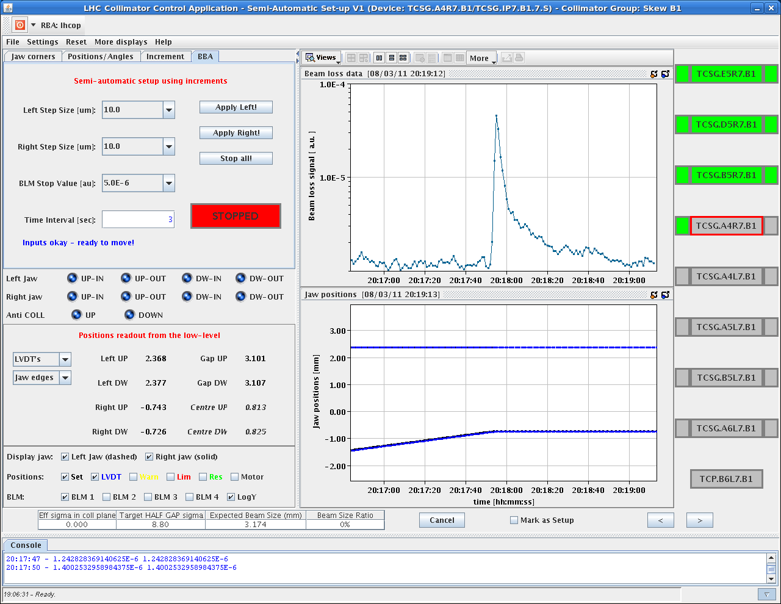
17:15 Ramp started for collimator set-up
more nice loss spikes with tails... maybe skew halo has longer tails!? 40s beautiful decay for second example!

Slide 10
Collimation summary
R. Bruce, S. Redaelli, D. Deboy, G. Valentino, R. Assmann
Completed setup of all collimators b1 and b2
Then took a while to set up TCDQ's. Lengthy due to various status handling issues (motors blocked in armed status without movement).
In parallel checked three collimators with suspicious beam-based calibration values. Found angular misalignments of whole tank >1.9 mrad for all three cases (jaws niclecy parallel inside tank). Determined sign of angle. Requires inspection during next technical stop.
Rechecked TCDQ after phone discussion with Brennan. Found ~1.1mm offset for b2 and ~0mm for b1. To be compared with 0.9mm in b2 and ~0.4mm in b1 from standard setup+calculation method (as used in 2010).
In parallel generated functions for injection, ramp and 3.5TeV (flat top before squeeze) from BBA data found.
Loaded functions and 3.5 TeV settings. To be updated tomorrow for linear scaling of TCT center with time during energy ramp (instead of linear scaling with energy).
Loss maps for the grand finale! Looks quite good. On first sight no abnormality seen. To be analyzed in detail.

Slide 11
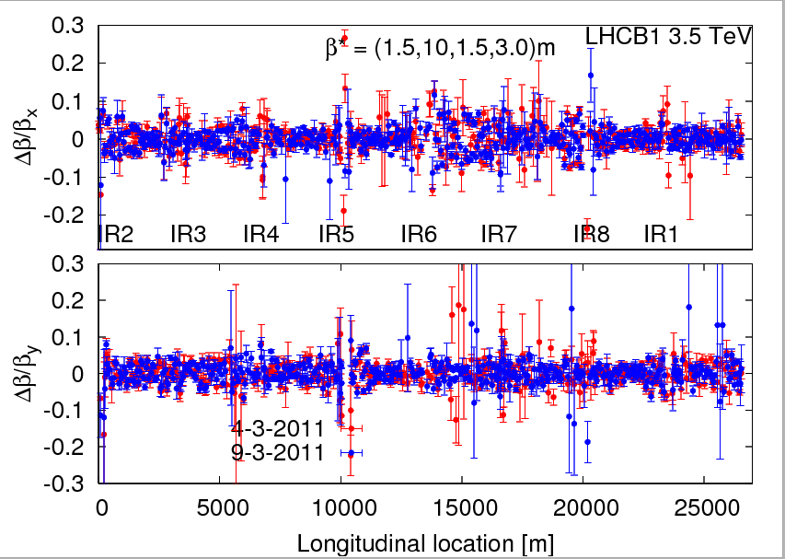
Later this night
2:30 beams back in at 450 GeV
Beating re-checked at 1.5 m
Beta* k-modulation scans ongoing…

Slide 12
Incoming…

