Slide 1
Saturday 12 March
Morning: problem on RSD1.A12B2 – flow rate problem on the cooling water for the converter.
14:00: Loss map -500 Hz (positive energy offset) at 3.5 TeV unsqueezed.
Very high loss on TCTV B2 in IR8.
21:00: Loss map end of squeeze H, V and +500 Hz (negative energy offset).
Looking good.
23:30: Loss map end of squeeze -500 Hz (positive energy offset).
Very high loss on TCTV B2 in IR8 - again.
Dumped on unmaskable BLM Q7.L3.

Slide 2
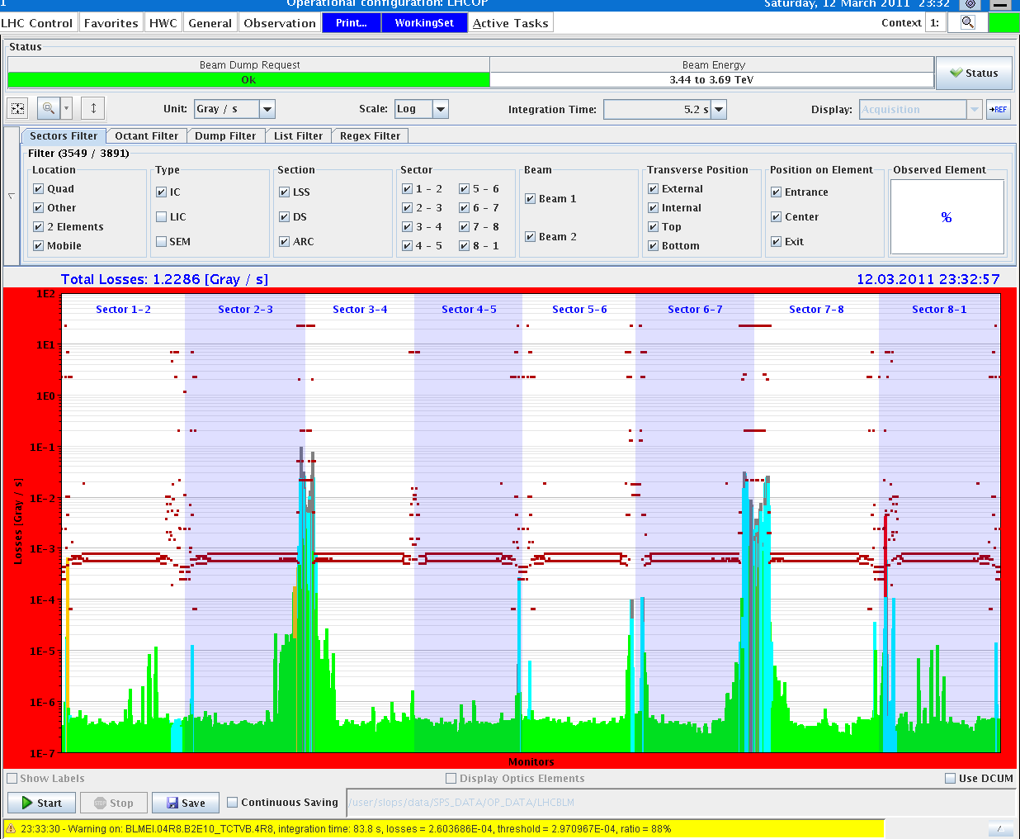
Positive dp/p, squeezed

Slide 3
Night
00:00: Injectors
Issues with SPS injection kicker – PFN1 to be replaced (1/2 day+) – trying to survive until Monday.
PS POPS down…
02:00: SPS & PS back.
03:15: Asynch. dump test squeezed.
05:30: Ditto in collision.
New settings OK.
Realized that procedure (delay after RF off) tuned for nominal bunch in bucket 1. Statistics hopefully good enough from probe.
07:30: Next go. Issues in the squeeze with OFB switching off in H. some beam lost.
08:00: Loss map with positive dp offset in collision.
Again TCTV in IR8 sticking out…

Slide 4
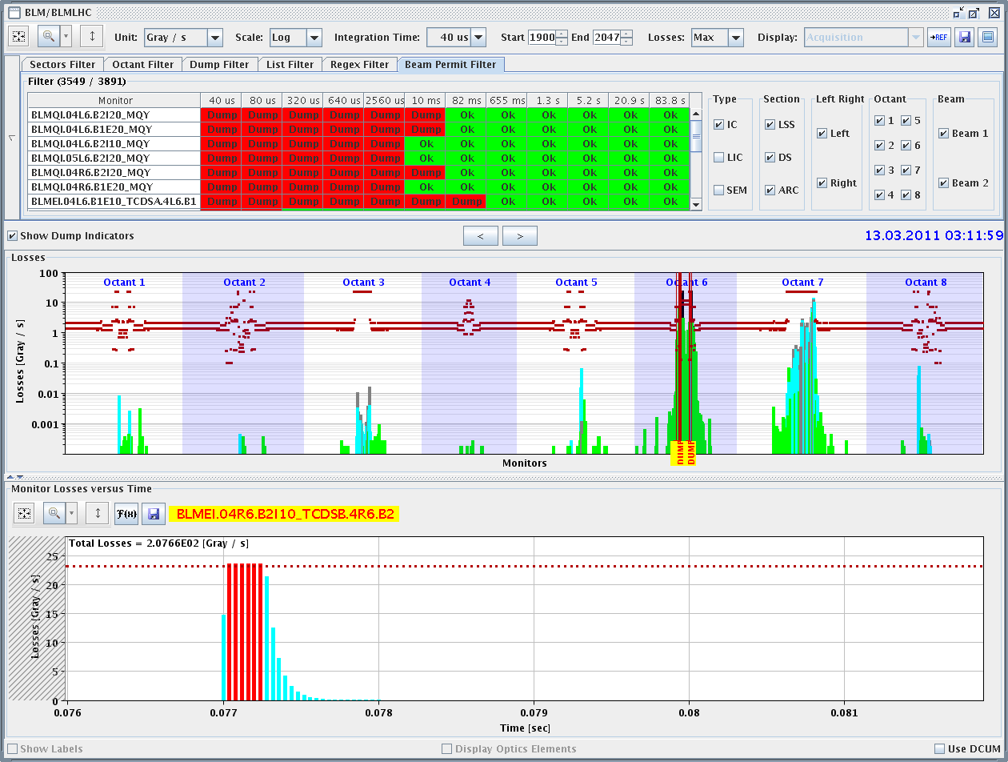
Asynch dump squeezed - clean

Slide 5
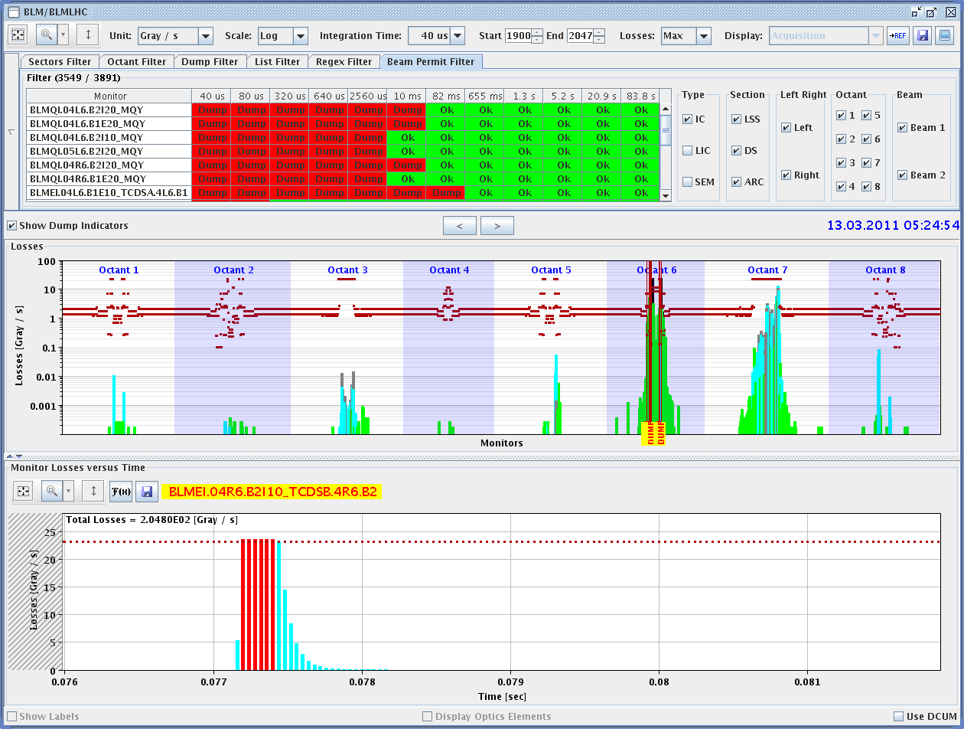
Asynch dump with colliding beams

Slide 6
Summary of validations
Condition | Betatron H | Betatron V | Dp/p + | Dp/p - | Dump
Injection | X | X | X | X | X
Flat top | X | X | X | X | X
Squeezed | X | X | X | X | X
Collisions | X | X | X | X | X

Slide 7
Saturday – Dump aperture
Aperture of dump line consistent with 2010 results.
Tested 14/15 kicker dump (using an orbit bump to simulate missing kicker).
OK.

Slide 8
Today
Decision for stable beams.
Collimation and dump colleagues have to check all the data.
Collimation OK – not worried about the TCTV in IR8.
Tentative planning:
Test ramp to 1.38 TeV
First fill with stable beams in the afternoon.
Then a few fills until Monday PM to bridge the SPS MKP intervention – no beam from SPS ~10:00 to 14:00 on Mo.

