Slide 1
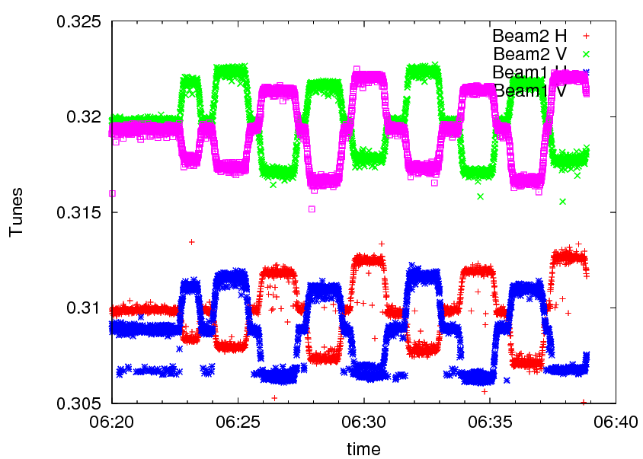
Wednesday 09 March
…:09:00: beta* measurement (1.5 m) by K-modulation and with AC-dipole excitation.

Slide 2
Wednesday 09 March
Beta*
K-modulation scans have been performed with different delta K.
The automatic codes gave too large error bars for using obvious bad points. We picked values an error bars with human algorithms.
Detailed analysis will come later. K-mod AC-dipole B2H 1.58 10% 1.40 8% B1H 1.51 16% 1.53 5% B2V 1.56 8% 1.62 8% B1V 1.48 9% 1.59 6% B2H 1.48 10% 1.52 10% B1H 1.5 18% 1.50 3% B2V 1.51 8% 1.51 10% B1V 1.50 9% 1.40 5%.
IR1
IR5

Slide 3
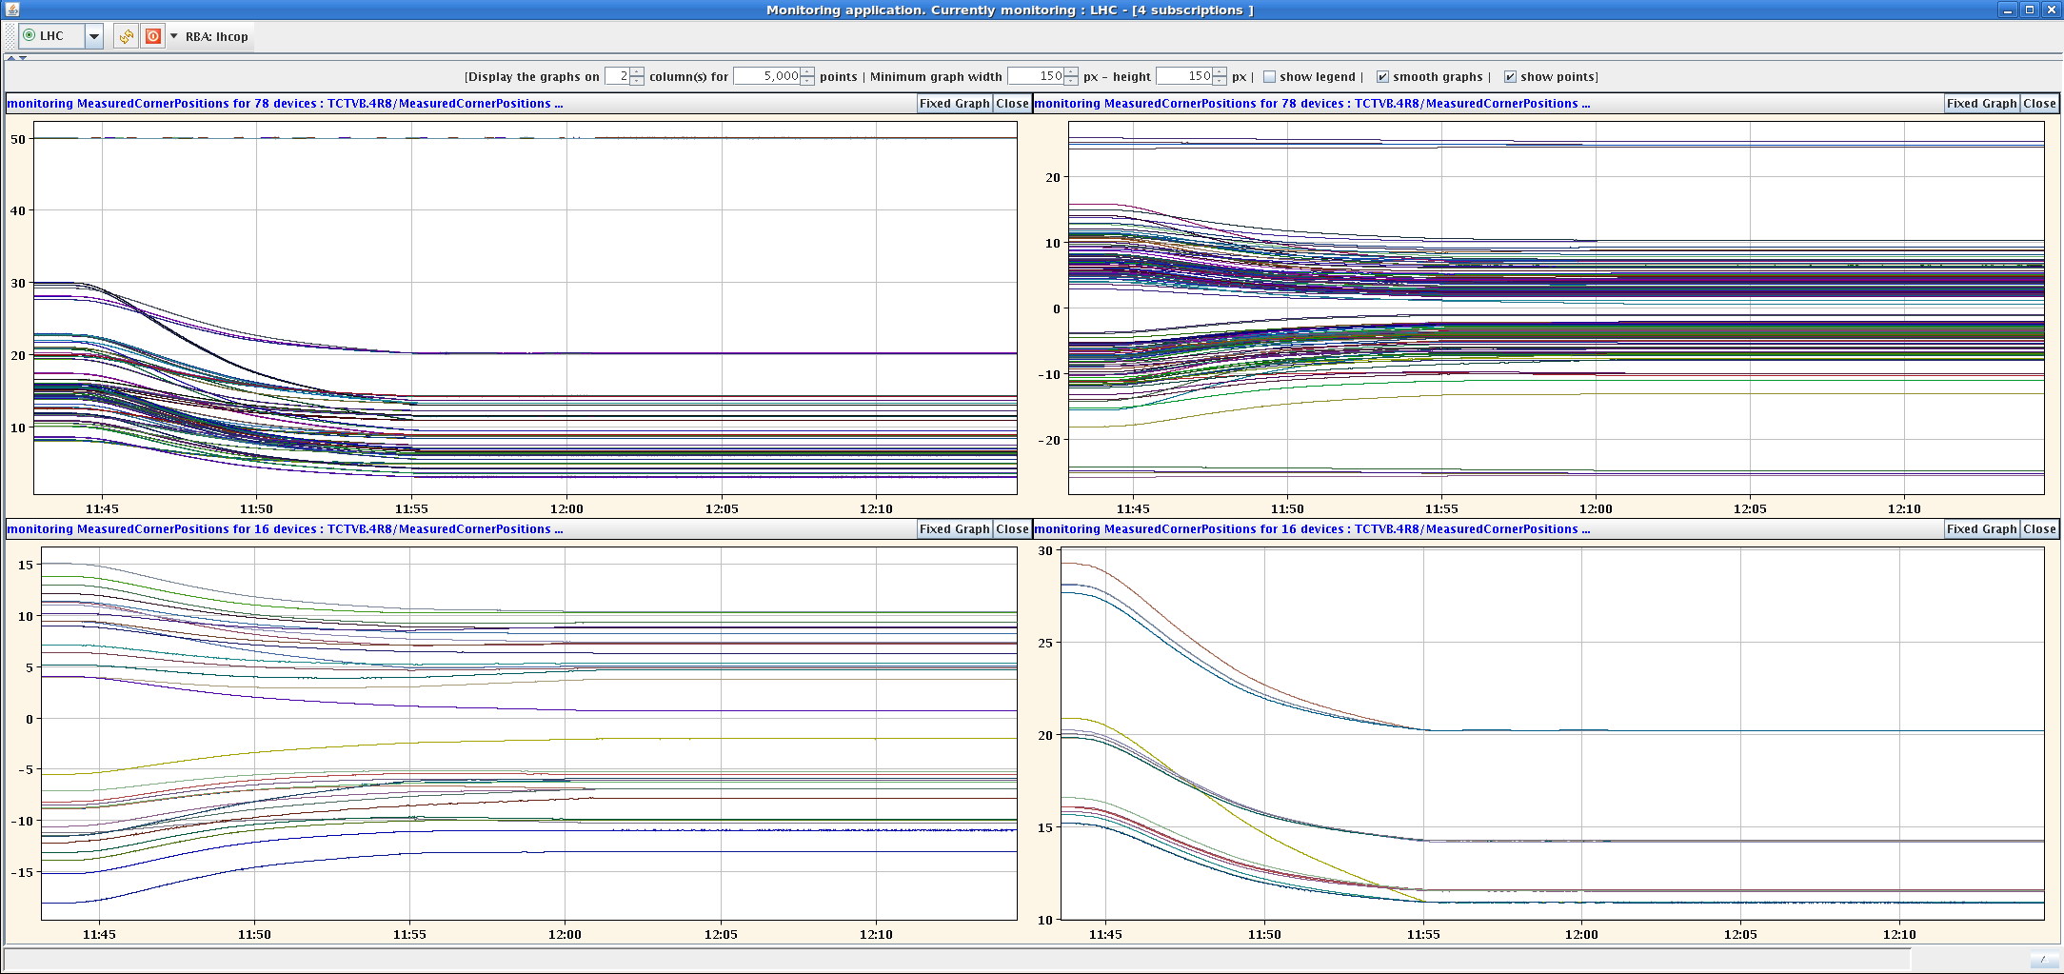
Wednesday 09 March
09:30: Access for LBDS, BI, RF…
10:30: Collimator ramp test (dry)
13:00: extra access for water cooled cable on RB81.

Slide 4
Wednesday 09 March afternoon
BETS:
Following access for TSU an energy scan has been done for B1 as the HV PS had been exchanged some days ago for MKD generator B1.
The XPOC references have been updated to re-centre the tolerances for the 100% point (was changed by 0.5%, which is half the XPOC2 margin).
LBDS re-armed and checked.
MKI energy tracking.
LHC energy trimmed below and above the BETS injection energy threshold (0.96 GeV, 0.2 %, 1.6 Amps), trims of 1 and 2 A.
MKI pulse was inhibited by the BETS only above threshold for both beams.
TOTEM interlock tests in the shadow.

Slide 5
Wednesday 09 March PM
18:00: access for water problem on PC for Q4.L1.
20:30: checking LBDS arming with inject-dump. No problems were observed.
21:30: ramp/squeeze/collide 2 probe bunches.
Ramp – no problem. Incorporated Q/orbit on flat top back into ramp & forward into squeeze.
Squeeze – tune almost perfectly flat, but still some orbit excursions between matched points (from earlier incorporations?).
Collide – technically ok, but Lumi seen only in IR1.
Orbit interlock settings prepared in SIS for collisions (also TOTEM & ALFA).
DIP problems with ALICE/LHCb lumi info (data structure??).
00:20: dump on RQ5.LR3 off – MPS test of FMCM – OK.

Slide 6
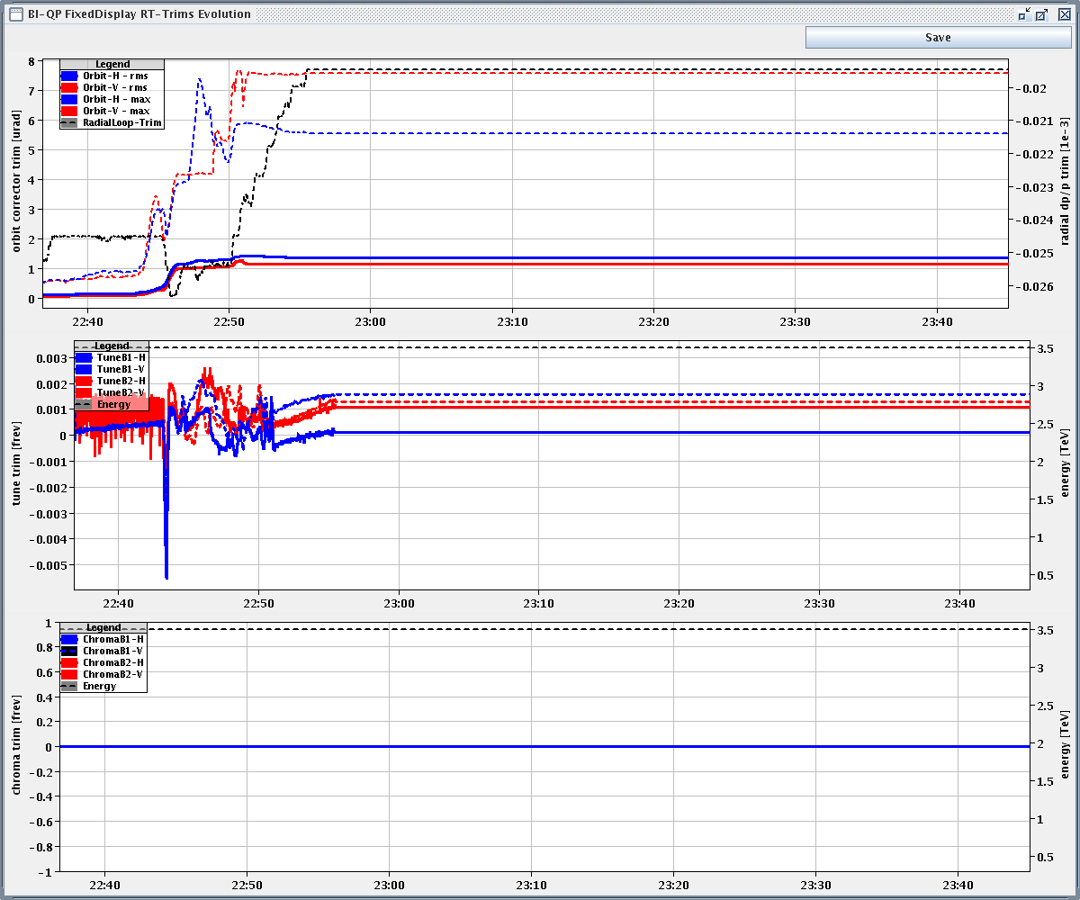
Tune in squeeze

Slide 7
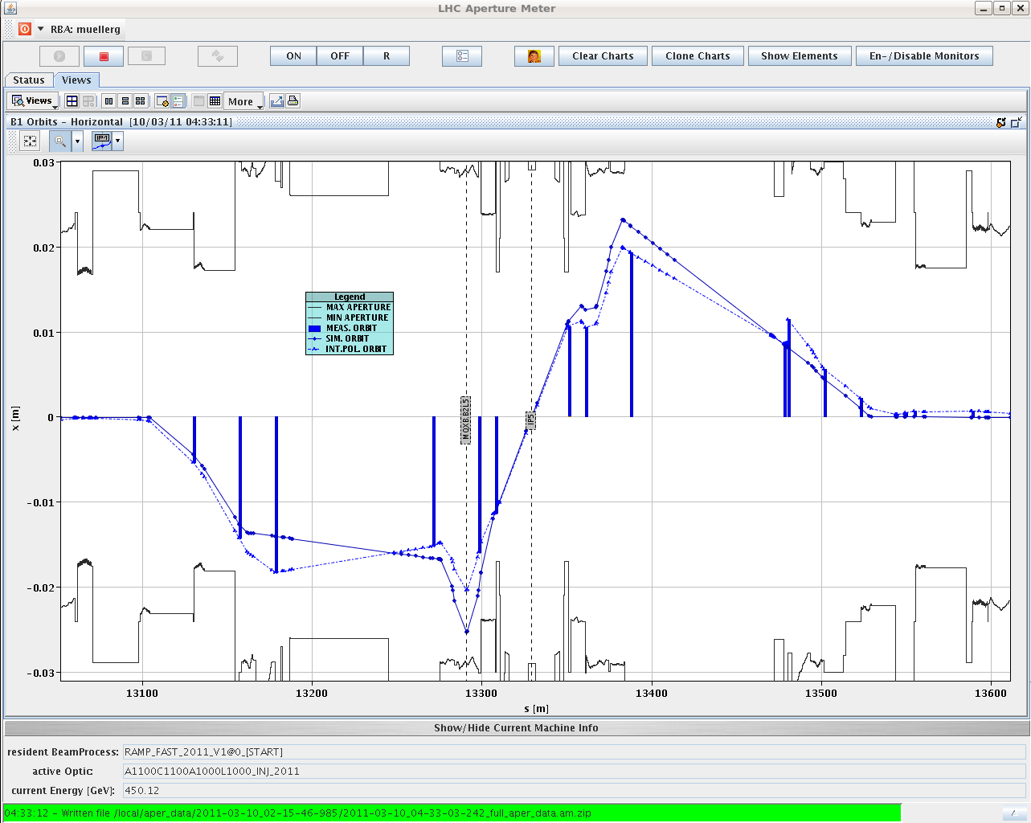
Aperture
BLM response collimator/SC region at Q9L7
Confirm factor 2 to 3 higher BLM response at TCP.
Local triplet aperture with bumps – preliminary:
IR1 V B1: 16 sigmas (was 16 in prev. meas.)
IR1 V B2: 14 sigmas (was 15 in prev. meas.)
IR5 H B1: 13.5 sigmas (was 15 in prev. meas.)
IR5 H B2: 13 sigmas (was 17 in prev. meas.)
H plane…

Slide 8
Today
-> 17:00 :
Multi-bunch injection (8 b 75 ns)
Dump protection validation…
Multi-bunch injection (24 b 75 ns)
From ~17:00: Collimator setup at 3.5 TeV squeezed.

