Slide 1
Monday 07 March
07:00-15:30: injection and dump protection.
Finished TI 8 phase coverage check.
Finished TDI angular adjustment. Settings updated.
Started TDI protection validation, beam 1.
To do:
re-check one phase of TI 2 collimators,
TDI protection validation beam 2, possibly TI 8 aperture.
Then move on to multi-bunch injection.
IR6 interlock BPM settings were re-adjusted, changes were < 1 mm, in most cases much less (2011 orbit not so different from 2010 one !).
TCDIs at 4.5 sigma.

Slide 2
Monday 07 March
16:00-19:00 access:
Quench of Q9 in sector 78 following a PS issue of a QPS crate. Fixed by MPE and EL.
QHPS in sector 56 (in the ‘shadow’, pending from the weekend).
Vacuum intervention in P6 for MKB.

Slide 3
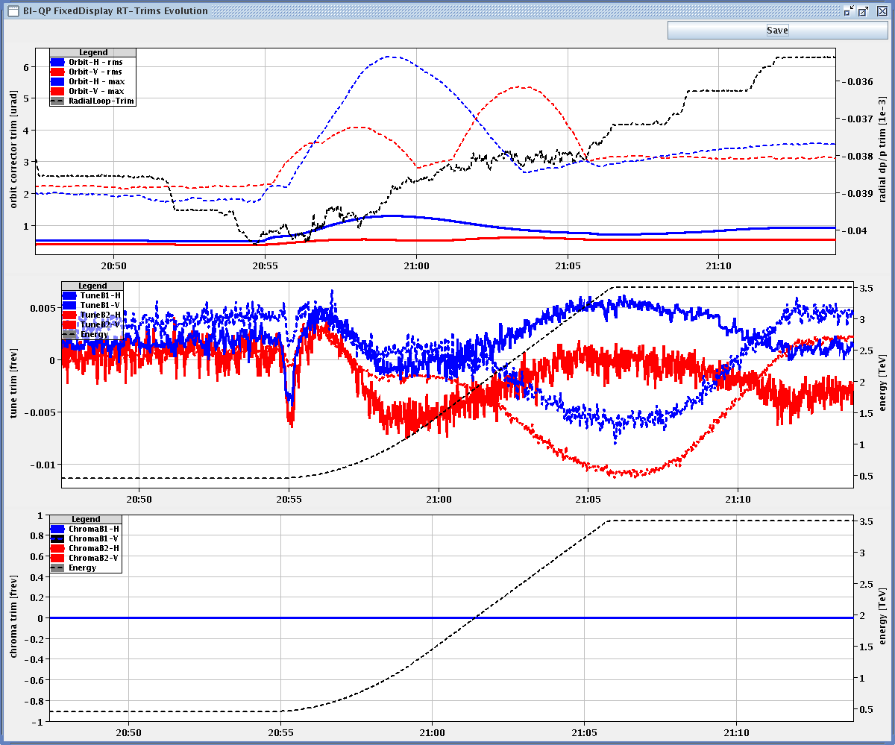
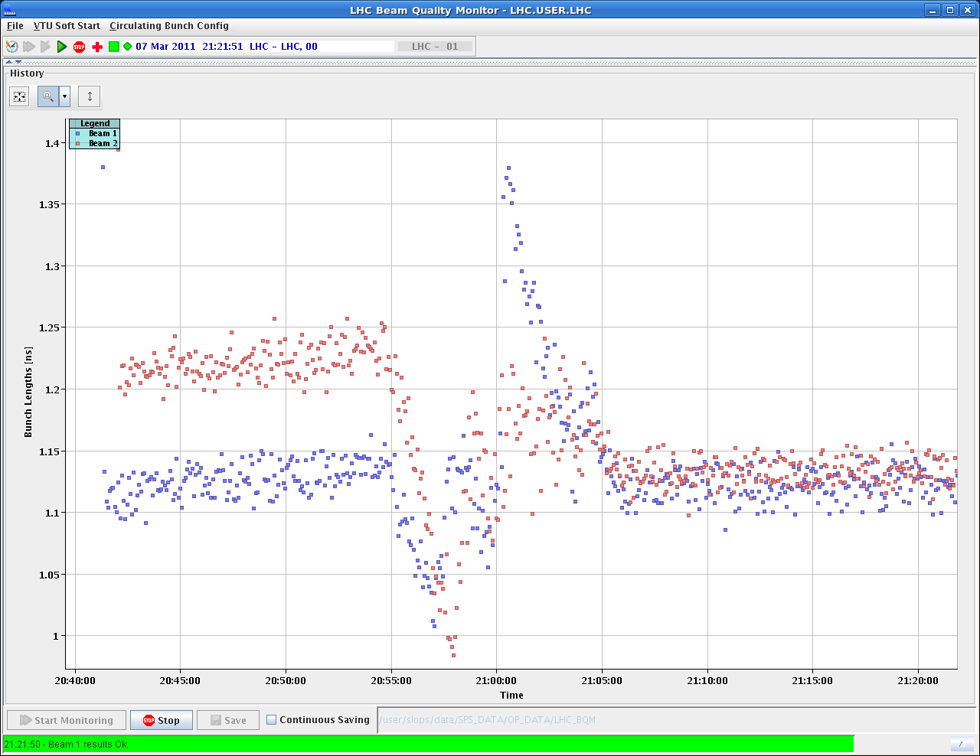
Collimators
20:30: ramp nominal bunch – OK.
Orbit at flat top very reproducible~ 50 um.
21:30: start of collimator setup at 3.5 TeV 10/11 m.

Slide 4
Collimators
RCBH28.R3B2 lost communication, then off.
By ‘miracle’ SIS did not dump the beam because the kick was so small. Back on with EPC piquet help.
02:30: collimation team finishes
B2 setup completed (besides TCDQ),
B1 horizontal completed (besides TCDQ) + 4 vertical collimators.
Re-setup TCTH.4L2.B1, again large beam size ratio (~200%).
Still to do: - B1: ver TCTs (4x), skew TCSGs (8x), TCDQ (1x) - B2: TCDQ (1x).

Slide 5
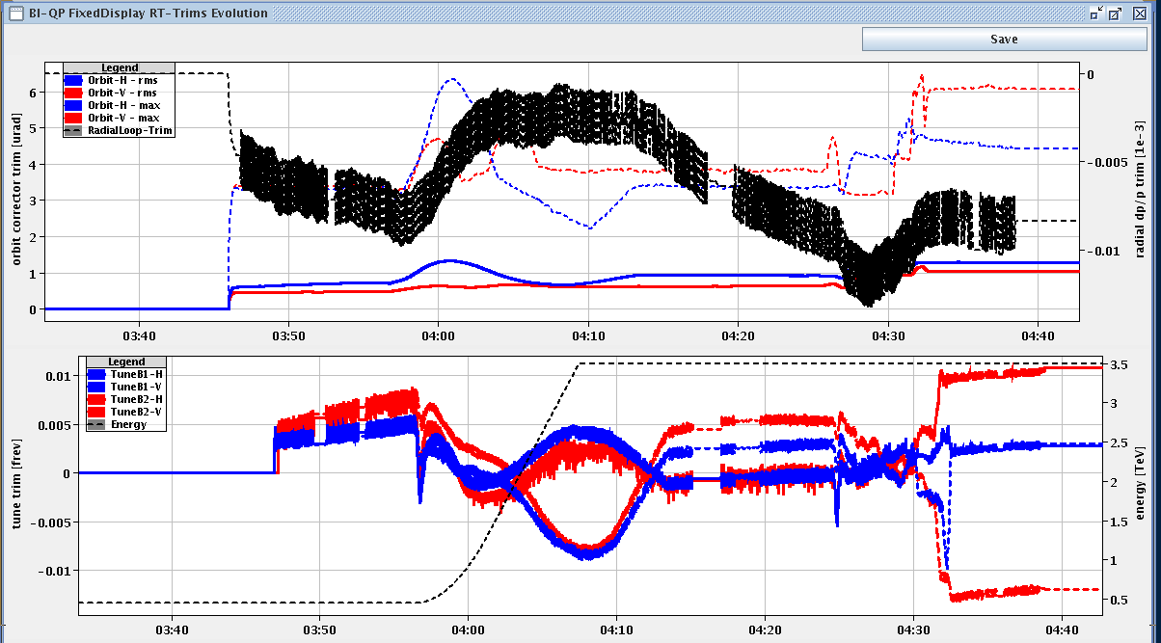
Test ramp
04:00: test ramp/squeeze (one step) for Q/Q’/coupling.

Slide 6
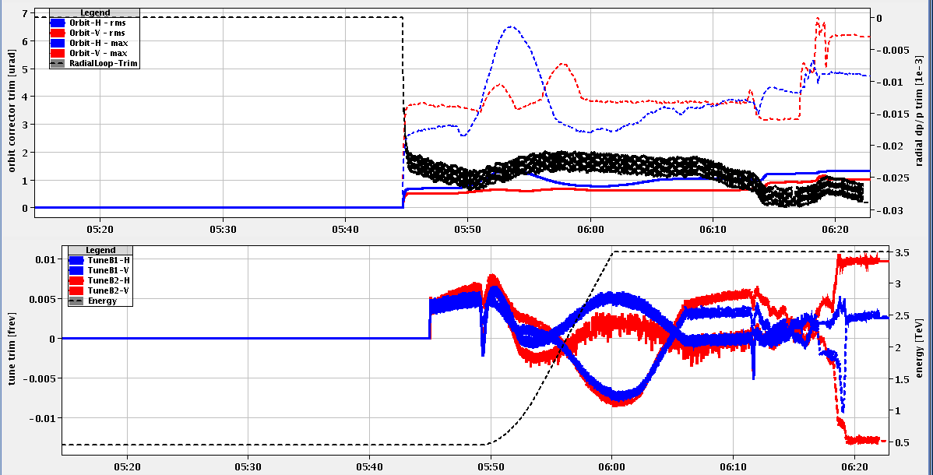
Another test ramp
05:30: test ramp/squeeze no. 2 for Q/Q’/coupling.
Almost copy-paste from previous!

Slide 7
Today
-> 10:30: BLM firmware update and BLM MP checks.
Then: Injection and dump protection.
From ~17:00: Collimator setup at 3.5 TeV.

